Slide 1
THESIS SYMPOSIUM PRESENTATION
Stress-Testing Biomedical RAG
Quantifying Pipeline Robustness Under
Noise, Conflict & Unanswerable Conditions
BioASQ Challenge 13b
LLaMA 3.1:8b (Ollama)
MedCPT Embeddings
FAISS Index
Tanushree Nepal

Slide 2
The Problem
RAG systems are increasingly deployed in clinical decision support and biomedical literature review.
But real-world evidence is rarely clean.
~
≠
?
Noise
Conflict
Unanswerable
Irrelevant and near-miss passages pollute the retrieved context
Contradictory evidence misleads generation even when retrieval is correct
Answer-bearing passages may be missing entirely from the index
How robust is a state-of-the-art biomedical RAG pipeline under these conditions?

Slide 3
Experimental Design
Noise Injection
Conflict Injection
Unanswerable
Levels: 30% · 50% · 70%
Levels: 50/50 · 70/30
Levels: Partial · Full removal
Irrelevant passages + near-miss passages injected into retrieved context
LLaMA-negated gold snippets replace a fraction of the true evidence
Answer-bearing passages removed from context, testing pipeline abstention
METRICS TRACKED
MAP@k
MRR@k
nDCG@k
Citation Precision
SCR (Groundedness)
Task Score
Question Types: Factoid · List · Yes/No · Summary | BioASQ-13b dataset

Slide 4
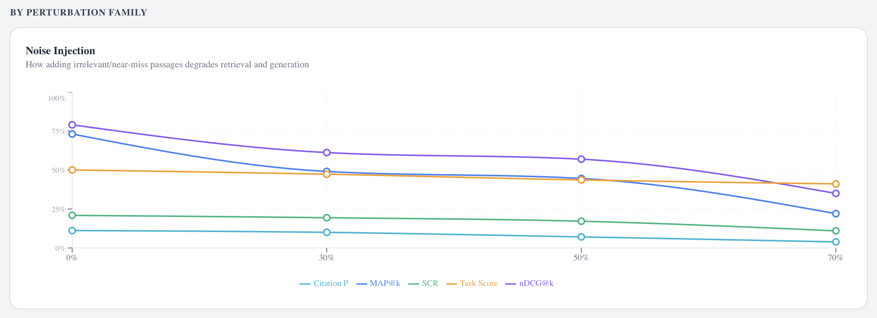
Noise Injection
How adding irrelevant/near-miss passages degrades retrieval and generation
88% → 36%
MAP@k at 70% noise
~50%
Citation Precision at 70% noise
Stable
Task Score (generation compensates)
Retrieval quality degrades monotonically with noise level. The generation layer partially compensates, but not enough to prevent task score decline.

Slide 5
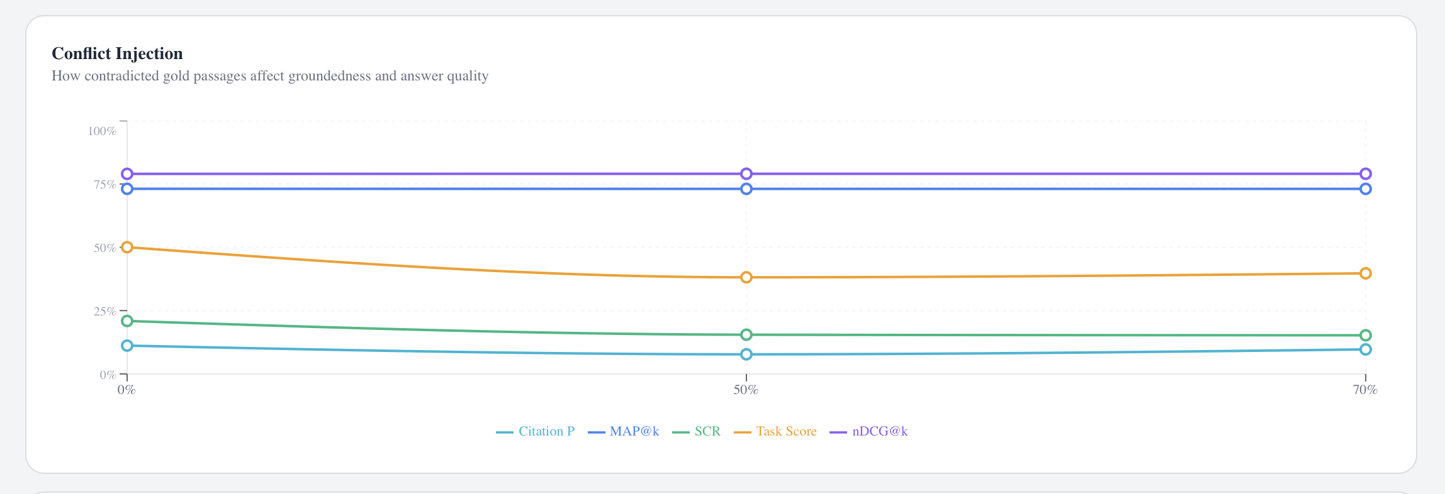
Conflict Injection
How contradicted gold passages affect groundedness and answer quality
88.4%
Retrieval — unchanged by conflict
50.8% → 39.7%
Task Score at 70/30 conflict
16.8% → 12.8%
SCR (Supported Claim Rate)
Conflict bypasses retrieval entirely. The pipeline retrieves correct gold passages but generates misleading answers — a generation-layer vulnerability.

Slide 6
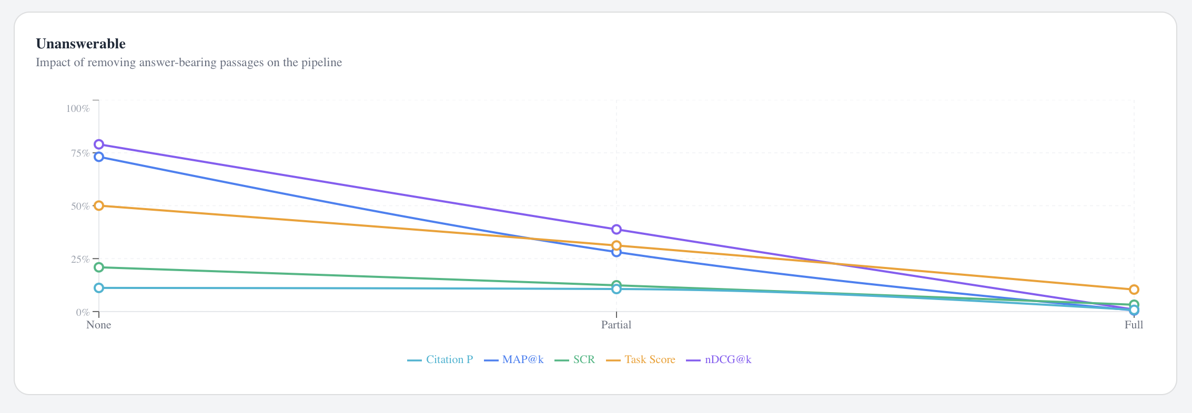
Unanswerable Queries
Impact of removing answer-bearing passages from the pipeline
88% → 1%
Retrieval at Full removal
50.8% → 18.4%
Task Score at Full removal
All → ~0%
Every metric collapses at Full
The most catastrophic condition. The pipeline has no abstention mechanism — it confidently generates incorrect answers when evidence is absent.

Slide 7
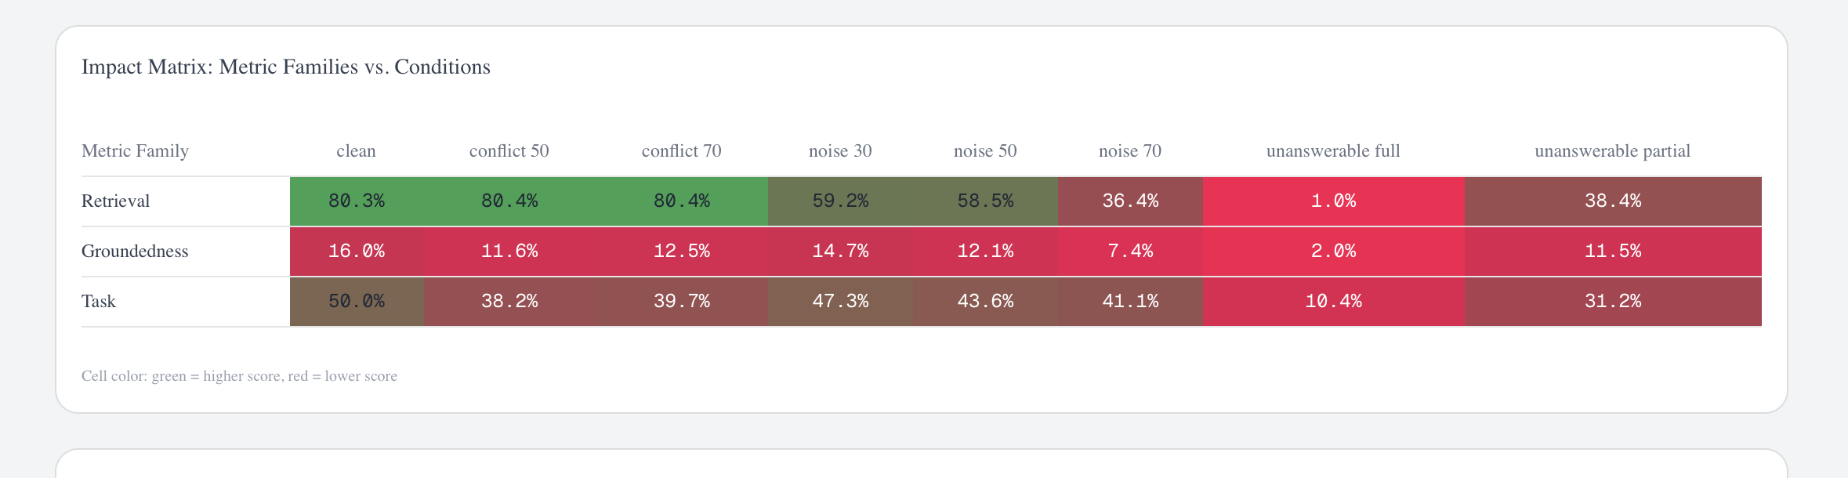
Which Conditions Hurt Which Metrics?
Retrieval is uniquely destroyed by Unanswerable Full (1.0%). Groundedness is low even at baseline (16.8%) — a pipeline-level finding. Conflict spares retrieval but damages generation.

Slide 8
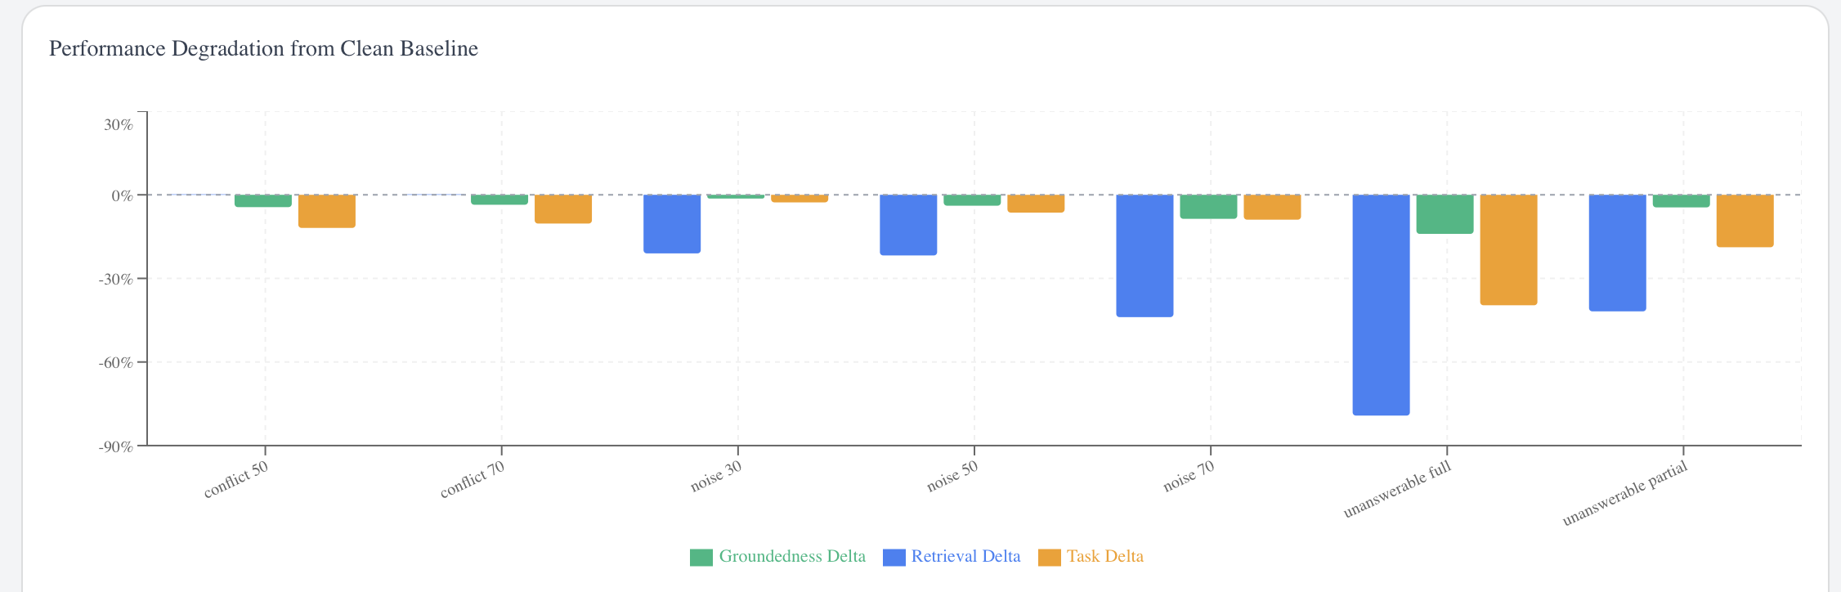
Performance Degradation from Clean Baseline
Groundedness Delta
Retrieval Delta
Task Delta

Slide 9
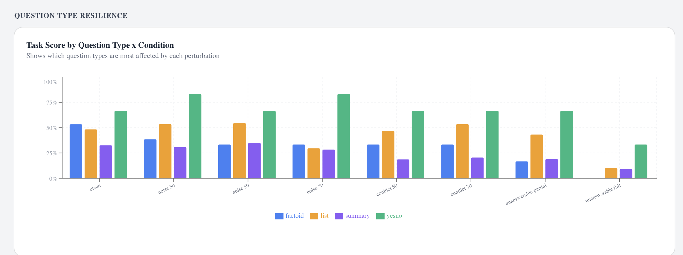
Not All Questions Are Equal
Task Score by Question Type × Condition — which types are most affected by each perturbation?
Summary questions are most resilient across all perturbation types. Yes/No questions show the highest variance. All types collapse under Unanswerable Full.

Slide 10
By the Numbers
The pipeline is fragile in predictable, interpretable ways
88% → 1%
−40 pp
Immune
Summary
Retrieval collapse
MAP@k drop
Retrieval under conflict
Most resilient type
Unanswerable Full
At 70% noise
Citation P: ~75%
Across all conditions

Slide 11
Conclusions
01
Noise is a retrieval-layer problem. MAP@k degrades monotonically; the generation layer cannot compensate at high noise levels.
02
Conflict is a generation-layer problem. Retrieval stays intact, but the model hallucinates when contradictory evidence is present.
03
Unanswerable conditions are catastrophic. The pipeline has no abstention capability — all metrics collapse to near zero.
04
Groundedness is low even at baseline (16.8% SCR). This is a fundamental limitation of the current prompting strategy.
Future Work
Cross-encoder recalibration for conflict-aware retrieval · Abstention mechanisms for unanswerable conditions · Larger N across all question types · Extensible to any domain-specific RAG evaluation

Slide 12
Thank You
Questions?
Tanushree Nepal
Biomedical RAG Stress-Test · BioASQ Challenge 13b · Local LLaMA 3.1:8b

