Slide 1
AI Credit Risk Prediction System
LightGBM-based Loan Default Risk Model | ML + Data Science Project

Slide 2
Problem Statement
Financial institutions face challenges in accurately identifying high-risk loan applicants.
Lack of reliable prediction models leads to loan defaults and financial losses.
Traditional assessment methods often fail to utilize full applicant data effectively.
There is a need for a data-driven solution to predict the probability of loan default.

Slide 3
Objective
Develop a machine learning model that analyzes applicant financial and demographic data to predict loan default risk and support better lending decisions.
Development Approach & Solution Design
Predict loan default risk using machine learning
Enable business users to query credit data using natural language

Slide 4
Solution Overview
Proposed Solution: The platform consists of:
Credit Risk Prediction Engine
Explainability Module
Natural Language Query Interface
REST APIs
Interactive User Interface
Expected Outcome
Automated risk assessment
Faster decision-making

Slide 5
Dataset
Home Credit Default Risk Dataset
- application_train.csv
- application_test.csv
Target: TARGET (0/1)
Phase 1 – Data Understanding
Analyzed Home Credit dataset
Identified target variable (TARGET)
Explored customer demographics and financial attributes
Performed data quality assessment

Slide 6
Data Preprocessing
Missing value handling
Duplicate removal
Feature selection
Categorical encoding
Data validation
Objective: Prepare clean and consistent data for model training.

Slide 7
Feature Engineering
Created Business-Relevant Features
Examples:
Income-to-Credit Ratio
Credit-to-Income Ratio
Employment Duration
Age-Based Features
Benefit
Improved predictive power of the model.

Slide 8
Model Used
LightGBM Classifier (Gradient Boosting Decision Trees)
High performance on tabular datasets
Handles missing values efficiently
Fast training and inference
Suitable for large-scale financial datasets
Training Process
Train-Test Split
Hyperparameter Tuning
Cross Validation

Slide 9
Model Overview
Risk Prediction Model
LightGBM-based machine learning model
Predicts portfolio risk scores
Explainability Layer
SHAP-based feature importance
Identifies key risk drivers
Data Intelligence
Natural Language → SQL queries
Enables conversational analytics

Slide 10
Tech Stack
Backend Deployment
Python Docker
FastAPI
Machine Learning Database
LightGBM SQLite
Scikit-learn
Pandas
NumPy

Slide 11
Model Evaluation
Metrics Used
ROC-AUC
Precision
Recall
F1 Score
Why ROC-AUC?
Industry-standard metric for credit risk prediction.

Slide 12
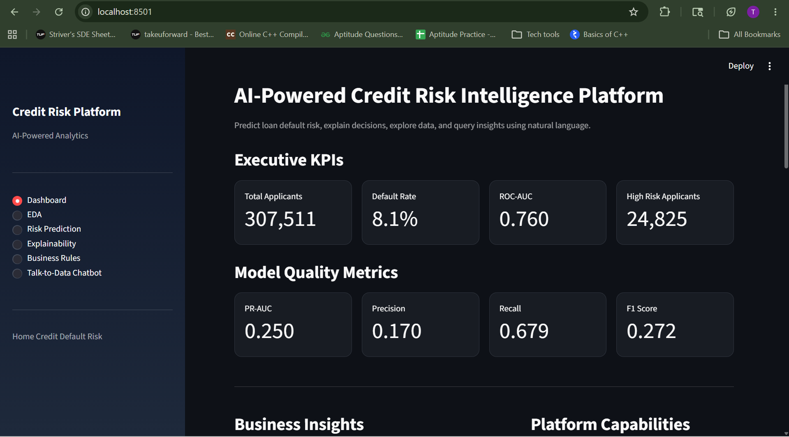
Evaluation Metrics
ROC-AUC, Accuracy, Precision, Recall, F1-score

Slide 13
Explainability Layer
Model Interpretability
Implemented feature importance analysis.
Examples:
Income
Credit Amount
Employment Status
Age
Business Value
Helps analysts understand why a customer is classified as high or low risk.

Slide 14
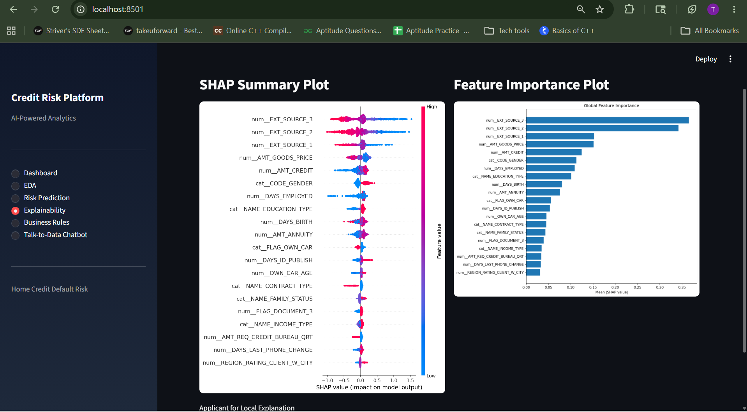
SHAP/Feature Importance

Slide 15
Natural Language Query Module
Objective
Allow users to ask questions in plain English.
Examples:
"Show average income by occupation"
"How many high-risk applicants are there?“
Approach
Natural Language → SQL Query → Database → Results

Slide 16
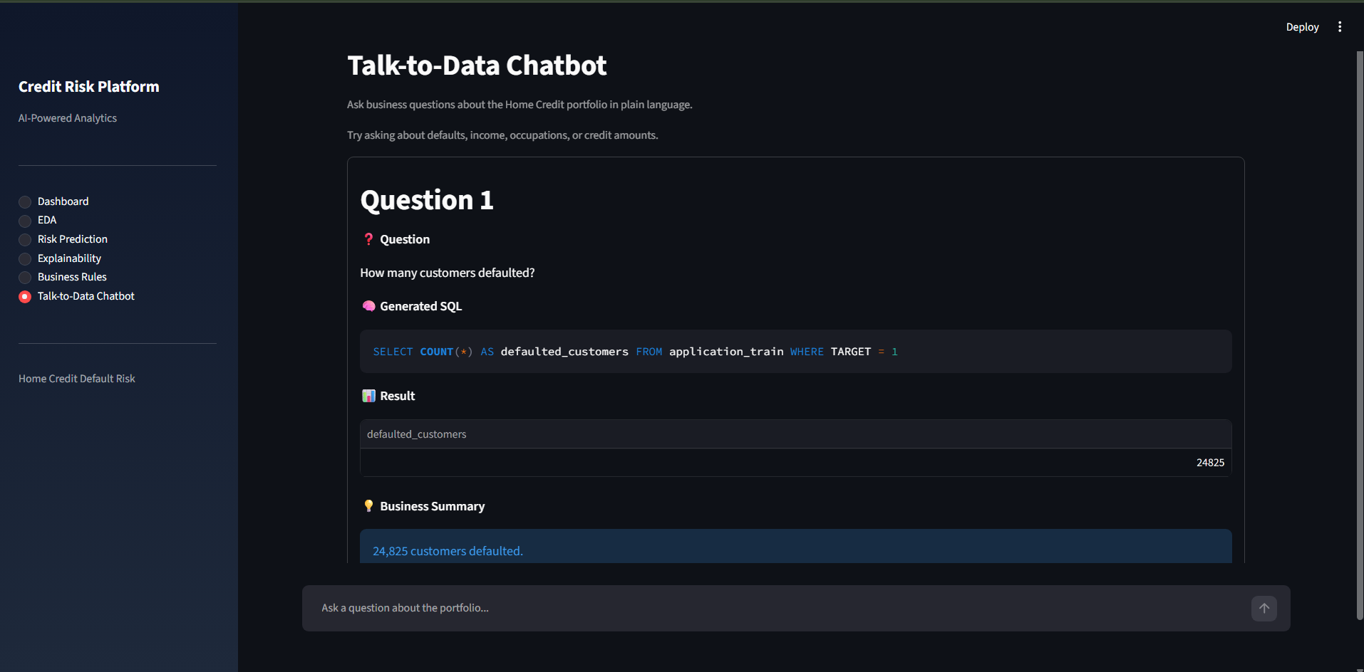
NL-to-SQL Screenshot

Slide 17
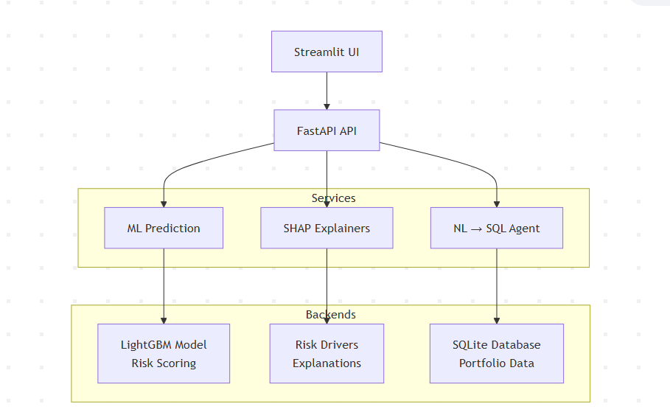
System Architecture

Slide 18
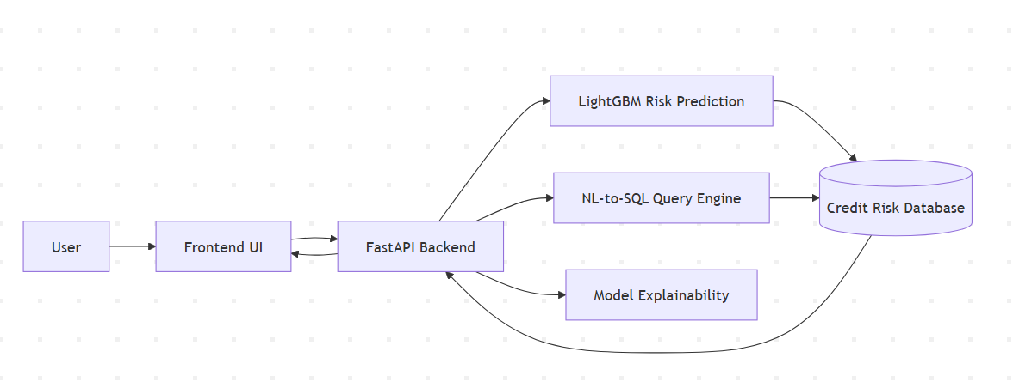
Work Flow
The platform integrates a LightGBM-based credit risk prediction engine, an NL-to-SQL query module, and an explainability layer through a FastAPI backend connected to a centralized credit risk database.

Slide 19
Output Screenshots

Slide 20
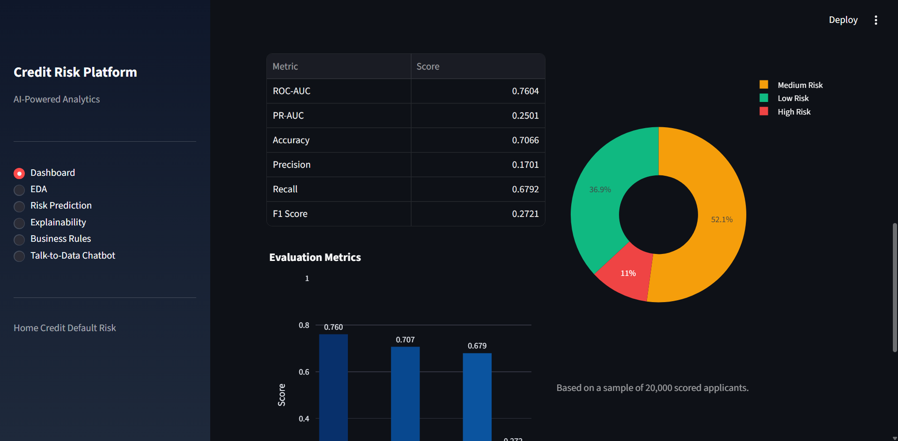
Risk Distribution

Slide 21
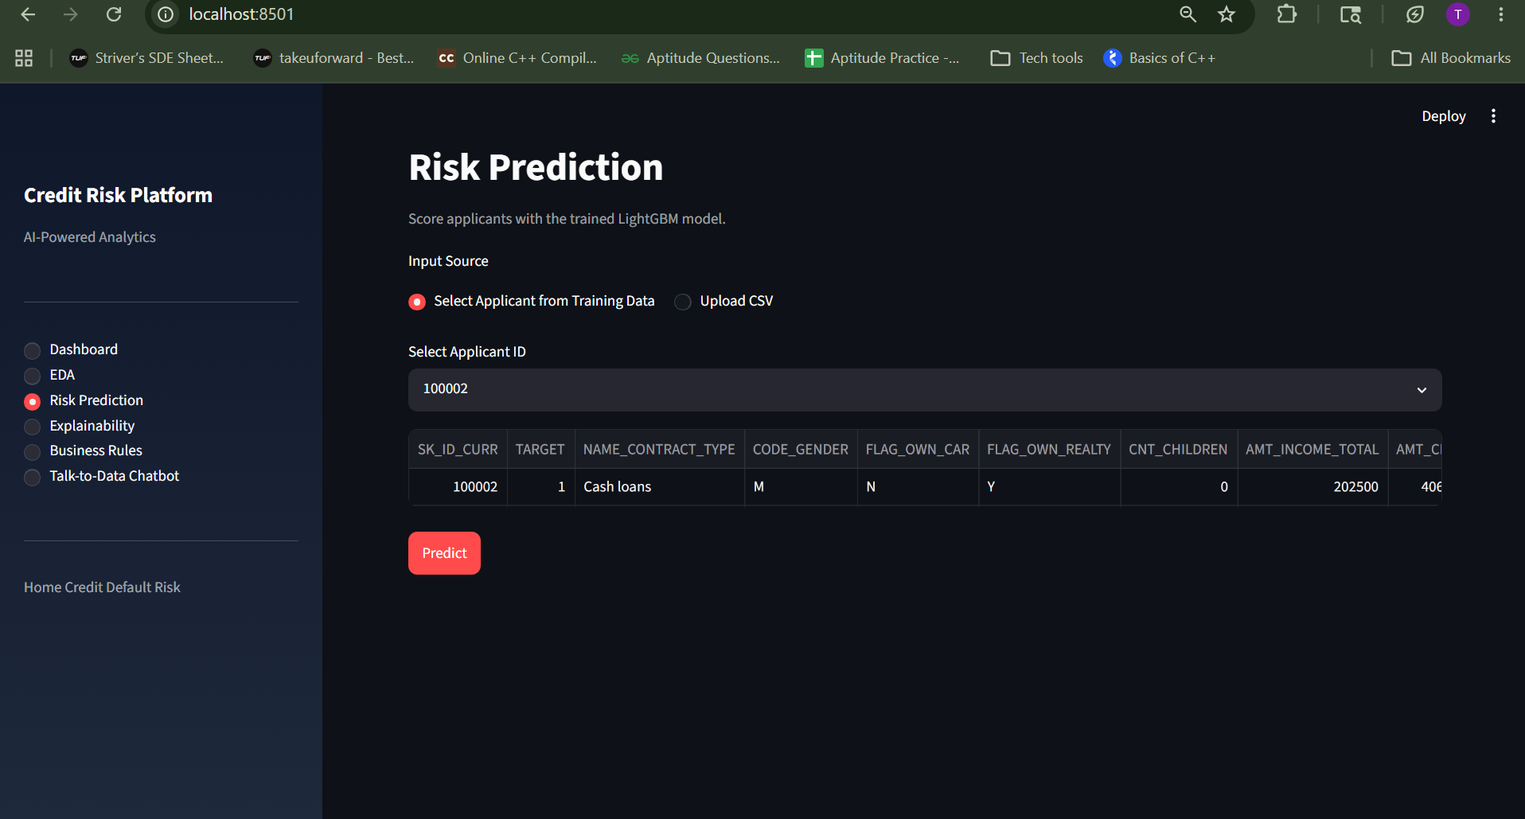
Risk Prediction

Slide 22
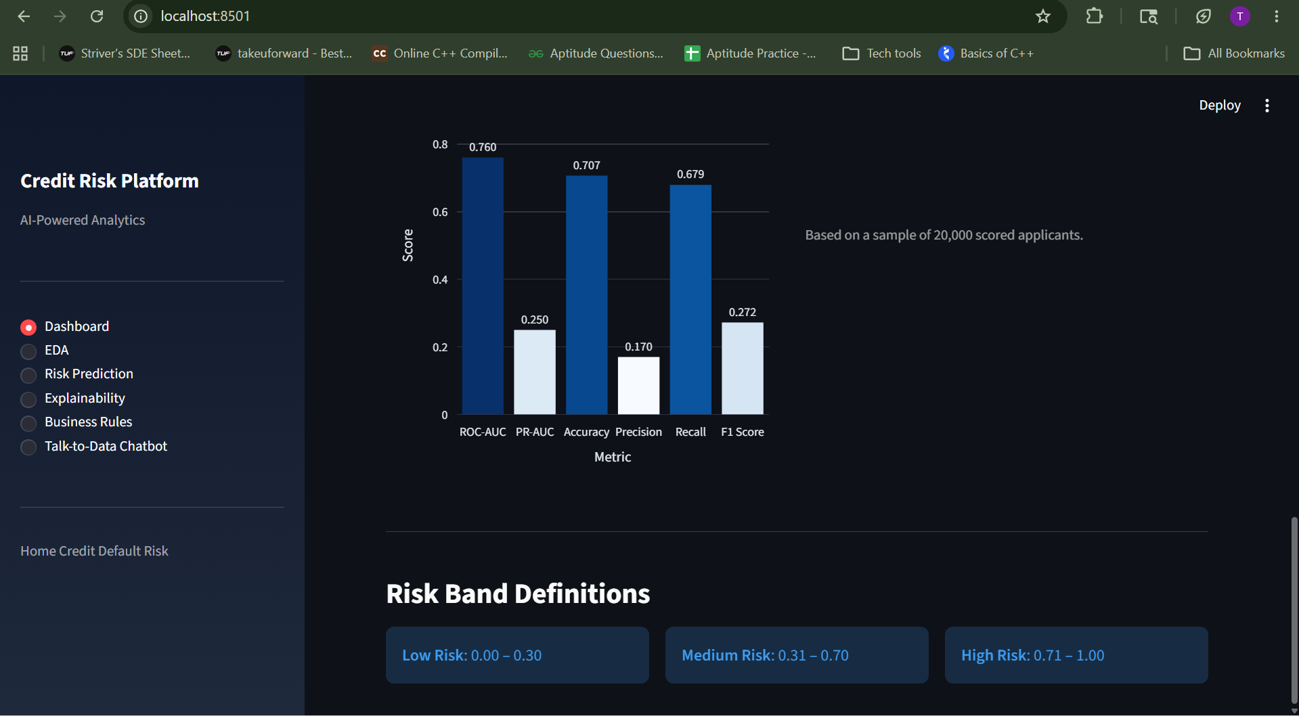
Model Performance & Risk Classification

Slide 23
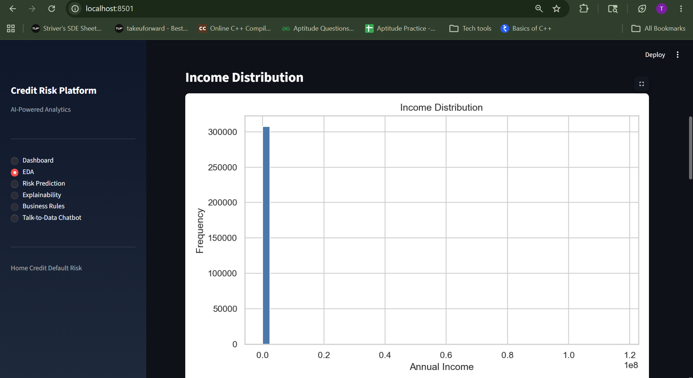
EDA

Slide 24
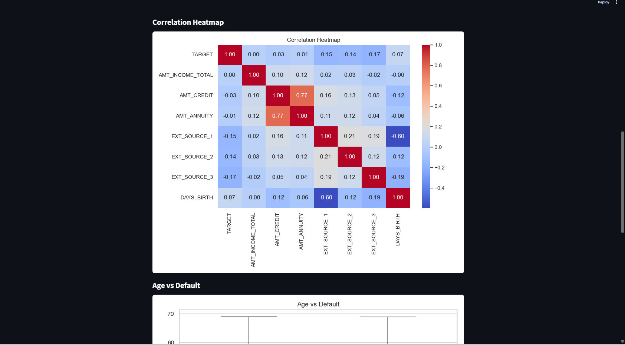
Heatmap

Slide 25
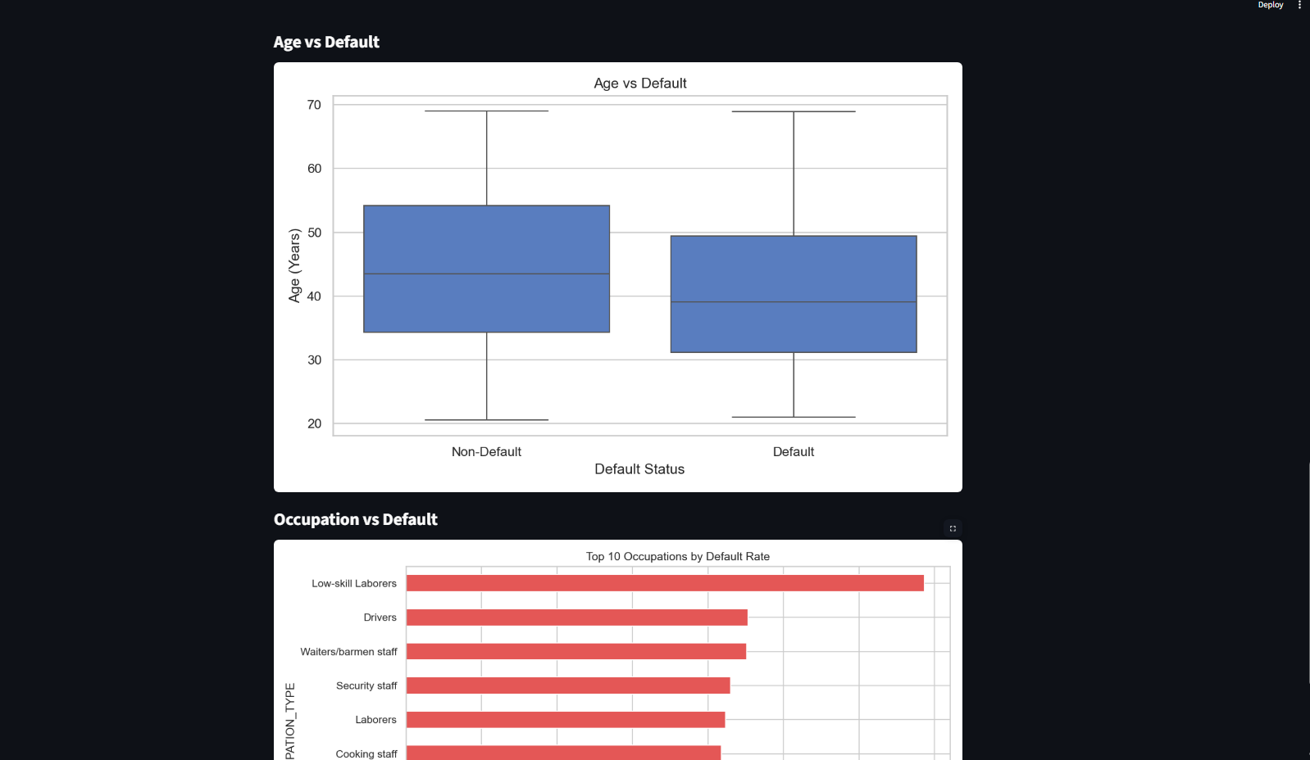
Key Risk Factors Influencing Loan Default

Slide 26
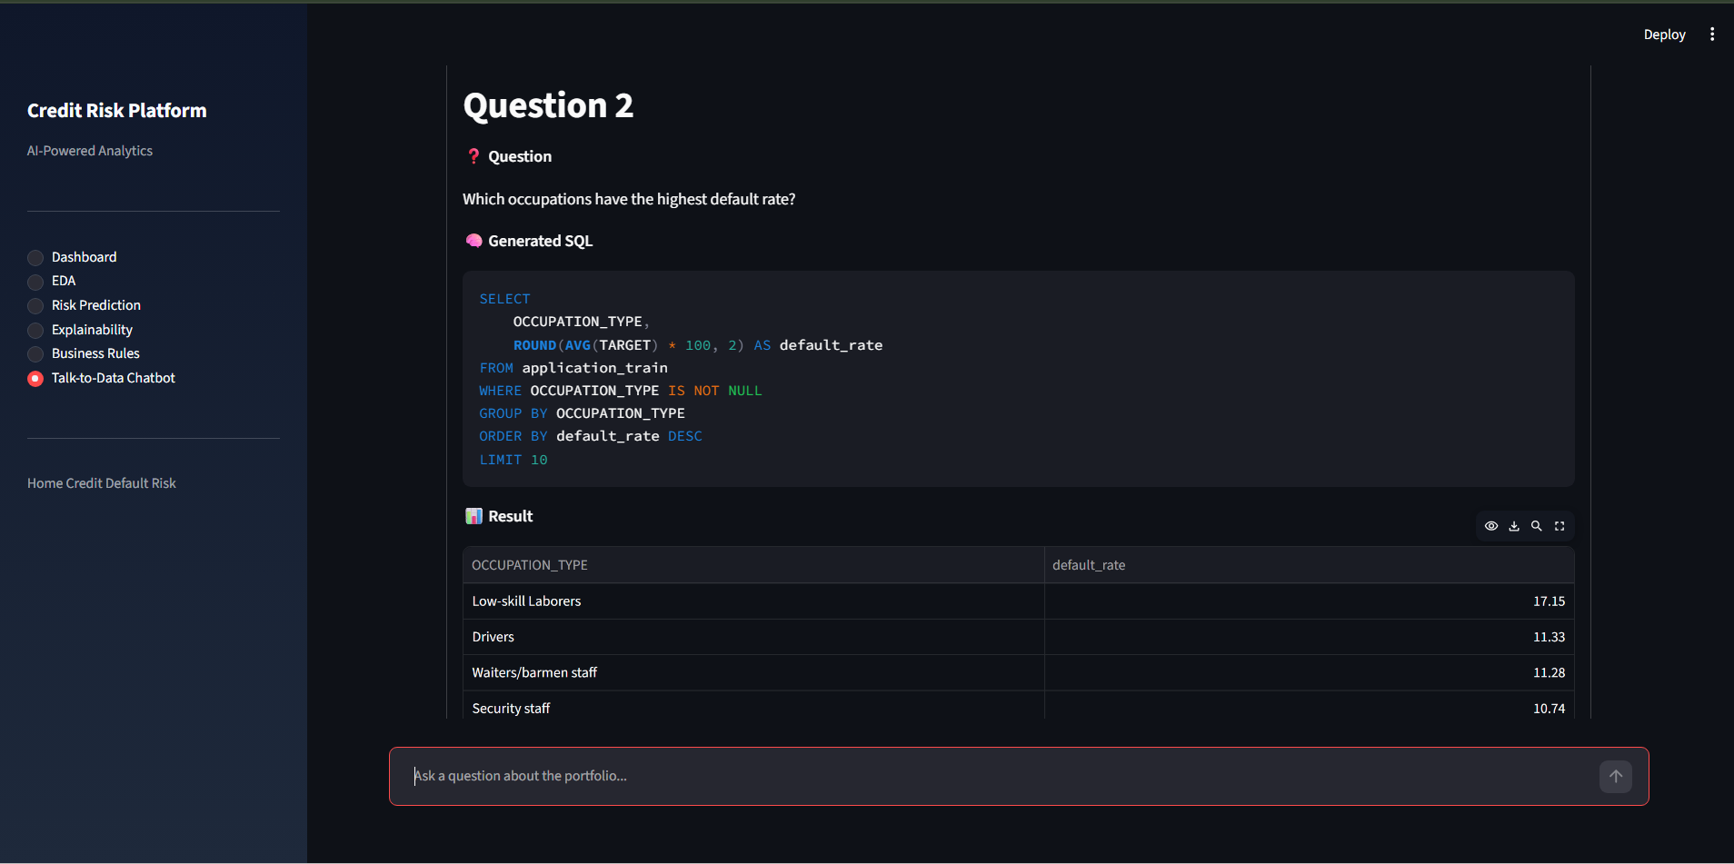
Query 2

Slide 27
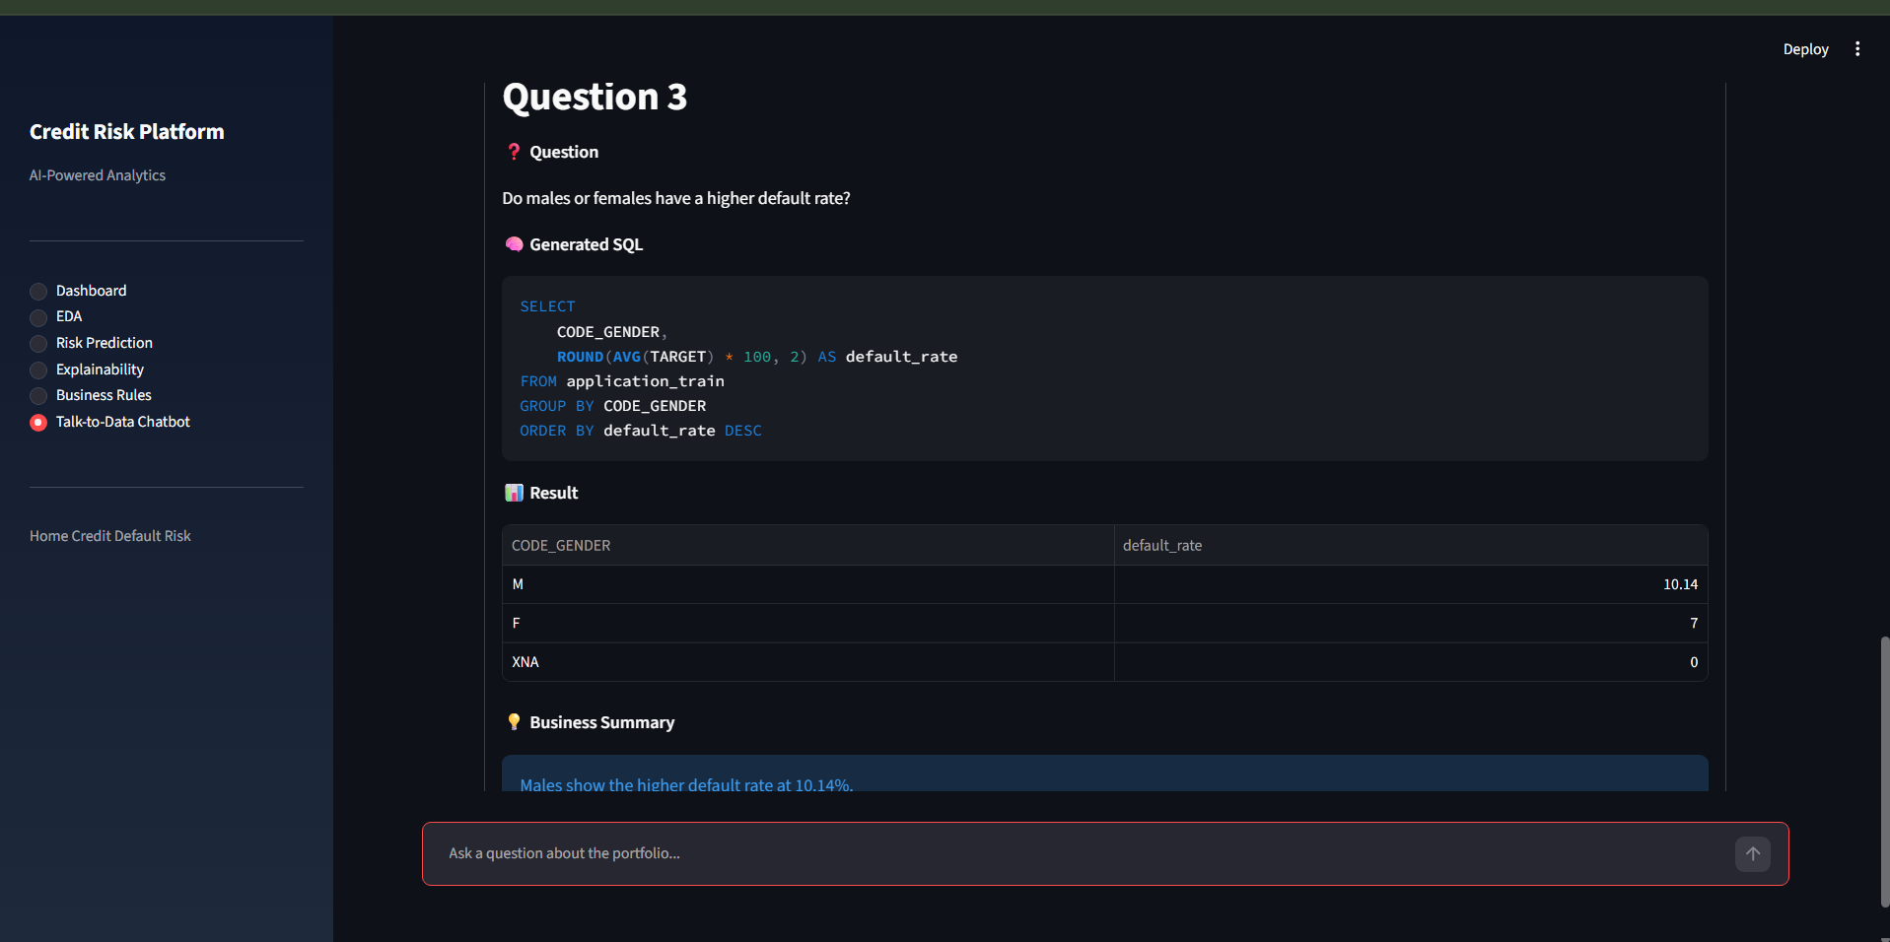
Query 3

Slide 28
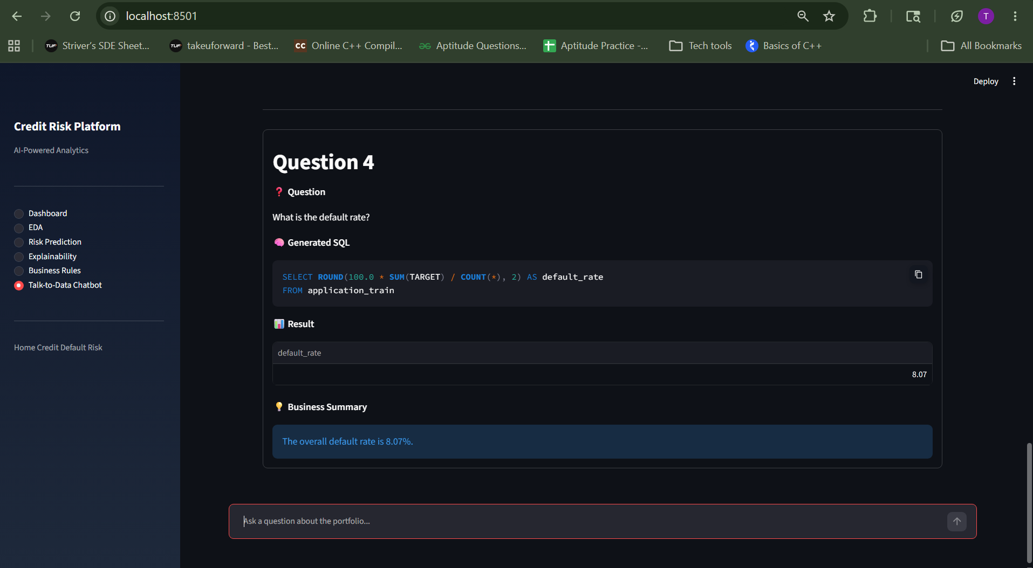
Query 4

Slide 29
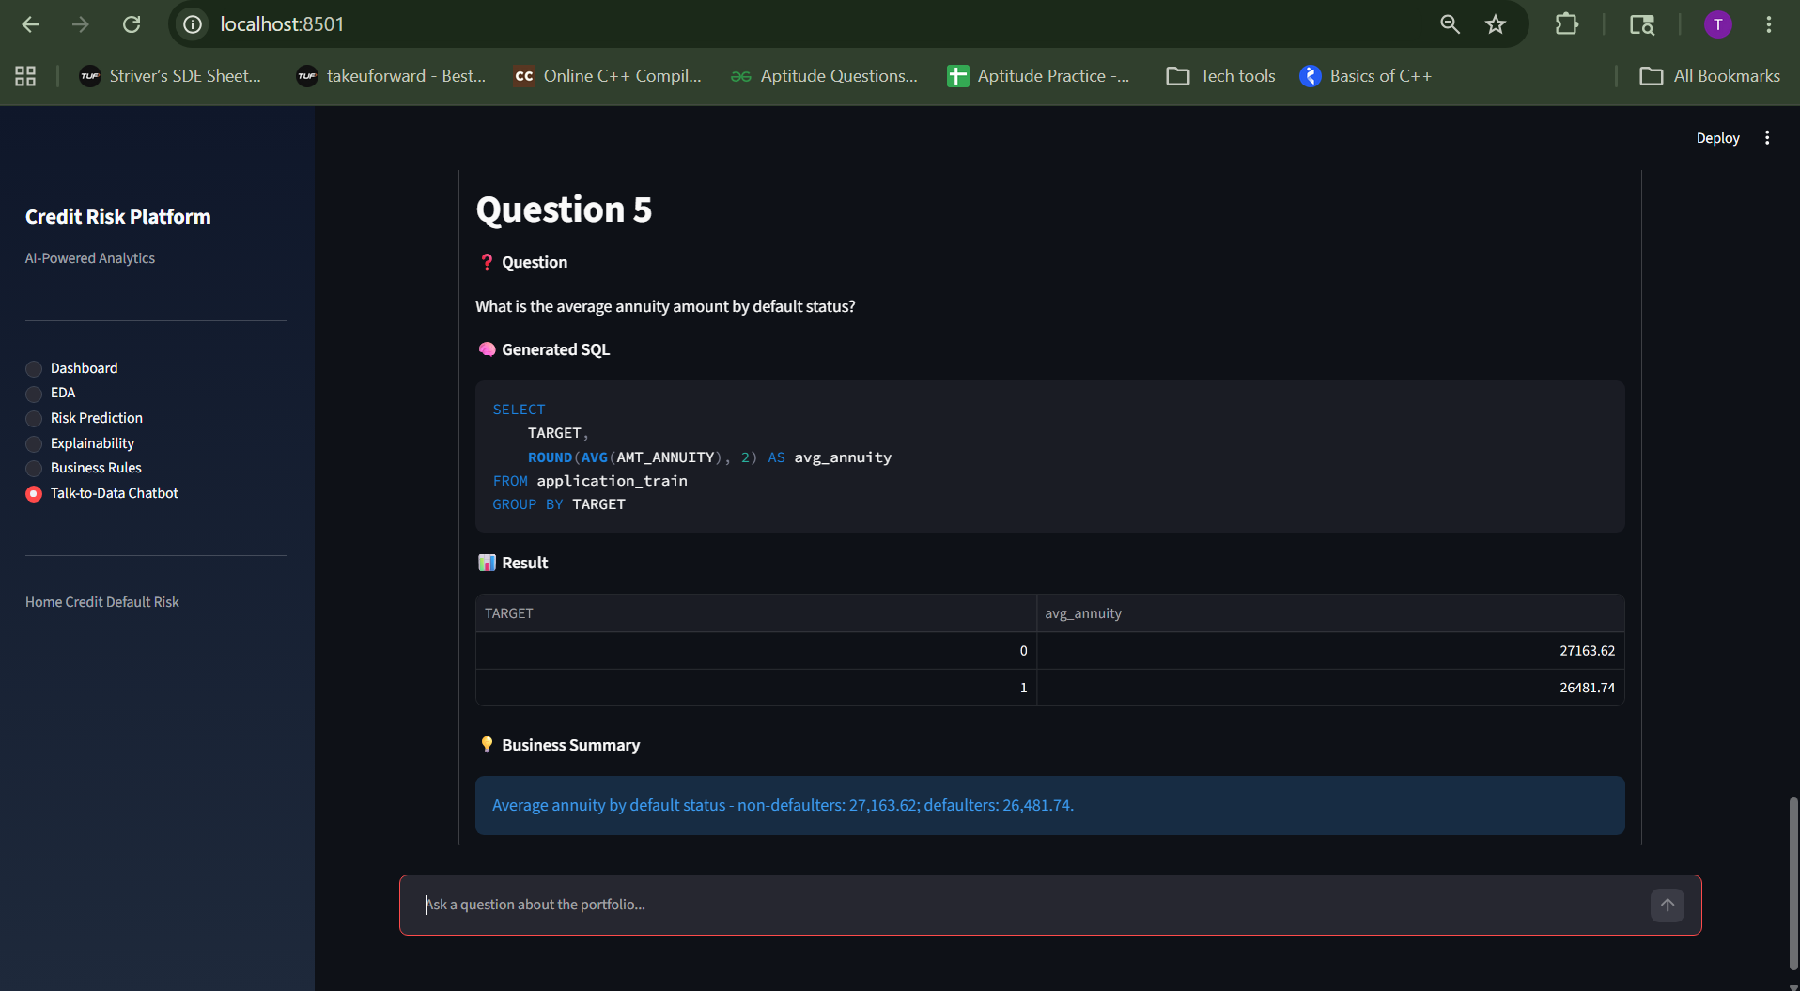
Query 5

Slide 30
Results
High ROC-AUC achieved, showing strong predictive performance on validation data.
Model helps reduce credit risk and improves loan approval decision-making.
It’s an end-to-end machine learning system to predict loan default risk using financial and behavioral data.

Slide 31
Further Enhancements and Conclusion
Future Enhancements
Real-time scoring
Advanced explainability with SHAP
Role-based access control
Continuous model monitoring
Key Takeaways
Built an end-to-end AI credit risk platform
Combined machine learning and NLP capabilities
Delivered scalable and production-ready architecture

