Slide 1

Human Resource Analytics
Neha Pawar
Sneha Krishnan
Tanushree Chaudhary

Slide 2
Why are our best and most experienced employees leaving prematurely?
People are the most important assets for companies
Necessary to retain employees and reduce costs associated with their replacement including: Hiring, Onboarding, Training
Used dataset of a well known technology company, IBM
Identified factors that lead to employees leaving IBM
Other companies can use similar approach to identify attrition reasons specific to them
“The biggest priority, and concern, for business leaders in 2017 will be retaining employees in a competitive talent marketplace” ^{[1]}
Notes:
[1] http://fortune.com/2016/12/28/employers-2017-employee-retention-unemployment/

Slide 3
DATASET OVERVIEW

Slide 4
Predictor Variables
Age
Business Travel
Daily Rate
Department
Distance from home
Education
Education Field
Employee Count
Employee Number
Environment Satisfaction
Gender
Hourly Rate
Job Involvement
Job Level
Job Role
Job Satisfaction
Marital Status
Age of employee
Travel Rarely, Travel Frequently, Non-Travel
Daily Wage Rate(assumption)
Departments: Sales, Research & Development, Human Resources
Distance from home to office for each employee
- 1: 'Below College’, 2: 'College’, 3: 'Bachelor’, 4: 'Master’, 5: 'Doctor’
- Life Sciences, Medical, Marketing, Technical Degree, Other
Numeric employee count for each observation i.e. 1 for all observations
Unique identifier for each employee
1: 'Low’, 2: 'Medium’, 3: 'High’, 4: 'Very High'
Male, Female
Hourly pay for each employee (assumption)
1 : 'Low’, 2: 'Medium’, 3: 'High,’ 4: 'Very High'
What job level employee has out of 1-5
Job Roles: Sales Executive, Research Scientist, Laboratory Technician, Healthcare Representative, Manufacturing Director
1 'Low' 2 'Medium' 3 'High' 4 'Very High'
Married Status: Married, Single, Divorced
* Metadata for the columns was not available so some columns were assumed and interpreted by analyzing individual observations

Slide 5
Predictor Variables
Monthly Income
Monthly Rate
Number of Companies worked
Over 18
Over Time
Percent Salary hike
Performance Rating
Relationship Satisfaction
Standard Hours
Stock Option level
Total Working years
Training times last year
Work life balance
Years at company
Years in current role
Years since last promotion
Years with current manager
Monthly Income of the employee
Monthly Rate for the employee (assumption)
How many companies the employee has worked for?
Is the employee an Adult? (‘Y’ for all i.e. All Adults)
Does the employee work Overtime : ‘Yes’ or ‘No’
Percentage hike received by the employee
1: 'Low’, 2: 'Good’, 3: 'Excellent’, 4: 'Outstanding’
1: 'Low’, 2: 'Medium’, 3: 'High’, 4: 'Very High'
Standard working hours for the employee
Stock option level for the employee
How many years the employee has been working in total
Number of times training attended last year by the employee
1: 'Bad’, 2: 'Good’, 3: 'Better’, 4: 'Best’
Number of years the employee has spent in the company
Number of years the employee has spent in the company in their current role
Years since last promotion for the employee
Number of years the employee has been working with current their manager
* Metadata for the columns was not available so some columns were assumed and interpreted by analyzing individual observations

Slide 6
Dependent Variable & Data Source
ATTRITION
- Is an employee likely to leave the company? ‘YES’ or ‘NO’
- https://www.kaggle.com/pavansubhasht/ibm-hr-analytics-attrition-dataset/data
DATA SOURCE

Slide 7
DATA PREPARATION

Slide 8
DATA PREPARATION
Step 3
Step 2
Step 1
Step 4
Step 5
No Null values
Dropped ‘EmployeeNumber’
as unique identifier
Dropped ‘Over18’
as no variance
All Adults
Dropped ‘EmployeeCount’
as no unique values
Dropped ‘StandardHours’ as same value throughout the dataset i.e. 80

Slide 9
Exploratory Data Analysis

Slide 10
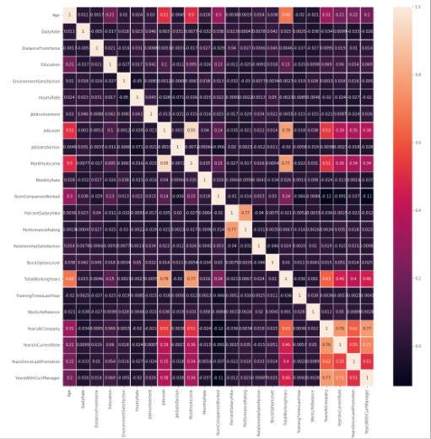
Correlation Matrix & Scatter Plot
Insights from correlation matrix:
There is slightly high correlation between some predictors like:
Age and Total Working Years
Total Working Years with Monthly Income
Years with Current Manager with Years At Company
Years with Current Manager with Years In Current Role
Years In Current Role with Years At Company
Years At Company with Years since Last Promotion
But most variables do not have high collinearity among each other

Slide 11
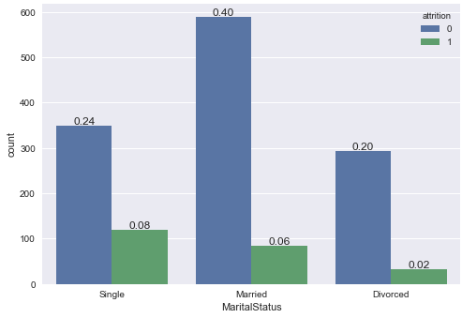
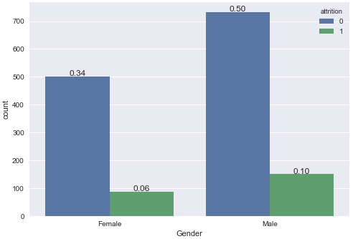
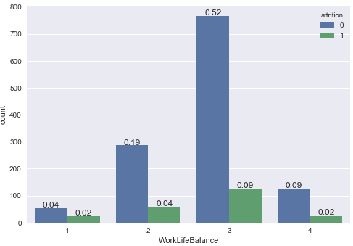
Categorical Variables & Attrition
Marital Status & Attrition
Gender & Attrition
Work life balance & Attrition
WorkLifeBalance - 1: 'Bad’, 2: 'Good’, 3: 'Better’, 4: 'Best’

Slide 12
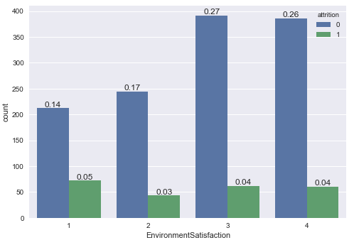
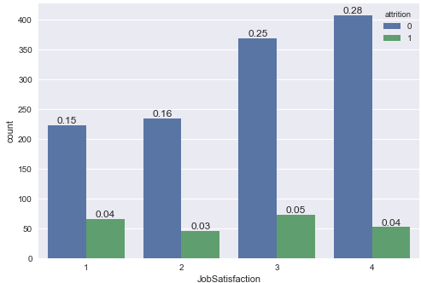
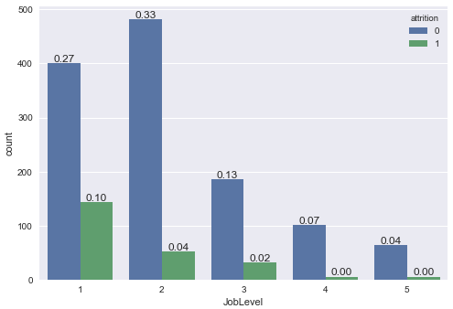
Categorical Variables & Attrition
Environment Satisfaction & Attrition
Job Satisfaction & Attrition
Job Level & Attrition
EnvironmentSatisfaction – 1: 'Low’, 2: 'Medium’, 3: 'High’, 4: 'Very High'
JobSatisfaction – 1: 'Low’, 2: 'Medium’, 3: 'High’, 4: 'Very High'

Slide 13
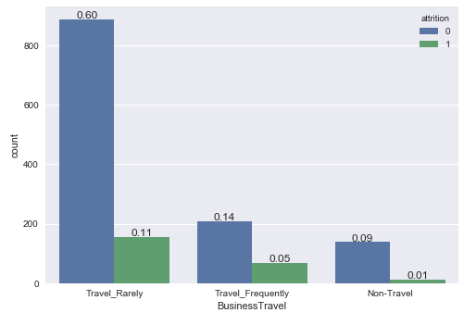
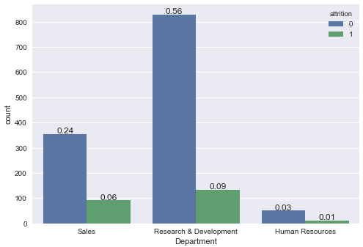
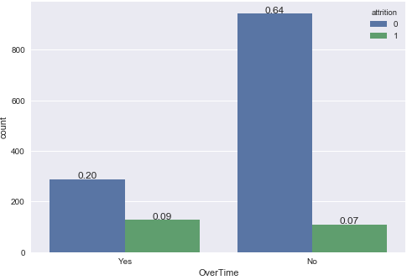
Categorical Variables & Attrition
Business Travel & Attrition
Department & Attrition
Overtime & Attrition

Slide 14
Observations
Single employees more leave the company
Male employees leave the company more than female employees
Assuming job levels 1 to 5 indicates growing levels of senior position, junior and other lower level employees leave the company more than senior levels
More attrition in Research & Development compared to other departments

Slide 15
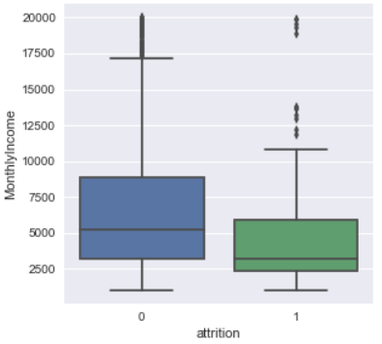
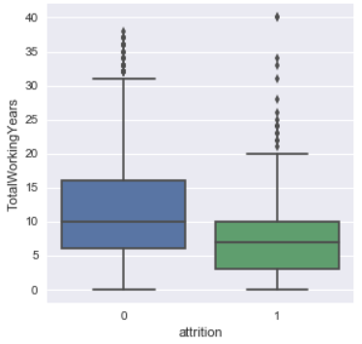
Numerical Variables & Attrition
Monthly Income & Attrition
Total Working years & Attrition

Slide 16
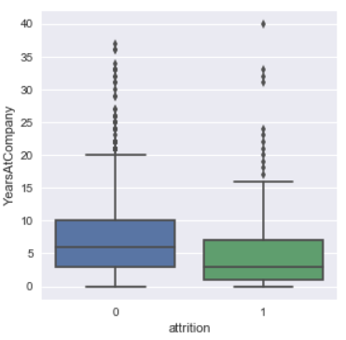
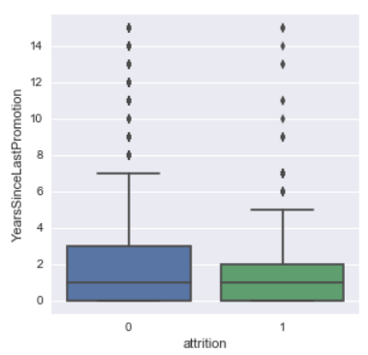
Numerical Variables & Attrition
Years at Company & Attrition
Years since last promotion & Attrition

Slide 17
Observations
Employees with lesser monthly income tend to leave the company more than those with higher monthly incomes
Employees early in their career show high attrition against more experienced employees
Employees who have spent relatively less time with the company tend to leave more
Higher attrition of those who have been recently been promoted could indicate employees in junior levels leaving the company more as with increasing seniority it takes longer to get promoted

Slide 18
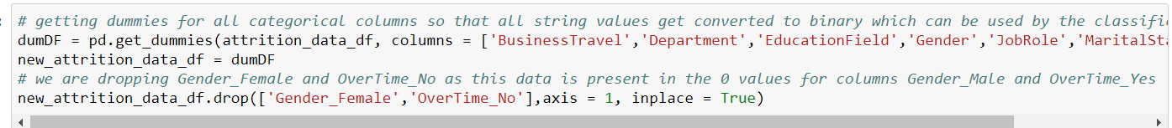
Feature Engineering for Categorical Predictors
Used Classification models with:
Class = 1 as our target class that indicates the employee leaves the company
Class = 0 as the class of employee that does not leave the company

Slide 19
MACHINE LEARNING MODELS

Slide 20
Splitting data into Train & Test sets
Training data – 80%
Test Data – 20%
We use the 80:20 ratio for train and test as we want the model performance to be good on seen and unseen data so that we get a generalized model that performs well on unseen data

Slide 21
IMBALANCED TARGET VARIABLE

Slide 22
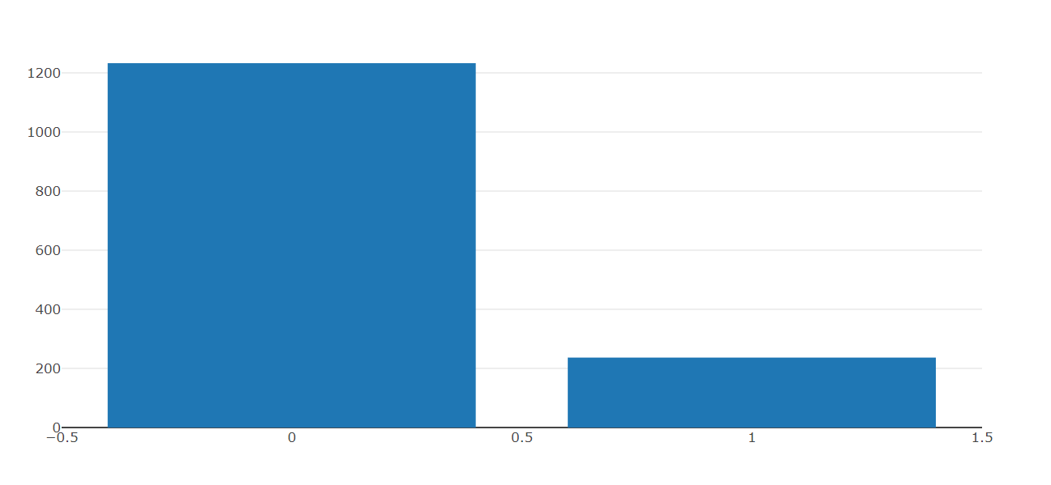
IMBALANCED TARGET VARIABLE
Observations in class 1 (target class) : 237 (~ 16.1%)
Observations in class 0 : 1233
Total Observations: 1470
Due to the dominance of the majority class, classifiers tend to ignore cases of the minority class as noise and therefore predict the majority class far more often
Hence, we get unsatisfactory results when faced with imbalanced datasets
Solution???
Notes:
Reference: https://mlr-org.github.io/mlr-tutorial/release/html/over_and_undersampling/index.html

Slide 23
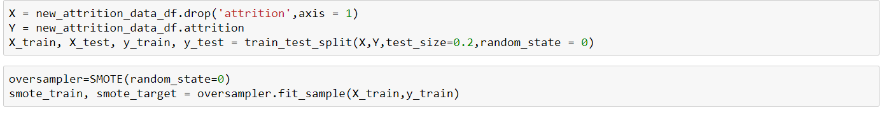
OVER-SAMPLING : SMOTE Algorithm
Over-sampling: Generation of additional cases (copies, artificial observations) of the minority class to increase their effect on the classifier. All cases of the majority class are kept
SMOTE (Synthetic Minority Over-sampling Technique): Creates synthetic samples from the minority class instead of creating copies. The algorithm selects two or more similar instances (using a distance measure) and perturbing an instance one attribute at a time by a random amount within the difference to the neighboring instances
Notes:
References: https://mlr-org.github.io/mlr-tutorial/release/html/over_and_undersampling/index.html
https://machinelearningmastery.com/tactics-to-combat-imbalanced-classes-in-your-machine-learning-dataset/

Slide 24
LOGISTIC REGRESSION

Slide 25
Logistic Regression
For Logistic Regression, the independent variables do not have to be normally distributed or have equal variance in each group, unlike in discriminant analysis.
The output of a Logistic Regression is more informative than other classification algorithms. Like any regression approach, it expresses the relationship between response variable and each of its predictors.
Not only it gives a measure of how relevant a predictor is (coefficient size) but also its direction of association (positive or negative). It helps to uncover hidden relationships in the data and find interesting correlations.
After all, the decision of which algorithm to finally deploy must be based on ROC AUC, accuracy, precision and recall. Nevertheless, the output of a logistic regression is a valuable by-product.
Logistic Regression requires that each data point be independent of all other data points. If observations are related to one another, then the model will tend to overweight the significance of those observations.
Logistic Regression attempts to predict outcomes based on a set of independent variables, but logit models are vulnerable to overconfidence. That is, the models can appear to have more predictive power than they actually do as a result of sampling bias.
Notes:
References: https://classroom.synonym.com/disadvantages-logistic-regression-8574447.html
https://www.quora.com/What-are-the-advantages-of-logistic-regression

Slide 26
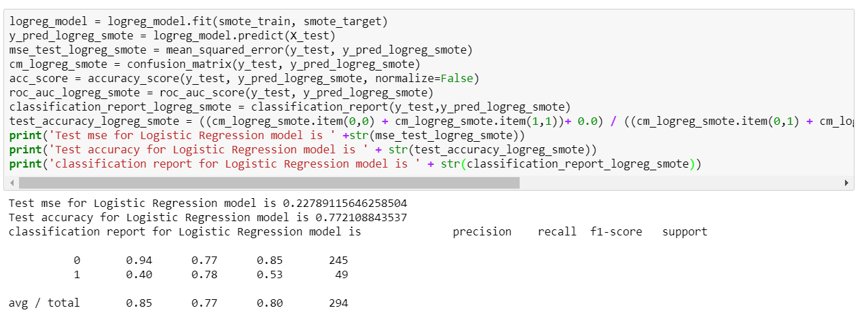
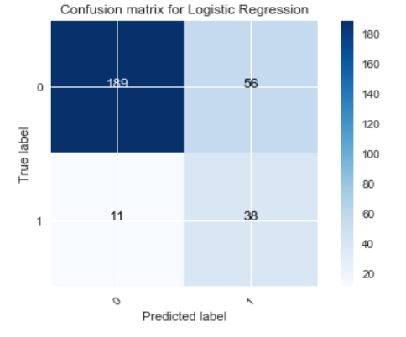
Test Accuracy of the model : 0.772108843537 AUC score of the model is: 0.843648 Test Accuracy of the model prior to oversampling of minority class observations was: 0.877551020408

Slide 27
LINEAR DISCRIMINANT ANALYSIS

Slide 28
Linear Discriminant Analysis
LDA is based upon the concept of searching for a linear combination of predictors that best separate two classes. In discriminant analysis consideration of normal distribution are stricter than logistic regression.
LDA implicitly requires equality of the population covariance matrices since a pooled estimator is used for the within covariance matrix. Under the additional assumptions of normality, equal prior probabilities and misclassification costs, the LDA is optimal in the sense that it minimizes the misclassification probability.
It optimally separates two groups, using generalized distance and gives the same linear separating decision surface as Bayesian maximum likelihood discrimination in the case of equal class covariance matrices.
LDA does not work well if the classes are not balanced i.e. the number of objects in various classes are highly different.
Another disadvantage of LDA is that it's not applicable for non-linear problems.
In addition, LDA can be sensitive to overfitting and need careful validation and testing.
Notes:
References: https://stats.stackexchange.com/questions/188416/discriminant-analysis-vs-logistic-regression

Slide 29
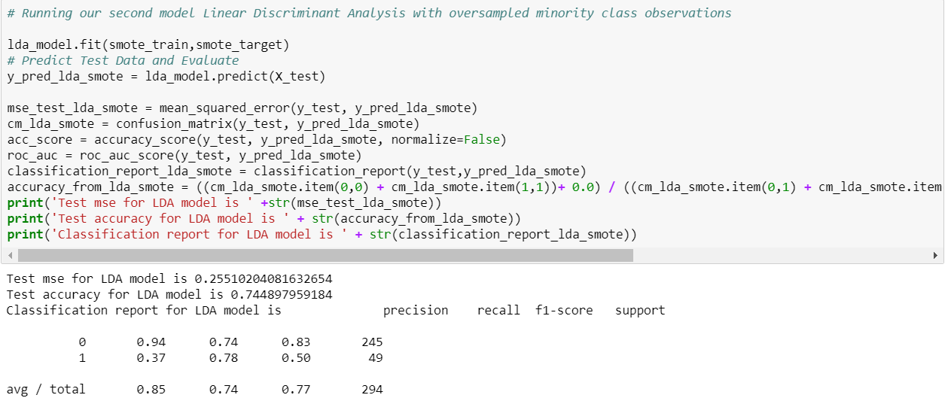
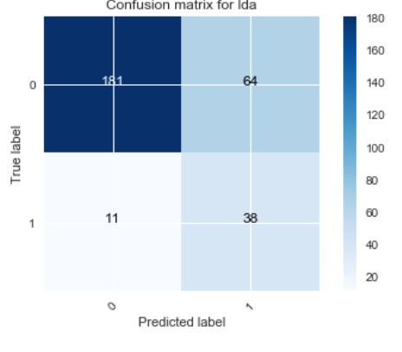
Test Accuracy: 0. 744897959184 AUC score: 0.84606 Test Accuracy of the model prior to oversampling of minority class observations was: 0.867346938776

Slide 30
Ensemble Models
The main principle behind ensemble methods is that a group of “weak learners” can come together to form a “strong learner”
It is the use of multiple learning algorithms to obtain better predictive performance than could be obtained from any of the constituent learning algorithms alone
Evaluating the prediction of an ensemble typically requires more computation than evaluating the prediction of a single model, so ensembles may be thought of as a way to compensate for poor learning algorithms by performing a lot of extra computation
Ensemble models help reduce variance and bias
Bagging : Many independent predictive models (Decision Trees)run parallelly on on a sub-sample of the data and are combined using some model averaging technique. An example of this is Random Forest
Boosting : In this method the individual predictive models (Decision Trees) run sequentially where each subsequent model learns from the mistakes of the previous model. An example of this method is Gradient Boosting
Notes:
References: https://medium.com/mlreview/gradient-boosting-from-scratch-1e317ae4587d
https://en.wikipedia.org/wiki/Ensemble_learning
http://blog.citizennet.com/blog/2012/11/10/random-forests-ensembles-and-performance-metricss

Slide 31
RANDOM FOREST

Slide 32
Random Forest
Builds a forest with an ensemble of Decision Trees
Uses the bagging method: builds multiple decision trees and merges them together to get a more accurate prediction
How does it improve over single decision trees: Instead of searching for the best feature while splitting a node, it searches for the best feature among a random subset of features. This creates a wide diversity, which generally results in a better model
Helps control variance
With more trees running within the model, chances of overfitting are thus greatly reduced, giving a better performance of the model on unseen data
The only main disadvantage is its execution becoming slow as the number of trees running within it increases, thus it might take it longer to predict an unseen dataset
Notes:
References: https://towardsdatascience.com/the-random-forest-algorithm-d457d499ffcd

Slide 33
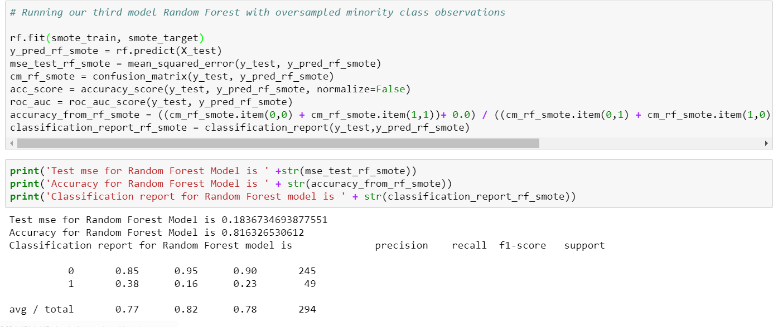
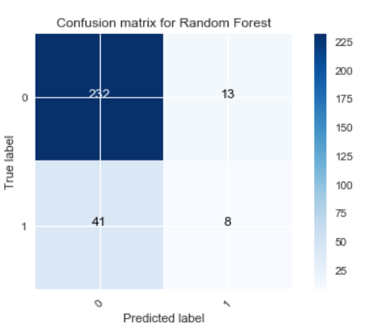
Test Accuracy: 0.816326530612 AUC score: 0.72802 Test Accuracy of the model prior to oversampling of minority class observations was: 0.84693877551

Slide 34
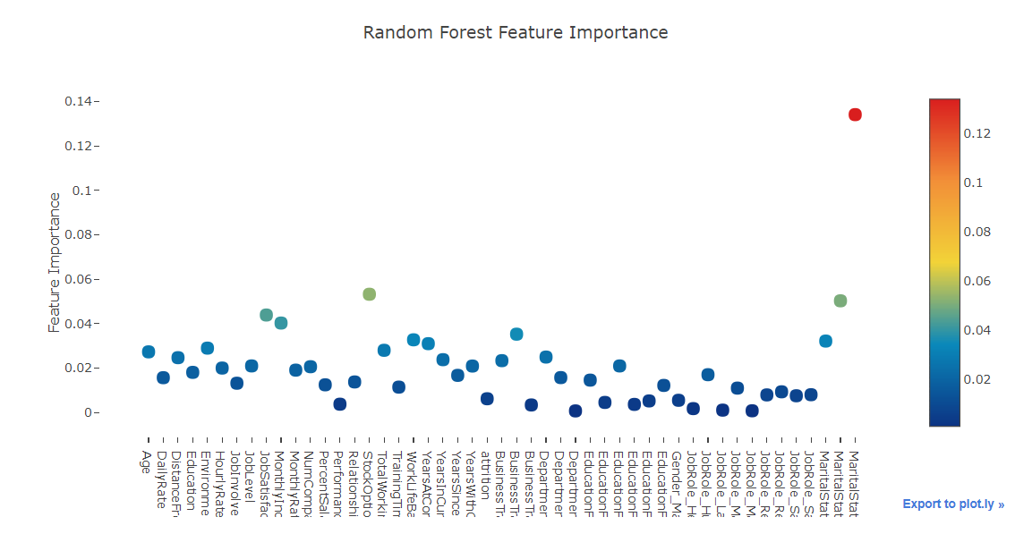
Feature Ranking with Random Forest

Slide 35
GRADIENT BOOSTING

Slide 36
Gradient Boosting
Uses an ensemble of Decision Trees working sequentially to give a high performing model
Uses the boosting method: Each Decision Tree applied sequentially learns from the mistake of the previous Decision Tree
They are better learners than Random Forest as each tree is built sequentially and learns from the previous tree’s mistakes. They also help control both variance and bias whereas Random Forest helps control variance alone
It takes longer for Gradient Boosting models to train as the trees are built sequentially
Notes:
References: https://medium.com/mlreview/gradient-boosting-from-scratch-1e317ae4587d
https://www.quora.com/What-are-the-advantages-disadvantages-of-using-Gradient-Boosting-over-Random-Forests

Slide 37
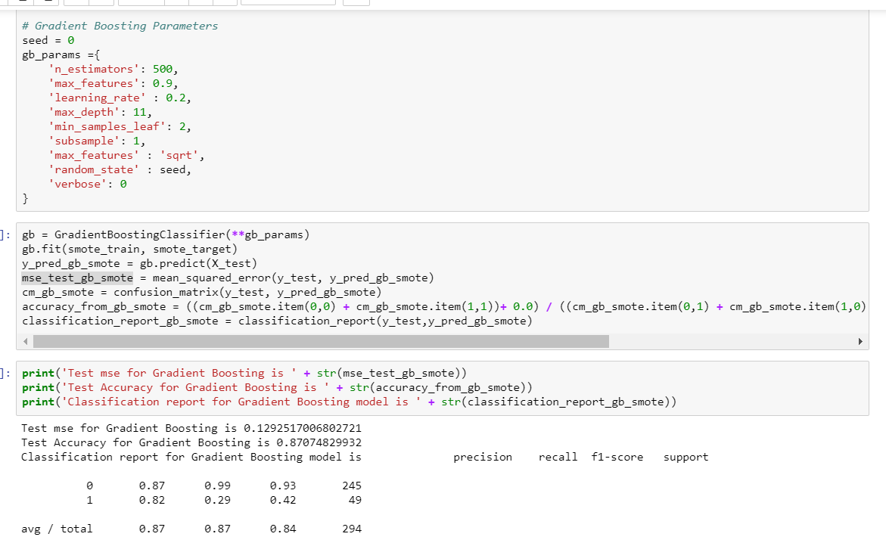
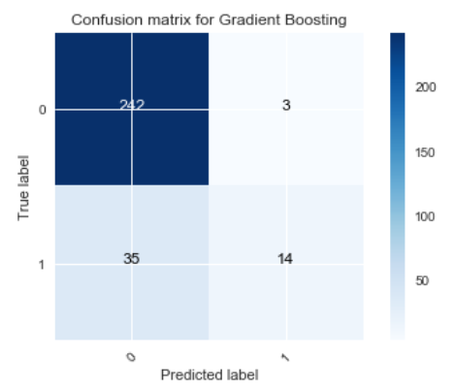
Test Accuracy: 0.87074829932 AUC score: 0.82057 Test Accuracy of the model prior to oversampling of minority class observations was: 0.857142857143

Slide 38
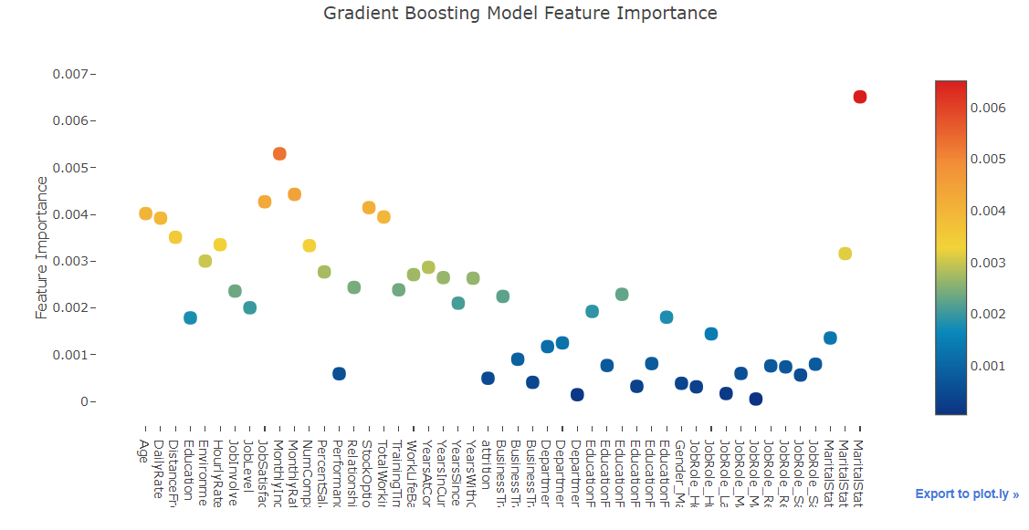
Feature Ranking with Gradient Boosting

Slide 39
Feature Engineering to improve Random Forest and Gradient Boosting performance

Slide 40
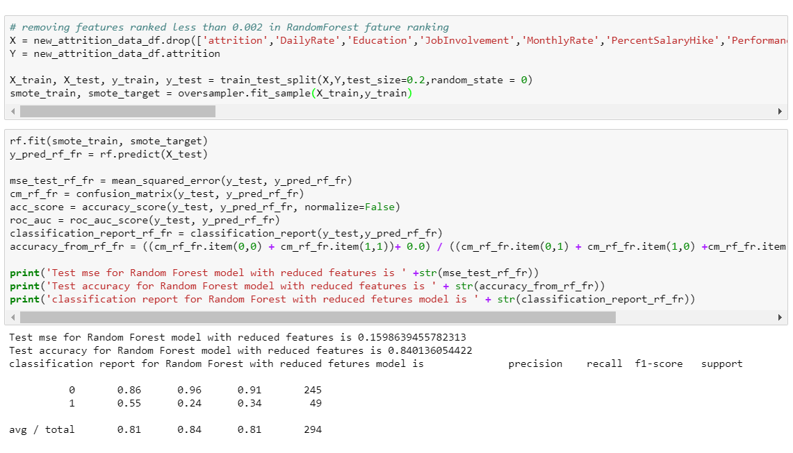
Test Accuracy: 0.840136054422 Previous test accuracy without feature reduction: 0.816326530612
We tried eliminating features that ranked less than 0.002 in Random Forest feature Ranking
Features eliminated:
DailyRate, Education, Gender_Male, JobInvolvement, MonthlyRate, PercentSalaryHike, PerformanceRating, RelationshipSatisfaction, TrainingTimesLastYear, YearsSinceLastPromotion, All Job Roles
The increased test accuracy with reduced features indicates that the original model was probably overfitted and reducing the features helped solve this problem

Slide 41
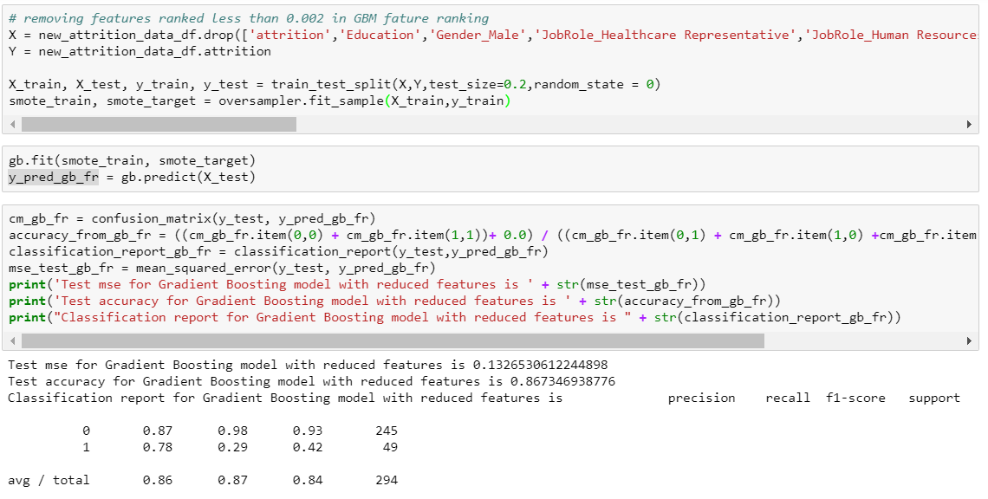
Test Accuracy: 0.867346938776 Previous test accuracy: 0.87074829932
We tried eliminating features that ranked less than 0.02 in Gradient Boosting feature Ranking
Features eliminated:
Education, Gender_Male, PerformanceRating, All Job Roles, All Departments
The slightly decreased test accuracy shows that the model loses some important predictors in the process of feature elimination and thus the earlier model itself looks an optimal GB model

Slide 42
SUMMARY OF MODEL PERFORMANCE
MODEL | ACCURACY | AUC | Precision | f1 | Recall
Logistic Regression | 0.7721 | 0.8436 | 0.85 | 0.80 | 0.77
LDA | 0.7448 | 0.8460 | 0.85 | 0.77 | 0.74
Random Forest (RF) | 0.8163 | 0.7280 | 0.77 | 0.78 | 0.82
RF with reduced Features | 0.8401 |  | 0.81 | 0.81 | 0.84
Gradient Boosting (GB) | 0.8707 | 0.8205 | 0.87 | 0.84 | 0.87
GB with reduced Features | 0.8673 |  | 0.86 | 0.84 | 0.87

Slide 43
RECOMMENDATION
Based on five parameters and the fact that it helps control variance and bias, we recommend using GRADIENT BOOSTING MODEL without Feature Reduction
Accuracy: 0.8707
AUC: 0.8205
Precision: 0.87
f1: 0.84
Recall: 0.87

Slide 44
Thank You!

Slide 45
Backup Slides

Slide 46
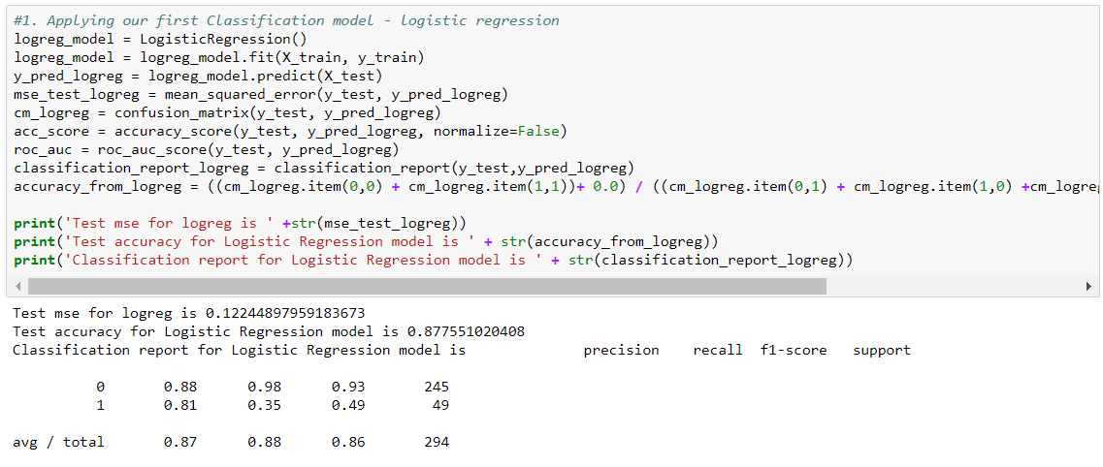
Performance of the models without minority class over-sampling
1. Logistic Regression

Slide 47
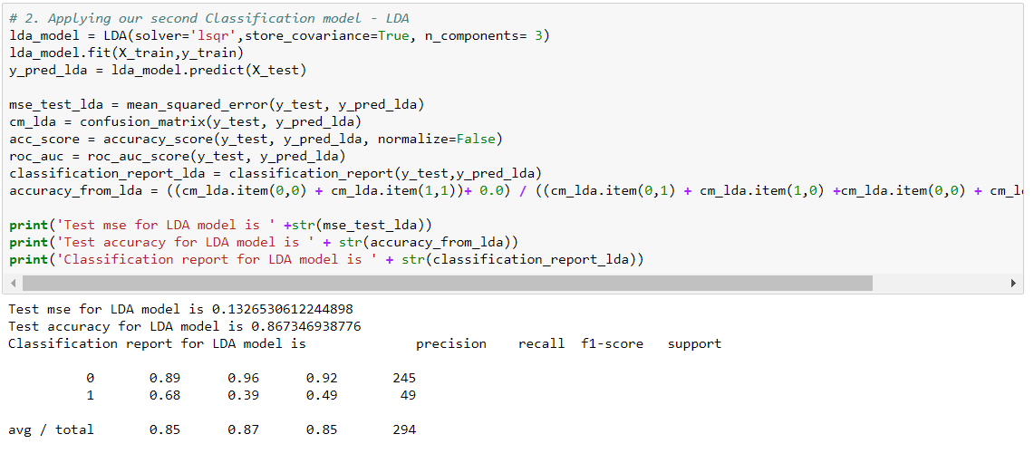
Performance of the models without minority class over-sampling
2. Linear Discriminant Analysis

Slide 48
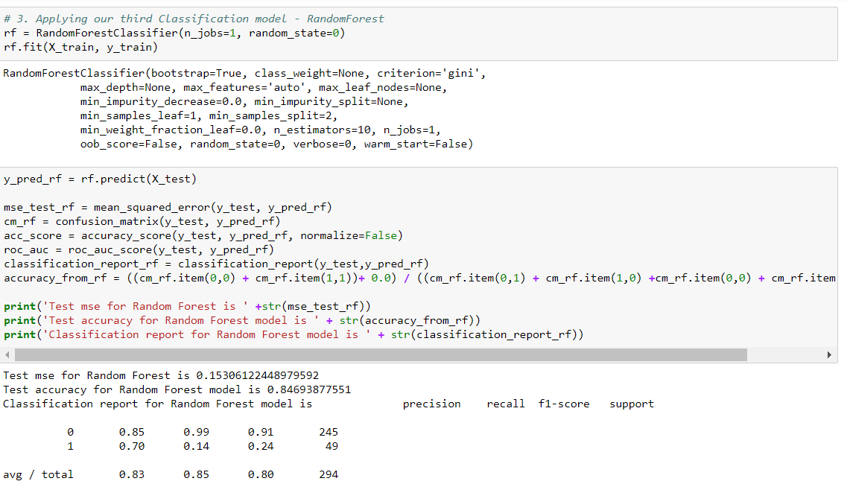
Performance of the models without minority class over-sampling
3. Random Forest

Slide 49
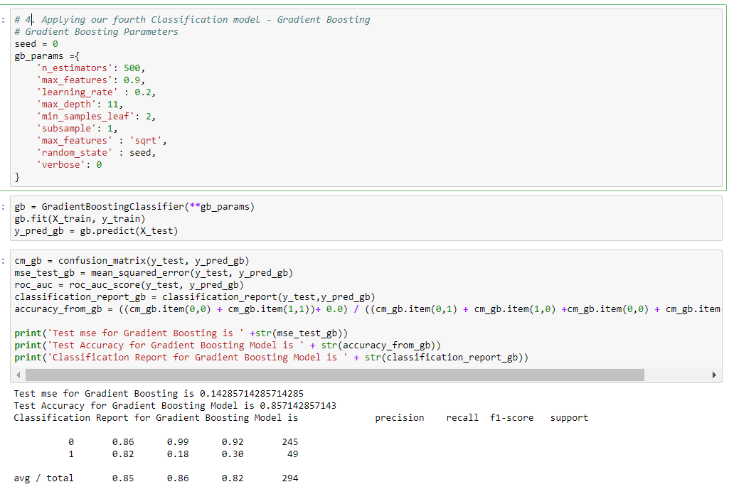
Performance of the models without minority class over-sampling
4. Gradient Boosting

