Slide 1

UB ROOM RESERVATION SYSTEM
Department of Computer Science and Engineering
Submitted By
Tanveen Kaur
1014603
Submitted To
Dr. Jeongkyu Lee

Slide 2
Introduction
The UB Room Reservation System will be used to reserve rooms in the different buildings of the University of Bridgeport by present Students or Faculty members based on their needs. It aims to provide an efficient and convenient way of reserving rooms for all the individuals involved. Not only just rooms, the faculty members or the students can also book an additional item like a computer or a projector in the room.

Slide 3
Summary of the Project
The proposed system will make the task of reserving a room with different equipments or the possibility to choose between different date and times, very easy. The basic functionality of the system would be to keep track of the reservations of the rooms in different buildings, along with the additional items reserved with the room. The system will also keep track of the student’s or faculty’s feedback for the reservation. The system will have an admin user who will monitor or approve all the requests for the reservations and the normal user i.e a Student or a Faculty member, who will request the reservation, or further modify or cancel the reservation. The system overall aims to prevent the errors caused by humans as the reservation of the rooms in large buildings or campus becomes tedious, complicated and more error prone task.

Slide 4
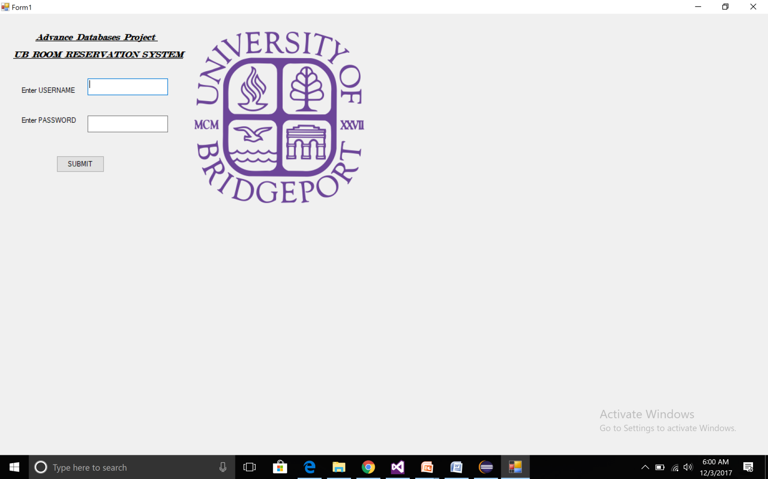
LOGIN PAGE

Slide 5
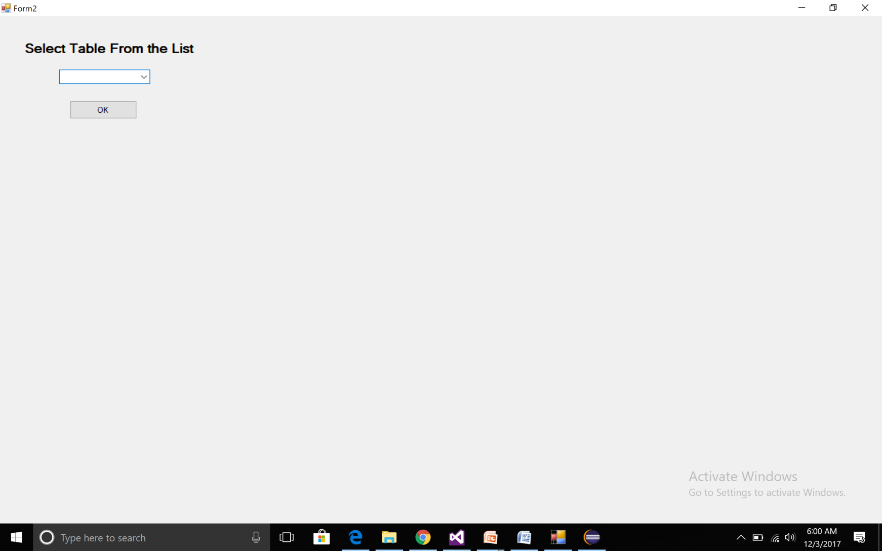
TABLE SELECTION PAGE

Slide 6
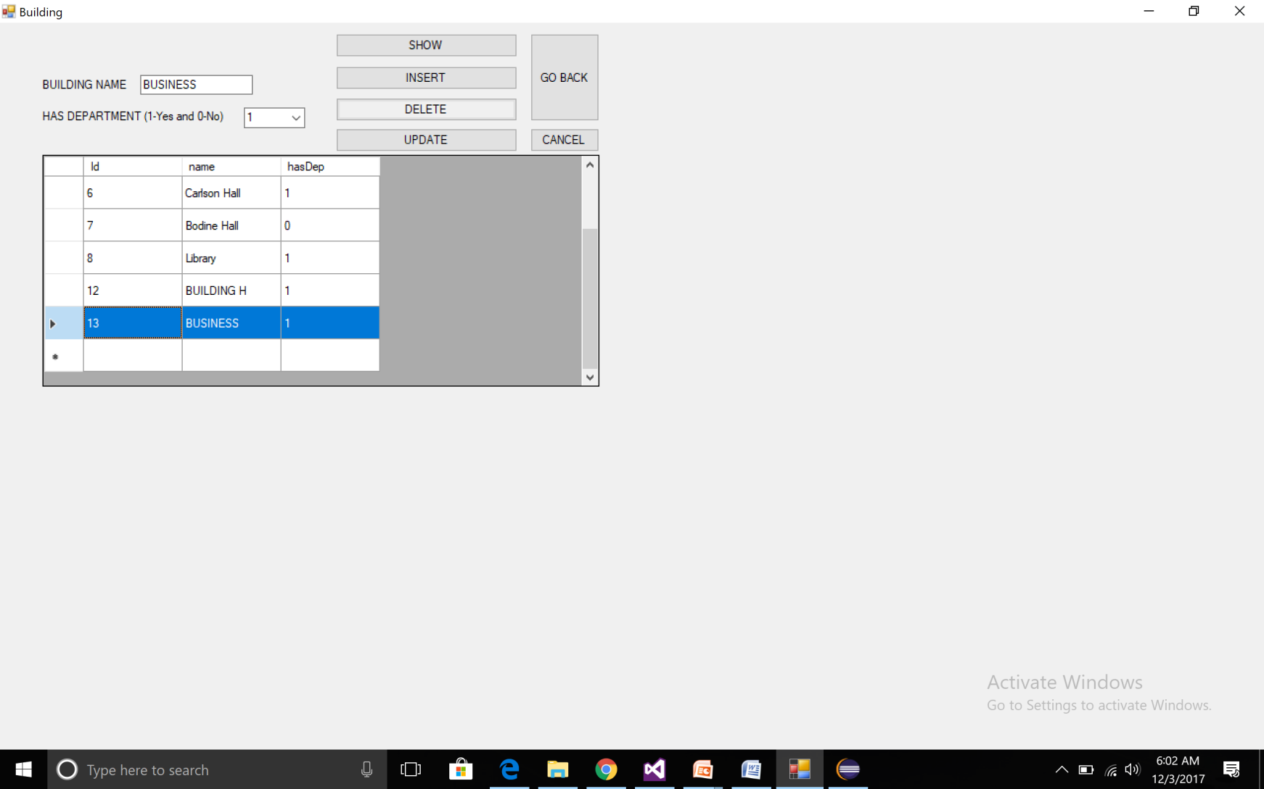
INSERT OPERATION

Slide 7
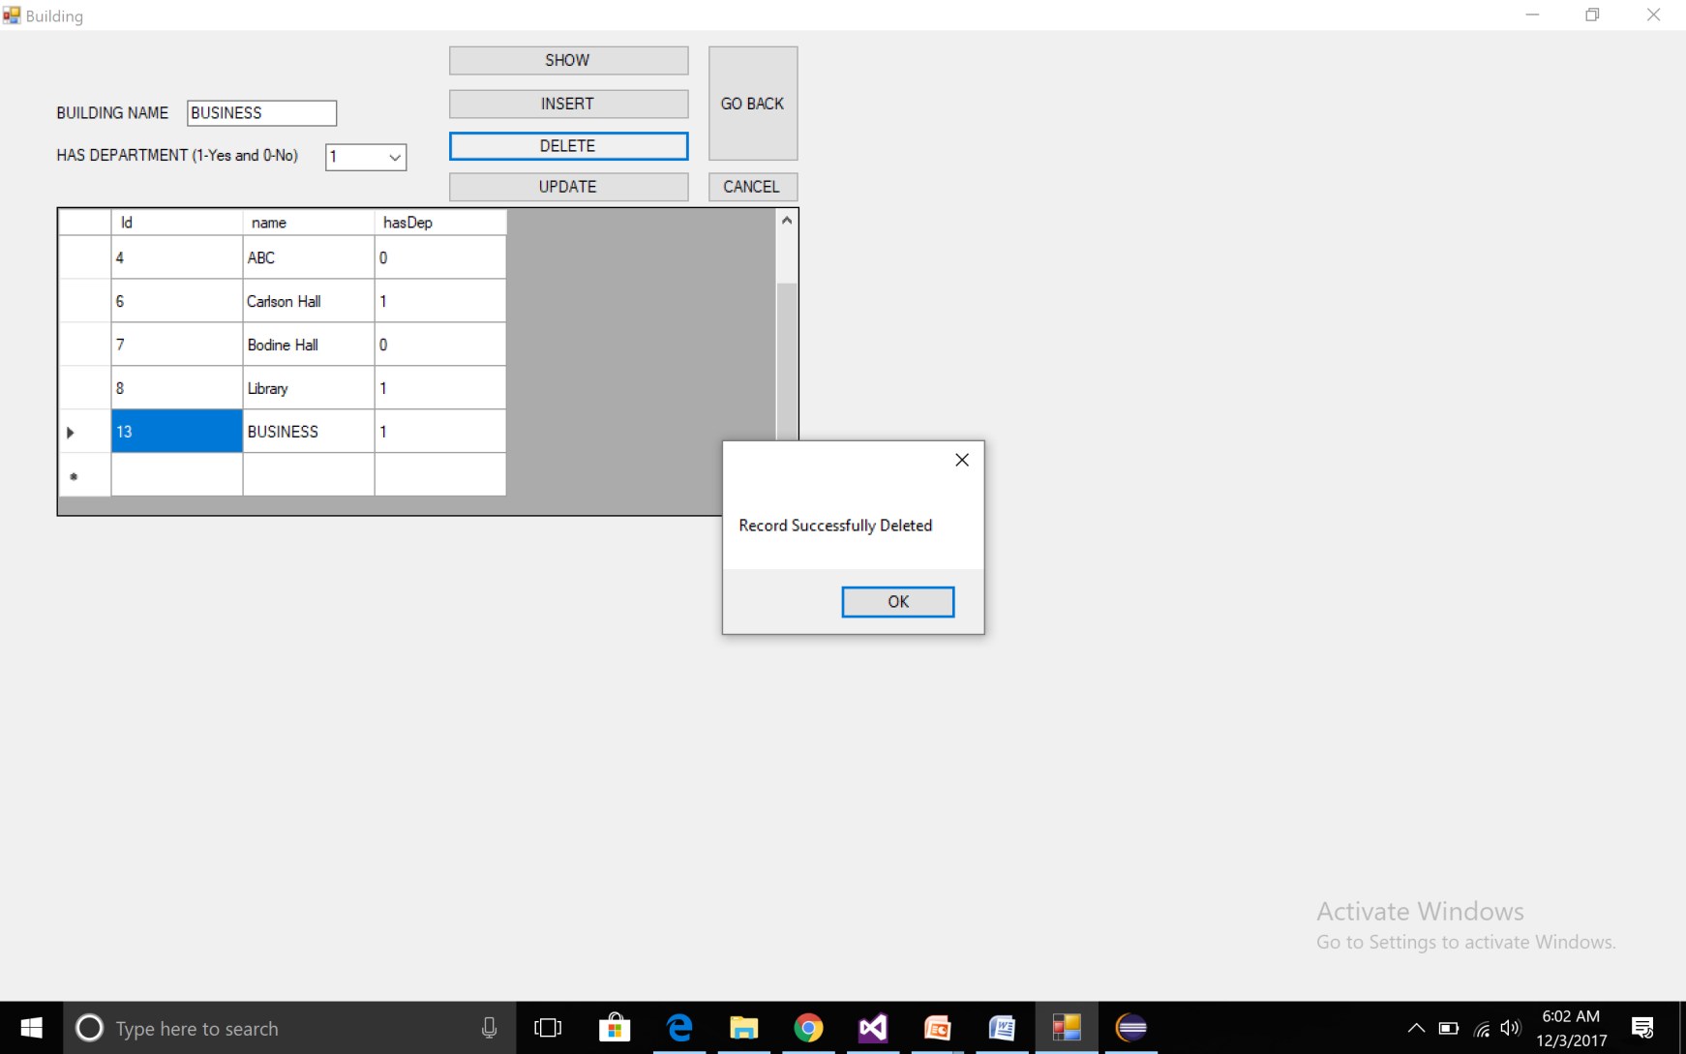
DELETE OPERATION

Slide 8
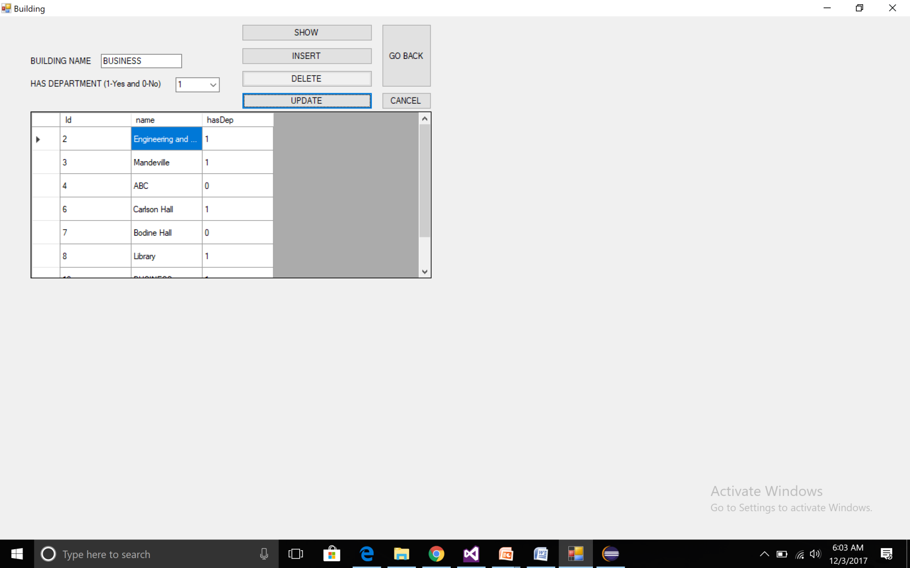
UPDATE OPERATION

Slide 9
Conclusion
These systems are not really common and the Room Reservation System is a project that tend to replace the reservation system, which is currently being implemented manually by people, building admin.
The Room Reservation System will aim to be self-contained, meaning that it will have no dependencies to other existing information system. It is expected that more functionalities will be included, or that this system might be extended.
This system is implemented and tested manually however, if successful, it can be done be deployed in the entire college.

