Slide 1

SMART INDIA HACKATHON 2026
TITLE PAGE
Problem Statement ID – SIH26176
Problem Statement Title- ORCA Marine EcOsystem Reasoning with Collaborative Agents
Theme- Disaster Management
PS Category- Software
Team ID-
Team Name- Don't Expecto

Slide 2
IDEA TITLE
Don't Expecto
Proposed Solution : A conversational, multi-agent AI platform that fuses live satellite, weather, and ocean advisory data into one natural-language interface. A fisherman can ask "is it safe to fish tomorrow near me?" and get a single explainable answer instead of manually cross-checking INCOIS's PFZ map, IMD's cyclone bulletin, and the ocean state forecast separately.
Overview:
Today, PFZ advisories, cyclone/lightning warnings, and ocean state forecasts are three separate one-way broadcast systems: WebGIS maps, SMS bulletins, static text advisories. A user has to manually find and reconcile all three to answer one operational question.
ORCA replaces that manual correlation with an orchestrator agent that decomposes a query, dispatches specialized sub-agents to each data source in parallel, and returns one synthesized, source-cited answer.
Key Features:
Multi-Agent Reasoning Core
Nine specialized agents handle planning, data discovery, weather intelligence, ocean analytics, geospatial reasoning, risk assessment, visualization, and reporting.
Each agent is grounded in a real government data source, not one model guessing across domains.
Conversational, Multi-Turn Access
Supports follow-up and refinement, such as “what about further north?”
Automatic language detection, with responses in Indian regional languages and audio responses via text-to-speech
Output via text + maps/charts/geospatial visualizations and update it with follow-up
Explainable, Cited Answers
Every recommendation states which source it drew from.
Reasoning path is shown alongside the verdict, not just the final answer.
Proactive Hazard and Geofencing Alerts
Cyclone, lightning, and high-wave alerts pushed based on the user's location.
Geofencing for international maritime boundaries, restricted waters, marine protected areas, and ecologically sensitive zones.
Route and Navigation Advisory
Suggests safer routing by weighing forecast wave and wind conditions.

Slide 3
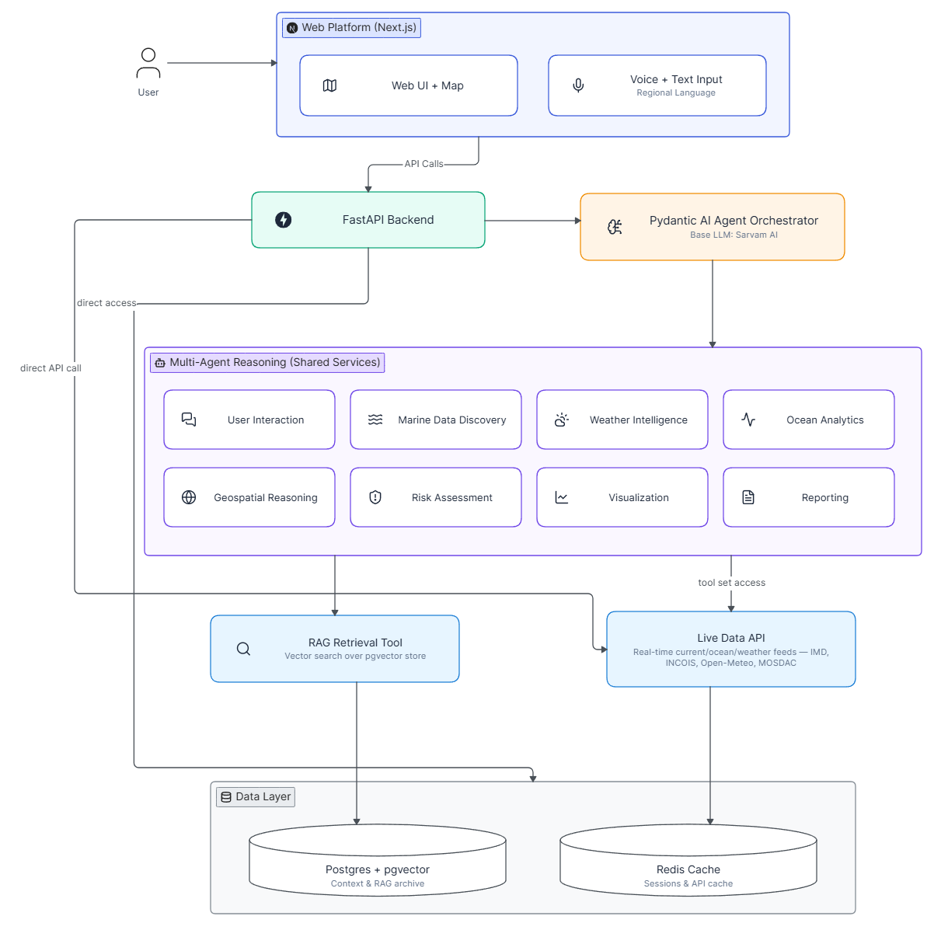
TECHNICAL APPROACH
Don't Expecto
Core Components
User Interface (Web Frontend)
Framework: Next.js (SSR for fast initial load) with PWA to provide app support
Map layer: Leaflet or Google Maps, rendering PFZ zones, cyclone tracks, and geofenced boundaries
Real-time: WebSocket client for streaming agent responses
Agent Core (Backend)
Framework: FastAPI (async), serving the orchestration layer
Agent Framework: Pydantic AI, type-safe orchestrator plus nine specialized sub-agents, with native MCP client support
Sarvam AI: Indic-tuned chat model, plus Saaras (speech-to-text, 22 Indian languages) and Bulbul (text-to-speech, 11 Indian languages)
Handles voice input and audio responses natively, without a separate translation layer
Data Management
Database: PostgreSQL, storing user context and agent decision audit trail
Vector store: pgvector, embedding CMFRI stock reports and INCOIS advisory archive for RAG
Caching: Redis for cache and response cache
Real-Time Data (MCP Tools)
IMD API: cyclone track, cyclone wind warning, lightning data, fishermen warning
INCOIS PFZ Advisory + Ocean State Forecast: nearest fishing zone, tide/wave/current conditions
Fig 1.1: ORCA System Architecture

Slide 4
FEASIBILITY AND VIABILITY
Don't Expecto
Feasibility
Technical Feasibility
Built on free, publicly documented government data sources (IMD, INCOIS, MOSDAC) plus Open-Meteo as a no-registration fallback.
Claude Agent SDK supports multi-agent orchestration and custom MCP tools natively, so the team builds domain tool wrappers, not an agent framework from scratch.
Open-Meteo runs as a working data source whenever IMD or INCOIS registration is still pending, so development never stalls on an external approval.
Pydantic AI enforces typed, schema-validated outputs and automatically retries on a malformed response instead of passing it through - this is the actual mechanism behind response reliability, not just a stated policy.
Operational Feasibility
Every alert cross-references its original government source before display; if that source is stale or unreachable, the Risk Assessment agent flags a data gap instead of defaulting to “no threat.”
Geofencing boundary layers pull directly from Bhuvan and re-validate on a scheduled refresh, keeping restricted and protected-zone data current rather than static.
Sarvam AI's Indic-tuned models cover speech and text across major regional languages, so the team isn't building translation or transcription from scratch.
Viability
No recurring data-licensing cost. Every source in the pipeline is free or government-published.
Extends directly to institutional users (Coast Guard, State disaster management agencies) without an architecture change.
A containerized, cloud-native deployment strategy ensures the solution is highly scalable, ready to support a growing user base across various institutions.
New data sources become new MCP tools, not a system rewrite, keeping long-term maintenance cost low.

Slide 5
IMPACT AND BENEFITS
Don't Expecto
Fisherman Safety
An estimated 7 million people in India depend on fishing for their livelihood, along a coastline of roughly 7,500 km (INCOIS/Ministry of Earth Sciences).
Proactive, geofenced alerts and route advisories remove the need to check three separate systems before departure.
Economic Impact
A 2002 study found that PFZ advisories saved ₹545 crore a year nationally at just 10% adoption, rising to ₹1,635 crore at 25% adoption.
Most fishermen skip these advisories since they're a text bulletin or map, not in their language. ORCA fixes access via voice/chat in local languages, not new data.
Operational Efficiency
Coastal authorities and disaster agencies get one conversational interface instead of checking IMD, INCOIS, and Bhuvan separately during an active weather event.
Digital Inclusion
Regional-language, conversational access lowers the literacy and technical barrier that English-only bulletins and static GIS maps currently impose.
Voice/text access reaches users who can't navigate a WebGIS map interface directly.
Audio output reaches users with limited reading fluency, not just non-English speakers.
Institutional Impact
Extends to Coast Guard and State disaster management agencies as institutional users without an architecture change.
One audit-trailed reasoning log per query supports post-event review, not just real-time alerting.
Direct Theme Alignment
The PS is filed under Disaster Management. Proactive hazard alerting, geofencing, and route advisory speak directly to that theme, ahead of the fisheries-productivity features.

Slide 6
RESEARCH AND REFERENCES
Don't Expecto
Data Sources
https://incois.gov.in/site/dataholdings.jsp
https://mosdac.gov.in
https://bhuvan.nrsc.gov.in
Real-Time / MCP Sources
https://api.imd.gov.in
https://incois.gov.in/MarineFisheries/PfzWebGis
https://incois.gov.in/MarineFisheries/TextDataHome
https://incois.gov.in/site/services/osf.jsp
https://open-meteo.com/en/docs/marine-weather-api
PFZ Advisory Research / Economic Study
https://arxiv.org/pdf/2411.10050 (cites the 2002 Nayak et al. PFZ savings study with the ₹545 crore / ₹1,635 crore figures)
Comparison with Existing Systems
Feature | ORCA | INCOIS PEZ WebGIS | Generic AI Chatbot
Multi-source data fusion | Yes | No (PFZ only) | No (no live grounding)
Conversational, multi-turn | Yes | No | Yes
Explainable, cited reasoning | Yes | No | Limited
Regional language support | Yes | Limited | Not Applicable
Proactive geofenced alerts | Yes | No | No
Route/navigation advisory | Yes | No | No
Grounded in live govt data | Yes | Yes | No
Audit trail / reasoning log | Yes | Limited | Limited

Slide 7
IMPORTANT INSTRUCTIONS
Please ensure below pointers are met while submitting the Idea PPT:
Kindly keep the maximum slides limit up to six (6). ( Including the title slide)
Try to avoid paragraphs and post your idea in points /diagrams / Infographics /pictures
Keep your explanation precise and easy to understand
Idea should be unique and novel.
You can only use provided template for making the PPT without changing the idea details pointers (mentioned in previous slides).
You need to save the file in PDF and upload the same on portal. No PPT, Word Doc or any other format will be supported.
Note - You can delete this slide (Important Pointers) when you upload the details of your idea on SIH portal.

