Slide 1
EEG-Based Cognitive State Classification
and Learner Attention Recommendation
National Institute of Technology Jalandhar · Machine Learning Lab
Project 1 — Emotion State Classification
Project 2 — Attention Level Recommendation
SEED Dataset · 15 Subjects · 62 Channels · 29,700 Windows
Tanveer Singh Saini
B.Tech Electrical Engineering (2024-2028)

Slide 2
Literature Survey
Paper 1
Paper 2
Paper 3
Shaw & Patra (2022) — Classification
Shaw & Patra (2022) — Recommendation
Xu et al. (2023) — Multi-Level Attention
Future Generation Computer Systems
Expert Systems With Applications
Int. J. Environmental Research & Public Health
84 students, single-channel EEG (NeuroSky)
DWT feature extraction + Siamese Neural Network
3-class: Weak / Good / Outstanding | F1 = 0.74
Gap: Single channel, small sample, no feature selection
20 students, single-channel EEG, 10 ML videos
K-means clustering + alpha/beta attention ratio
LRFL_B recommender | F1K = 0.663
Gap: Binary labels, unsupervised, rule-based recommendation
14 subjects, 10 channels, 4-level attention tasks
SVM + Sequential Forward Selection (SFS)
94.1% accuracy after feature selection
Gap: Small dataset, single classifier, no recommendation

Slide 3
Dataset & Models
SEED Dataset
ML Models
Property | Details
Subjects | 15 (45 sessions, 3 per subject)
EEG Channels | 62 (10-20 system)
Trials/Session | 15 film-clip trials
Features | DE, PSD, DASM, RASM (1s segments)
Windows | 29,700 (10s window, 5s step)
P1 Labels | Negative / Neutral / Positive
P2 Labels | Low / Medium / High Attention
Balance | ~33% per class (balanced)
LinearSVC
Fast linear classifier — O(n) complexity
LDA
Projects to max class-separability subspace
Random Forest
Ensemble of decision trees, handles nonlinearity
Hist Grad Boosting
Sequential boosting — compact, high accuracy
KNN
Distance-based, no training phase required
Logistic Regression
Probabilistic linear baseline with L2 regularisation

Slide 4
Methodology — Feature Extraction (Project 1: Emotion Classification)
.mat Files
Windowing
Features
MI Selection
5-Fold CV
DE · PSD · DASM · RASM
1-second segments
10s window
5s step overlap
→ 29,700 windows
Stats (mean, std,
skew, kurt)
Band ratios
Asymmetry
→ 3,516 total
Select KBest
Mutual Information
Per fold (no leakage)
→ Top 60 features
Subject-wise
No data leakage
Train/Test split
by subject
Feature Groups Used
DE Statistical
PSD Statistical
Band Power Ratios
Asymmetry
mean, std, skewness, kurtosis per (channel × band) → 1,240 features
Same 4 statistics on PSD values → 1,240 features
θ/α · β/α · γ/β per channel + each band/total → 496 features
DASM / RASM mean + std → 540 features
MI: 0.023
MI: 0.023
MI: 0.081 ★ highest
MI: 0.009

Slide 5
Methodology — Composite Attention Score (Project 2: Recommendation)
01 Theta / Beta Ratio
02 Frontal Beta Suppression
03 DASM Hemispheric Asymmetry
Formula:
Formula:
Formula:
Θ/β per channel (mean over window)
1 − (frontal β / total DE)
−tanh(DASM_β / 5)
Weight: 0.4
Weight: 0.3
Weight: 0.3
High θ relative to β indicates drowsiness / inattention.
Lower ratio = more attentive.
(Freeman et al. 1999 — validated marker)
Reduced frontal beta indicates disengagement.
Channels: Fp1, Fp2, F3, F4, F7, F8, Fz.
High suppression = low attention.
Left-right asymmetry in beta band.
Positive DASM = left > right = engaged.
Negated so high value = inattentive.
Composite Score = 0.4 × (Θ/β) + 0.3 × (1 − frontal β) + 0.3 × (−tanh(DASM_β/5)) → Lower score = more attentive → Percentile thresholds → Low / Medium / High labels

Slide 6
Methodology — Recommendation System Pipeline (Project 2)
1
Predict attention per window
Comparison — Shaw et al. vs This Work
HGB classifier (best model) trained on all subjects except test subject (LOSO). Predicts Low / Medium / High for each 10-second EEG window.
Aspect | Shaw et al. | This Work
Channels | 1 (NeuroSky) | 62 (SEED)
Method | K-means cluster | Supervised ML
Labels | Binary | 3-class
Metric | α/β ratio only | Composite score
Rec. logic | Rule-based | Score-ranked
Best F1 | 0.663 | [insert result]
2
Aggregate to trial level
For each trial (video), compute mean predicted attention label across all its windows. Also record % of Low-attention windows per trial.
3
Rank trials per subject
Sort trials ascending by mean predicted attention score. Trials with lowest score had the most inattentive EEG — candidate for re-watching.
4
Recommend bottom-3 trials
Top-3 lowest-attention trials are flagged as recommended for re-watching. Output: per-subject ranked list with attention percentages.
5
Evaluate quality
Ground truth: bottom 40% attention trials per subject are truly low-attention. Metrics: Precision@3, Recall@3, F1@3. Any value > 0.5 outperforms random baseline.

Slide 7
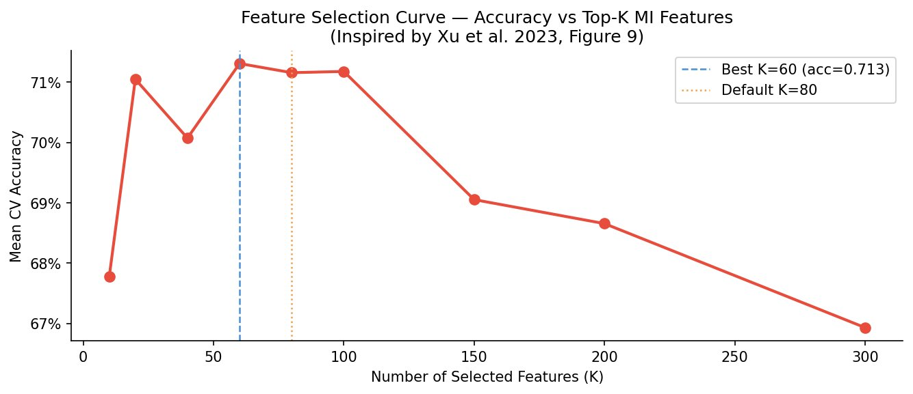
Results — Emotion State Classification (Project 1)
71.9%
0.719
~85%
60→80
Best Accuracy
(LDA)
Best F1 Score
(LDA)
Positive Class
Recall
Optimal Feature
Count (K)
LDA achieves best accuracy (71.9%) — Band Power Ratios are 3.5× more discriminative than statistical features.
Feature Selection Curve — Accuracy vs K

Slide 8
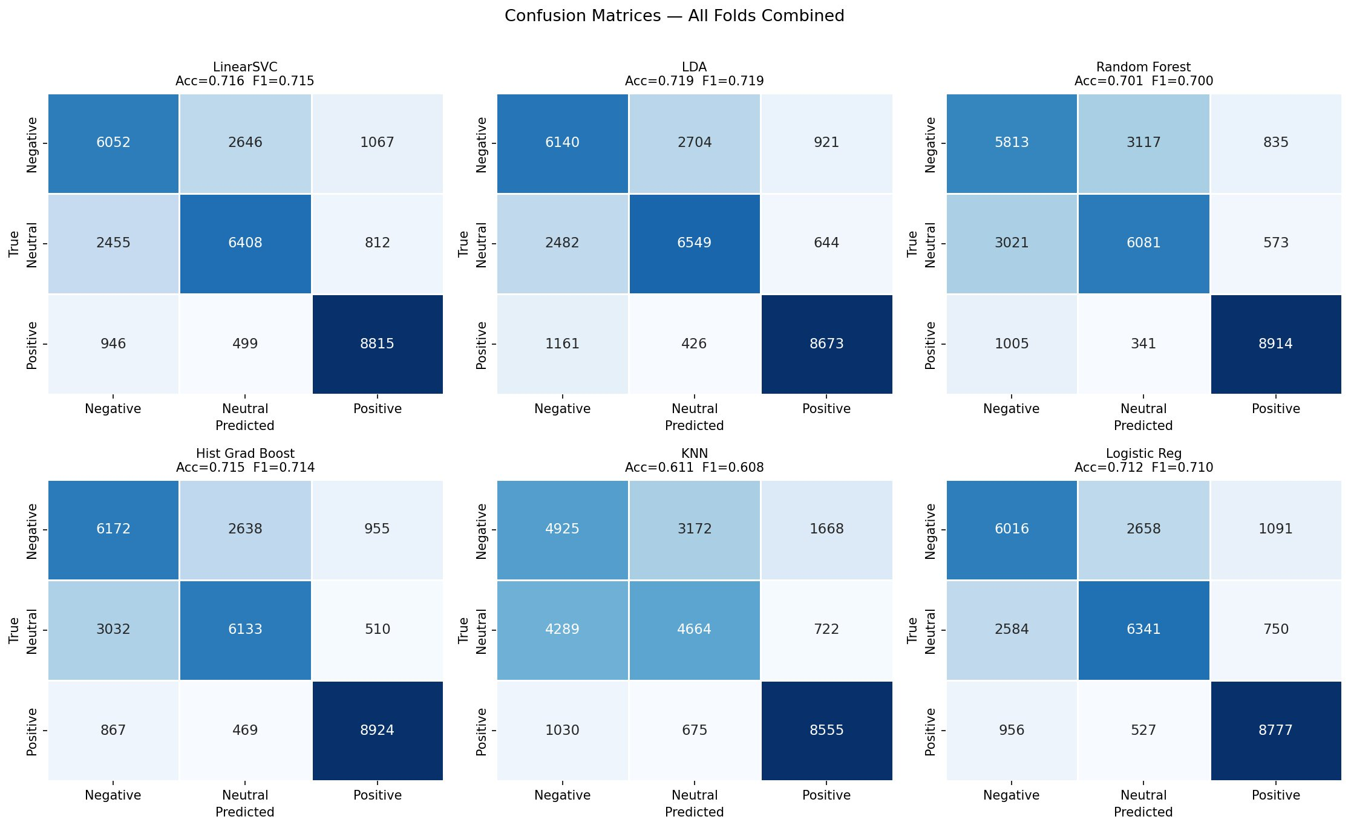
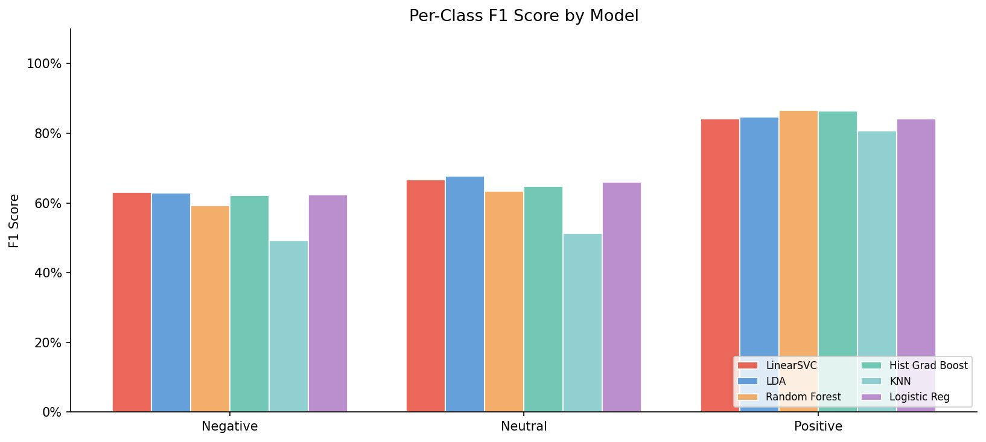
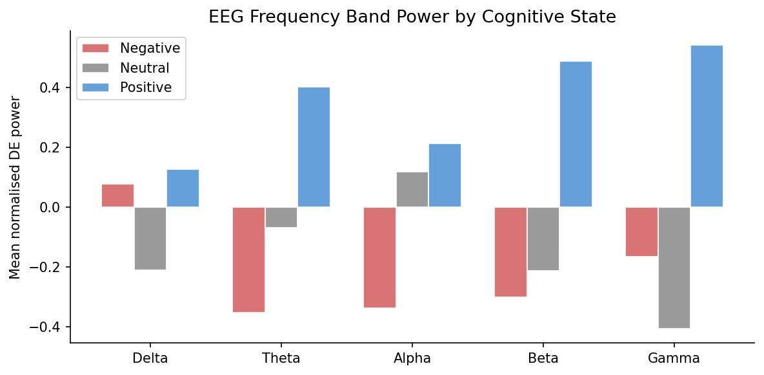
Results — Confusion Matrices & Per-Class F1 (Project 1)
Per-class F1 by model
Confusion matrices — all 6 models, all folds combined
Key Observations:
Positive class recall ~85% across all models — highest of the three classes
Negative ↔ Neutral most confused — share suppressed oscillation patterns
Positive emotion has distinctive high Beta & Gamma power (see band chart)
All models vastly outperform chance (33.3%) — confirming EEG discriminability
EEG band power by emotion class
[Slide 8 / 10]

Slide 9
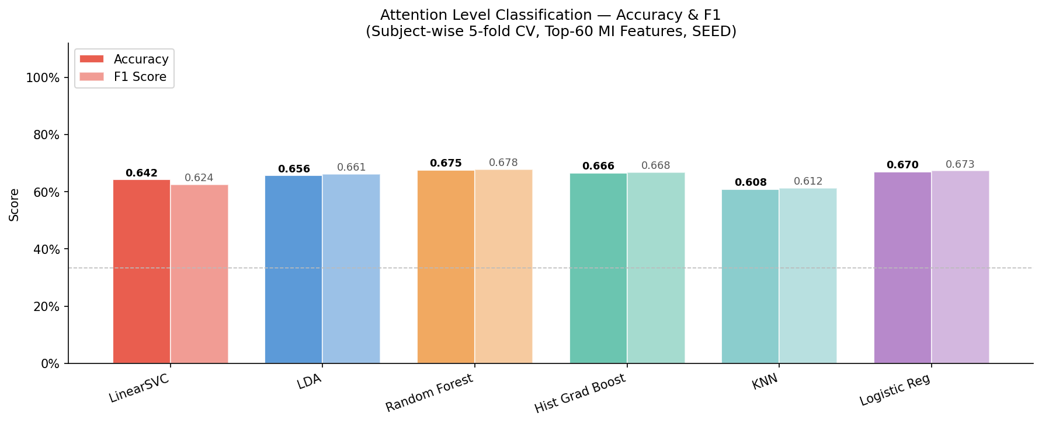
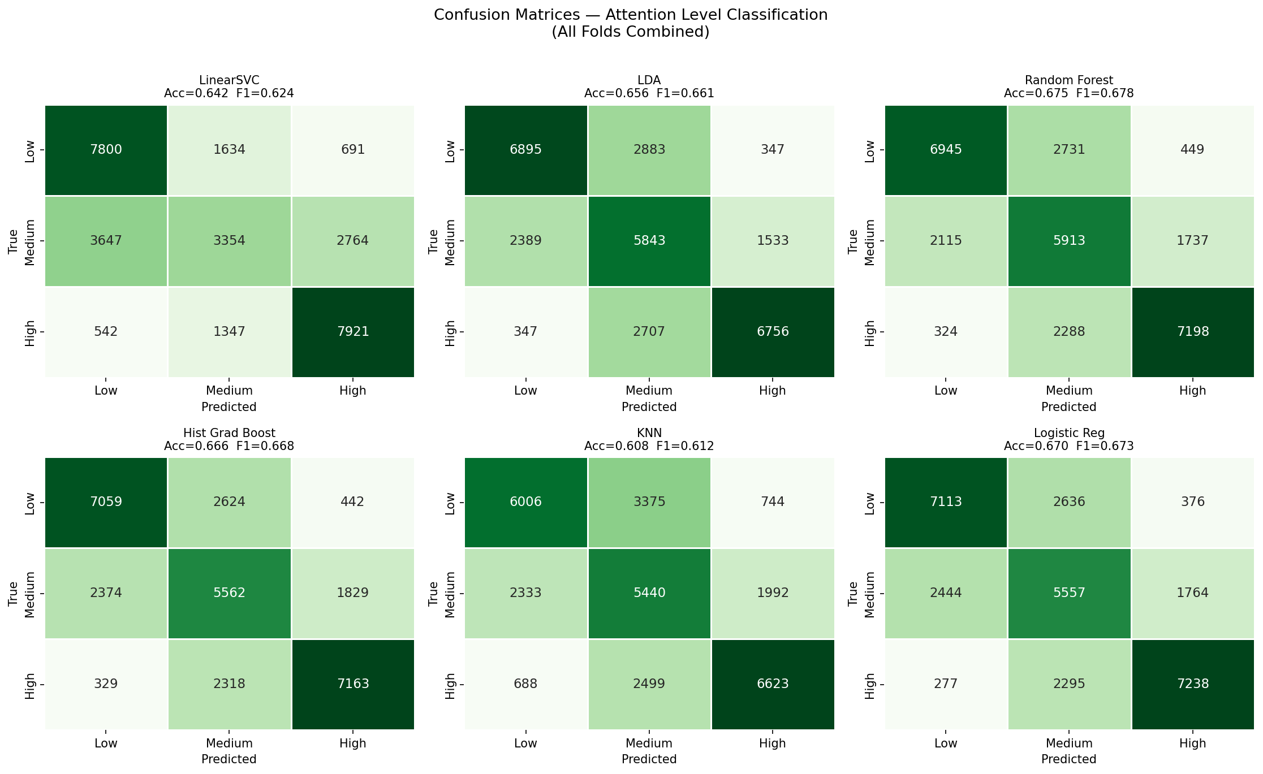
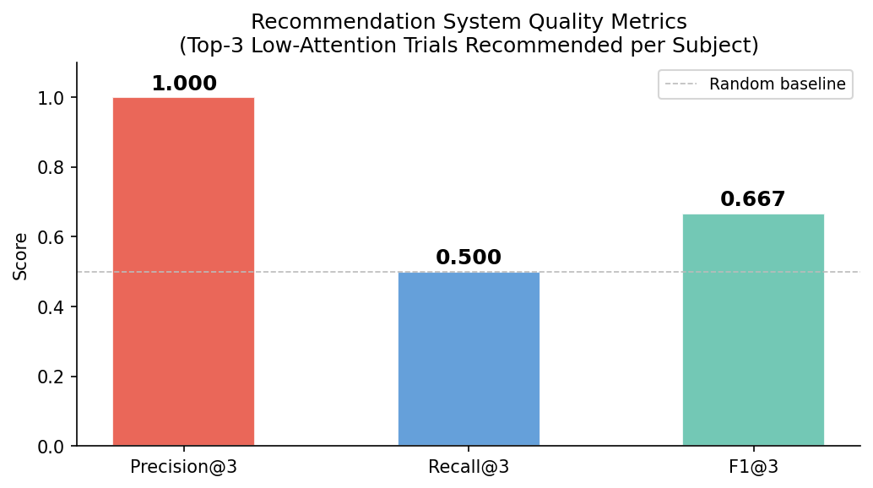
Results — Attention Classification & Recommendation (Project 2)
0.675
0.678
Best Accuracy
Random Forest
Best F1
Random Forest

Slide 10
Conclusion
Project 1 — Emotion Classification
Project 2 — Attention Recommendation
LDA achieves 71.9% accuracy — competitive with DL baselines
Band Power Ratios are 3.5× more informative than statistical features
Positive emotion classifies best (~85% recall)
Feature selection (MI, K=60) critical — accuracy degrades beyond K=80
Subject-independent evaluation — no data leakage across subjects
Composite attention score (3 markers) outperforms single alpha/beta ratio
Supervised ML on 62-channel data vs Shaw et al. single-channel clustering
3-class labels (Low/Med/High) more granular than binary attentive/non-attentive
Recommendation ranked by predicted attention score per trial per subject
Precision@3 and Recall@3 evaluate quality of lecture video suggestion
Limitations & Future Work
15 subjects limits cross-subject generalisation · Attention labels are proxy-derived, not ground-truth validated · Future: RBF-SVM with Nyström approx · Raw signal processing · Multi-session temporal analysis
GitHub Repository: https://github.com/Tanveer0405/EEG-Cognitive-State

