Slide 1
For the Foodies by a Foodie..!
The objective of the campaign is maintaining, tracking and analyzing the web traffic coming to my blog for web optimization
Google Analytics and MS Office
Campaign Blog: Highly Recommended Delicacies of Pune
URL: https://delicaciespune.blogspot.com

Slide 2
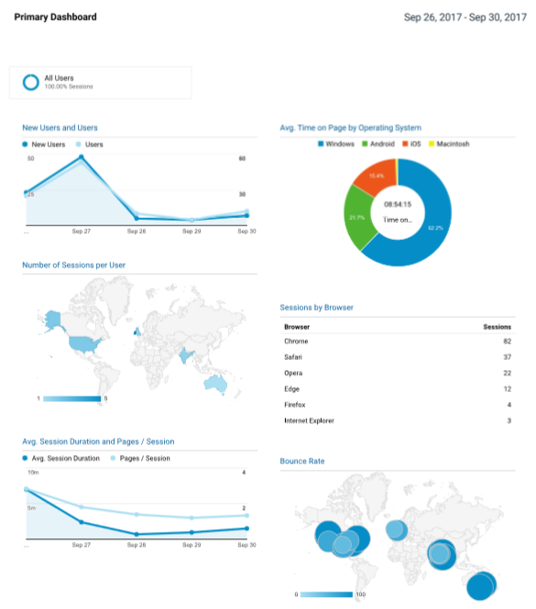
Campaign Statistics
Filtering by OS, the windows users spent more time on the blog than other users
As per expectations, the first day statistics reveal that 88% of traffic came from new users
Location wise, city of Dallas and Pune lead the way with users accessing 62 and 45 sessions respectively
The popularity of campaign steadily dropped, evident from pages users visited per session from 2.83 on day 1 to 1.29 on day 5
Highest bounce rate of 100% was observed from the Australia while users from United Kingdom had the lowest bounce rate of 40%
When it comes to browsers, chrome users dominated the figures while firefox and explorer users gave the lowest number of visits.

