Slide 1

ALY6010 Final Project
Exploring Global Happiness Factors
Social Support, Freedom, and Economic Wealth
Isaac (Ying Shuo) Su
Tanveer Begum
Prof. Yvonne Leung
Date: 15 DEC 2024

Slide 2
Introduction
Happiness is a universal goal, but what truly makes people happy? Over the years, researchers and policymakers have sought to identify the factors that contribute to happiness. The World Happiness Report offers valuable insights into this question.
Using dataset World Happiness Report 2023, this project examines key influences on happiness, including:
Healthy Life Expectancy
Social Support
Freedom to Make Life Choices
GDP per Capita

Slide 3
Research Questions
1
2
Does social support amplify the impact of healthy life expectancy on happiness?
3
Does GDP per capita moderate the relationship between freedom and happiness?
Does social support amplify the impact of healthy life expectancy on happiness?

Slide 4
Methodology
Data Collection
World Happiness Report 2023 dataset
EDA
Identified initial trends
Regression Analysis
Used linear regression models with interaction terms to explore relationships between variables
Grouping
Countries grouped by social support (Low, Medium, High)
Countries categorized by GDP per capita (Low, Medium, High)
Visualization and Interpretation
Graphical representations (scatterplots and regression lines) used to communicate findings clearly.

Slide 5
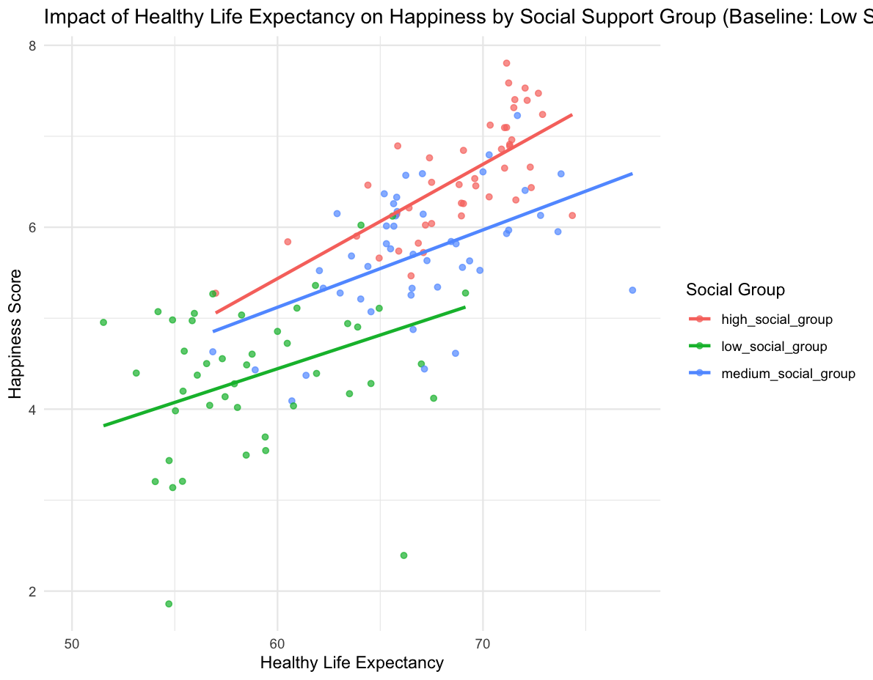
Key Finding 1: Social Support and Life Expectancy
Social support amplifies the positive effect of healthy life expectancy on happiness.
Strongest relationship seen in high social support countries.
P-value: 0.0391 (significant)

Slide 6
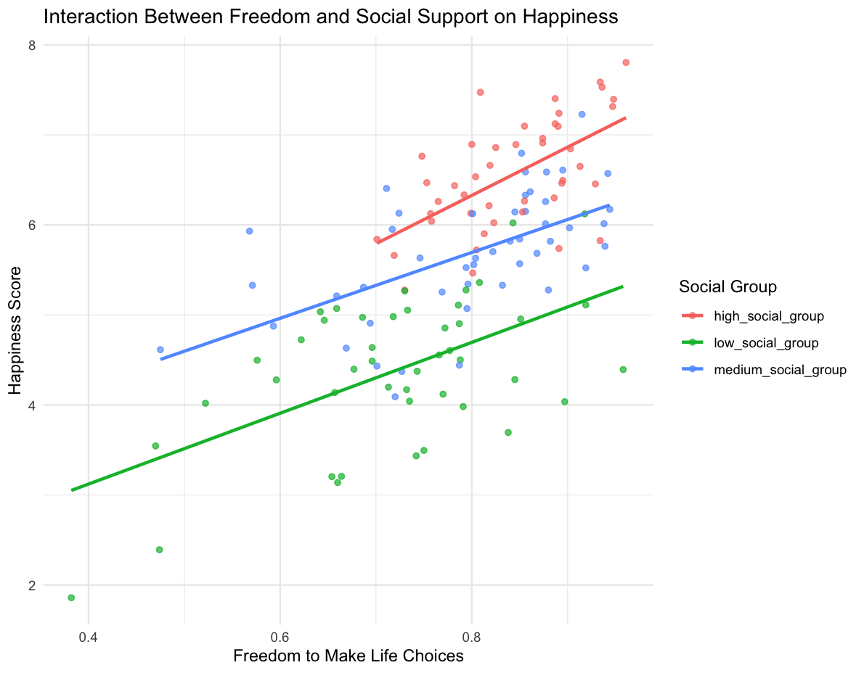
Key Finding 2: Freedom and Social Support Interaction
Combined freedom and social support predict happiness better than either factor alone.
Strongest combined effect in high social support countries.
P-value: 0.0001 (highly significant).

Slide 7
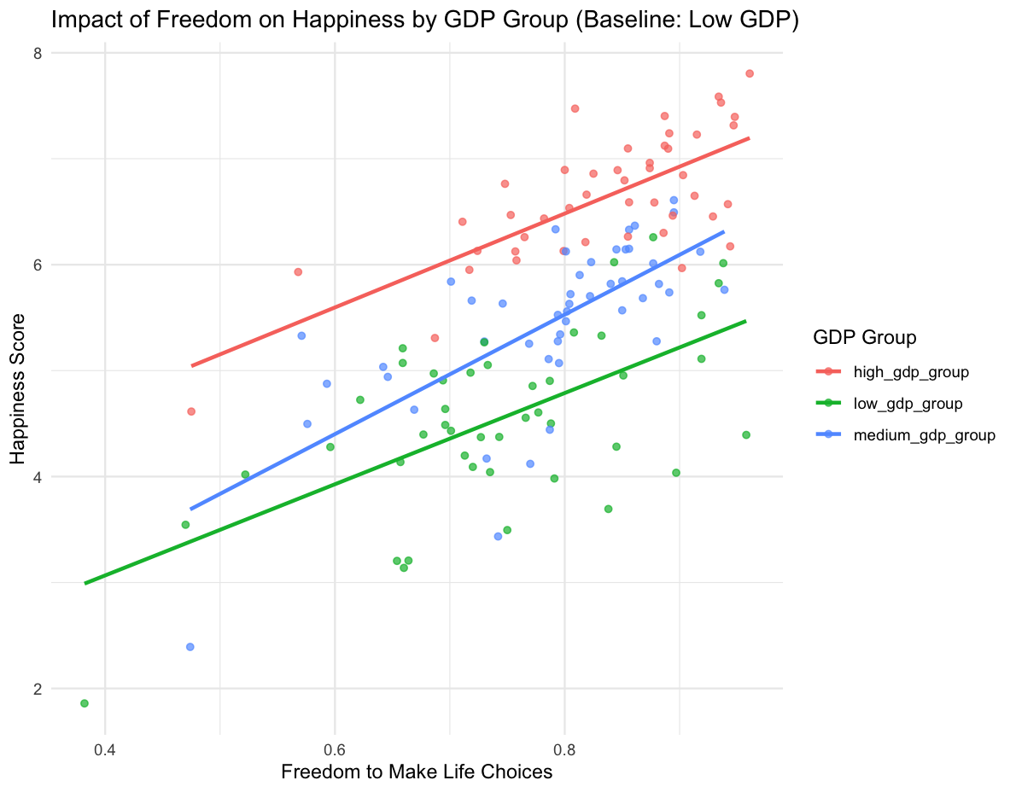
Key Finding 3: GDP Moderation of Freedom
GDP significantly moderates the relationship between freedom and happiness.
Freedom has the strongest positive effect in high GDP countries.
P-value: < 0.001 (significant).

Slide 8


Conclusion
Healthy Life Expectancy & Social Support
Strong community connections amplify the benefits of living a longer, healthier life.
Freedom & Social Support
Combining these factors has a greater impact on happiness than analyzing them individually.
Freedom & GDP
In wealthier countries, economic stability enhances the positive effect of personal freedoms on happiness.

Slide 9
Reference
PhilippeCodes. (n.d.). World-happiness-report-data-analysis/world happiness report.csv at master · Philippecodes/world-happiness-report-data-analysis. GitHub. https://github.com/PhilippeCodes/World-Happiness-Report-Data-Analysis/blob/master/World%20Happiness%20Report.csv

Slide 10


Thank You For Your Attention

