Slide 1
Reputation-based Moving Target DDoS Defense Mechanism
    Huangxin Wang
    2013-12-13

Slide 2
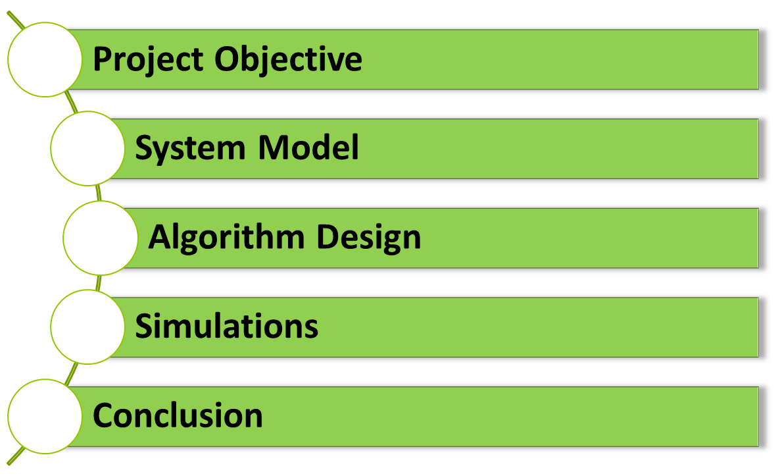
OUTLINE

Slide 3
1. PROJECT OBJECTIVE
Goal
  Protect web server from DDoS attack
    Existing moving target defense mechanism
    Limitation: assume the attacker is aggressive
  Remove this assumption
    design algorithm, work in more general case

Slide 4
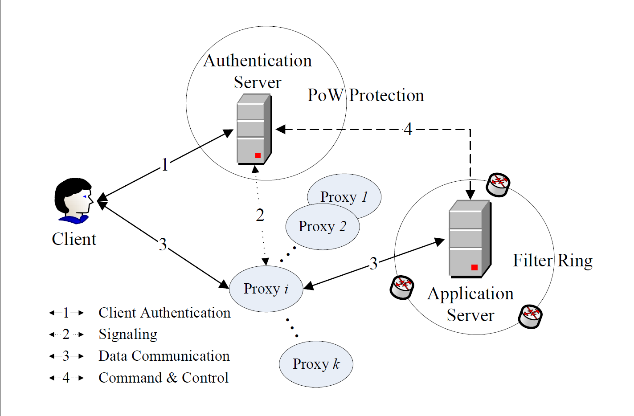
2. SYSTEM MODEL
Authentication Server
Client
Web Server
Attack!
Proxy

Slide 5
3. ALGORITHM DESIGN
Goal:
Build credit history for clients
Isolate attackers from benign clients ASAP
Reputation-based approach

Slide 6
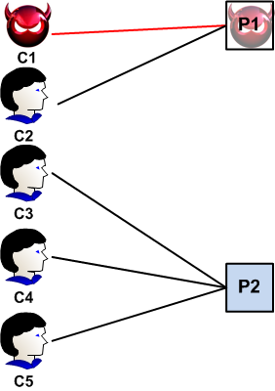
EXAMPLE
Step1：
Client
Proxy
-1
-1
1
1
1

Slide 7
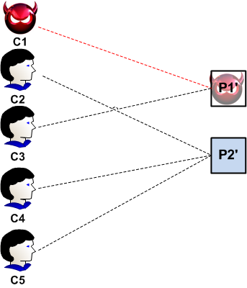
EXAMPLE(CON’T)
non-aggressive attackers
Step2:
Client
Proxy
-2
How many clients to assign to each proxy
0
0
2
2
How to update the credit

Slide 8
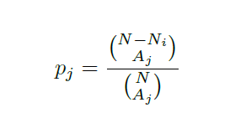
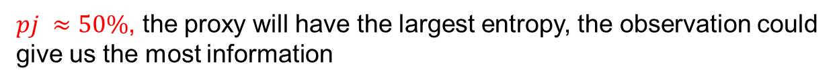
HOW TO ASSIGN CLIENTS?
Entropy based:
  Assume N clients, N_i insiders
  When assign A_j clients to a proxy, the probability it will not be attacked is:

Slide 9
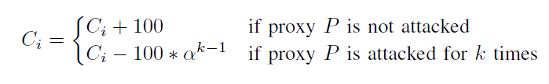
CREDIT UPDATING STRATEGY
Independent
Dependent: continuously being attacked, more likely to be attacker, more severe punishment

Slide 10
4. SIMULATION RESULTS
Compare entropy-based with evenly distributed client-to-proxy assignment
Compare different credit updating strategy
Explore how the degree of aggressive of attacker will affect the performance

Slide 11
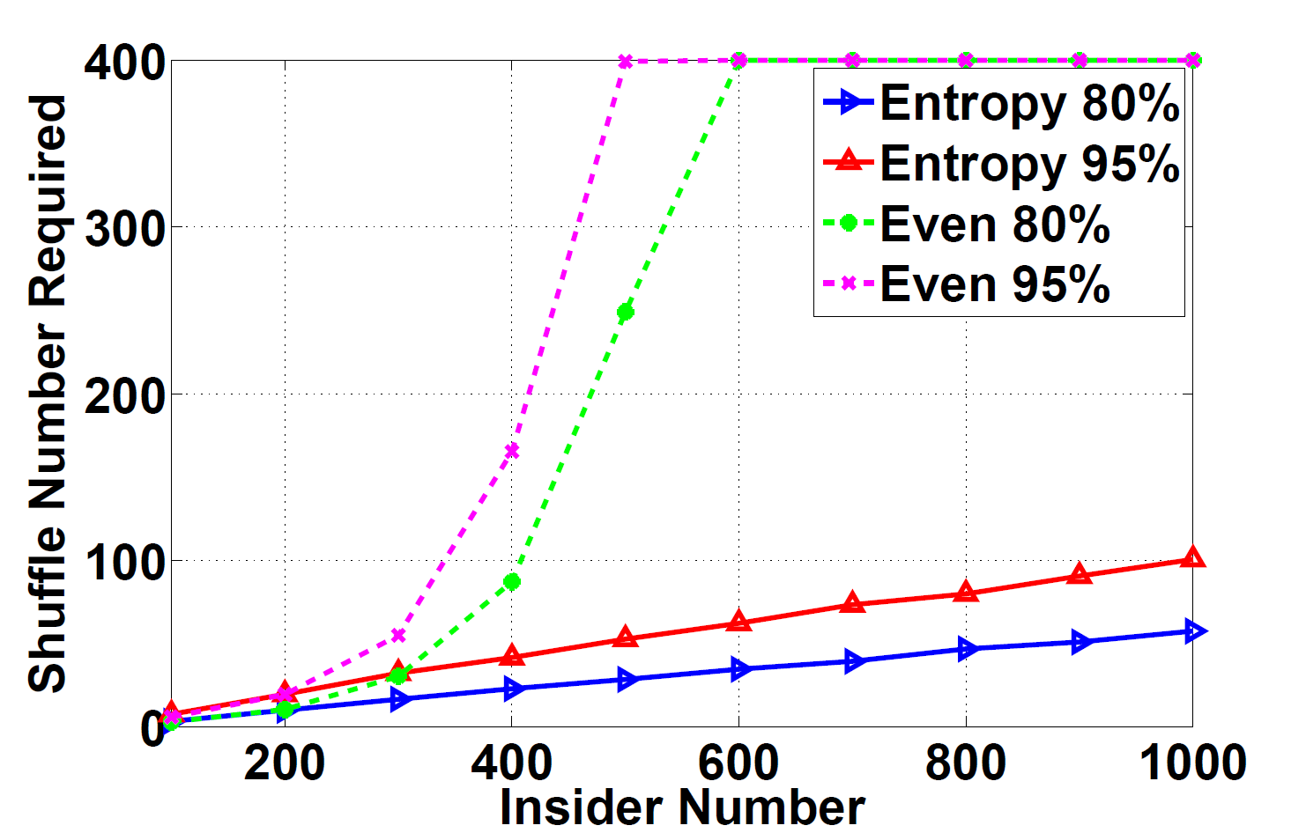
Evenly VS. Entropy (client 10K)
Much Better!!

Slide 12
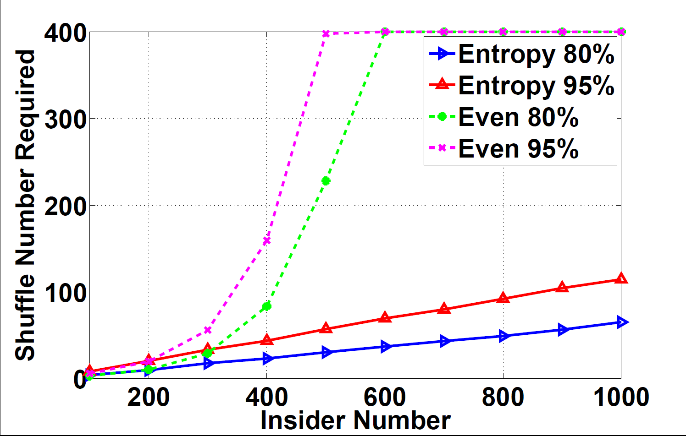
Evenly VS. Entropy (client 100K)

Slide 13
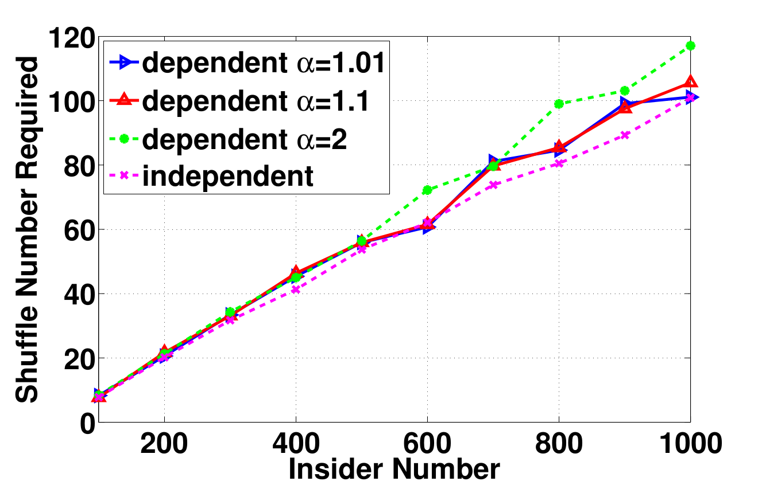
Updating Strategy

Slide 14
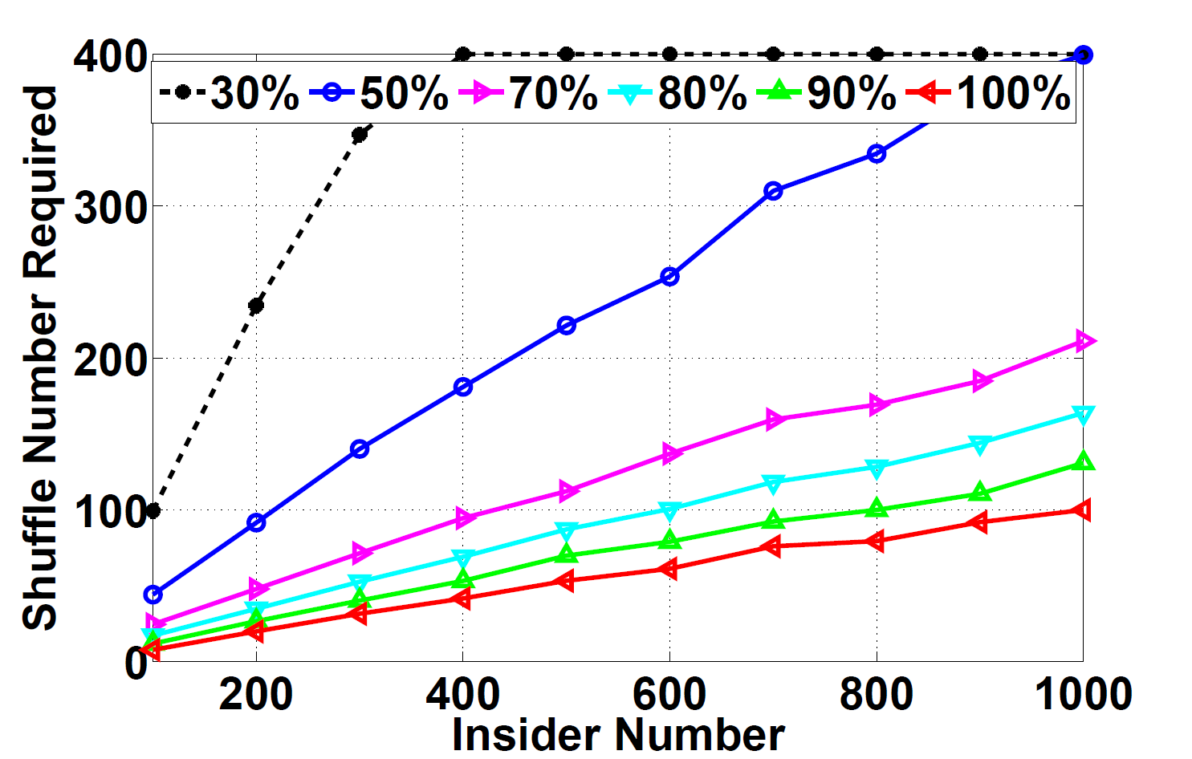
Non-aggressive Attackers

Slide 15
5. CONCLUSION
1. Reputation-based approach, efficiently isolate benign clients from insiders
2. Entropy-based client-to-proxy assignment which can accelerate attacker isolation process
3. Non-aggressive attackers will take longer time to identify

Slide 16
Thank you!

Slide 17
BACKUPS

Slide 18
3. Algorithm Design
When attackers are not aggressive
  One time information may be faulty
  History information
    Reputation-based approach, building a credit history of each clients
    Credit is based on whether the home proxy of the clients is attacked or not

