Slide 1
Profit Management of Green Data Centers
CS773 Final Project
Huangxin Wang
12/10/2014

Slide 2
Introduction
Green Data Centers: data centers are powered partially by green energy and brown energy
Profits = Revenue - Cost
Revenue: completing jobs from users
Cost: energy cost
Objective: study jobs scheduling algorithms in maximizing profit

Slide 3
Related work
Related works
Centralized data center
Distributed data center
Objective
Minimize brown energy consumption/cost
Maximize green energy consumption
Maximize profit:
only a few [SmartGrid-2013], make strong stochastic assumption of workloads
no theoretical analysis

Slide 4
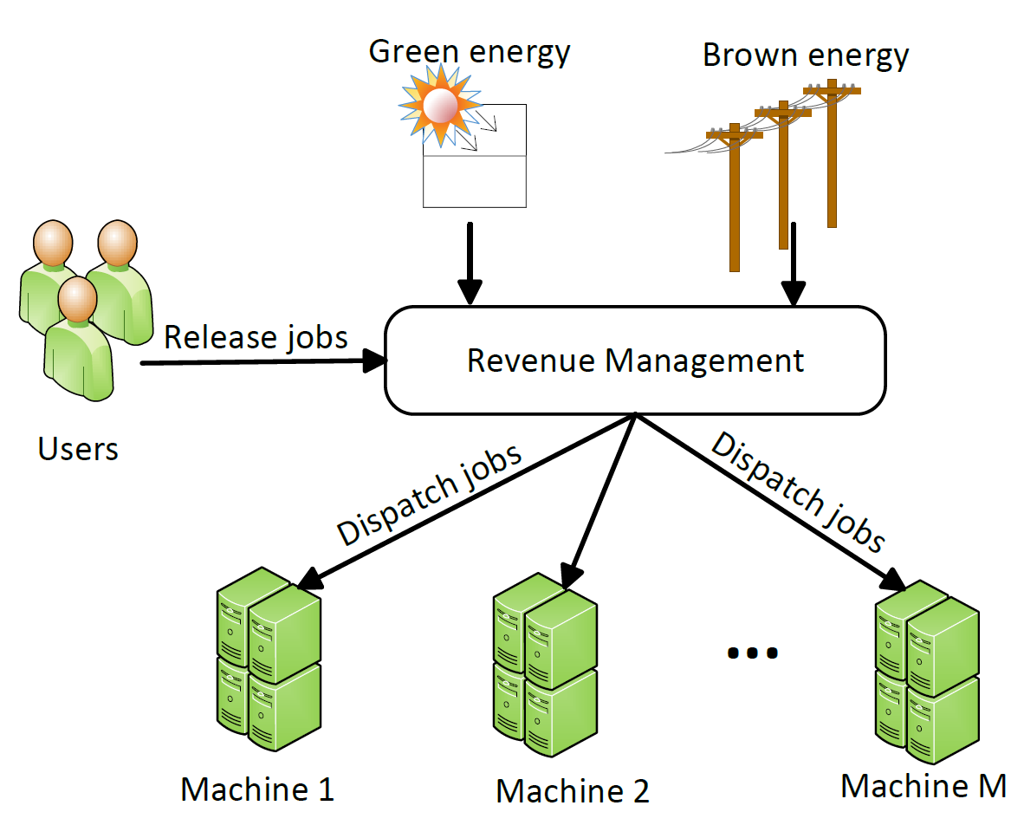
Problem Model
Free!
No battery!
On-peak/off-peak
Job: has deadline
Non-preemptable

Slide 5
Overview of our work
Theoretical analysis of some classical algorithms in this model
Optimal offline solution using integer linear program
Simulations
Study the running time of OPT
Study performance of heuristic algorithms against OPT
Study heuristic algorithms in large scale settings

Slide 6
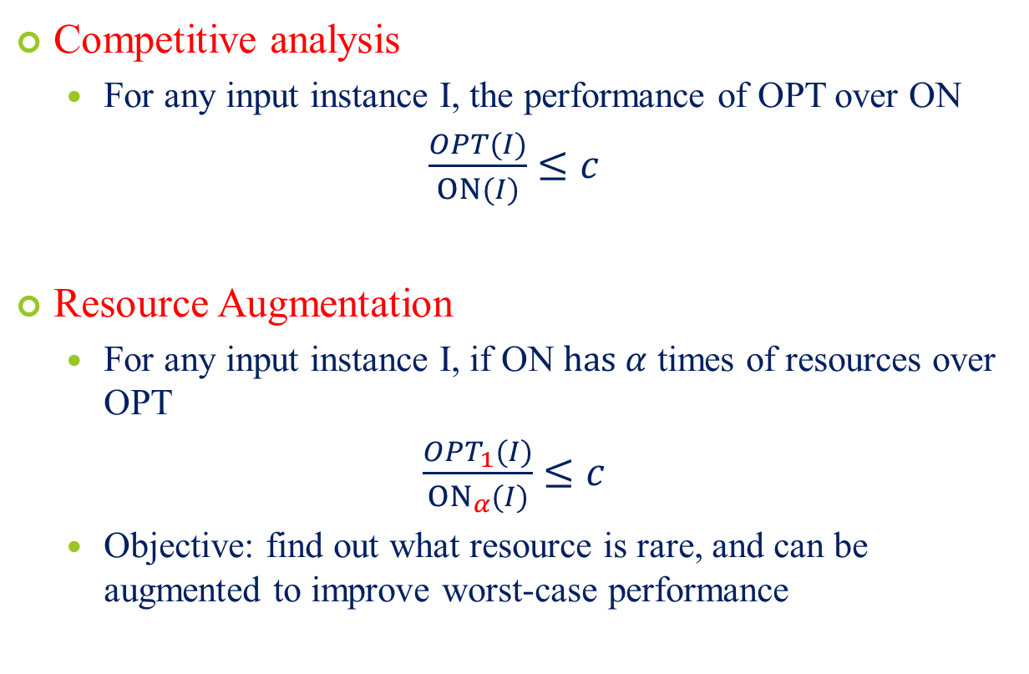
Theoretical analysis
Competitive analysis
For any input instance I, the performance of OPT over ON
$\frac{OPT(I)}{ON(I)}$ $≤c$
Resource Augmentation
For any input instance I, if ON $has α$ times of resources over OPT
$\frac{OPT_{1}(I)}{{ON}_{α}(I)}$ $≤c$
Objective: find out what resource is rare, and can be augmented to improve worst-case performance
Notes:
e.g. if c =2

Slide 7
Classical Algorithms
FirstFit
For each arriving job, schedule it to the earliest available time
BestFit
For each arriving job, schedule it to the time when energy is cheapest

Slide 8
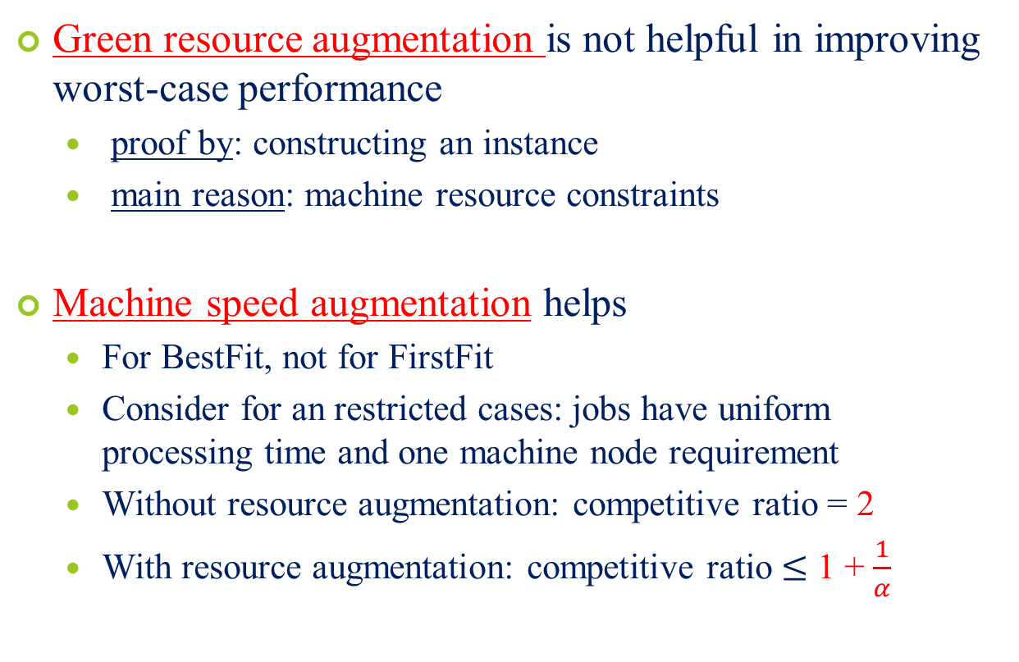
Competitive analysis Result
Green resource augmentation is not helpful in improving worst-case performance
proof by: constructing an instance
main reason: machine resource constraints
Machine speed augmentation helps
For BestFit, not for FirstFit
Consider for an restricted cases: jobs have uniform processing time and one machine node requirement
Without resource augmentation: competitive ratio = 2
With resource augmentation: competitive ratio $≤$ 1 + $\frac{1}{α}$

Slide 9
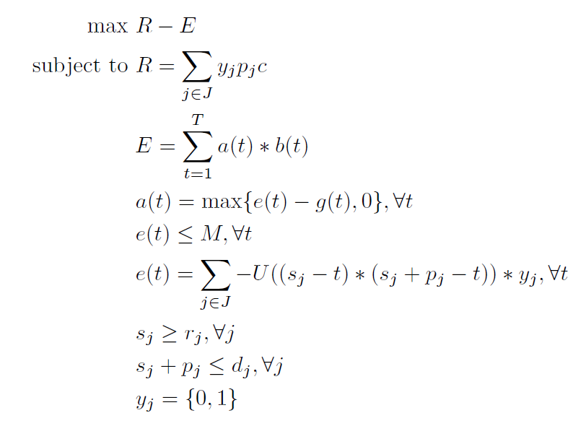
Offline Optimal Algorithm
Profit = Revenue – Energy Cost
Revenue = {job scheduled}
Energy cost = brown energy demand * price
BED = total energy demand – green energy
Total energy demand
Release time constraints
Deadline constraints
Whether job j is scheduled

Slide 10
Offline Optimal Algorithm (Con’t)
Migration is not necessary
Provide an approach to convert a solution with migration with one without migration

Slide 11
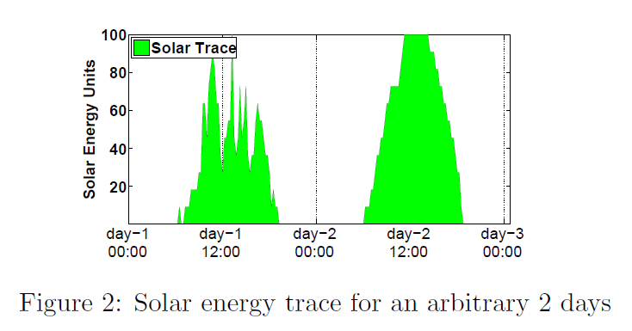
Simulation
Setting
Data center: 100 machine nodes
Green energy: real solar trace from whether station
Job profits: 10 per unit
Brown energy: on-peak/off-peak

Slide 12
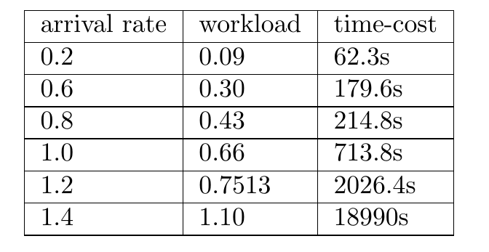
Offline OPT running time
Implementation: LINGO solver
5 hours
Running time cost. 48 time slots, 16 machine nodes, job has average length of 10

Slide 13
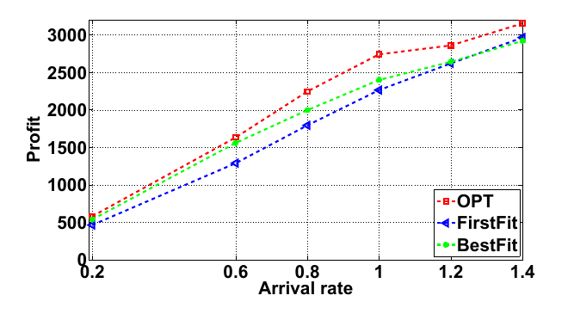
Offline v.s. FirstFit, BestFit
Running time cost. 48 time slots, 16 machine nodes, job has average length of 10

Slide 14
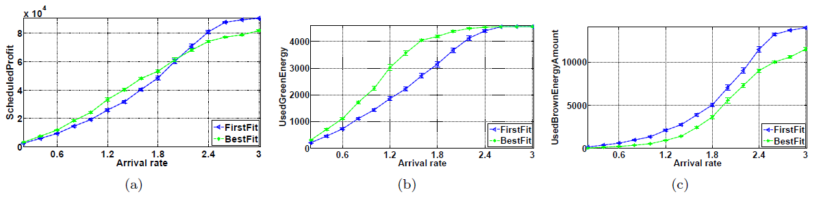

BestFit v.s. FirstFit
Workload $≈$ 50%
Scheduled profit
Used green energy
Used brown energy

Slide 15
Conclusion
Resource augmentation:
Green energy augmentation is not helpful
Machine speed augmentation is helpful
Offline algorithm
FirstFit v.s. BestFit:
BestFit is more profitable when the workload utilization is less than round 50% and less profitable otherwise

Slide 16
Future work
1. Analyze based on stochastic assumption of jobs
2. Integrate workload prediction, and design algorithms that combine FirstFit and BestFit
3. Extend to distributed data centers

Slide 17
Thank You!

