Slide 1
intro to Data Visualization
A Brief introduction to ‘Data Viz’ and the Data Visualization resources of the Texas Tech University Libraries
Webpage (LibGuide) for this workshop:
https://guides.library.ttu.edu/IntroToDataViz
All Emerging Technology LibGuides:
https://guides.library.ttu.edu/Make
Notes:
This workshop is Intro to Virtual Reality (VR), presented by Jake Syma, Associate Librarian.

Slide 2
Overview
Introducing your Personal Librarians in ‘RIO’ (the ‘Research, Instruction, & Outreach’ dept)
Introducing the Library Makerspace & Emerging Technologies Area
Intro to Data Visualization (aka ‘DataViz’)
Intro to Data Visualization Software
Data Visualization Resources Available
Tour of aforementioned areas for in-person attendees
  All attendees can email one of us (or make@ttu.edu) to try to set up a tour for a different date/time
Q&A
  Yes, you will get a copy of the slides (should already have one)

Slide 3
Research, Instruction, & Outreach (RIO) and Your personal/subject Librarians
Library, West side
The two main components of the RIO area:
  Rm.132: Research Hub (RIO’s departmental office, and a ‘shared space’ for students/librarian collaboration, as well as just studying)
    The Research Hub is open most hours the Library is open
  Mezzanine (middle/balcony level)
    Personal/subject librarians’ offices can be found here
    M116: Cynthia Henry’s office
Email:
  libraries.reference@ttu.edu
Find Your Subject and/or Personal Librarian:
  https://guides.library.ttu.edu/

Slide 4
The Emerging Technologies Area
Library, second floor (East)
The main components of the Emerging Technologies Area:
  Rm. 210: Makerspace (most well-known)
  Rm. 205A: Multipurpose Room
    Primary: 3D Animation Lab
    Secondary: Classroom and Study Area
  Rm. 201A: VR Lab
  Coming Soon, to Rm. 201B: Immersion/Data Lab
Open ‘most’ hours the Library is open (esp. 205A)
make@ttu.edu

Slide 5
Hardware in Immersion/DATA Lab
2x higher-end computers
  1.) Dell Pro Max Tower T2 FCT2250
    Intel Core Ultra 7 265 processor (w/ Intel AI Boost) [Intel]
    32gb RAM
    NVIDIA RTX 2000 Ada [NVIDIA]
  2.) Dell 5820 Tower Data Science Workstation
    Intel Xeon Processor (W-2245) [Intel, CPUBenchmark]
      better for workstation, 3D, data sci/viz, and server applications
      ‘backdated’ as prob. a 5th gen Xeon processor
    128gb (4x32) DDR4 RAM
    NVIDIA RTX A5000 GPU [NVIDIA1, NVIDIA2, TechPowerUp]
      better for virtualization, visualization, and ML tasks
    512GB NVME SSD (primary)
    4TB M.2 NVME SSD (secondary)

Slide 6
Terminology
Data Visualization: Kind of self-explanatory, on a surface level; however, there is also the implication that these data will be communicated effectively (and sometimes even efficiently), which… ‘complicates’ things.
Charts vs. Graphs: Charts are the larger category; graphs are the narrower sub-category. A chart is simply a graphical expression or representation of data, whereas a graph is a specific type of chart that is especially good at showing the relationship between (usu. two) variables… often over time.
  “All graphs are charts, but not all charts are graphs.”
  Note: These definitions may also vary some, by discipline.
  Charts: Flow, Gantt, gauge/dial, etc
    (incl. Venn & Euler diagrams)
  Graphs: line, bar, histogram, scatter plot, etc
    (usu. illustrate a mathematical relationship; esp. x+y axes, & influence)
Note: Data Visualization is but one step in the ‘Data Science’ or more accurately ‘Data Analysis’ process… what some people are too quick to consider ‘the last one’. Consider that it doesn’t have to be this way (but often is).
EDA: Exploratory Data Analysis (IBM, R4DS, NIST, etc)

Slide 7
Intro to Data Visualization
Common Steps:
  ID question(s), data collection, data entry/storage, data editing (e.g. ‘cleaning’), data analysis, data communication/visualization.
  Disclaimer: Again, some of this can vary a bit by discipline
Some basic advice:
  Use color!
    Stark contrast to highlight big/important differences
      (good example of not enough of this on next slide)
    Consider using shading to show smaller differences
    Consider accessibility (e.g. color-blindness)
Common/important concepts to consider:
  Infographics
  Visual storytelling (e.g. Knaflic)
  Data visualization vs. data revelation (e.g. Wexler)

Slide 8
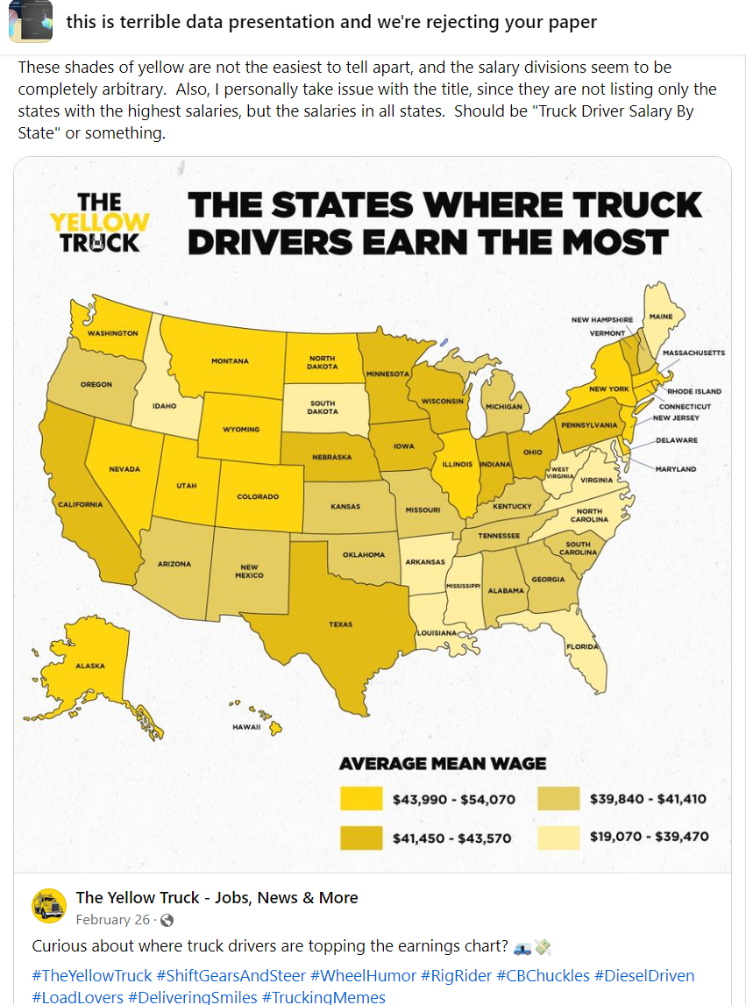

Slide 9
‘Common’ commercial data Visualization software
Microsoft Excel [TTU has a license; part of the O365 suite]
  certainly not the most glamorous choice, but lots of people start in Excel
SAS (originally “Statistical Analysis System”) [TTU has a license]
  https://www.depts.ttu.edu/itts/software/sas.php
JMP (originally “John’s Macintosh Project”) [TTU has a license]
  https://www.depts.ttu.edu/itts/software/jmp.php
SPSS (originally “Statistical Package for the Social Sciences,” and later “Statistical Product and Service Solutions”) [TTU has a license]
  https://www.depts.ttu.edu/itts/software/spss.php
Tableau (free version available: ‘Tableau Public’)
  https://www.tableau.com/en-gb/products/public
Power BI (free version available) [TTU had a license… until recently]
  https://www.microsoft.com/en-us/power-platform/products/power-bi/desktop
MATLAB [TTU has a license] [older link]
  https://www.depts.ttu.edu/itts/software/matlab/index.php
Stata [no TTU license]
Note: Be sure to check out TTU’s main/general site licenses page:
  https://www.depts.ttu.edu/itts/software/

Slide 10
‘Common’ open-source data Visualization software
R and/or RStudio (often using ggplot2)
  Helpful instructions at: https://rstudio-education.github.io/hopr/starting.html
Python (using Matplotlib, Plotly, etc)
D3.js
ECharts / EChartsJS
  GitLab (not GitHub): “Why we chose ECharts for data visualizations”
Vega
deck.gl

Slide 11
other Related Workshops
Cynthia Henry & Jingjing Wu usually give ~1 workshop per semester on Tableau
  https://guides.library.ttu.edu/tableau
Cynthia & Jingjing also have an occasional (4-6 part) workshop series introducing R, and working in R Studio
  https://guides.library.ttu.edu/R4Beginners
Sean Scully gives 1-3 ‘Make with MATLAB’ workshops per [long] semester
  https://guides.library.ttu.edu/makewithmatlab
National Wind Institute (NWI) two-day Data Science Training
  keep an eye on TechAnnounce [not sure if their grant was renewed]
The ATLC (Locations; Software) also gives 1-2 ‘Intro to Power BI’ workshops (ShortCourses) each semester
  https://www.depts.ttu.edu/itts/training/shortcourses/
  next will be on… I’m not sure anymore, now that they let the license lapse
    select ‘Microsoft’ category to see the full list
    also check out the ‘HPCC’ category!

Slide 12
O’reilly (via TTU Libraries)
E-books and other digital resources that cover many software platforms, including resources for data analysis and visualization.
Free to Texas Tech students.
Start at the Library homepage: library.ttu.edu
Click on Databases A-Z
Click on the “O” or type “O’Reilly” (or ‘oreilly’) into search box
Select “O’Reilly for Higher Education” from the results
Sign in (start off using your TTU email, then finish with your eRaider username+password)
Once in the database, use the search box to search for “SPSS” or “Tableau” (or “data visualization,” or whatever other topic you want to find resources on)
Can limit/filter results by: All, Books, Courses, Videos, Audiobooks, Playlists
Notes:
O’Reilly contains many e-book titles covering topics and software that will help you learn more about DataViz.

Slide 13
O’reilly (cont’d)
A small sampling of related O’Reilly content:
Claus Wilke (2019). “Fundamentals of Data Visualization,” O’Reilly.
Dougherty & Ilyankou (2021). "Hands-On Data Visualization: Interactive Storytelling from Spreadsheets to Code," O'Reilly.
Jeffrey Heer (2015). "Effective Data Visualization," O'Reilly. [Course]
James Miller (2017). "Big Data Visualization," Packt Publishing.
Cole Nussbaumer Knaflic (2015). "Storytelling with Data: A Data Visualization Guide for Business Professionals," Wiley.
Kyran Dale (2022). "Data Visualization with Python and JavaScript: Scrape, Clean, Explore, and Transform Your Data," 2nd Ed, O'Reilly.
Notes:
O’Reilly contains many e-book titles covering topics and software that will help you learn more about DataViz.

Slide 14
Udemy (via TTU)
https://ttu.udemy.com/
More info here:
  https://www.depts.ttu.edu/itts/training/online/
  https://www.depts.ttu.edu/itts/software/cbt.php
Free (to authorized TTU-affiliated users) ‘massive[ly] open’ online course provider’ platform. You can find courses you are interested in and add them to your personal playlist.
A small sample of ‘general’ DataViz courses:
  Mastering Data Visualization: Theory and Foundations
  How To Tell A Story With Data
  Data Storytelling and Data Visualization Mastery
Also includes ‘applied’ courses, such as:
  Microsoft Excel - Data Visualization, Excel Charts & Graphs
  Mastering Data Visualization in D3.js
  Learning Python for Data Analysis and Visualization Ver 1

Slide 15
Coursera (via TTU) [New!]
https://www.depts.ttu.edu/online/careercertificates/
More info here:
  Special No-Cost Industry Career Certificates Designed for Faculty & Staff [TechAnnounce, 5/10/2024]
Free (to authorized TTU-affiliated users) ‘massive[ly] open’ online course provider’ platform. You can find courses/certs you are interested in and add them to your personal playlist.
A small sample of ‘general’ DataViz courses/certs/etc:
  Google Data Analytics Professional Certificate
    Share Data Through the Art of Visualization (part of the above cert)
  Meta Data Analyst Professional Certificate
  Plenty of others, including by IBM, UI-UC, etc:
  https://www.coursera.org/search?query=data%20visualization
Also includes ‘applied’ courses, such as:
  Data Visualization in Excel
  Data Visualization with Python
  Data Visualization & Dashboarding with R Specialization

Slide 16
Additional Resources
1.) Tufte (1983/2001). "The visual display of quantitative information," Graphics Press.
  Author: Edward R. Tufte 1942- (142 results)
  Author: Edward R. Tufte 1942- author (9 results)
  LCSH: Statistics--Graphic methods (199 results)
  LCSH: Information visualization (8,065 results)
  LCSH: Visual communication (8,276 results)
2.) IBM: “What is data visualization?”
  https://www.ibm.com/topics/data-visualization
  Article/resource: Visualizing your data in Data Refinery
3.) Online Communities
  Reddit: r/dataisbeautiful
  Facebook: this is terrible data presentation and we're rejecting your paper
4.) Websites
  Storytelling With Data (https://www.storytellingwithdata.com/)
  NASA Scientific Visualization Studio (https://svs.gsfc.nasa.gov/)
5.) Google Digital Garage
  learndigital.withgoogle.com (now grow.google in the US)
    Google Data Analytics Certificate (via Coursera) [variable price, starting @ free-$40]
      Reviews here, here, here, here, and here
  Still free via UK/EUR) [alt link]
    https://grow.google/intl/uk/courses-and-tools/?category=career&topic=data-analytics
      https://rsvp.withgoogle.com/events/gdg-telling-stories-with-data-visualisation
      https://rsvp.withgoogle.com/events/gdg-decision-making-with-data
      https://rsvp.withgoogle.com/events/gdg-find-insights-with-analytics
Note: LCSH = Library of Congress Subject Headings
  https://www.loc.gov/aba/publications/FreeLCSH/freelcsh.html

Slide 17
Additional Resources (cont’d)
Who to follow, read, watch, etc:
  Edward Tufte
    https://www.edwardtufte.com/
  Steve Wexler
    https://x.com/DataRevelations
    https://www.datarevelations.com/
  Cole Nussbaumer Knaflic
    https://x.com/storywithdata
    https://www.storytellingwithdata.com/
    Storytelling with Data (Talks at Google) [YouTube, 53mins]
  Jeffrey Shaffer
    https://x.com/DataPlusScience
    https://dataplusscience.com/
    https://bigbookofdashboards.com/
  Brent Dykes
    https://x.com/analyticshero
    https://www.effectivedatastorytelling.com/

Slide 18
Thank you
Jake Syma
Technology Services Librarian
Office: 201B
Phone: 806.834.2514
Email: jake.syma@ttu.edu
Cynthia Henry
Librarian for the College of Human Sciences
Office: M116 (M=Mezzanine)
Phone: 806.834.0898
Email: cynthia.henry@ttu.edu
Please also consider taking our online survey about this workshop:
  https://ttu.libwizard.com/f/workshop-eval-24-25_emerging_tech
Notes:
If you have any questions or comments relating to this presentation or to VR/AR/XR/MR technologies at the TTU Libraries, please feel free to contact me at jake.syma@ttu.edu or at make@ttu.edu.

Slide 19
Appendix: Applied Exercise(s)
Find/identify (then Download + Save) a dataset from somewhere
(e.g. from the Mergent Online database)
ko > Equity pricing > Report > Download
In MS Excel:
Open file, then clean, then highlight entire data range
Data > Sort > (Date, Cell Values, A to Z) > ‘OK’
[deal with your ‘Sort Warning’ dialogue box, if applicable]
You can see that it now goes from 2021→2024
Re-highlight entire data range
Insert > Charts > All Charts > Line > Line w/ Markers
Re-size to your liking
<compare to auto-generated chart in Mergent>
<rescale chart, if needed>

