Slide 1
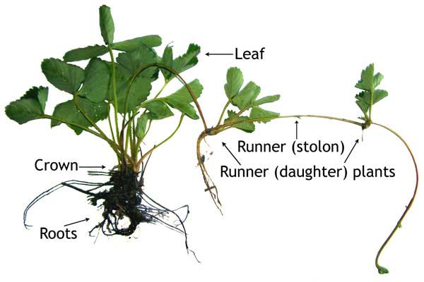
The Plant Propagation Algorithm for Discrete Optimization: The Case of the Travelling Salesman Problem
Birsen ˙I. Selamo˘glu and Abdellah Salhi
University of Essex,
Wivenhoe Park, Colchester CO4 3SQ, UK
Presented by
Md. Siddiqur Rahman Tanveer
Roll: 1707505
Department of CSE, KUET

Slide 2
History..
The Plant Propagation Algorithm (PPA) introduced by Salhi and Fraga, [1] emulates the strategy that plants deploy to survive by colonising new places which have good conditions for growth. Plants, like animals, survive by overcomeing adverse conditions using strategies.

Slide 3
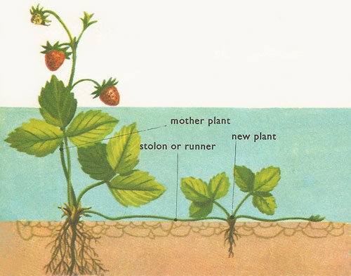
Strawberry Plant Propagation
There are three main ways to propagate strawberry plants [2]
The plants can be divided and transplanted once multiple crowns have been grown (or division of rhizomes)
new plants can be grown from strawberry seeds
or the runners that strawberry plants put out can be controlled, guided, and caused to root where clone plants can be utilized most efficiently.

Slide 4
Strawberry Plant Propagation
The strawberry plant, for instance, has a survival and expansion strategy
Send short runners
exploit local area
if the latter has good conditions
Send send long runners
explore new and more remote areas
i.e. to run away from a not so favorable current area

Slide 5
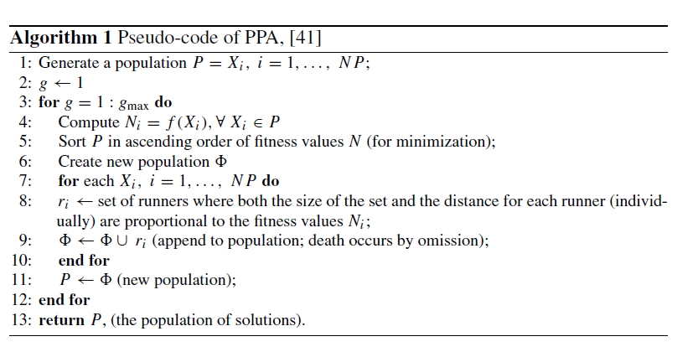
Plant Propagation Algorithm
The algorithm starts with a population of plants each of which represents a solution in the search space

Slide 6
Key elements of Plant Propagation Algorithm
Xi - denotes the solution represented by plant i in an n-dimensional space.
Xi ∈ Rn, i.e. Xi = [xi, j ], for j = 1, . . . , n and xi j ∈ R
NP is the population size, i.e. i = 1, . . . , n where nmax denotes the maximum number of runners that each plant can send.
This iterative process stops when g the counter of generations reaches its given maximum value gmax.
Individuals/plants/solutions are evaluated and then ranked (sorted in ascending or descending order) according to their objective (fitness) values and whether the problem is a min or a max problem.
The number of runners of a plant is proportional to its objective value and conversely, the length of each runner is inversely proportional to the objective value, [41]

Slide 7

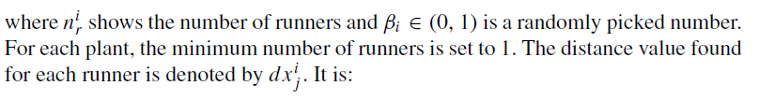

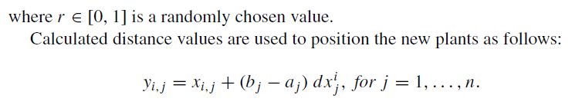
For each Xi , Ni ∈ (0, 1) denotes the normalized objective function value. The number of runners for each plant to generate is

Slide 8

where yi, j shows the position of the new plant and [aj , bj ] are the bounds of the search space.
The new population that is created by appending the new solutions to the current population is sorted. In order to keep the number of population constant, the solutions that have lower objective value are dropped.

Slide 9
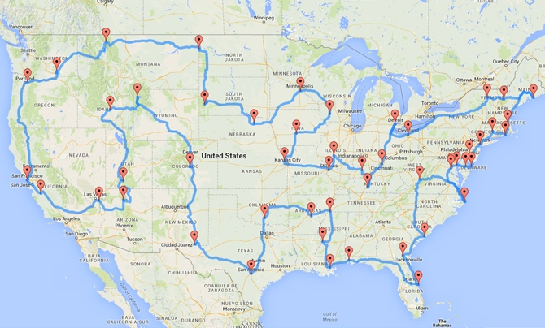
Travelling Salesman Problem
Given a set of cities and distance between every pair of cities, the problem is to find the shortest possible route that visits every city exactly once and returns to the starting point.

Slide 10
Extension to Discrete Optimization Problems
PPA has been shown to work well on continuous unconstrained and constrained optimization problems, [47–49]. In this study, they consider the case of the Travelling Salesman Problem (TSP). The issues with the implementation of PPA to solve discrete optimization problems are:
1. Finding/Defining the equivalent of a distance between two solutions in the solution space which is a set of permutations representing tours.
2. Defining the neighborhood of a solution, here a tour or permutation.

Slide 11
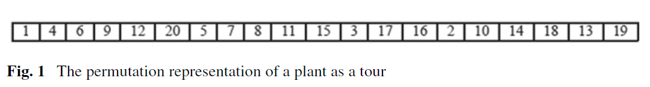
Implementation of PPA to Handle TSP
In any algorithm and in particular in population-based ones, representation of individuals/solutions is a key aspect of their implementation. The issue here is the representation of a plant which itself represents a solution. A solution here is any Hamiltonian cycle (tour) of the complete graph representation of the TSP. Note that representation affects the way the search/optimisation process as well as any stopping criteria are implemented.
The Representation of a Tour
A plant in the population of plants maintained by PPA is a tour/solution represented as a permutation of cities. Xi is tour i , i = 1, . . . , NP. This means that the size of the population of plants is NP. Tours/plants are ranked according to their lengths. The tour length of plant i is denoted by Ni ; it is a function of Xi . Without loss of generality, the Euclidean TSP is considered here.

Slide 12
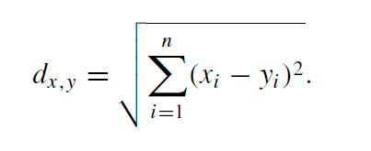
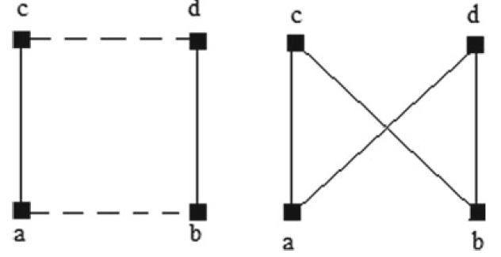

Distance Between Two Plants
Without loss of generality, the Euclidean TSP is considered here. Tour lengths, therefore, are calculated according to the Euclidean distance
Short and Long Runners
One of the issues in implementing PPA is defining the distance that separates tours. Here it is defined as the number of exchanges to transform one tour into another. After sorting the tours by their tour lengths, a pre-determined number of the tours is taken amongst the ones that have good short lengths; short runners are then sent from these plants, i.e. new neighbouring tours are generated from them. The 2-opt rule is used for this purpose since it require the minimum number of changes to create new tours. The 2-opt move is implemented by removing two edges from the current tour and exchanging them with two other edges, [18].
An illustration of a 2-opt exchange can be seen in Fig.2. There, tour a-b-d-c-a
has been transformed into a-d-b-c-a by exchanging edges a-b and d-c.

Slide 13
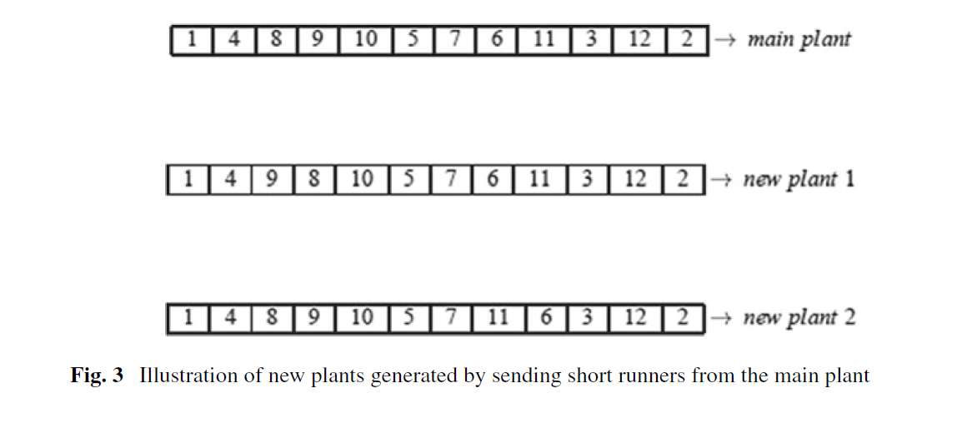
New plants generated by sending short runners from the main plant

Slide 14
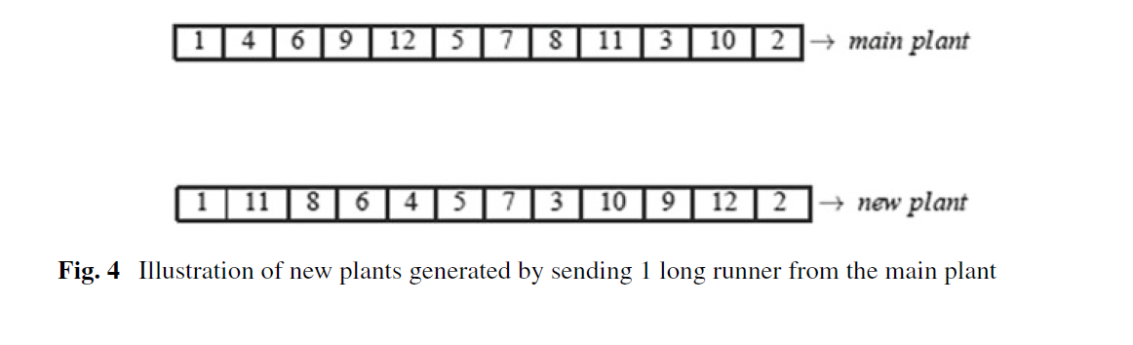
Similarly, long runners are implemented by applying a k-opt rule with k > 2. In fact, this is pretty much the Lin-Kernighan algorithm (LK). It changes k edges in a tour, with k other edges. If, in this process, shorter tours are preferred and kept, then it will converge to potentially better solutions than it started with, [13].
An illustration of a new plant produced by sending a long runner can be seen in Fig. 4. The new plant is a 6-opt neighbour of the main plant. A 6-opt move can either be achieved by exchanging 6 edges chosen with other 6 edges or by implementing a number of 2-opt moves sequentially.

Slide 15
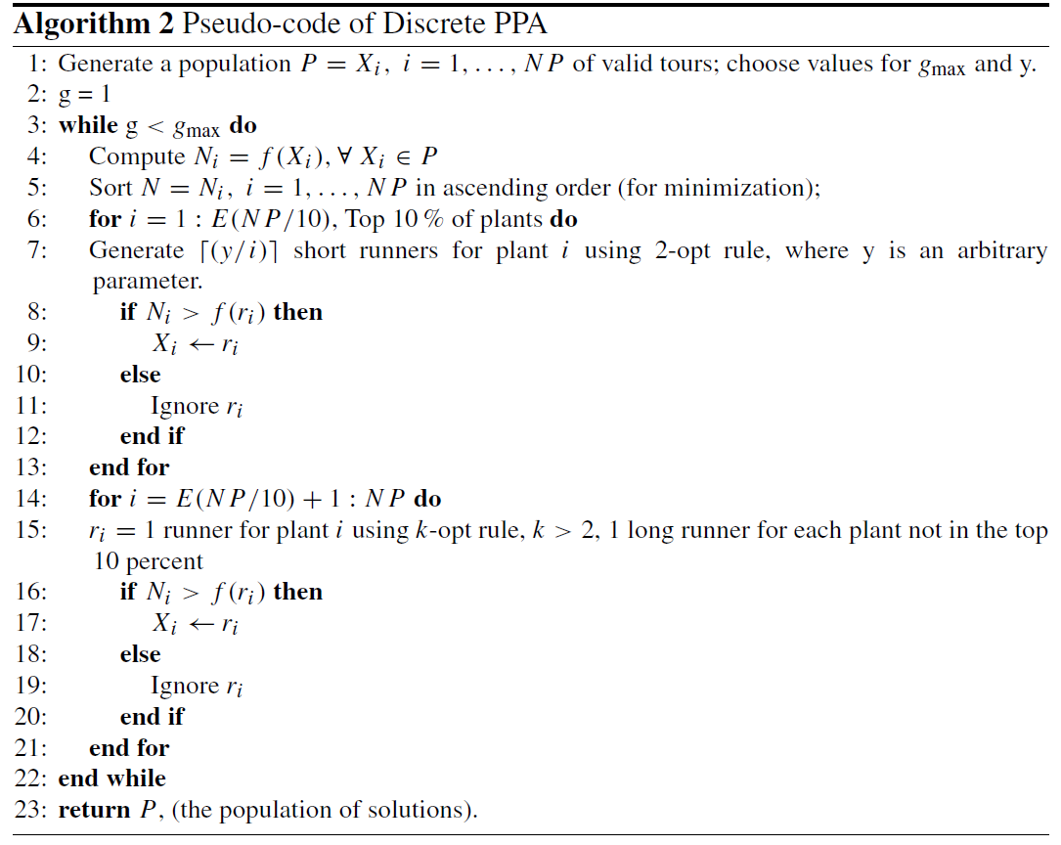
Pseudo-code of Discrete PPA

Slide 16
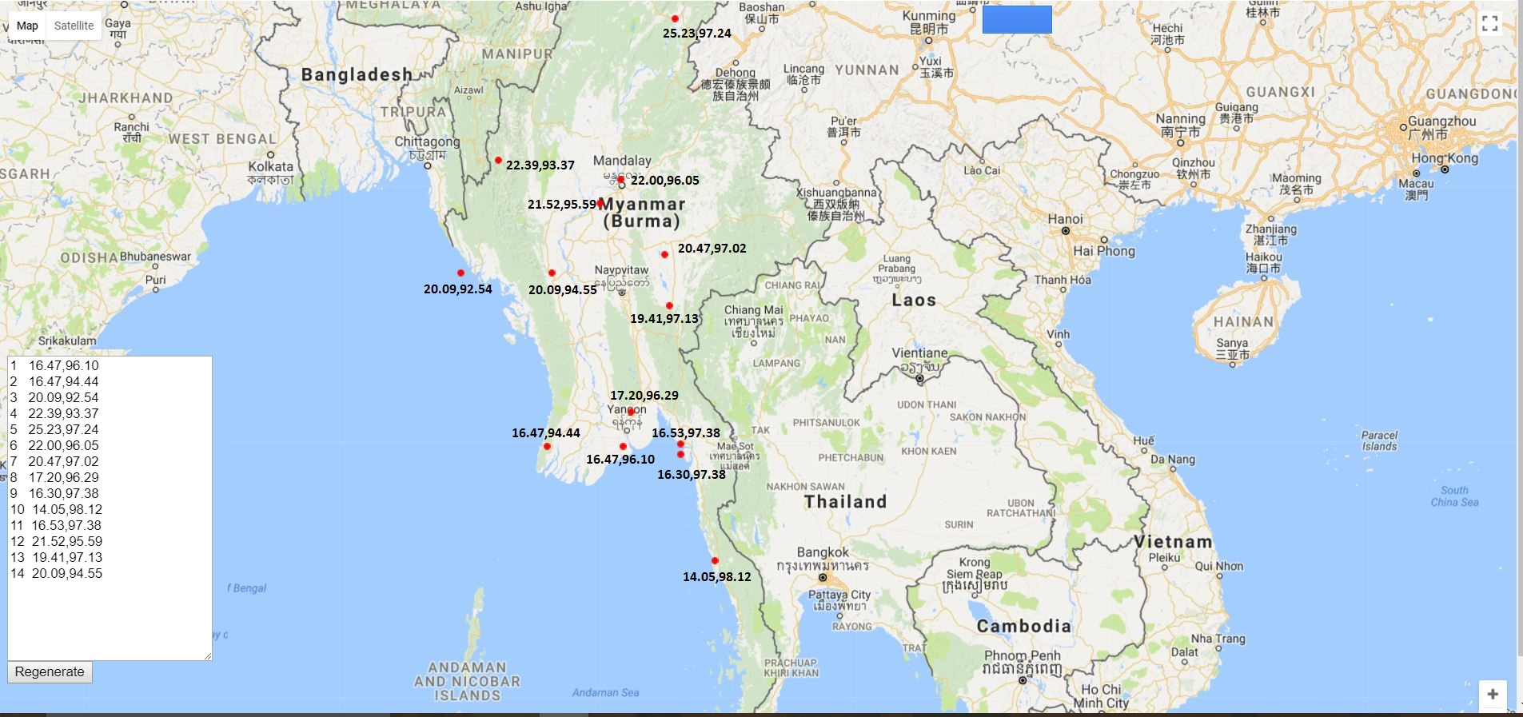
burma14

Slide 17
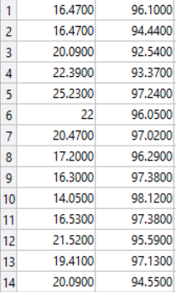
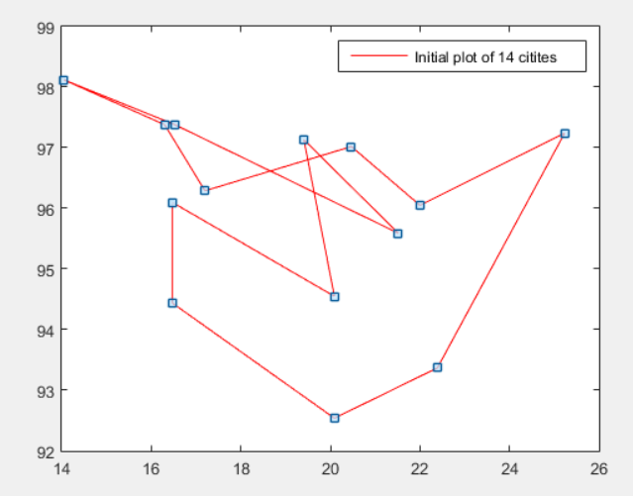

Slide 18
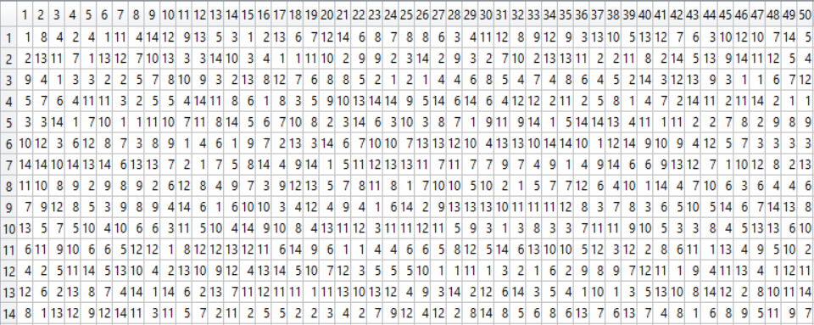
Generate a population P = Xi , i = 1, . . . , NP of valid tours; NP=50, Total city = 14, (14x50)

Slide 19
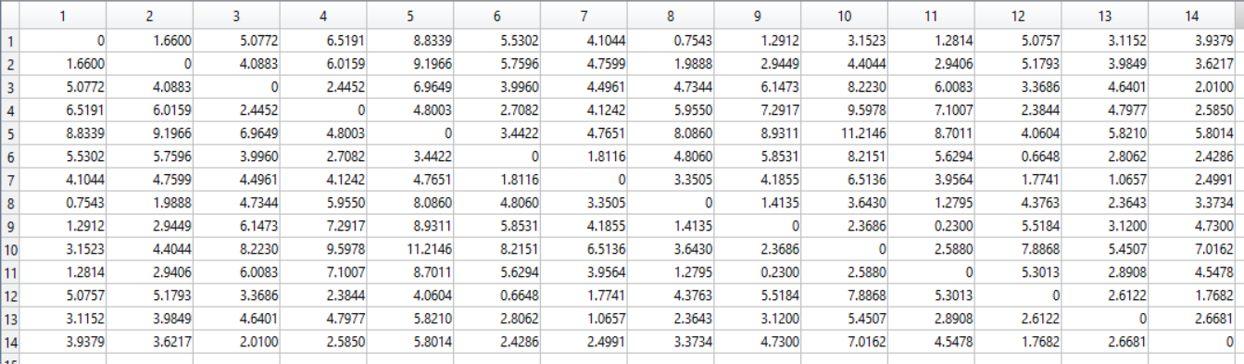
Compute Ni = f (Xi ), ∀ Xi ∈ P

Slide 20
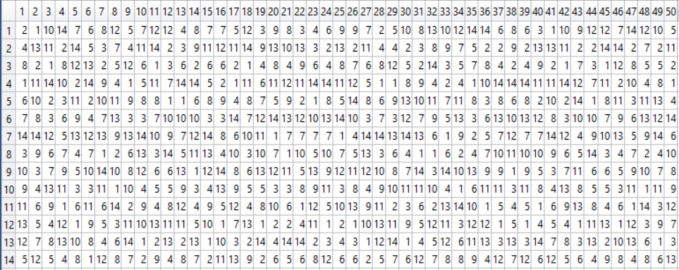
Sort N = Ni , i = 1, . . . , NP in ascending order (forminimization);

Slide 21


for i = 1 : E(NP/10), Top 10% of plants do
Generate (y/i ) short runners for plant i using 2-opt rule, where y is an arbitrary parameter.
y = 1 (generated arbitrarily) so 1 short runner will be generated for X1
swapPosition1 = 5
swapPosition2 = 14
X1
Short runner

Slide 22
Exploit using the short runner
if Ni > f (ri ) then
Xi ←ri
else
Ignore ri
end if
X1
Short runner
Path Cost : 44.9611435667493
Path Cost : 47.8227529664884

Slide 23

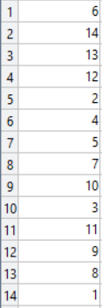
for i = E(NP/10) + 1 : NP do
ri = 1 runner for plant i using k-opt rule, k > 2, 1 long runner for each plant not in the top 10 percent
So 1 long runner for X6. for k-opt rule, k>2; k=3, the 3 swapping positions are
7 2 4
X6
Long runner

Slide 24
Explore using the long runner
if Ni > f (ri ) then
Xi ←ri
else
Ignore ri
end if
X6
Long runner
Path Cost : 48.8701495669961
Path Cost : 51.6121726742571

Slide 25
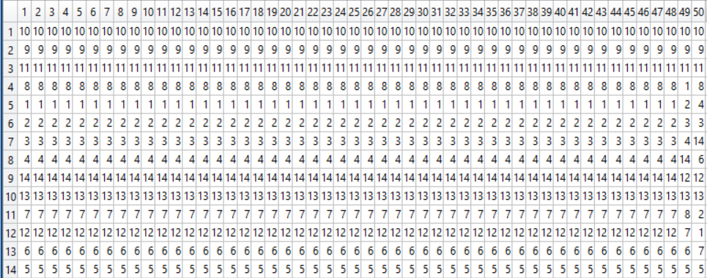
return P, (the population of solutions).
Path Cost : 25.0258364541142

Slide 26
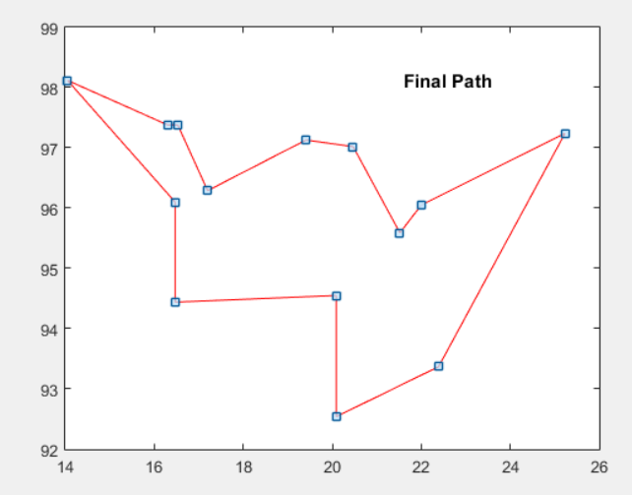
Path: 6 5 4 3 14 2 1 10 9 11 8 13 7 12
Path Cost : 30.8785

Slide 27
References
[1] Salhi, A., Fraga, E.: Nature-inspired optimisation approaches and the new plant propagation algorithm. In: Proceedings of the ICeMATH2011 pp. K2–1 to K2–8 (2011)
[2] https://www.linkedin.com/pulse/strawberry-plant-propagation-dr-tohid-nooralvandi
[3] Sulaiman,M., Salhi, A.: A Seed-based plant propagation algorithm: the feeding station model. Sci World J (2015)
[4] Sulaiman, M., Salhi, A., Fraga, E.S.: The Plant Propagation Algorithm: Modifications and Implementation. ArXiv e-prints (2014)
[5] Sulaiman,M., Salhi, A., Selamoglu, B.I.,Kirikchi, O.B.:Aplant propagation algorithm for constrained engineering optimisation problems. Mathematical Problems in Engineering 627416, 10 pp (2014). doi:10.1155/2014/627416

