Slide 1



Sustainability Intelligence: A Data Mining and Data Warehouse Based Decision Support Web Application
CSA1615-DATA WAREHOUSING AND DATA MINING
Presented by:
S Tanveer Muhammed(192311296)
SSE, SIMATS Engineering
Guide By:
DR. Terrance Frederick Fernandez
Professor:
SSE, SIMATS Engineering

Slide 2
ABSTRACT
Sustainability Intelligence is a data-driven web application designed to analyze household electricity consumption and promote sustainable energy usage.
Integrates smart meter readings, household information, weather data, and holiday records into a structured data warehouse.
Uses K-Means clustering and DBSCAN to identify consumption patterns and detect unusual electricity usage.
Applies association rule mining to discover relationships between electricity consumption and contextual factors.
Estimates potential electricity savings and CO₂ emission reductions through what-if analysis.
Generates evidence-based energy-saving recommendations using a knowledge retrieval system.
Supports SDG 7, SDG 11, SDG 12, and SDG 13 by encouraging energy efficiency and responsible resource consumption.

Slide 3
SDG Goals
SDG 7 – Affordable and Clean Energy: Optimizes energy efficiency by identifying consumption patterns and encouraging demand shifting to reduce peak electricity usage.
SDG 11 – Sustainable Cities and Communities: Supports sustainable urban planning through community-level energy analysis and targeted grid management.
SDG 12 – Responsible Consumption and Production: Promotes responsible energy consumption using behavioral pattern mining and personalized energy-saving recommendations.
SDG 13 – Climate Action: Quantifies potential carbon emission reductions through data-driven energy interventions and policy impact simulations.

Slide 4
Introduction
Household electricity consumption plays a significant role in energy sustainability and carbon emissions.
Smart meters generate large amounts of data that can reveal valuable consumption patterns.
Traditional monitoring methods provide limited insights into unusual usage and energy-saving opportunities.
Sustainability Intelligence uses data warehousing and data mining techniques to analyze electricity consumption.
An interactive dashboard provides actionable recommendations to improve energy efficiency and promote sustainable living.

Slide 5
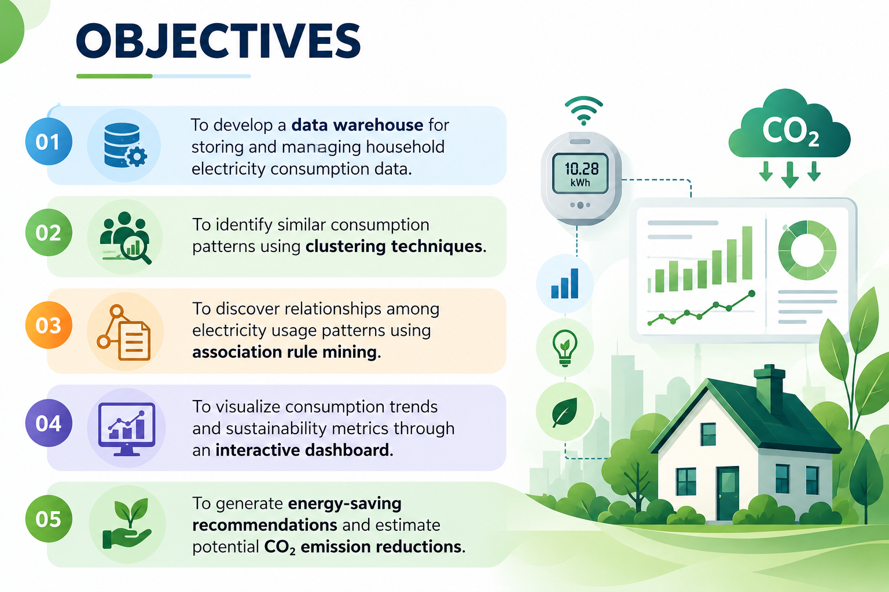
Objectives
To develop a data warehouse for storing and managing household electricity consumption data.
To identify similar consumption patterns using clustering techniques.
To discover relationships among electricity usage patterns using association rule mining.
To visualize consumption trends and sustainability metrics through an interactive dashboard.
To generate energy-saving recommendations and estimate potential CO₂ emission reductions.

Slide 6



LITERATURE REVIEW
S.No | Research Area | Author & Year | Technology / Method | Key Finding | Use in Our Project
1 | Electricity Load Profiling | Michalakopoulos et al., 2024 | K-Means Clustering, Machine Learning | Clustering household load profiles helps identify consumption patterns and demand-response opportunities. | Identifies household energy personas and peak-demand patterns.
2 | Smart-Grid Behavioral Analysis | IEEE Research, 2019 | Energy Consumption Pattern Mining | Mining smart-meter data reveals recurring household electricity consumption behaviors. | Supports behavioral analysis and targeted energy-saving recommendations.
3 | Residential Energy Consumption | Wang et al., 2018 | Association Rule Mining, Clustering | Household characteristics and consumption patterns reveal useful relationships in electricity usage. | Applies Apriori rules to discover energy-wasting behaviors and usage correlations.
4 | Demand Response and Renewable Energy | Smart Meters Time-Series Study, 2021 | Time-Series Clustering, Demand Response | Smart-meter clustering helps identify flexible consumption patterns that can support renewable energy integration. | Identifies opportunities to shift electricity usage away from peak hours.
5 | Energy Forecasting and Climate Impact | de Mattos Neto et al., 2021 | Extreme Learning Machine Ensemble | Ensemble machine-learning models can improve electricity consumption forecasting. | Provides a research foundation for energy forecasting and data-driven policy impact analysis.

Slide 7
Module 1:Data Management & Data Warehouse
Collects smart meter readings, household information, weather data, and holiday records.
Cleans and preprocesses data by handling missing values, duplicate records, and anomalous readings.
Transforms half-hourly electricity readings into hourly, daily, and monthly consumption records.
Stores structured data in a SQLite-based data warehouse for efficient querying and analysis.
Supports data aggregation and OLAP operations to analyze electricity consumption by time, household group, and tariff.

Slide 8
Module 2:Data Mining & Predictive Analytics
Applies K-Means clustering to group households with similar electricity consumption patterns.
Uses DBSCAN clustering to identify unusual consumption patterns and outlier households.
Evaluates clustering performance using silhouette scores and the Davies–Bouldin index.
Implements association rule mining to discover relationships between electricity usage and factors such as season, tariff, and peak hours.
Analyzes household load profiles and identifies opportunities for improved energy efficiency.

Slide 9
Module 3:-Decision Support & Sustainability Dashboard
Displays electricity consumption, household statistics, and estimated CO₂ emissions through an interactive dashboard.
Visualizes consumption trends and compares household groups based on usage patterns.
Generates energy-saving recommendations using a knowledge-based retrieval system.
Estimates potential electricity savings and CO₂ emission reductions through what-if analysis.
Supports informed decision-making for energy efficiency and sustainable electricity consumption.

Slide 10
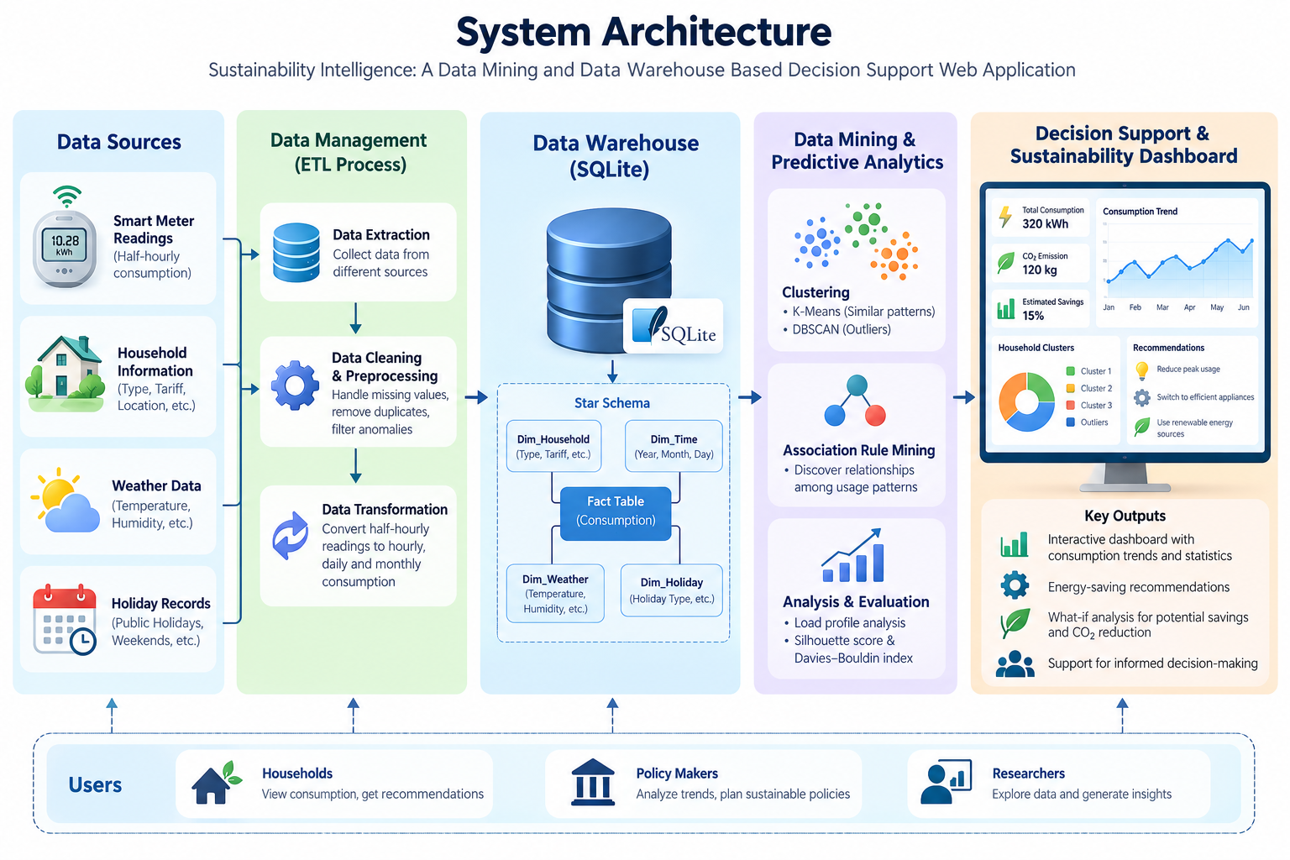
ARCHITECTURE DIAGRAM

Slide 11


Conclusion
Provides a centralized platform for analyzing household electricity consumption.
Uses data warehousing and data mining to identify consumption patterns and unusual usage.
Presents actionable insights through an interactive sustainability dashboard.
Generates energy-saving recommendations and estimates potential CO₂ emission reductions.
Promotes responsible electricity consumption and supports sustainable energy management.

Slide 12
Future Scope
Integrate AI-based electricity consumption forecasting.
Enable real-time monitoring through smart meter integration.
Incorporate GPS and regional energy data for location-based analysis.
Add electricity tariff integration to estimate potential cost savings.
Develop mobile applications with personalized recommendations and notifications.

Slide 13
References
[1] V. Michalakopoulos et al., “A machine learning-based framework for clustering residential electricity load profiles to enhance demand response programs,” Applied Energy, vol. 361, Art. no. 122943, 2024, doi: 10.1016/j.apenergy.2024.122943.
[2] “Mining energy consumption behavior patterns for households in smart grid,” IEEE Transactions on Emerging Topics in Computing, vol. 7, no. 3, pp. 404–419, 2019, doi: 10.1109/TETC.2017.2692098.
[3] F. Wang et al., “Association rule mining based quantitative analysis approach of household characteristics impacts on residential electricity consumption patterns,” Energy Conversion and Management, vol. 171, pp. 839–854, 2018, doi: 10.1016/j.enconman.2018.06.017.
[4] “Data-driven resource planning for virtual power plant integrating demand response customer selection and storage,” IEEE Transactions on Industrial Informatics, vol. 18, no. 3, pp. 1833–1844, 2022, doi: 10.1109/TII.2021.3068402.
[5] “Smart meters time series clustering for demand response applications in the context of high penetration of renewable energy resources,” Energies, vol. 14, no. 12, Art. no. 3458, 2021, doi: 10.3390/en14123458.

Slide 14


