Slide 1





Namma Hack
Team Details
Team name: Xcape matriX
Team leader name: Tanveer Pasha S & Vishwas K
Problem Statement: Open Innovation – Campus & Student Life

Slide 2

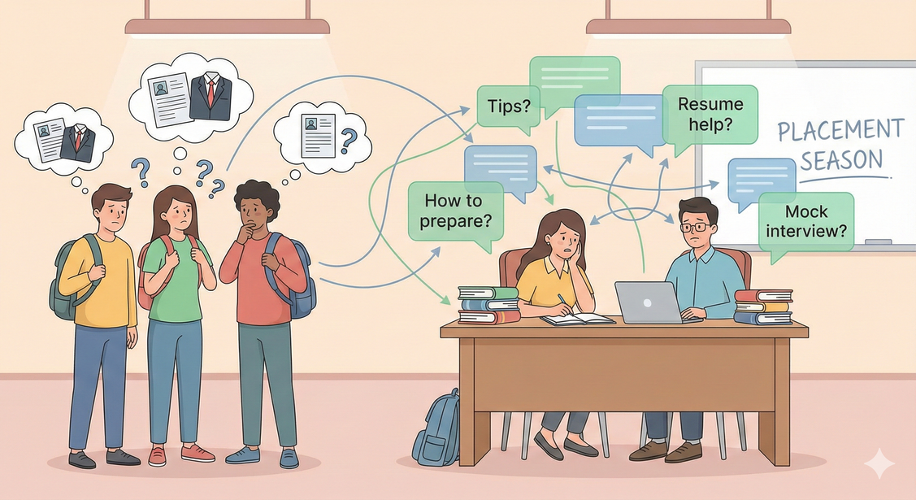
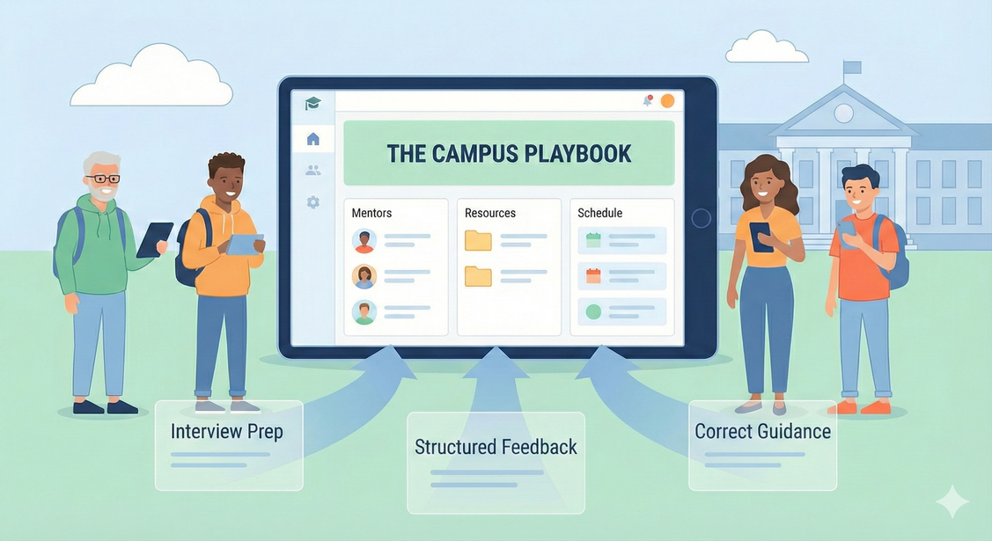

Problem Statement addressing and Solution
“ By Seniors, For Juniors – A Verified Placement Knowledge Archive “
Our Solution: The Campus Playbook
The Campus Playbook is a college-exclusive, peer-driven platform where seniors document their complete placement journeys in a structured format, and juniors access them to prepare effectively.
By Seniors, For Juniors.
A permanent placement knowledge archive for the campus.
The platform ensures:
Verified college-only access
Honest and detailed experiences
Long-term knowledge preservation
Problem Statement
Within college campuses, there exists a critical knowledge gap between seniors who secure placements and juniors who are preparing for them.
Currently:
Placement experiences are scattered across WhatsApp groups, informal chats, or not shared at all
Juniors hesitate to approach seniors directly
Information shared is often incomplete and unstructured
Seniors repeatedly answer the same questions, leading to burnout
This results in:
Increased anxiety among juniors
Repeated preparation mistakes
Inefficient use of campus knowledge
There is no trusted, structured, college-verified system to preserve and pass down placement knowledge.

Slide 3
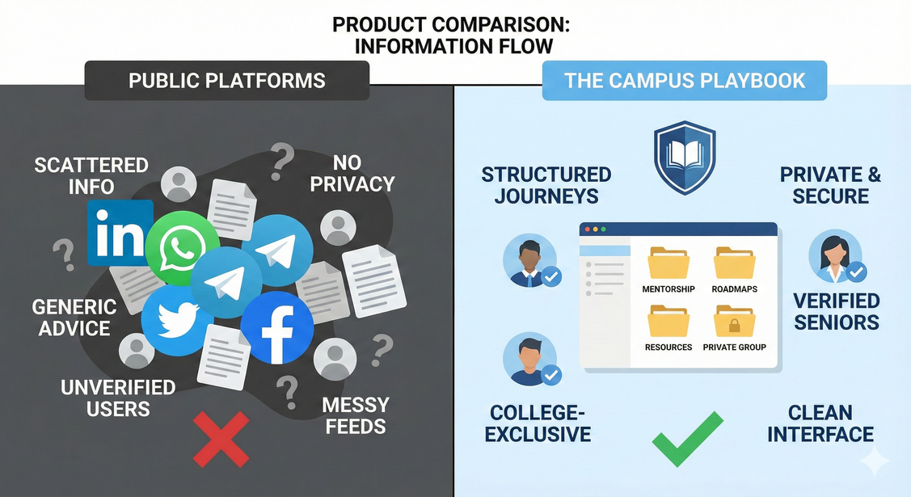
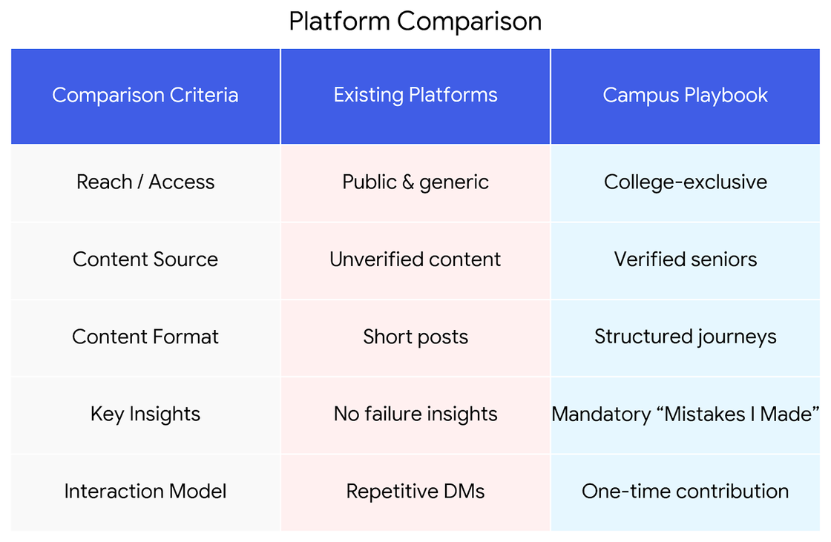
Uniqueness and Oppurtunities
How is this solution different?
Existing platforms are public, generic, and unverified, often focusing only on success highlights.
The Campus Playbook is built on trust, structure, and relevance.
Key differentiators :
Access restricted to official college email IDs
Content shared only by verified seniors from the same campus
Structured, step-by-step interview documentation
Mandatory inclusion of mistakes and learnings
Option for controlled anonymity to encourage honesty
Opportunity :
Improves placement preparedness across the campus
Reduces inequality in access to guidance
Minimizes repetitive effort by seniors
Creates a long-term institutional knowledge base
Can be scaled to other colleges in the future

Slide 4

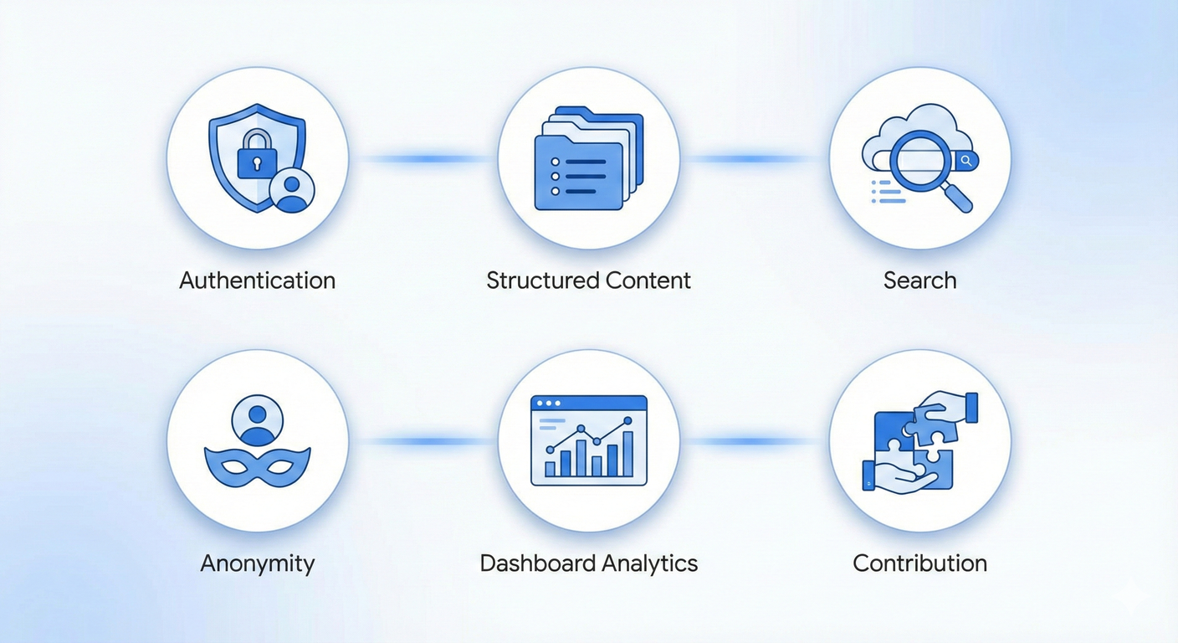
List of features offered by the solution
🔐 College-Exclusive Authentication: Secure login using official college email IDs only
📘 Structured Playbook Submissions: Guided forms capturing complete interview journeys
🎭 Controlled Anonymity: Seniors may choose to publish with or without their identity
🔍 Advanced Search and Filters: Filter by company, role, placement type, and branch
📊 Unified Dashboard: Single dashboard for both juniors and seniors
✍️ Multi-Step Contribution Flow: Progress-based submission to ensure high-quality data
Each feature is designed to directly address a real campus problem.

Slide 5

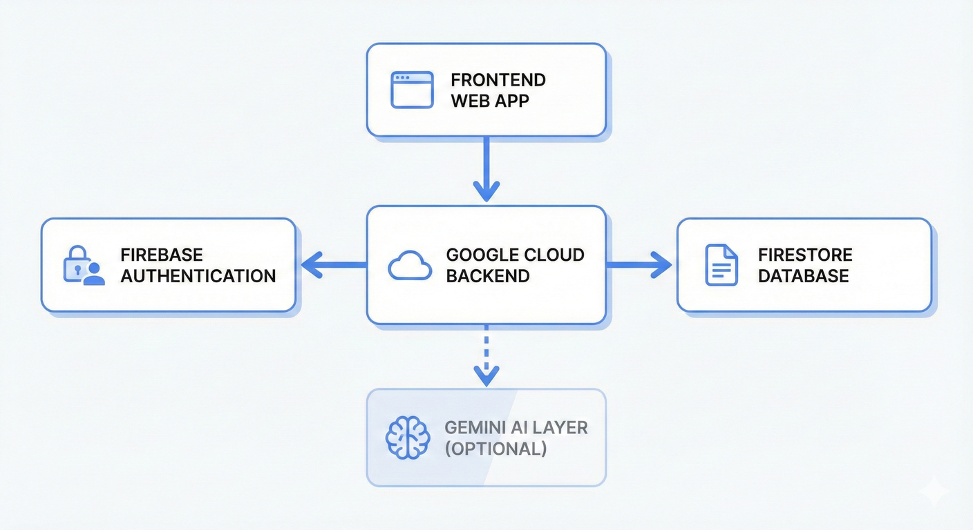
Google Technologies used in the solution
The solution leverages Google technologies to ensure scalability, security, and reliability.
Firebase Authentication:Enables secure Google Sign-In restricted to college email domains
Firebase Firestore:Stores structured playbook data with real-time access
Google Cloud Platform:Supports backend services and future scalability
Gemini AI (Future Enhancement):Used to summarize playbooks, extract key topics, and generate preparation insights
This technology stack aligns with Google Solution Challenge standards.

Slide 6
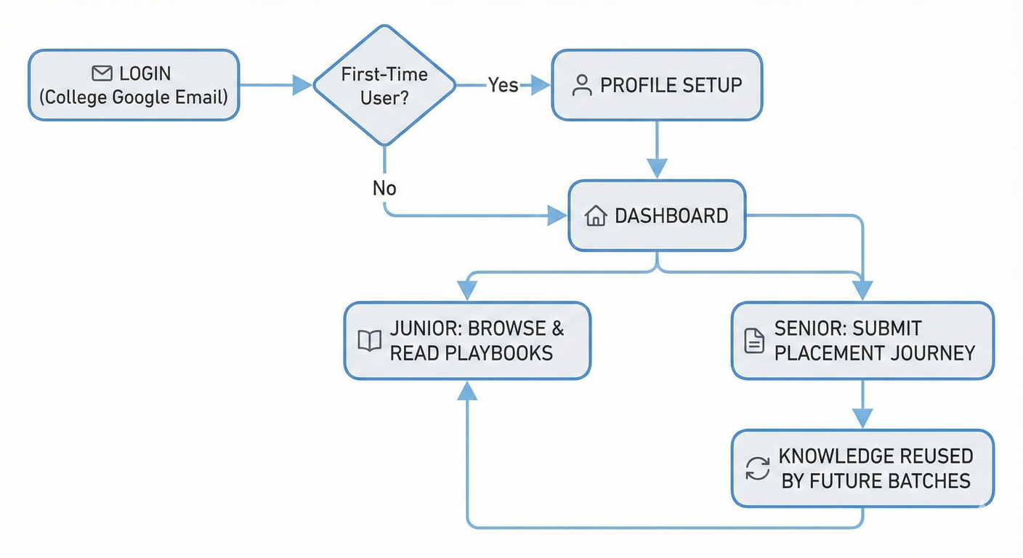

Process flow diagram or Use-case diagram
User Journey:
User logs in using college email
First-time users complete profile setup
User is redirected to the dashboard
Junior users browse and read placement playbooks
Senior users submit their interview journeys
Content is stored and reused by future batches
The same platform supports both roles, ensuring simplicity and consistency.

Slide 7
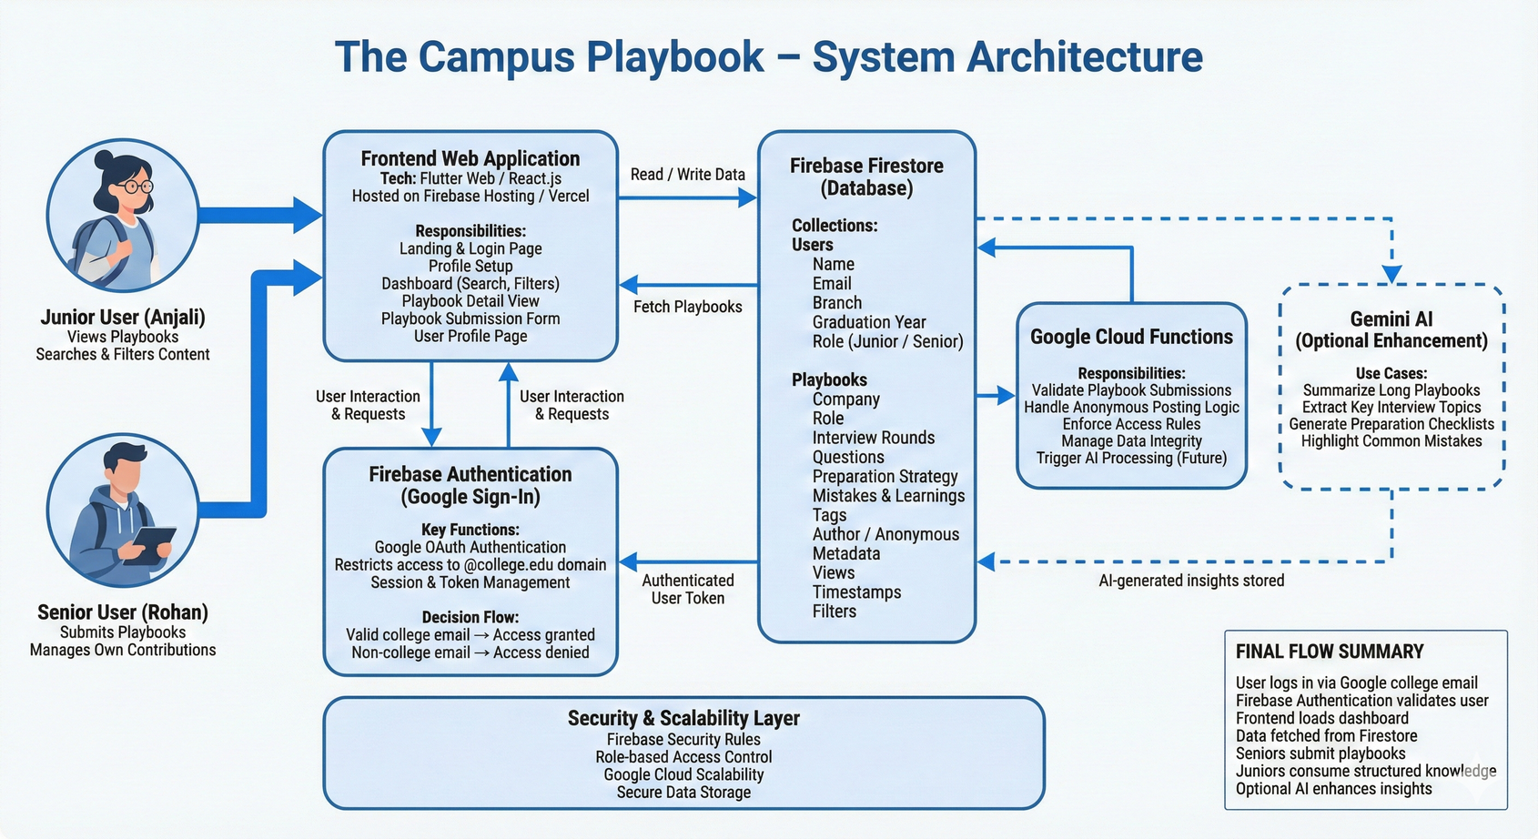
Architecture diagram of the proposed solution
System Architecture Overview:
Frontend Web Application handles user interaction
Firebase Authentication verifies college email access
Firestore Database stores playbooks and user profiles
Google Cloud Services manage backend operations
Optional Gemini AI layer enhances content intelligence
The architecture is simple, secure, and feasible for hackathon-level implementation.

Slide 8
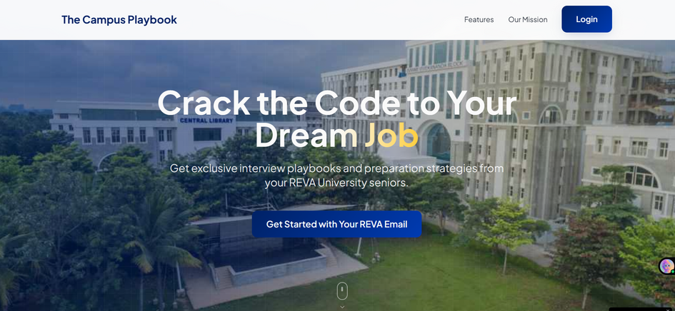
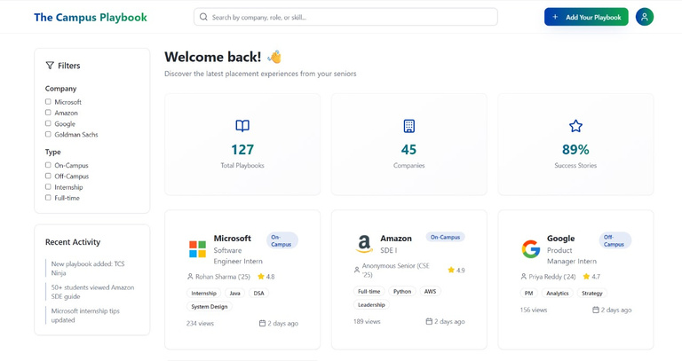
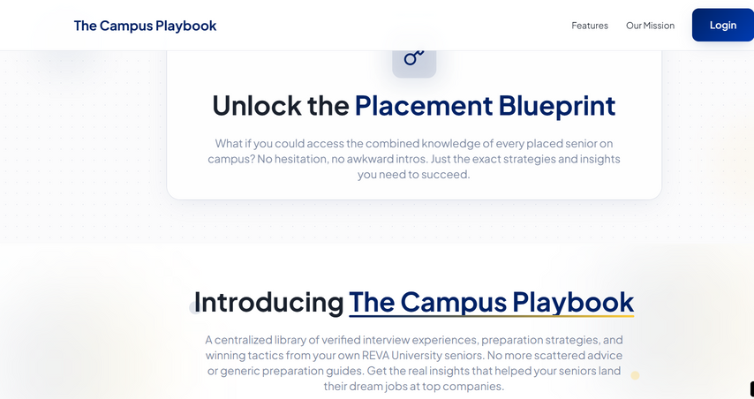
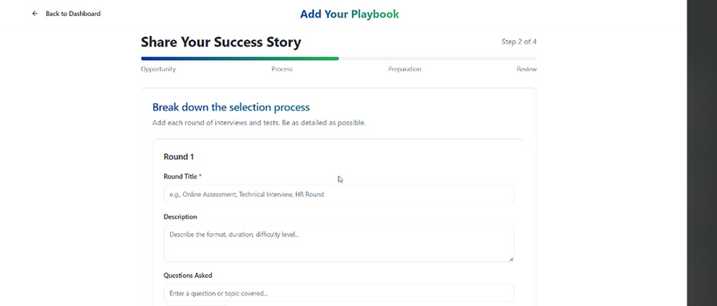
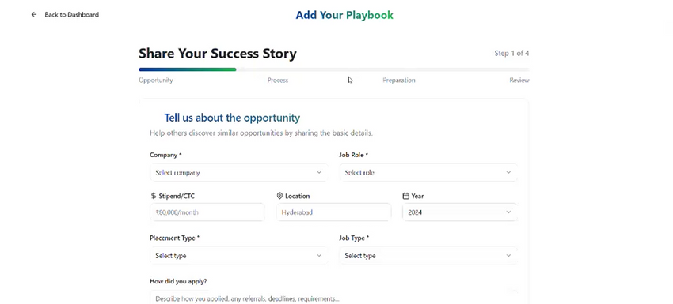
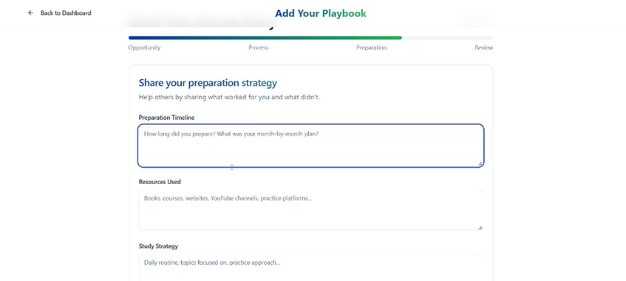
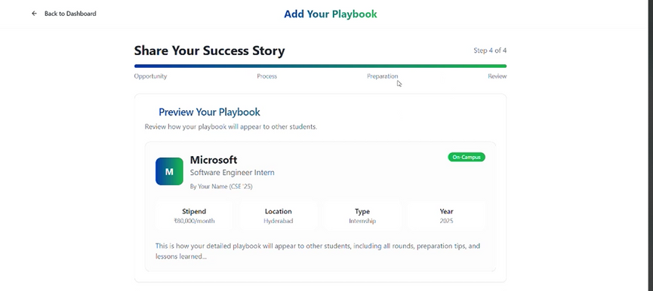
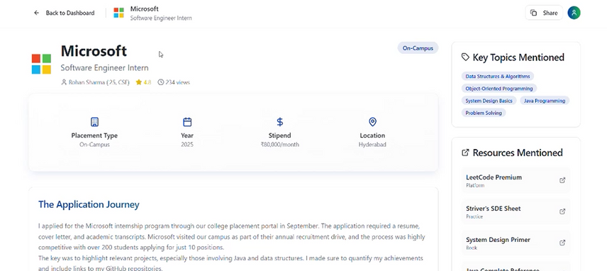
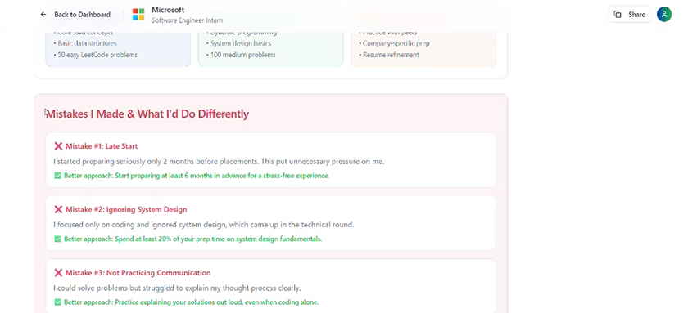
Snapshots of the MVP

Slide 9
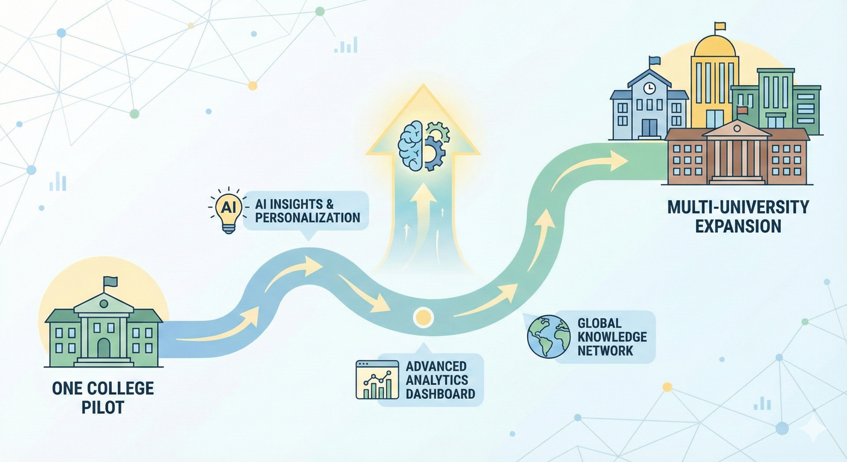
Additional Details/Future Development
Future Enhancements
Expansion to multiple colleges
AI-powered summarization and topic recommendations
Analytics on frequently asked interview topics
Placement trend insights across batches
Mentor recommendation features
UN SDG Alignment
SDG 4 – Quality Education
SDG 8 – Decent Work and Economic Growth

Slide 10
Provide links to your:
GitHub Public Repository
Demo Video Link (3 Minutes)
MVP Link

Slide 11
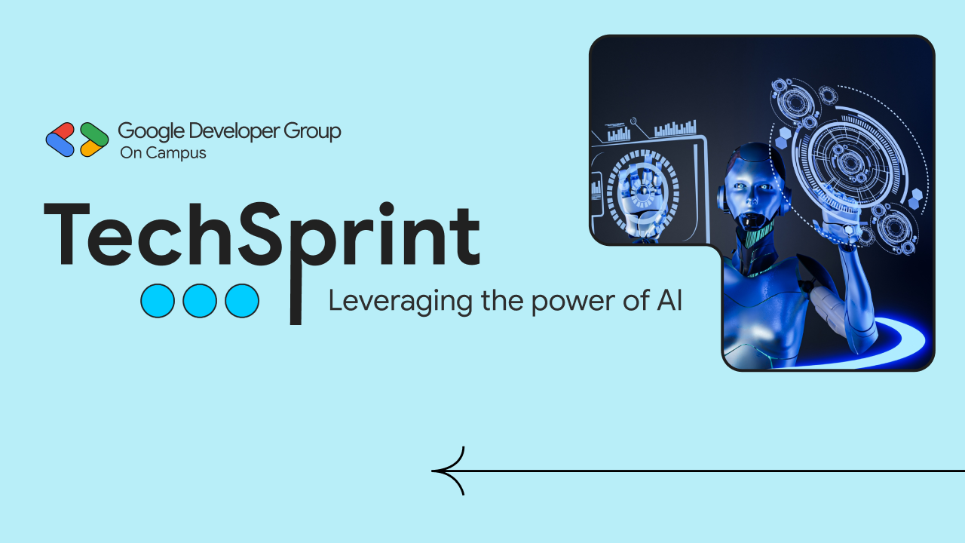



Namma Hack
Thank you!

