Slide 1
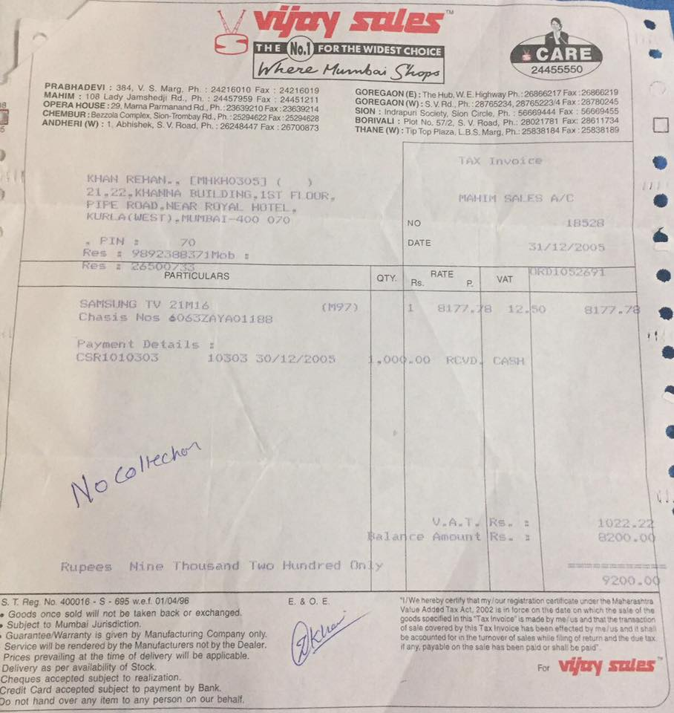
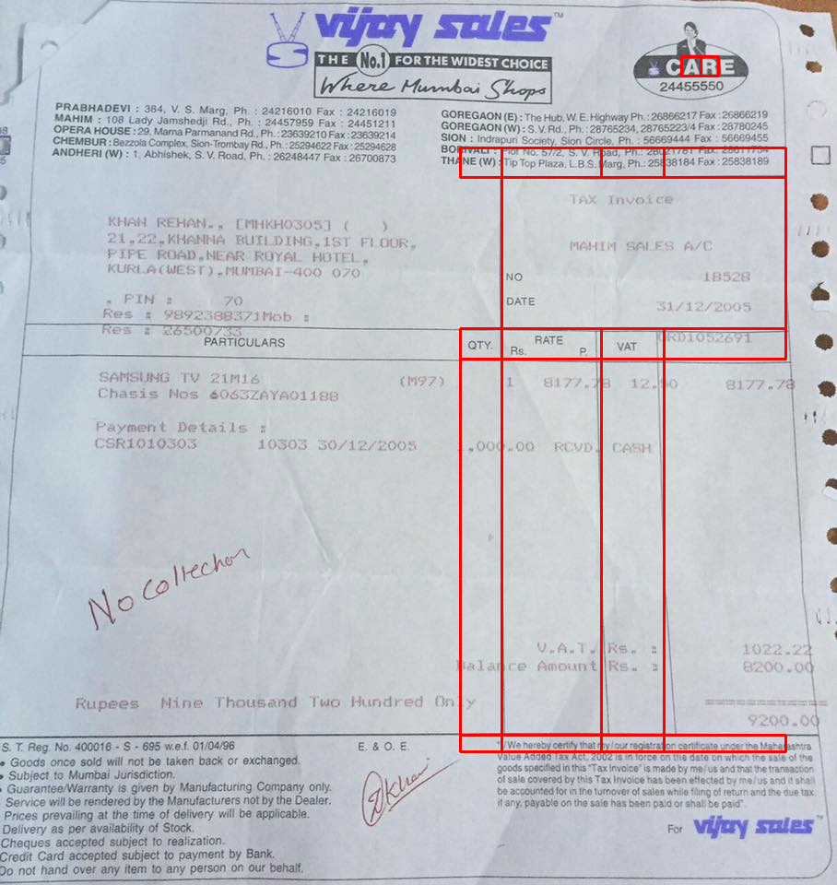
IMAGE
Vzw 5ues FHENIFORTHEWIDEST cHoich CARE Whene Hunbai Shepa 24455550 PaabHaDeVi Jo 384, Marg; 24218010 Fax 24216019 GOREGAON (E) : The Hub W E Highway Ph; 28866217FJX 26880219 OPERA HOuSE: Jamishedji Ru; 24457959 Fax 2445121 GOREGAON (W) VAd 28765234.28765223\' Fax.28780245 :29 Mama Parmanand Rd 22639210Fax.22830214 CHEMBUR : Bezzola Compiex Sion-Trombay Rd , Pn 25204622Fax 25204628 SION Indrapun Scc ety Sion Circle; Pn; 56689444 Fax 56689455 ANDHERI (Wi Abhishen. Roza; Ph; 26248447 BORIVALI Ploi No; 57/2, Rosd; Ph . 28021781 Fax: 28611734 Fax 26700873 THANE (W Tp Top Plaza LB SMarg Ph_25838184 Fax 25838188 Tnx Tnvoce KHAN KEHANa Lkhoso:] 21 KHANNA MUfLDING_ IST FL @UR NciM SAES FC FIFE ROAD NGAR ROAL HCTFI KURI A( WCST).TiMaai 400 070 NO 10528 FUH 70 DATE 31712/2005 Res 9892388371iob Fe 3650 PARTICULAAS OTY RaTE VAT 7R0o5z571 SAriSVNG TV 21016 (157) 817/.a 42-60 8177-78 Chasis Nos Go63zayA0ij88 Poyment Detail5 CSRT010SOS 1050
Easyocr output
Image2table output

Slide 2
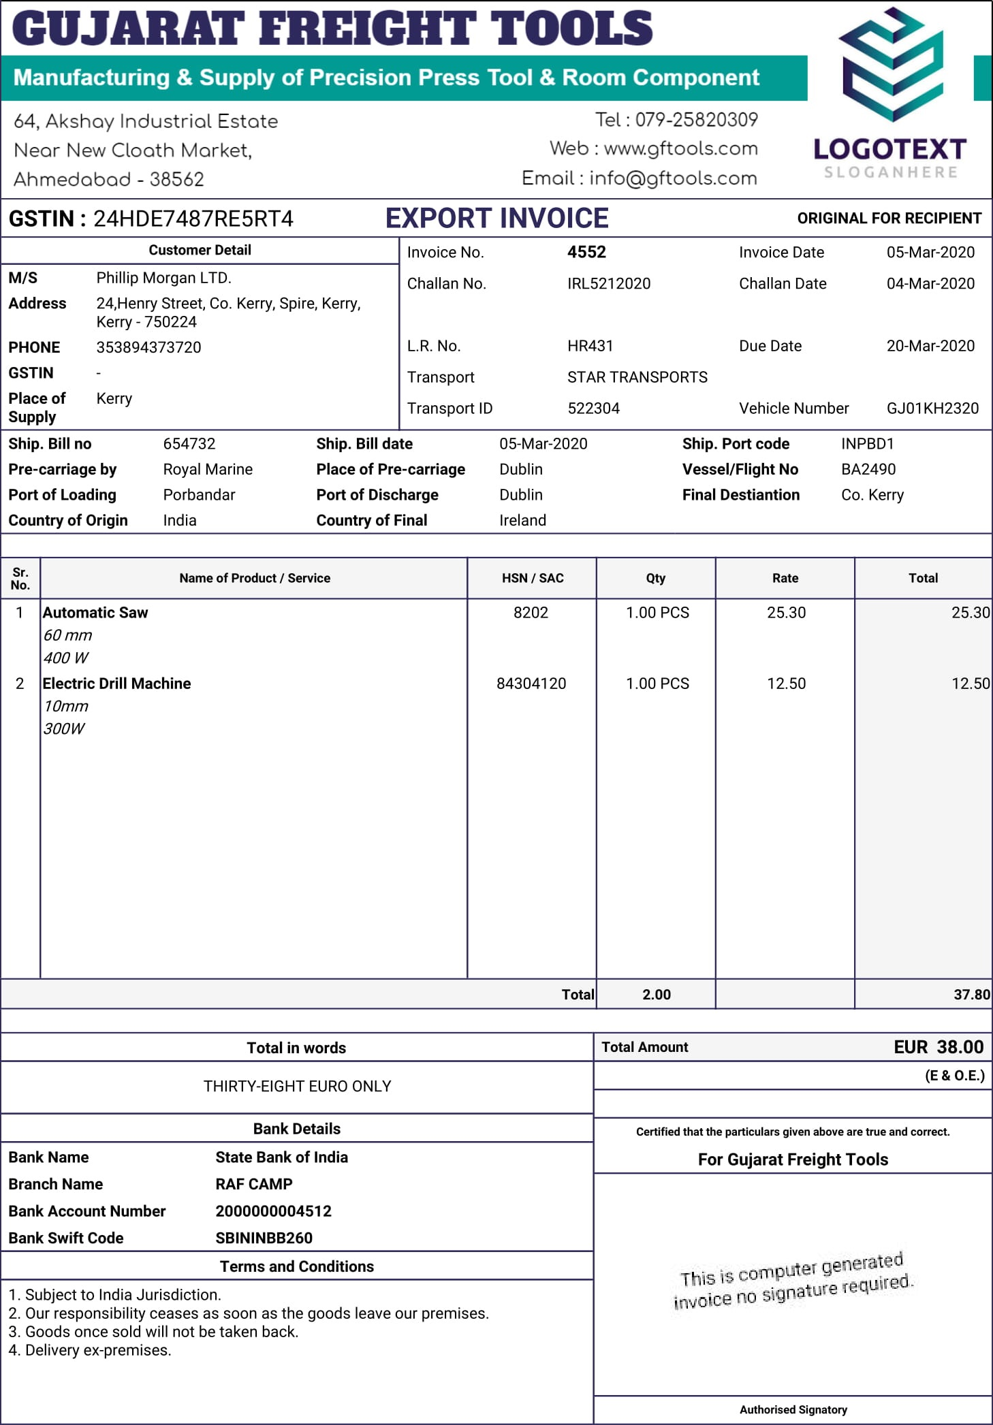
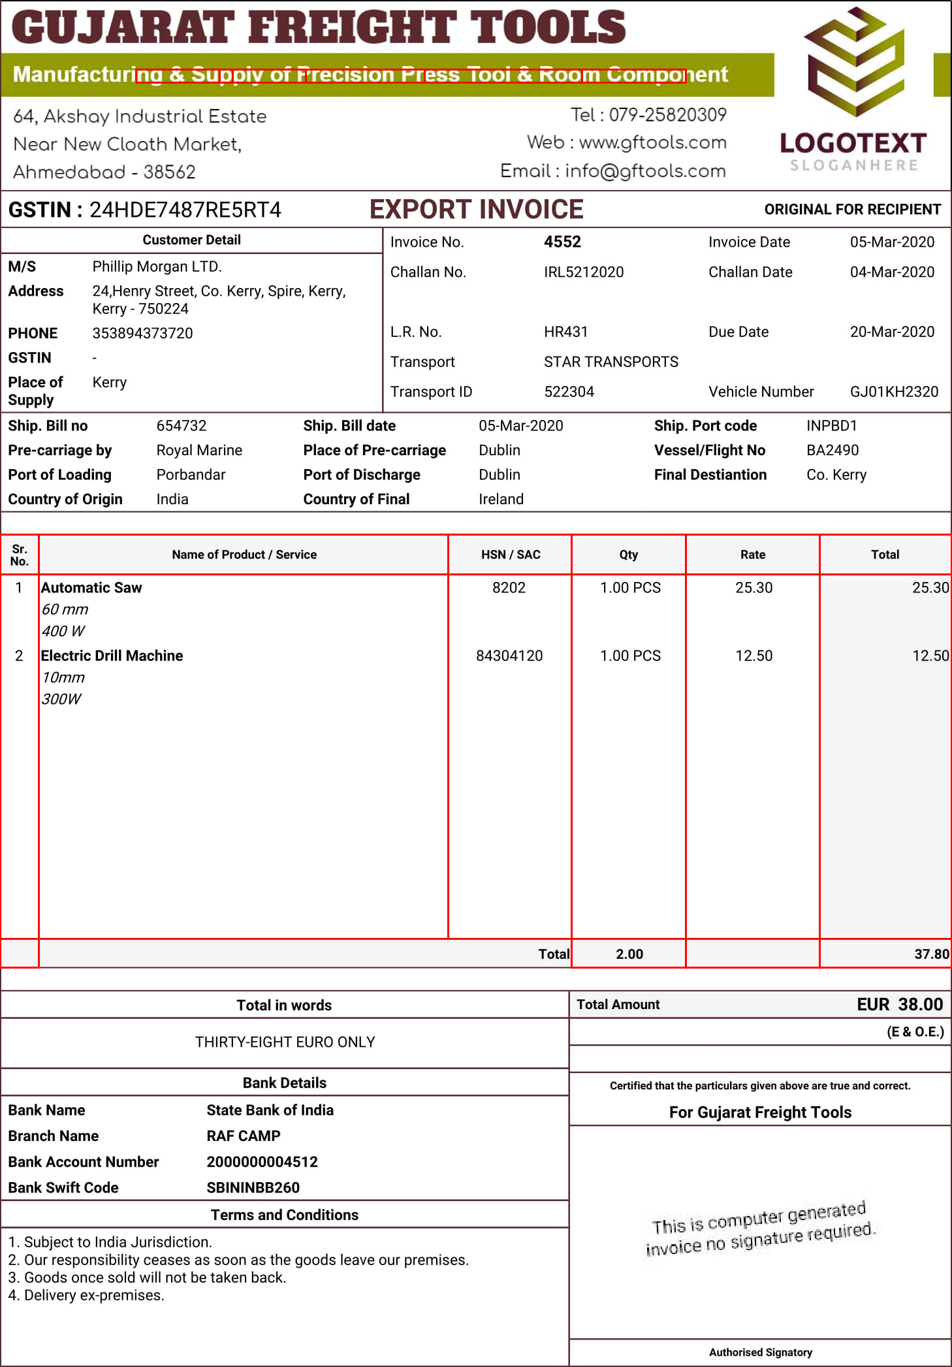
IMAGE
CUJARAT EREIGHT TOOLS Manufacturing & Supply of Precision Press Tool & Room Component 64,Akshoy Industriol Estote Tel : 079-25820309 Near New Cloath Market, Web : wwwgftools.com LOGOTEXT Ahmedabad 38562 Email info@gftools.com SLOGANHE R E: GSTIN 24HDE7487RESRT4 EXPORT INVOICE ORIGINAL FOR RECIPIENT Customer Detail Invoice No. 4552 Invoice Date 05-Mar-2020 M/S Phillip Morgan LTD. Challan No_ IRL5212020 Challan Date 04-Mar-2020 Address 24,Henry Street; Co. Kerry, Spire, Kerry 750224 PHONE 353894373720 LR No. HR431 Due Date 20-Mar-2020 GSTIN Transport STAR TRANSPORTS Place of Transport ID 522304 Vehicle Number GJO1KH2320 Supply Ship: Bill no 654732 Ship. Bill date 05-Mar-2020 Ship. Port code INPBDI Pre-carriage by Royal Marine Place of Pre-carriage Dublin Vessel/Flight No BA249O Port of Loading Porbandar Port of Discharge Dublin Final Destiantion CoBranch Name RAF CAMP Bank Account Number 2000000004512 Bank Swift Code
Easyocr output
Image2table output

