Slide 1


Insurance Analytics
Presentation By GROUP-06 :-
Kunal Bhanjdeo
Madhura R Malapur
Santanu Choudhury
Thota Venkata Pavani

Slide 2

Introduction:
Domain - Insurance Analysis
Tools Used - Excel, Tableau, Power BI, MY SQL .
Business Problem - The insurance dashboard may lack visibility into key
risk indicators like high claim ratios, low policy retention, or underperforming
products, which could mask critical business issues.
Goal - The goal can be to optimize profitability and risk management by
improving claim processing efficiency, increasing policy retention, and
identifying underperforming insurance products.

Slide 3
Data Overview:
Files : brokerage, fees, Individual Budgets, invoice, Meeting, Opportunity, Policy Data .
Size :~ 26,278 Rows across all files along with their sheets .
Key Columns : Account_Exe_ID, Income_Class, Stage .
Aggregations : Total Amount(Brokerage) ₹6.67 Cr, Total Amount(Fees) ₹5.14 lakh, Total Amount(Invoice) ₹1.22 Cr, Premium Amount ₹14.31 Cr, Revenue Amount ₹68.78 lakh.

Slide 4
Objectives-KPIs:
No of Invoice by Account Executive
Yearly Meeting Count
Cross Sell-Target, Achieve, new
New-Target, Achive, new
Renewal-Target, Achieve , new
Stage Funnel by Revenue
No of meeting By Account Executive
Top Open Opportunity

Slide 5
Process:
Data Collections.
Data Cleaning: Replacing Null Values, Deleting Columns, Merging Columns.
Data Modelling: Build the relationship between 2 tables.
Data Transformation: Created new metrics.
Visualization: Power BI, Tableau, Excel, SQL.
Insight Extraction.

Slide 6
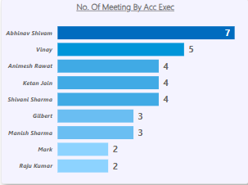
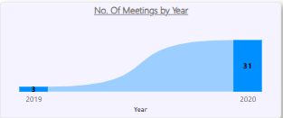
Meeting Analysis:
Abhinav Shivam conducted the highest number of meetings (7),followed by Vinay with 5. Most other executives held between
2 to 4 meetings, indicating a moderate distribution of activity.
The number of meetings significantly increased
from 3 in 2019 to 31 in 2020, indicating a sharp rise in engagement or activity.
This suggests improved efforts or expansion during 2020.

Slide 7
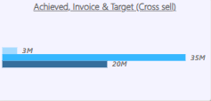
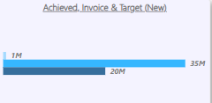
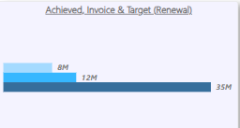
Income Class Analysis:
The cross-sell target was 35M, but only 3M was achieved and 20M invoiced. This indicates a significant gap in both a chievementand conversion toward the target.
For the new sales, the target
was 35M, but only 1M was
achieved while 20M was
invoiced. This reflects a major
Shortfall in achievement
despite moderate invoicing.
In the renewal category, the target
was 35M, but only 8M was
achieved and 12M invoiced.
This shows underperformance
in both achievement and invoicing
relative to the set goal.

Slide 8
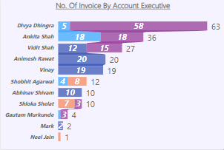
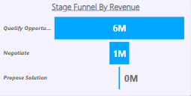
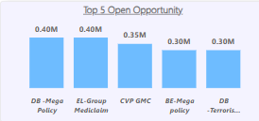
Invoice And Opportunity Analysis:
Divya Dhingra led with 63 invoices, followed by Ankita Shah and Vidit Shah with 36 and 27 respectively. Most other account executives had significantly fewer invoices, indicating a heavy skew in performance.
The funnel shows a sharp drop in revenue from 6M at the
"Qualify Opportunity" stage
to just 1M in "Negotiate," and 0M
in "Propose Solution." This indicates major leakage in progressing leads through the sales pipeline.
The top 5 open opportunities range from 0.30M to 0.40M in value, with DB-Mega Policy and EL-Group Mediclaim leading at 0.40M each. These represent key prospects that could significantly impact revenue if closed.

Slide 9
Recommendations And Insights:
The Renewal segment is outperforming with 150.23% achievement, while New and Cross Sell segments lag behind their targets.
Focus should shift to improving New and Cross Sell strategies, especially invoice conversion, to balance overall performance.
Most opportunities are concentrated in Fire and Employee Benefits, indicating a strong product focus.
However, the Stage Funnel shows a sharp drop from "Quality Opportunity" to "Propose Solution," suggesting a need to improve conversion tactics in mid-funnel stages

Slide 10
Conclusion:
In Conclusion, The Dashboard is focused on monitoring key insurance metrics like Claims, Premiums, and Policies, but may lack deeper insights into performance issues such as High claim ratios, Low policy retention, or Regional risk trends.
To drive better decisions, the Dashboard could benefit from more visible KPIs related to Efficiency, Profitability, and Risk Management.

Slide 11
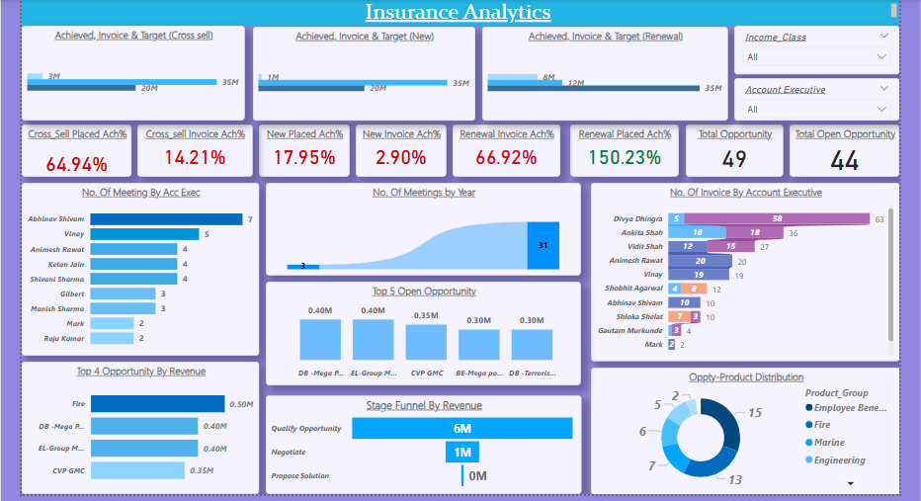
Power BI Report:

Slide 12
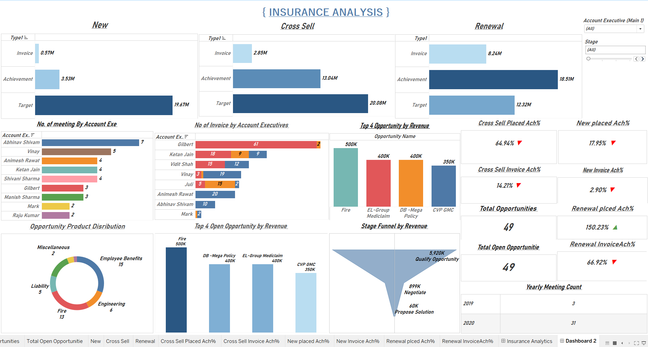
Tableau Report:

Slide 13
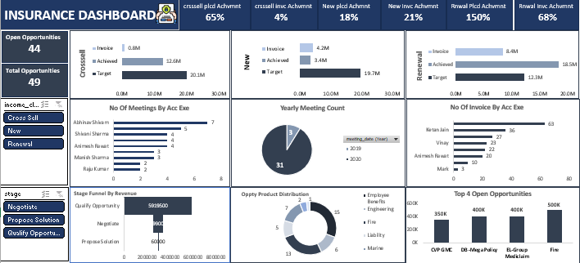
Excel Report:

Slide 14
Thank You ☺

