Slide 1
Secure Data Hiding in Images using Steganography
CYBERSECURITY PROJECT
Presented By: Tanvi Adivarekar
Student Name : Tanvi Tukaram Adivarekar
College Name & Department : ARMIET

Slide 2
OUTLINE
Problem Statement
Technology used
Wow factor
End users
Result
Conclusion
Git-hub Link
Future scope

Slide 3
Problem Statement
In an era of increasing cyber threats, securing sensitive information has become a major concern. Conventional encryption methods often raise suspicion, making steganography a powerful alternative for hidden communication. This project introduces a Python-based image steganography system that seamlessly hides confidential messages within images while ensuring security through password protection. By leveraging OpenCV and Tkinter, the solution provides a user-friendly yet robust approach to data concealment, enhancing privacy and minimizing the risk of interception.

Slide 4
Technology used
Programming Language: Python
Libraries & Modules:
OpenCV (cv2): For image processing
Tkinter: For building the graphical user interface (GUI)
OS Module: For file handling and directory management
Security Mechanism:
Password protection for encrypted messages
Character-to-pixel mapping for data embedding
Software & Tools:
Python IDE (e.g., PyCharm, VS Code)
Windows/Linux/Mac OS for execution

Slide 5
Wow factors
Enhanced User Interface: Unlike standard command-line steganography tools, this project integrates Tkinter to provide an intuitive and interactive Graphical User Interface (GUI).
Secure Password Protection: Implements a password-based authentication system, adding an extra layer of security to the hidden message.
Ease of Use: The GUI eliminates the need for manual coding inputs, making encryption and decryption accessible to non-technical users.
Automated File Handling: The project automatically saves and retrieves encrypted images, ensuring smooth processing without manual file management.

Slide 6
End users
Cybersecurity Enthusiasts & Researchers:– Individuals exploring data security and encryption techniques.
Journalists & Whistleblowers:– People who need covert communication to share sensitive information securely.
Government & Intelligence Agencies:– For secure data transmission without raising suspicion.
Corporations & Businesses:– To protect confidential documents and prevent unauthorized access.
Students & Educators:– Useful for learning steganography concepts in an interactive way.
Digital Forensics Experts:– Can be applied in detecting hidden messages in digital media.

Slide 7
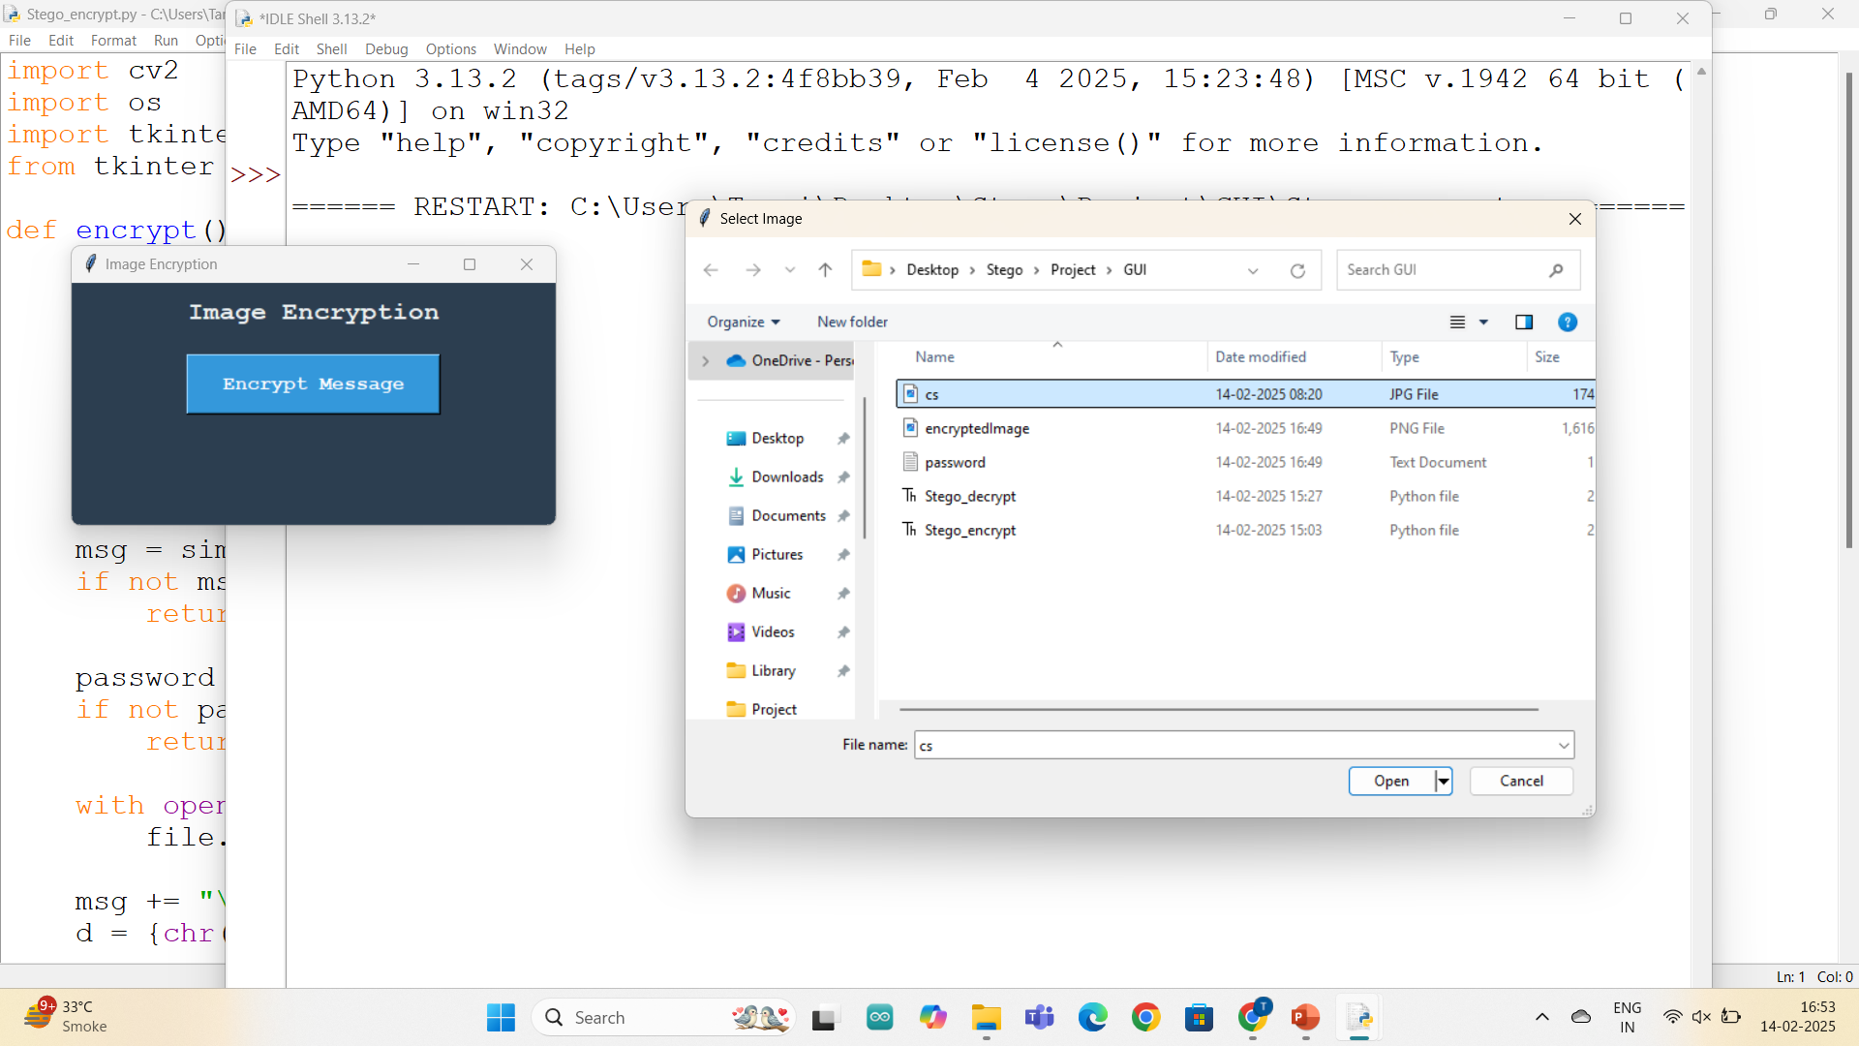
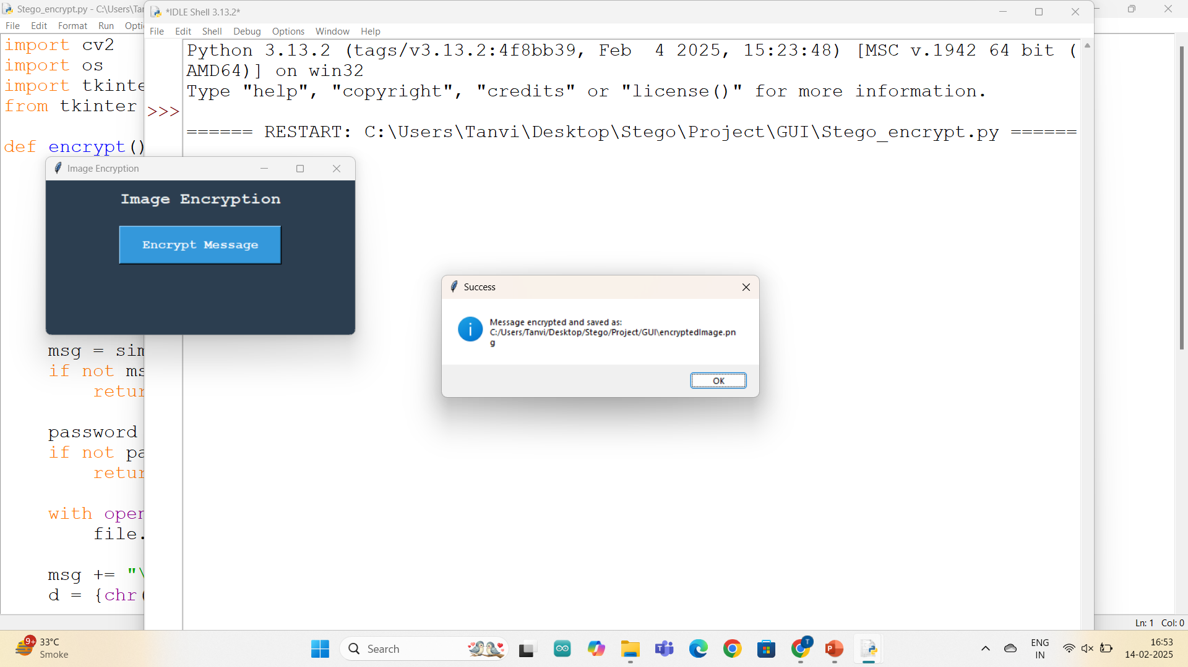
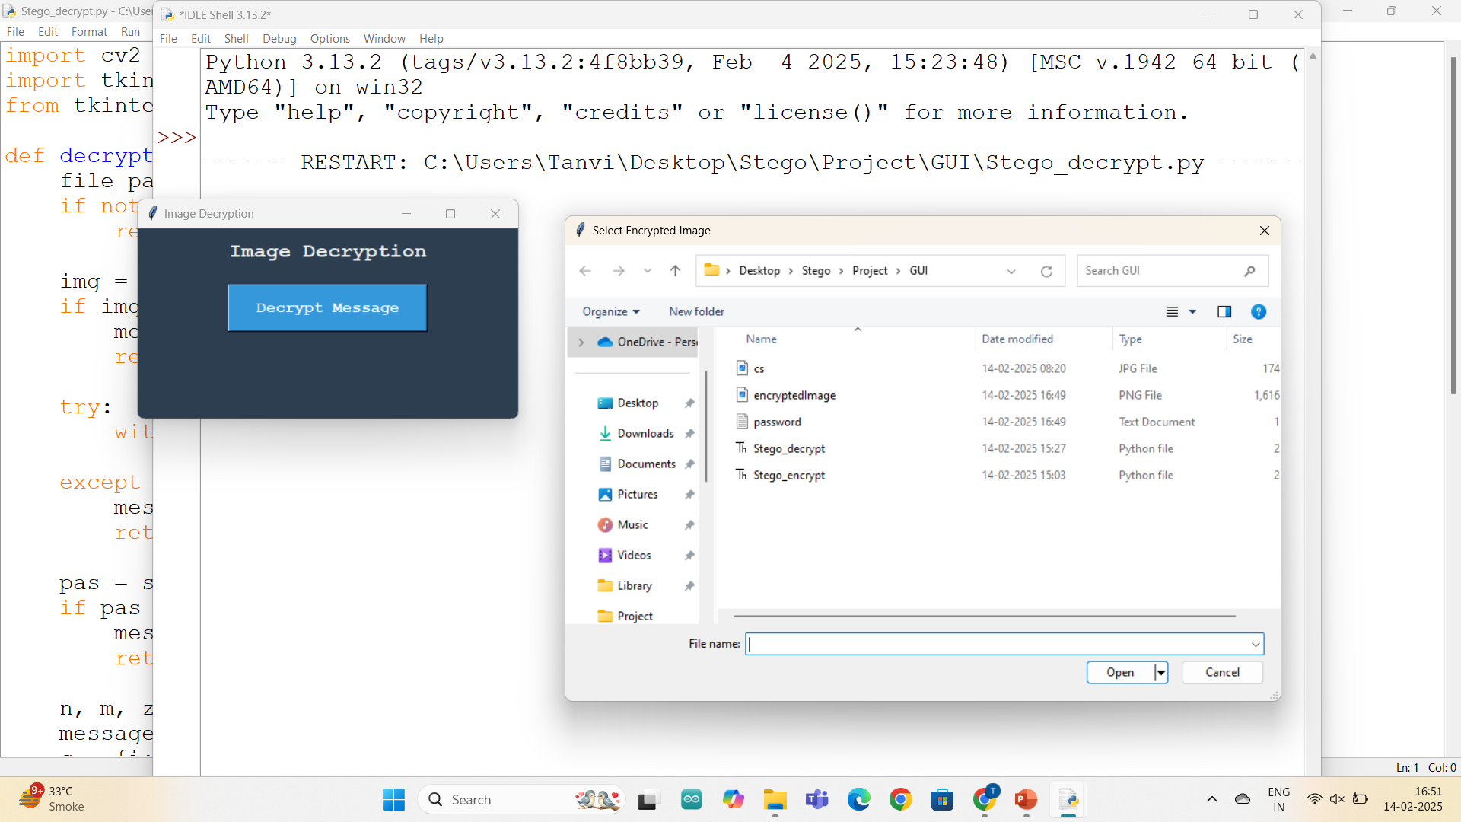
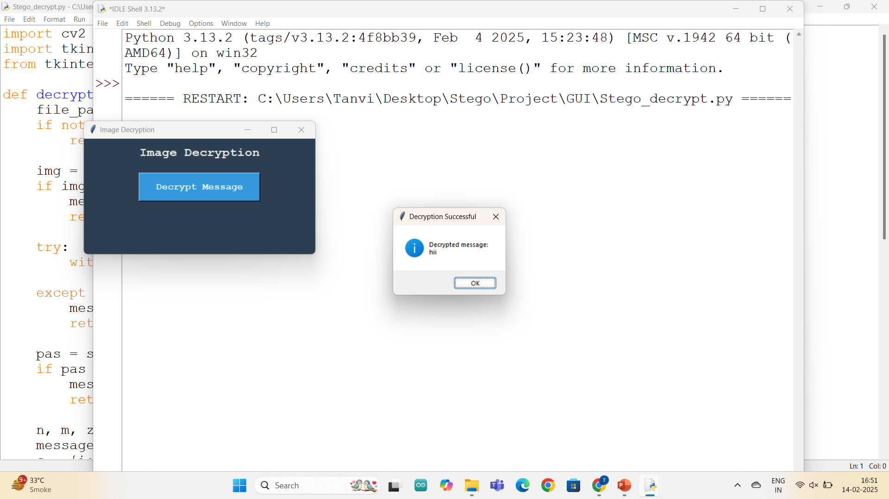
Results

Slide 8
Conclusion
This project effectively demonstrates image steganography as a secure method for hiding and retrieving messages within images. By integrating Python, OpenCV, and Tkinter, we have developed a user-friendly GUI that makes encryption and decryption accessible to all users, including non-technical individuals. The addition of password protection ensures that only authorized users can access the hidden message, enhancing security.
The system is efficient, lightweight, and maintains image quality, making it a practical solution for secure communication. With future improvements such as advanced encryption techniques and multi-layer security, this project can be further optimized for higher security and broader real-world applications.

Slide 9
GitHub Link
https://github.com/Tanvi-Adivarerkar/AICTE-Project.git

Slide 10
Future scope(optional)
Support for Multiple File Types: Extending the project to hide text, audio, or other file formats within images.
Cloud Integration: Enabling secure cloud-based storage and retrieval of encrypted images
Drag-and-Drop Functionality: Improving user experience by adding intuitive drag-and-drop support for image selection.
Advanced Encryption Techniques: Integrating stronger encryption algorithms like AES (Advanced Encryption Standard) for enhanced security.

Slide 11
THANK YOU !

