Slide 1
School Registration
System
Tanvi Arora
200449051

Slide 2
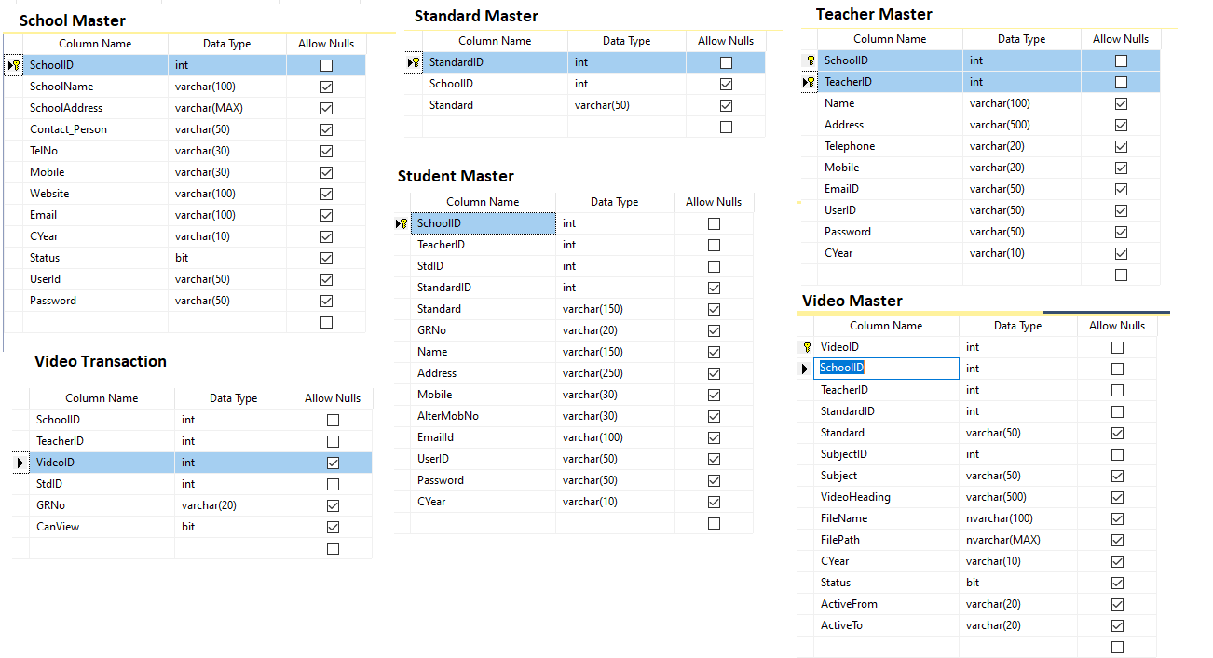
DATA DICTIONARY

Slide 3
Georgian technology of school Management System
to provide educators and trainers with unique opportunities to enhance learning and teaching
in school education.
This application serves as a forum to facilitate the exchange of information on the school syllabus.
It includes all the subject teach in school with topics and sub-topics.
Georgian technology comes in different configurations that dictate the depth of a needs online learning. The simple Integrated School Management System implementations, such as those following an application service provider (ASP) model, won't necessarily look any different from a resource requirement perspective than traditional classroom training.

Slide 4
Scope. Developing an Integrated School Management System initiative is a typically much larger endeavor than that of an online training program. Consider the increased expenses, number of people involved, development time, technological requirements, and delivery options.
Visibility. When a traditional teaching program goes boring for student, a student dissatisfaction is usually voiced by word of mouth. Again, due to the scope of the undertaking (especially the high budget and number of resources required), the efficacy of an School Management System program will be delivered to a larger group of student

Slide 5
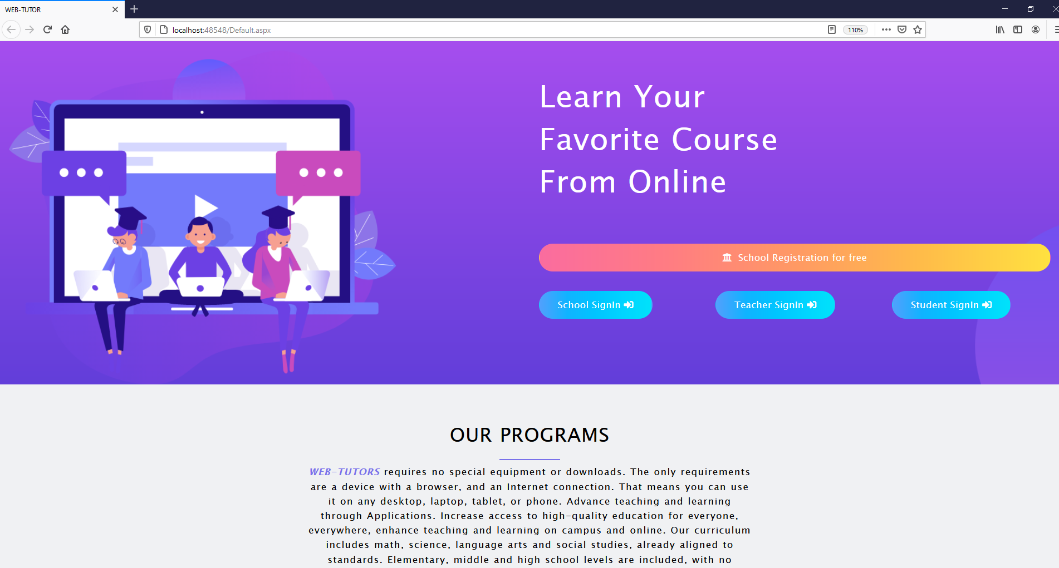
Home page

Slide 6
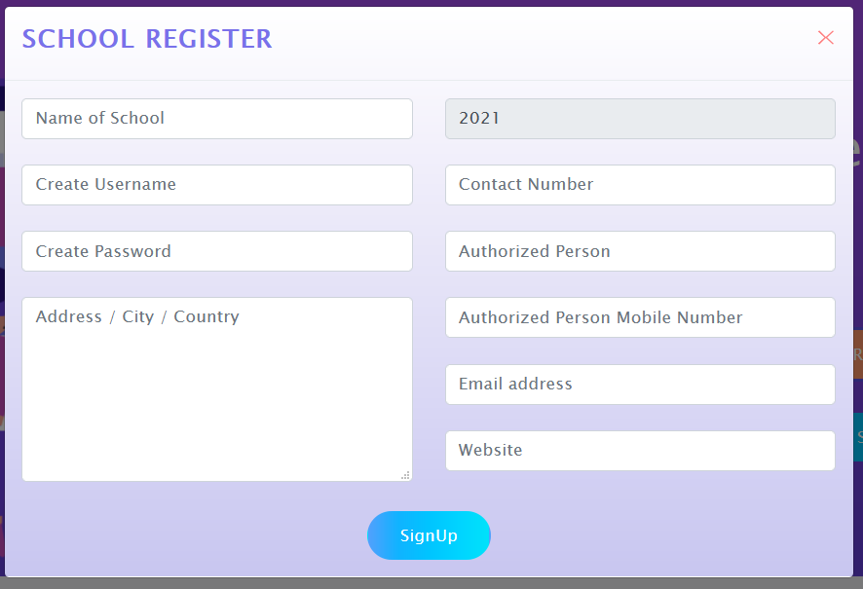
School Registration Form

Slide 7
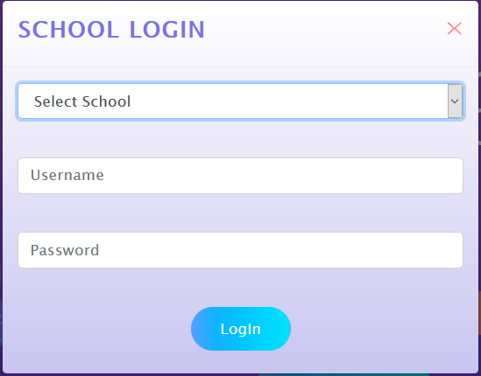
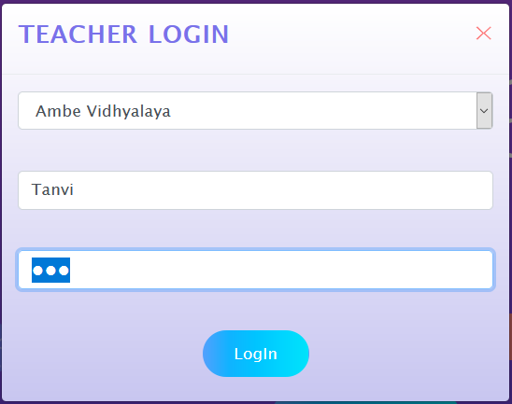
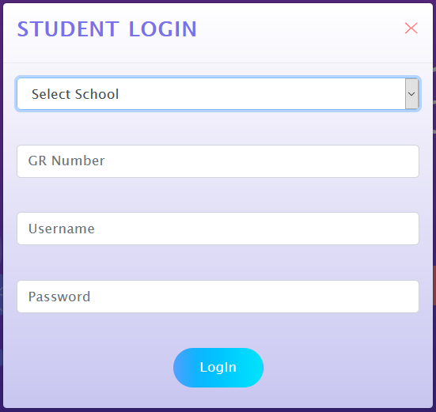

Slide 8
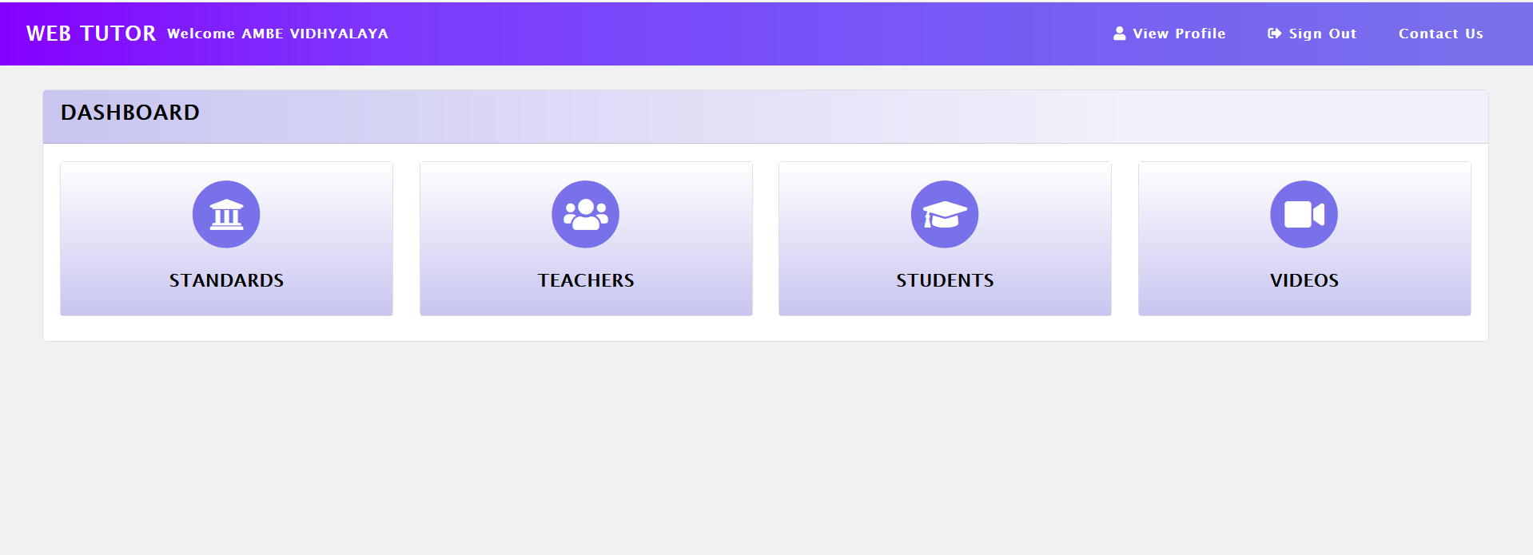
School DashBoard

Slide 9
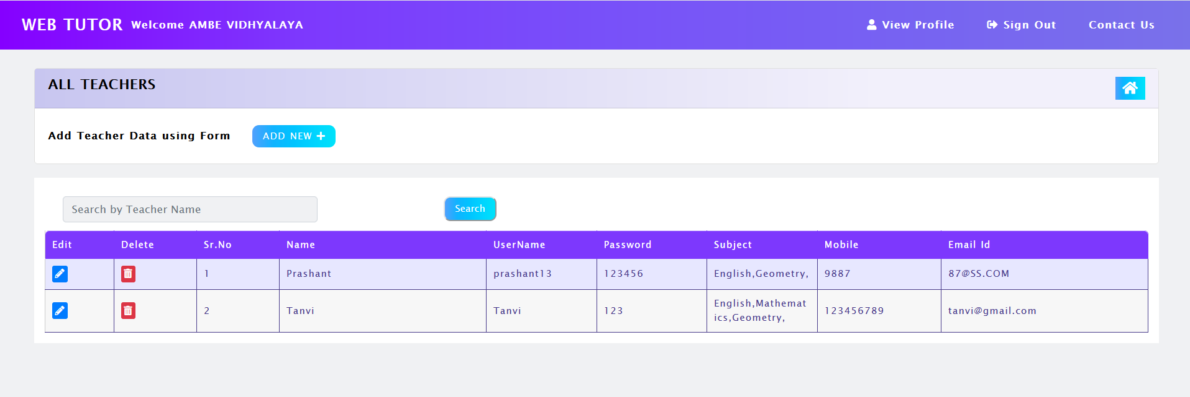
Add Teacher

Slide 10
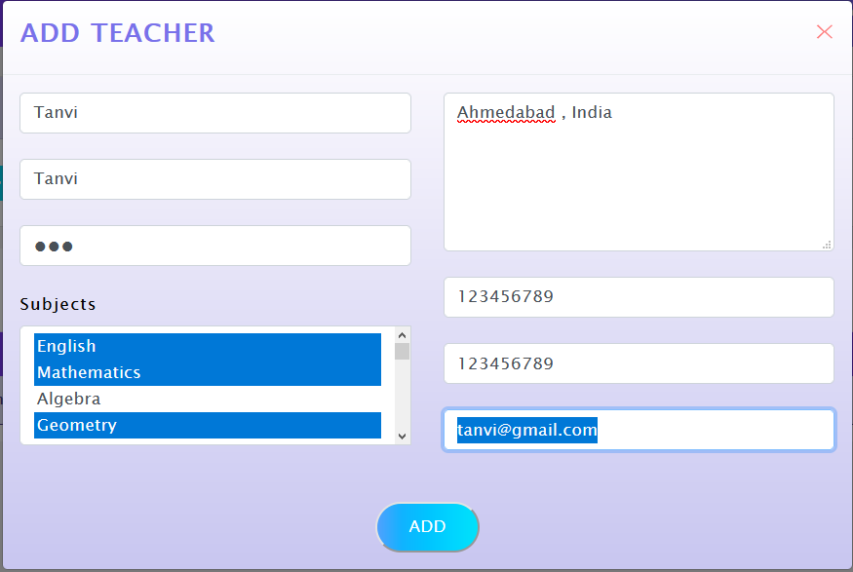
Add New Teacher

Slide 11
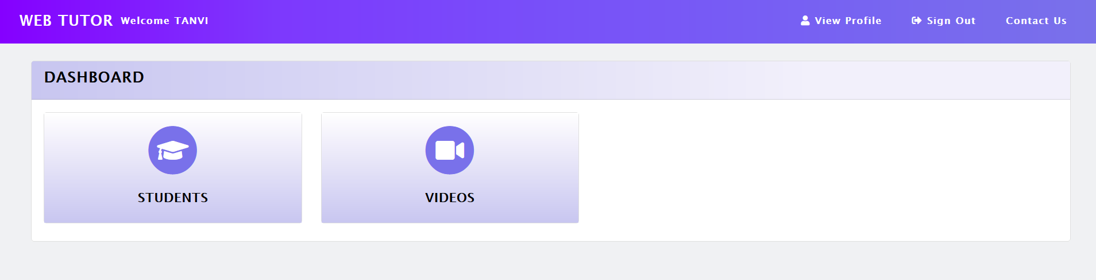
Teacher Dashboard

Slide 12
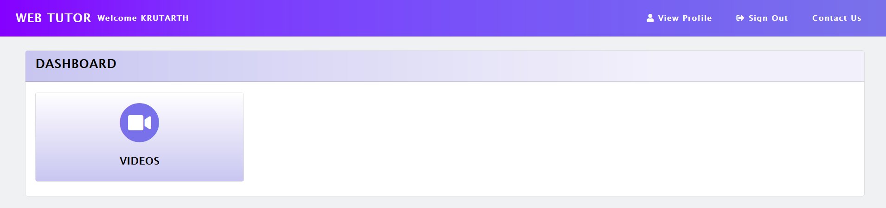
Student Deshboard

Slide 13
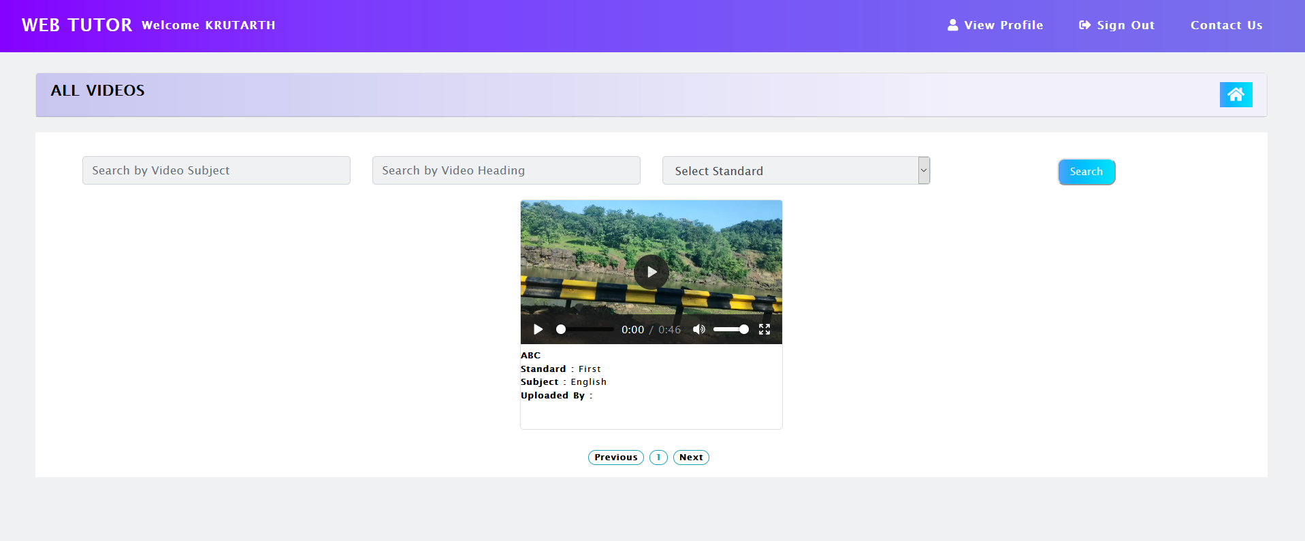
Video Uploaded by teacher

Slide 14
Thank you!!

