Slide 1
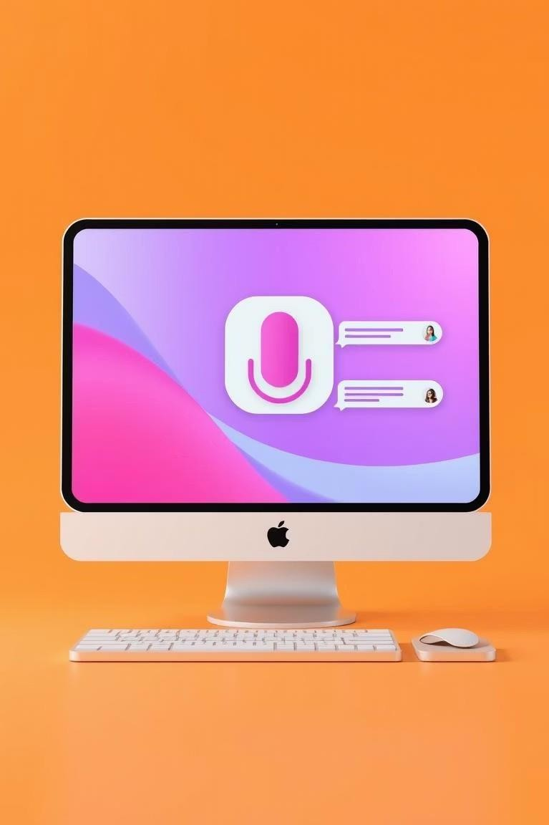
Smarticle: Speech-to-Text for Everyone
Empowering users with an accessible, lightweight, and intuitive desktop speech-to-text solution.

Slide 2




The Problem: Bridging the Speech-to-Text Gap
Many users face challenges with traditional typing due to physical limitations, multitasking demands, or language barriers.
Existing voice-to-text solutions are often buried in complex software ecosystems, making them less approachable for daily use.
There's a critical need for a straightforward, chat-style interface that delivers real-time speech-to-text directly on the desktop.

Slide 3
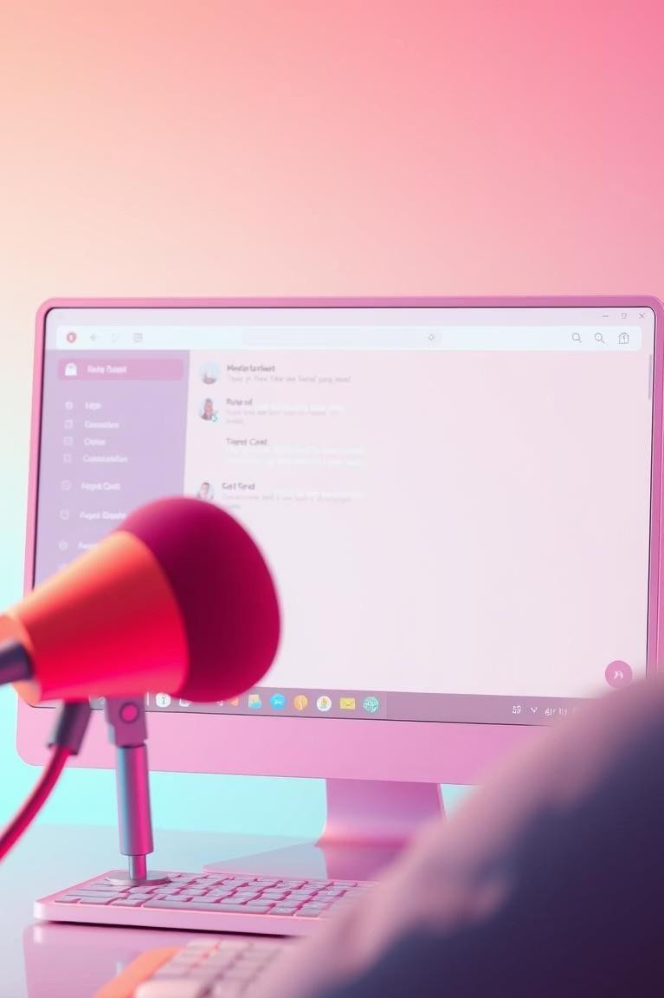
Introducing Smarticle: Your Desktop Voice Assistant
Smarticle is a desktop-based voice-to-text chat application, built with Python and Tkinter. It captures spoken input via microphone and transcribes it in real time using Google's Speech Recognition API, displaying the text in an intuitive, scrollable chat interface.

Slide 4
Why Smarticle Matters
Enhanced Accessibility
Boosted Productivity
Smarticle breaks down barriers for users with motor impairments or dyslexia, providing an alternative input method that is both efficient and user-friendly.
Ideal for note-taking, journaling, or transcribing meetings in real time, allowing users to focus on content rather than typing mechanics.
This project aligns perfectly with the goals of the Foss Fest Hackathon by promoting inclusive and open-source solutions for everyday problems.

Slide 5



Our Solution Approach
Audio Capture & Transcription
Utilizes the speech_recognition library for precise audio capture and Google's powerful API for transcription.
Responsive Chat GUI
Transcribed text is instantly displayed in a dynamic, chat-style GUI built with Tkinter, ensuring a familiar user experience.
Multithreaded Performance
Speech recognition runs on a separate thread, guaranteeing a smooth and uninterrupted user interface.
Real-time feedback via a status bar and system messages keeps users informed throughout the process.

Slide 6






Under the Hood: Technology Stack
Tkinter
Powers our intuitive and responsive desktop graphical user interface.
Google Speech API
Utilized via speech_recognition library for accurate and real-time speech-to-text transcription.
PyAudio
Manages seamless audio input capture from your microphone devices.
Threading Module
Python's built-in module ensures smooth, non-blocking operation by processing speech in the background.
Custom Styling
A dedicated style.py defines the application's aesthetic, including colors, fonts, and emoji support.
ScrolledText Widget
Provides the dynamic, scrollable chat interface for displaying transcribed text.
Our choice of technologies ensures a robust, cross-platform, and extensible application.

Slide 7










Key Advantages
Clean and simple design minimizes learning curve for all
users.
Minimal latency ensures a seamless speech-to-text
experience.
Runs efficiently on any OS supporting Python, requiring minimal resources.
Easy to personalize styling, colors, and fonts via style.py.

Slide 8
Overcoming Challenges
UI Freezing
Solution: Implemented multithreading to keep the GUI
responsive during recognition.
2
Ambient Noise
Solution: Utilized adjust_for_ambient_noise() for microphone calibration.
Unrecognized Speech
Solution: Gracefully handled UnknownValueError
with user-friendly prompts.
3
4
Continuous Listening
Solution: Designed a robust loop with clear exit conditions and feedback.
Visual Clarity
Solution: Implemented role-based color tagging and
emoji cues in chat display.
5

Slide 9
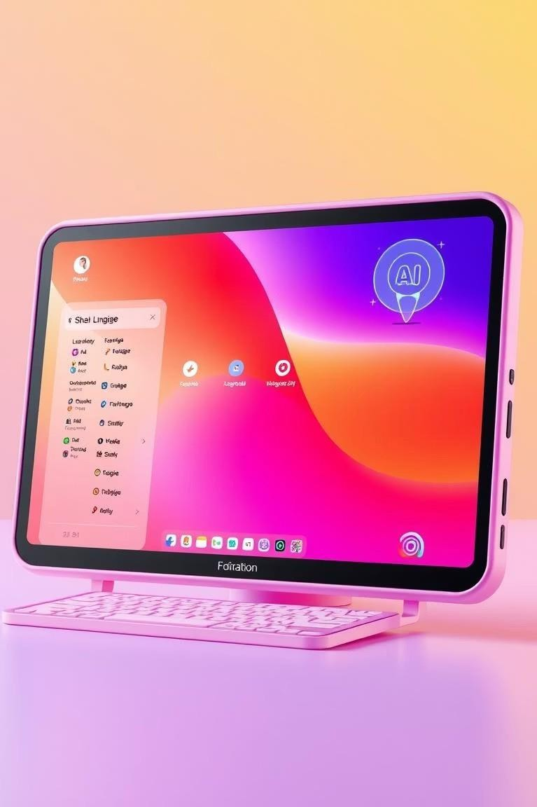
Future Horizons: What's Next for Smarticle?
Multilingual Support: Integrate language selection for broader accessibility.
Offline Recognition: Explore CMU Sphinx for transcription without internet.
Transcript Saving: Enable saving output to common formats (.txt, .docx).
Voice Commands: Add triggers like "Stop listening" or "Save note."
Enhanced UI: Introduce themes and dark mode for personalized aesthetics.

Slide 10
Conclusion: A Seamless Voice Experience
Smarticle demonstrates the potential of voice technology to significantly enhance accessibility and productivity in desktop environments. Our lightweight, user-friendly tool is a step forward in bridging the gap between speech and text in real time.
References:
Speech recognition library Google Speech-to-Text API Tkinter documentation PyAudio

