Slide 1
Machine Learning and Computer Vision Approach to Detect Parkinson's Disease
By TANVI KARANTH

Slide 2
Abstract
Parkinson's disease (PD) is one of the most common neurodegenerative disease of central nervous system (CNS).
One of the symptoms of Parkinson's is tremors and rigidity in the muscles which directly impact the visual appearance of the hand drawn spirals and waves.
The project makes use of hand drawn images of spirals and waves to detect PD.
Computer vision and machine learning approach is used to detect Parkinson's disease.

Slide 3
Contents
Introduction
Objectives
Methodology
Proposed System
Requirement Specification And Analysis
System Design
System Implementation
System Testing
Results And Screenshots
Conclusion
Applications

Slide 4
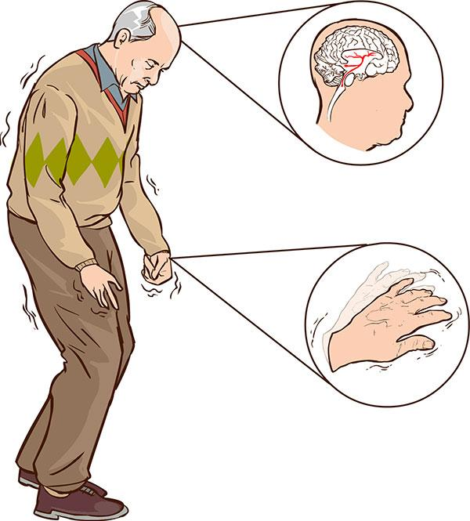
Introduction
What is Parkinson's disease?
Figure 1 : A PD Patient

Slide 5
Introduction
One of the earlier symptoms of Parkinson's is tremors and rigidity in the muscles which directly impact the visual appearance of the hand drawn spirals and waves.
This variation in visual appearance will enable us to train a computer vision and machine learning algorithm to automatically detect Parkinson’s disease.

Slide 6
Objectives
This project will:
Eliminate additional hardware to recognize voice, measure physical activities and track pen speed and pressure.
Utilize hand drawn images of spirals and waves alone, as dataset for training and testing.
Detect Parkinson’s disease using machine learning and computer vision techniques.

Slide 7
Methodology
The image dataset is collected and split into training and testing sets consisting of spirals and waves and is followed by
Reading all the images
Extracting the features and quantifying the input images using Histogram of Oriented Gradients image descriptor
Training the machine learning model using a Random Forest Classifier with about 100 decision trees in the forest.

Slide 8
Proposed System
Takes the hand drawn images of spirals and waves gathered from both patients with and without Parkinson’s.
Quantifies the variation in the visual appearances of the input images using HOG(Histogram of Oriented Gradients) image descriptor.
Trains a machine learning model to classify using Random Forest Classifier.
Automates the detection of Parkinson’s disease.

Slide 9
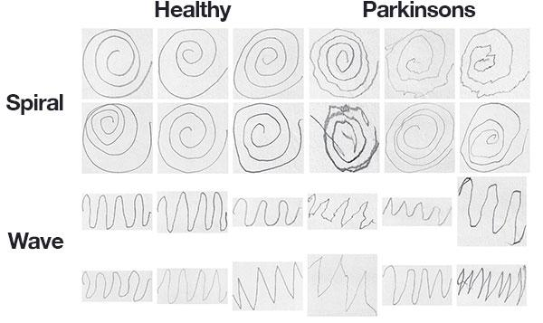
Requirements Specification And Analysis
Functional Requirements :
Dataset
Computer Vision methodology - HOG
Machine learning methodology - Random Forest Classifier
 | Healthy | Parkinsons
Spiral
Wave

Slide 10
Requirements Specification and Analysis
Non Functional Requirements :
Accessibility
Testability
Reliability
Maintainability
Robustness

Slide 11
Requirements Specification and Analysis
User Interface Requirements :
To upload the sample image.
To see the result.
Software Requirements :
Operating System - Ubuntu
Software – OpenCV
GUI: Tkinter toolkit

Slide 12
Requirements Specification and Analysis
Hardware Requirements :
Processor - Intel Pentium onwards Compatible Hardware.
RAM - 4 GB.
Hard Disk - 3 GB (minimum).
Keyboard

Slide 13
System Design
Figure 3: Steps involved in detecting Parkinson’s disease
INPUT IMAGE
PRE-PROCESSING
FEATURE EXTRACTION
CLASSIFICATION

Slide 14
System Design
START
Read the training images
Get the training feature matrix using HOG and target vector from the file path.
Build a random forest classifier model with 100 decision trees
Fit the random classifier model for training set
Read the testing images
Get the testing features using HOG
Get the predictions using the model.
Figure 7: Flow chart for Parkinson’s disease detection
END

Slide 15
System Implementation
The project is implemented using the following steps:
Image pre-processing by thresholding the image using Otsu’s thresholding method.
Feature Extraction of these images using HOG image descriptor.
Classification using Random forest classifier algorithm.

Slide 16
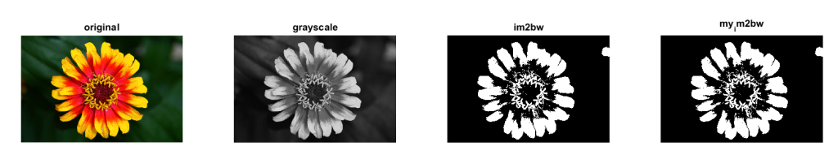
System Implementation
Image pre-processing:
Thresholding is a method to segment the images.
Example - greyscale image to a binary image.
Greyscale Black and white
Figure 8: Thresholding example

Slide 17
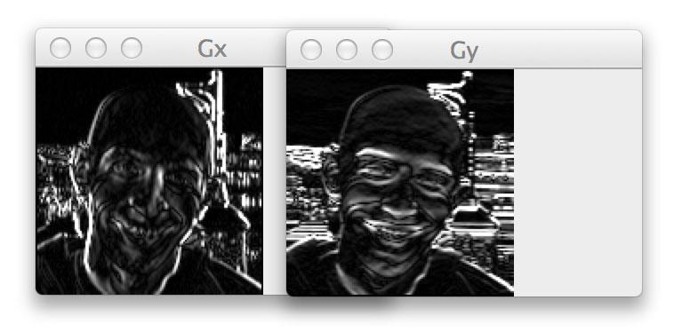
System Implementation
Feature Extraction:
Gradient of the image in x and y direction which gives us the magnitude and angle.
Figure 9: Gradient of an image

Slide 18
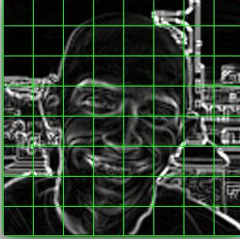
System Implementation
Feature Extraction:
Divide image into cells.
Figure 10: Division into cells.

Slide 19
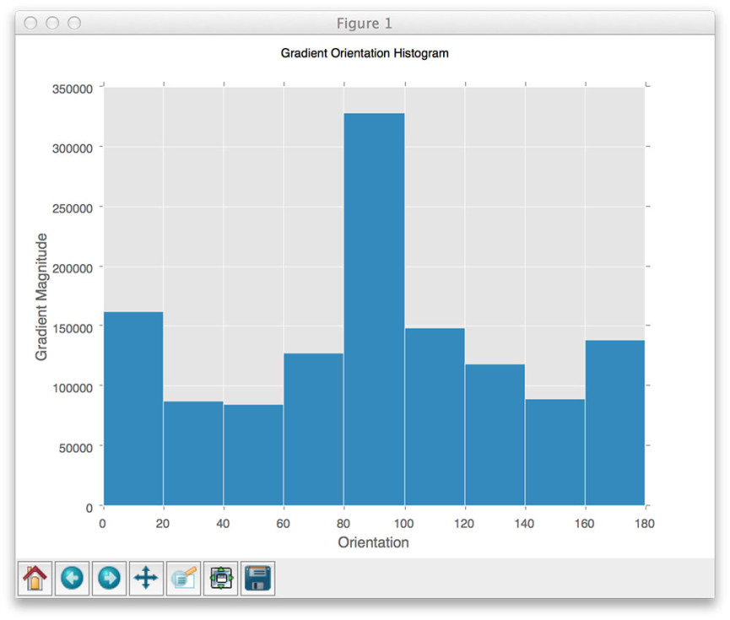
System Implementation
Feature Extraction:
Calculate histogram for each cell.
Figure 11: Histogram of a cell

Slide 20
System Implementation
Feature Extraction:
Block normalization.
The resulting features are a 12,996-dim feature vector
Figure 12: Block

Slide 21
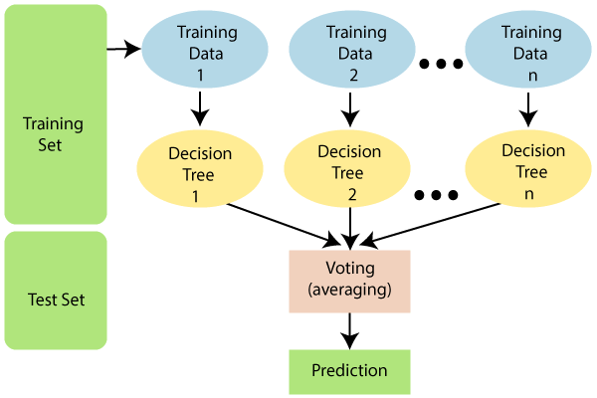
System Implementation
Feature Extraction:
Classification
Figure 13: Random Forest Classifier

Slide 22
System Testing
SL. No. | Test case | Expected Output | Obtained Output
1 | Pressing ‘Performance metrics for wave’ button. | Display the message box which is having Accuracy, Specificity and Sensitivity for wave dataset. | Same as expected.
2 | Pressing ‘Select a wave image to view result’ button. | Display the file browser to select a wave image and display the result. | Same as expected.
3 | Pressing ‘Performance metrics for spiral’ button. | Display the message box which is having Accuracy, Specificity and Sensitivity for spiral dataset. | Same as expected.
4 | Pressing ‘Select a spiral image to view result’ button. | Display the file dialog box to select a spiral image and display the result. | Same as expected.

Slide 23
Results And Screenshots
Performance Evaluation and Comparison:
Sl. No. | Algorithm | Accuracy
1 | Random forest classifier for spiral dataset | 86.66%
2 | SVM classifier for on-surface and in_air features. | 85.61%
3 | Random forest classifier for wave dataset | 70.00%
4 | Cascading of Chi2 and Adaboost model for handwriting features | 76.44%

Slide 24
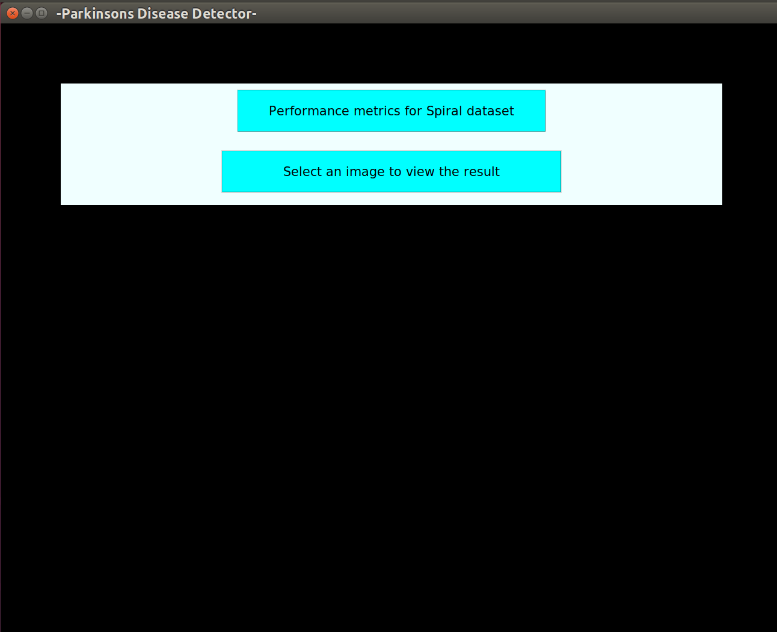
Results And Screenshots
Figure 14: Home screen for spiral dataset.

Slide 25
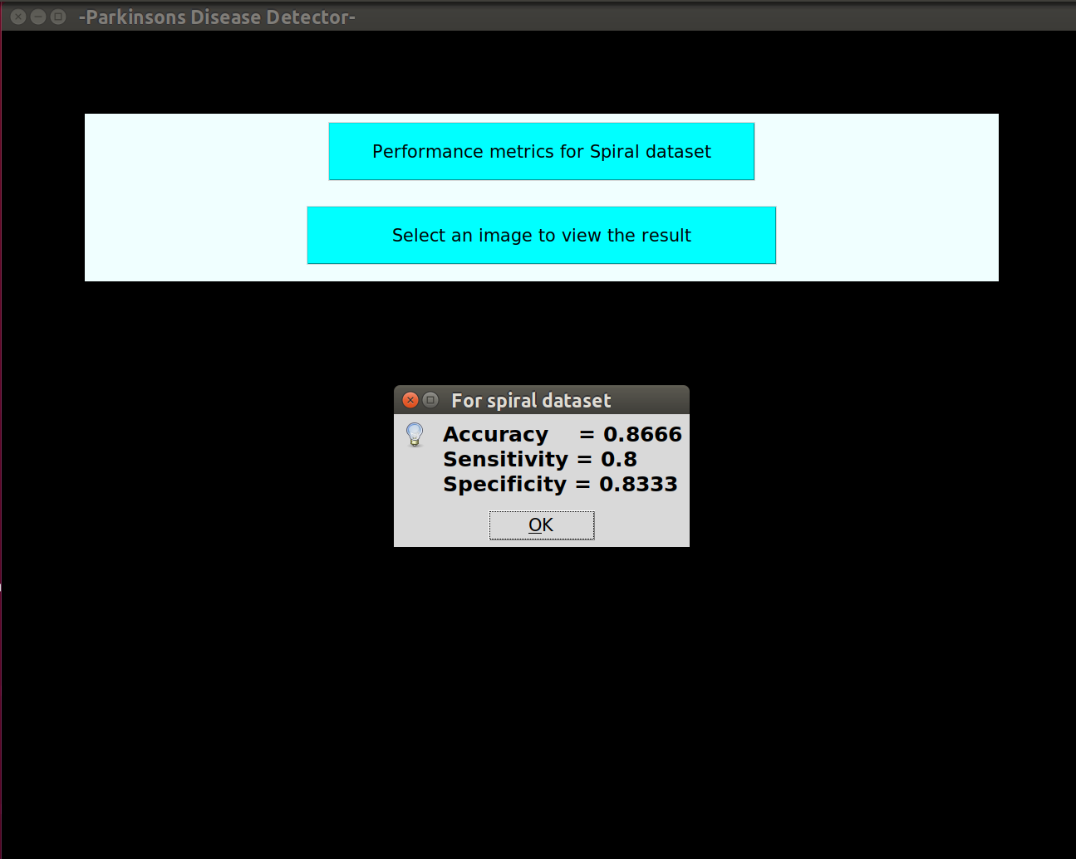
Results And Screenshots
Figure 15: Message box showing performance metrics for spiral dataset.

Slide 26
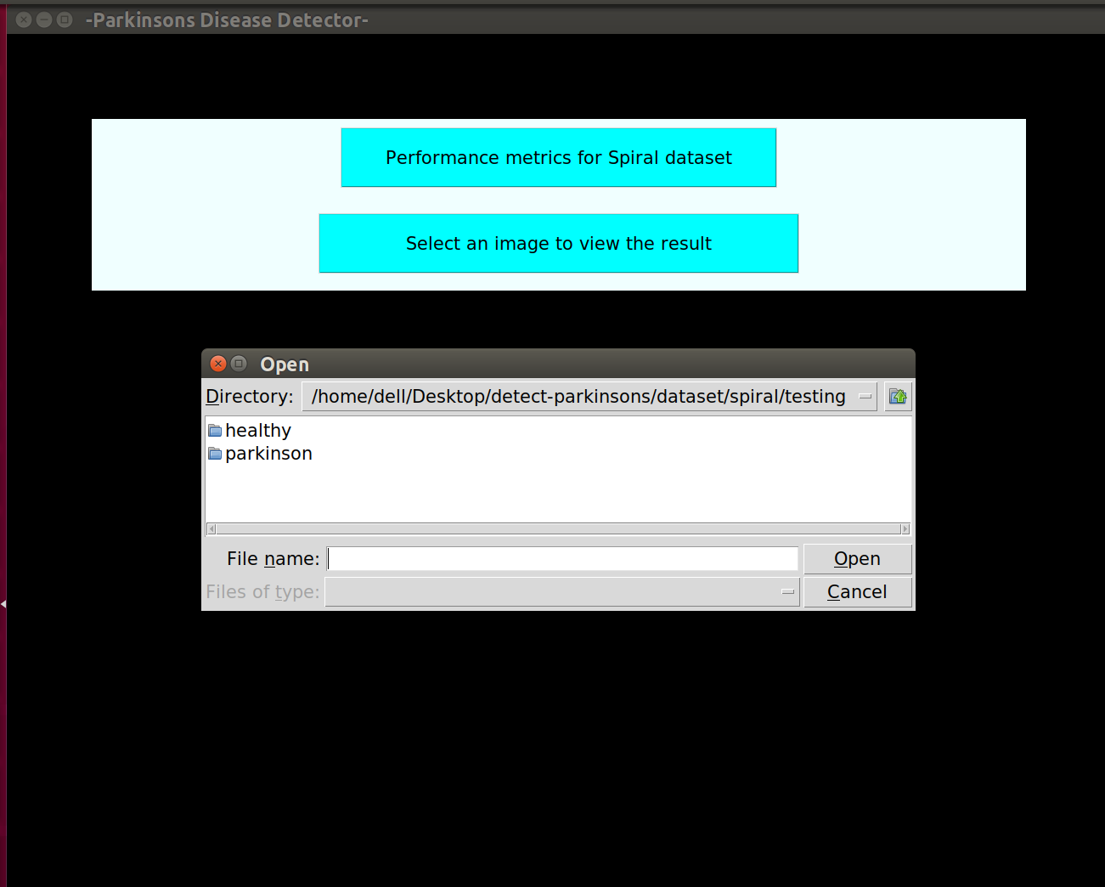
Results And Screenshots
Figure 16: File browser to select the spiral image.

Slide 27
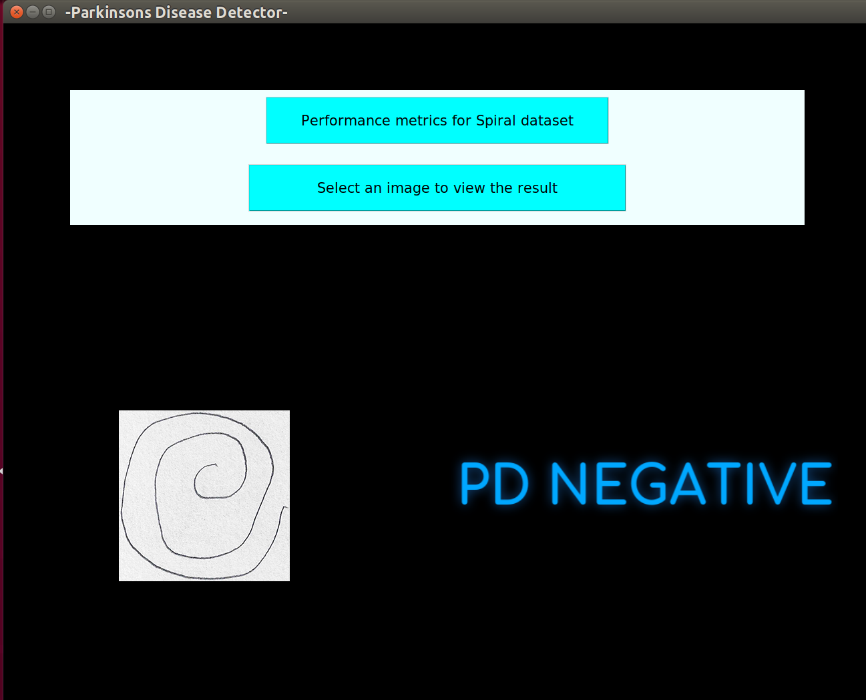
Results And Screenshots
Figure 17: Showing PD negative result for spiral image.

Slide 28
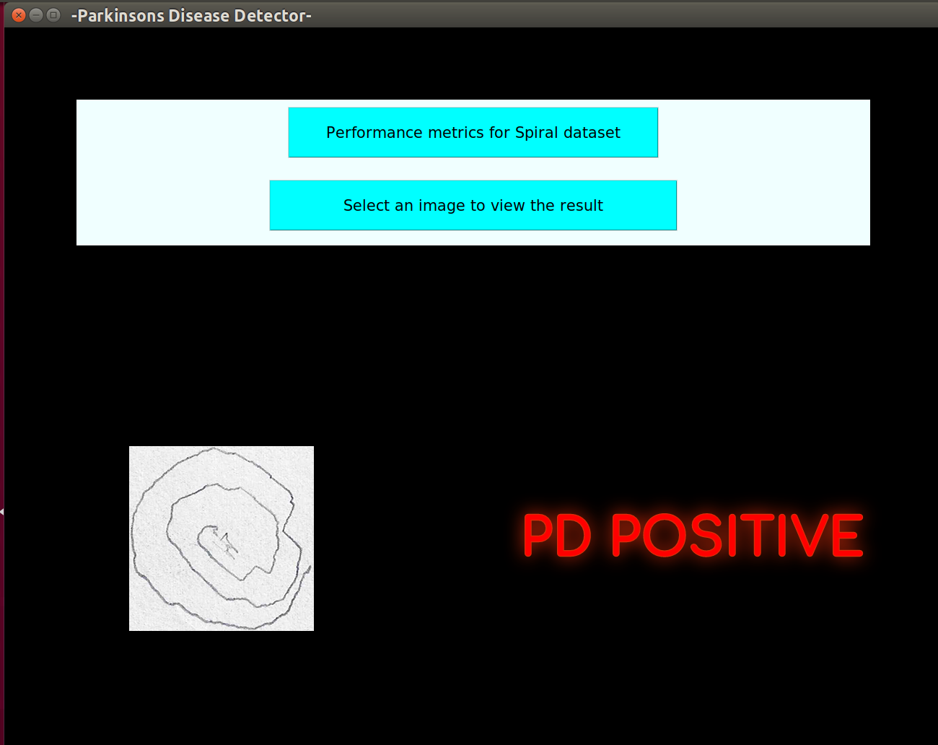
Results And Screenshots
Figure 18: Showing PD positive result for spiral image.

Slide 29
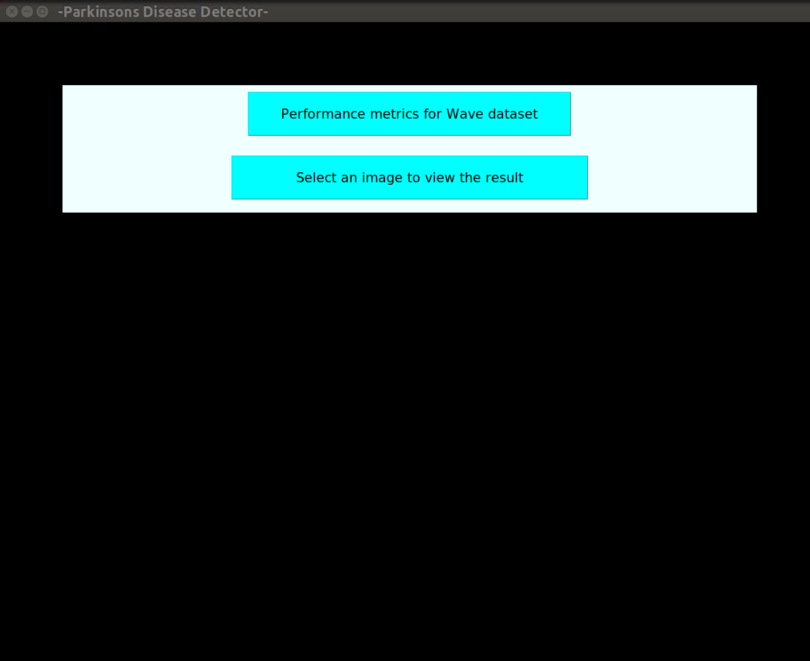
Results And Screenshots
Figure 19: Home screen for wave dataset.

Slide 30
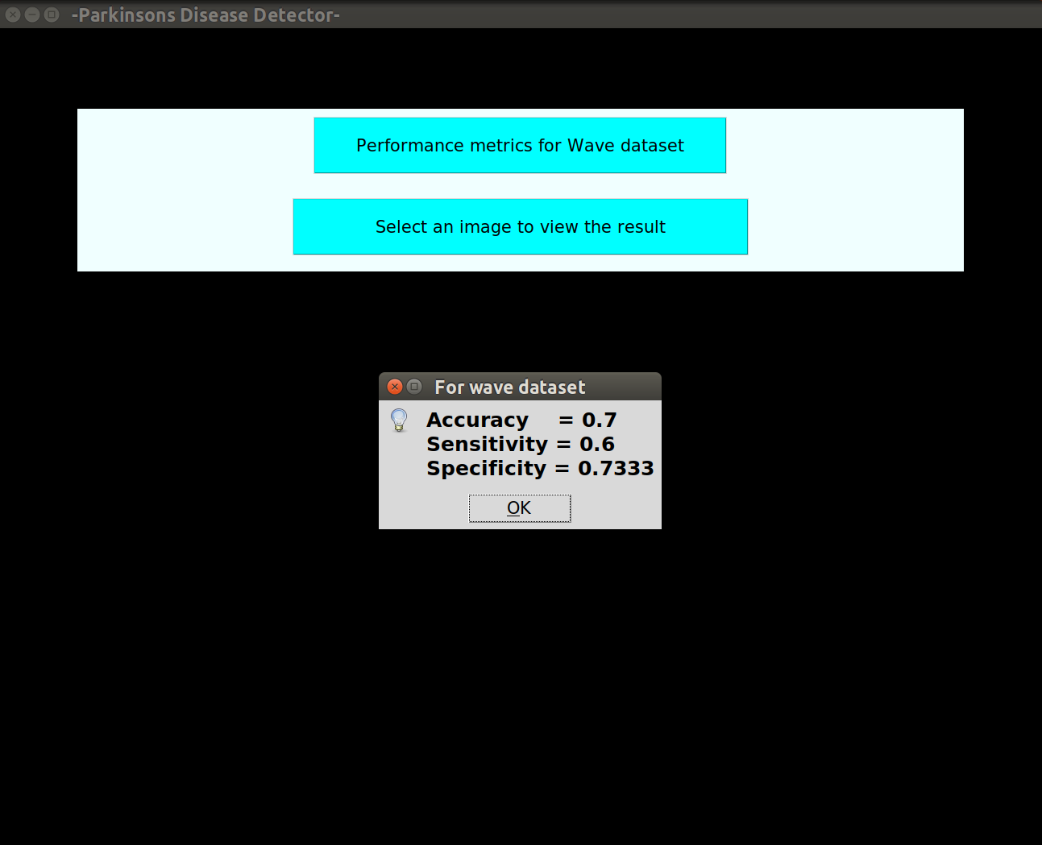
Results And Screenshots
Figure 20: Message box showing performance metrics for wave dataset.

Slide 31
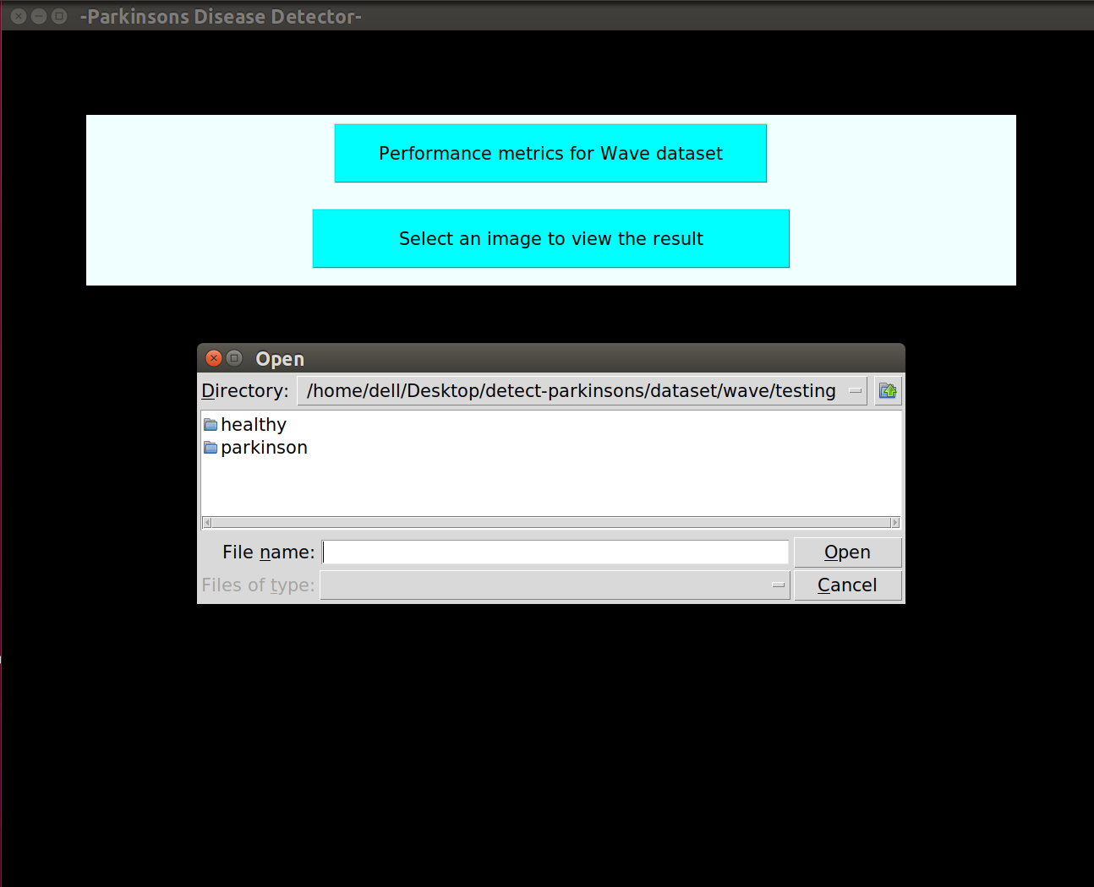
Results And Screenshots
Figure 21: File browser for spiral dataset.

Slide 32
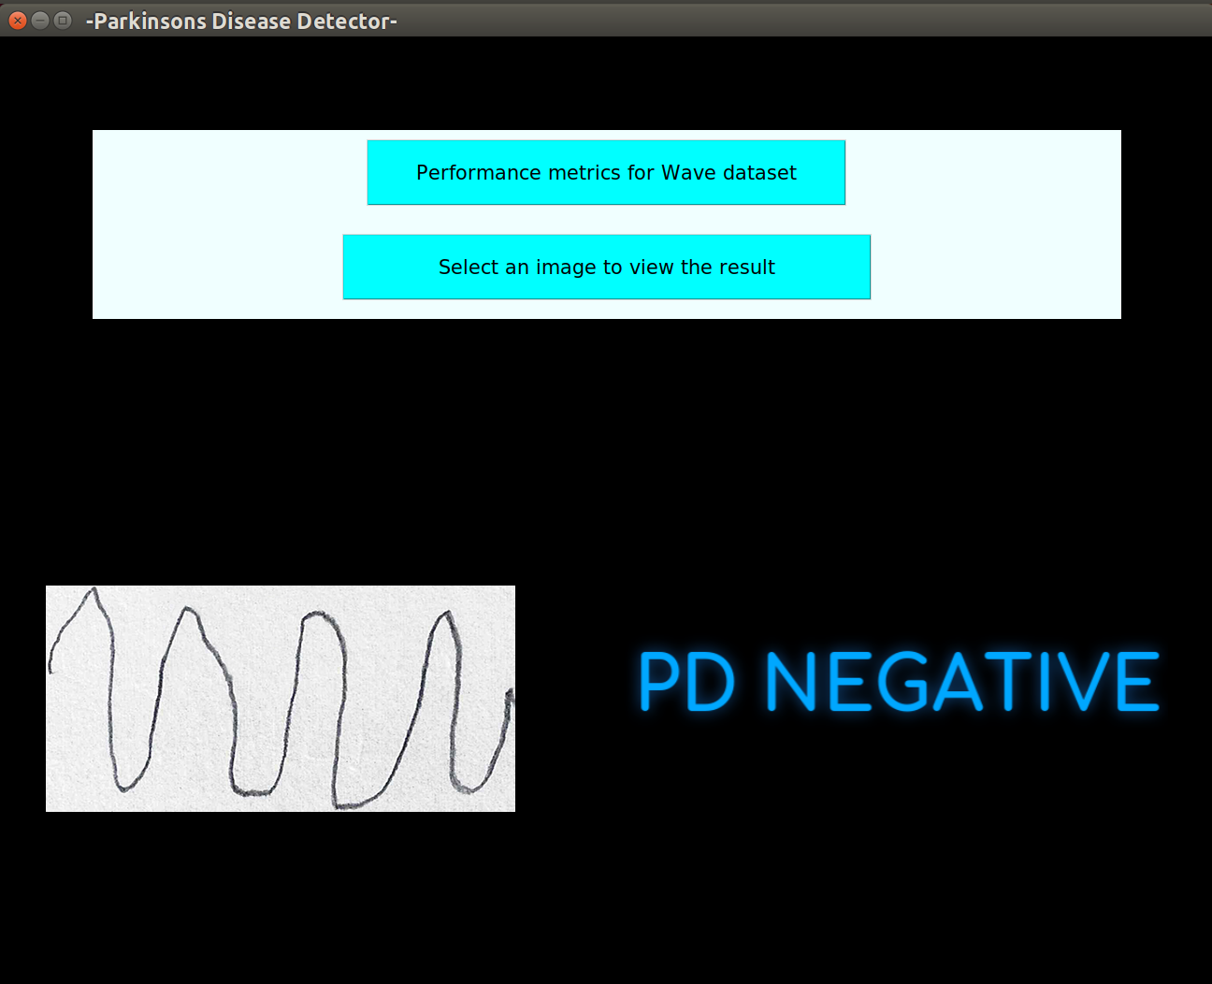
Results And Screenshots
Figure 22: Showing PD negative result for wave image.

Slide 33
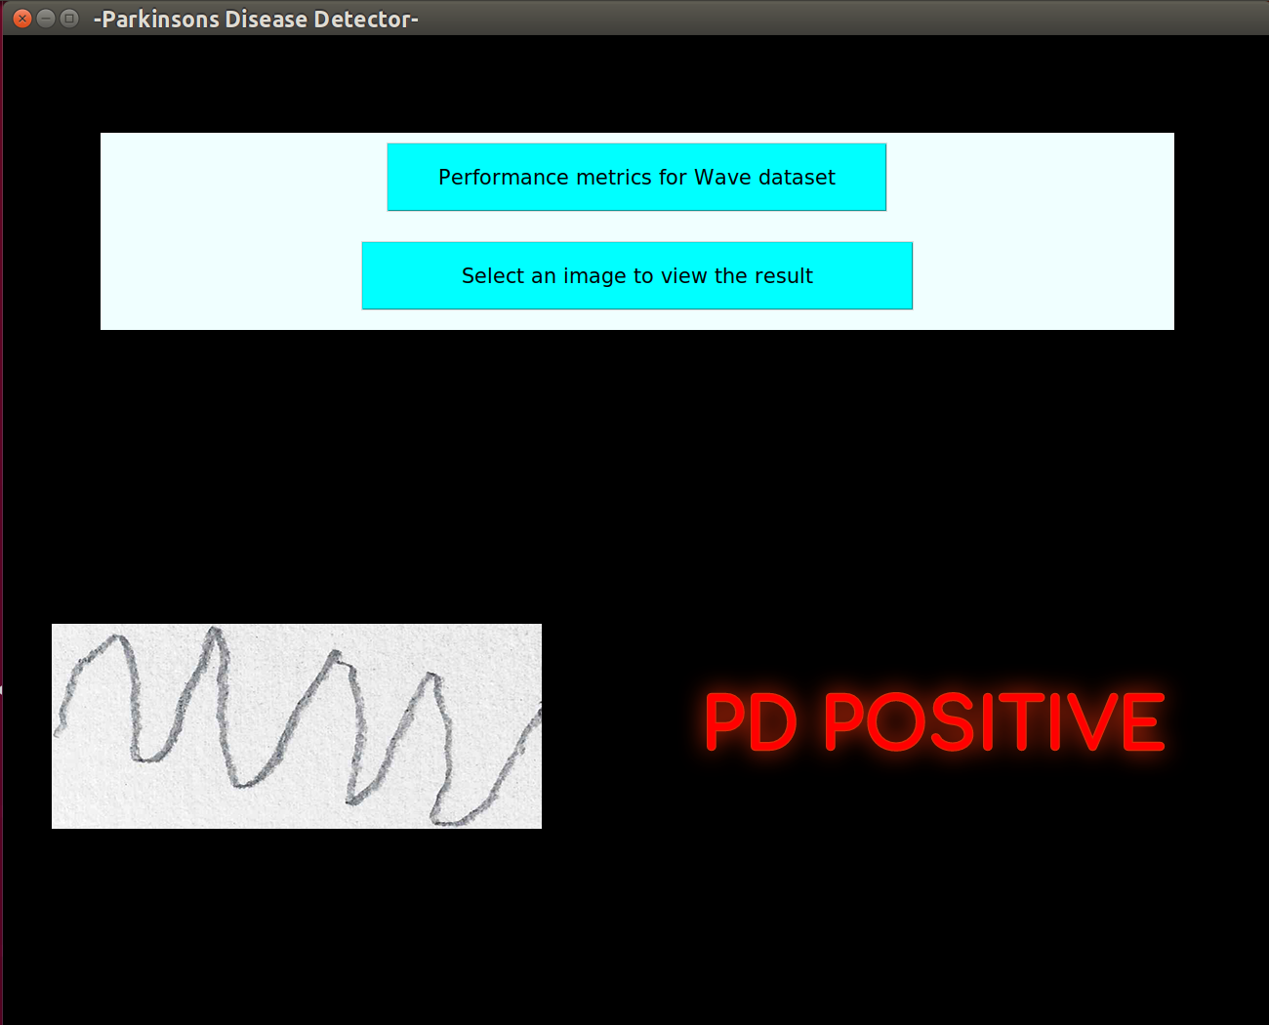
Results And Screenshots
Figure 23: Showing PD positive result for wave image.

Slide 34
Conclusion
The Computer Vision technique helped in easy processing and analysis of hand drawn images.
The Machine learning methodology helped in training a model to detect PD.
The system will be developed without additional hardware. Thus, reducing the overall cost.
PD detection at an earlier stage.
The system replaces the manual method of detecting PD at health care centres which requires expert lab technicians.

Slide 35
THANK YOU

