Slide 1
CitI Bridge Program 2019 Cummins College of Engineering for Women , Pune

Slide 2
Project #1 Clearing Feed Generation
Group Number 2:
Mentor Name : Suyog Wankhede
Group Members:
Simran
Komal
Rasi
Priyanka
Tanvi

Slide 3
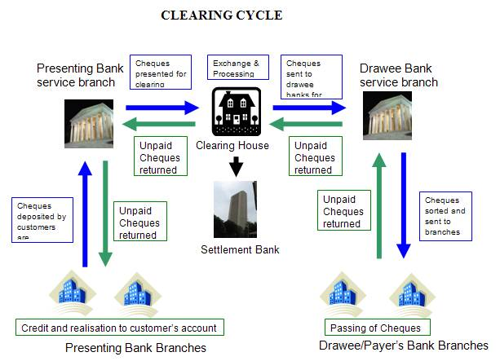
What is a Clearance?
Source :https://rahulcvijay.wordpress.com/2010/12/06/clearing_system_in_indian_banking/

Slide 4
Feed File
A data feed is an ongoing stream of structured data that provides users with updates of current information from one or more sources.
In our project we will be uploading a Feed File From a Excel Document.

Slide 5
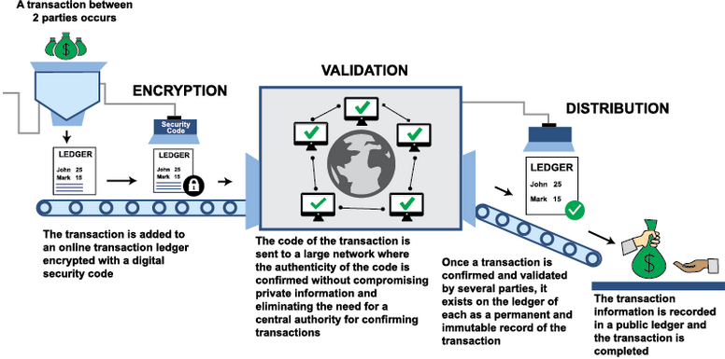
Project Objective:
Generate The Feed File Towards Clearing System in a Specific Format Based on the Input Transactions to the System.
Moneycontrol.com

Slide 6
Assumptions Made
Mentioned Account with basic details entered are authenticated and do exist.
Balance is checked before transaction is processed.
Payer and Payee accounts mentioned do exist.
Uploaded file is CSV .

Slide 7
Flow Of Our Project
Validate Fail
Login Page:
Name:
Password:
Register:
Reset:
Upload Page:
If File’s validation Fails it is displayed here
Upload
Validate
On Validate Fail
On Validate Fail
On Upload
On Validate
Upload
Validate Successful
Validate Success
Validate Fail
On Success
Feed Generated
Validate Successful
On Validate Success
Validate
Success
Validate Fail

Slide 8




ToolSet Used
FrontEnd
JavaScript
HTML
BackEnd
PHP
MySQL

Slide 9
Supporting Deliverables
After Uploading, File is Validated.
Transaction File is proceeded, and whether valid or invalid transaction is displayed in table format.

Slide 10
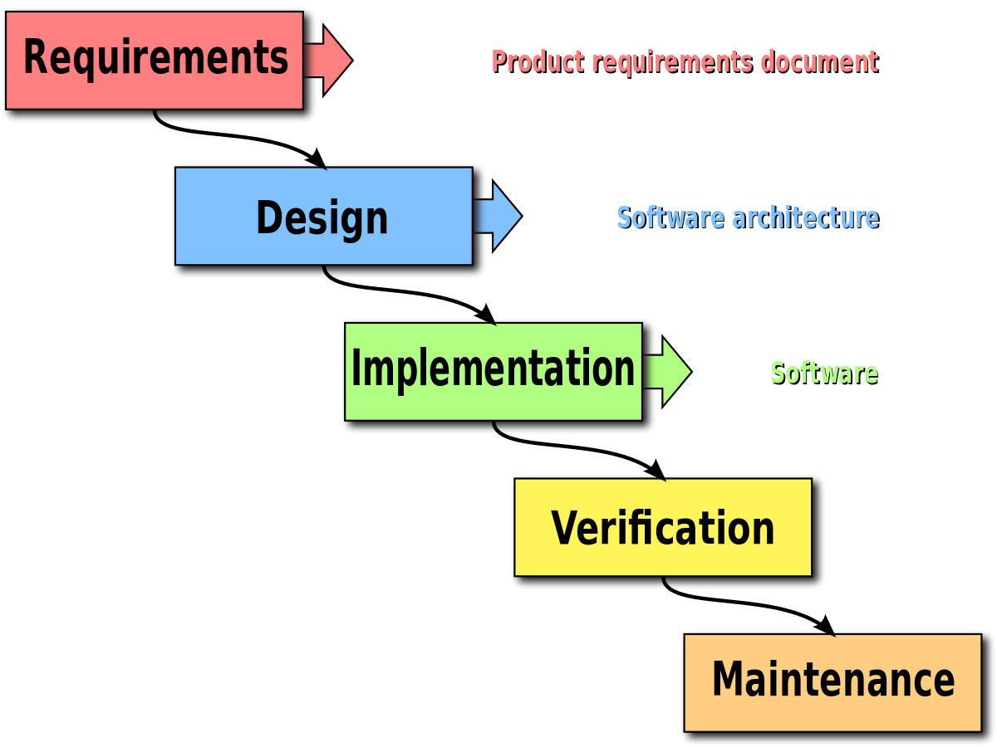
Model Used : WaterFall
Wikipedia

Slide 11
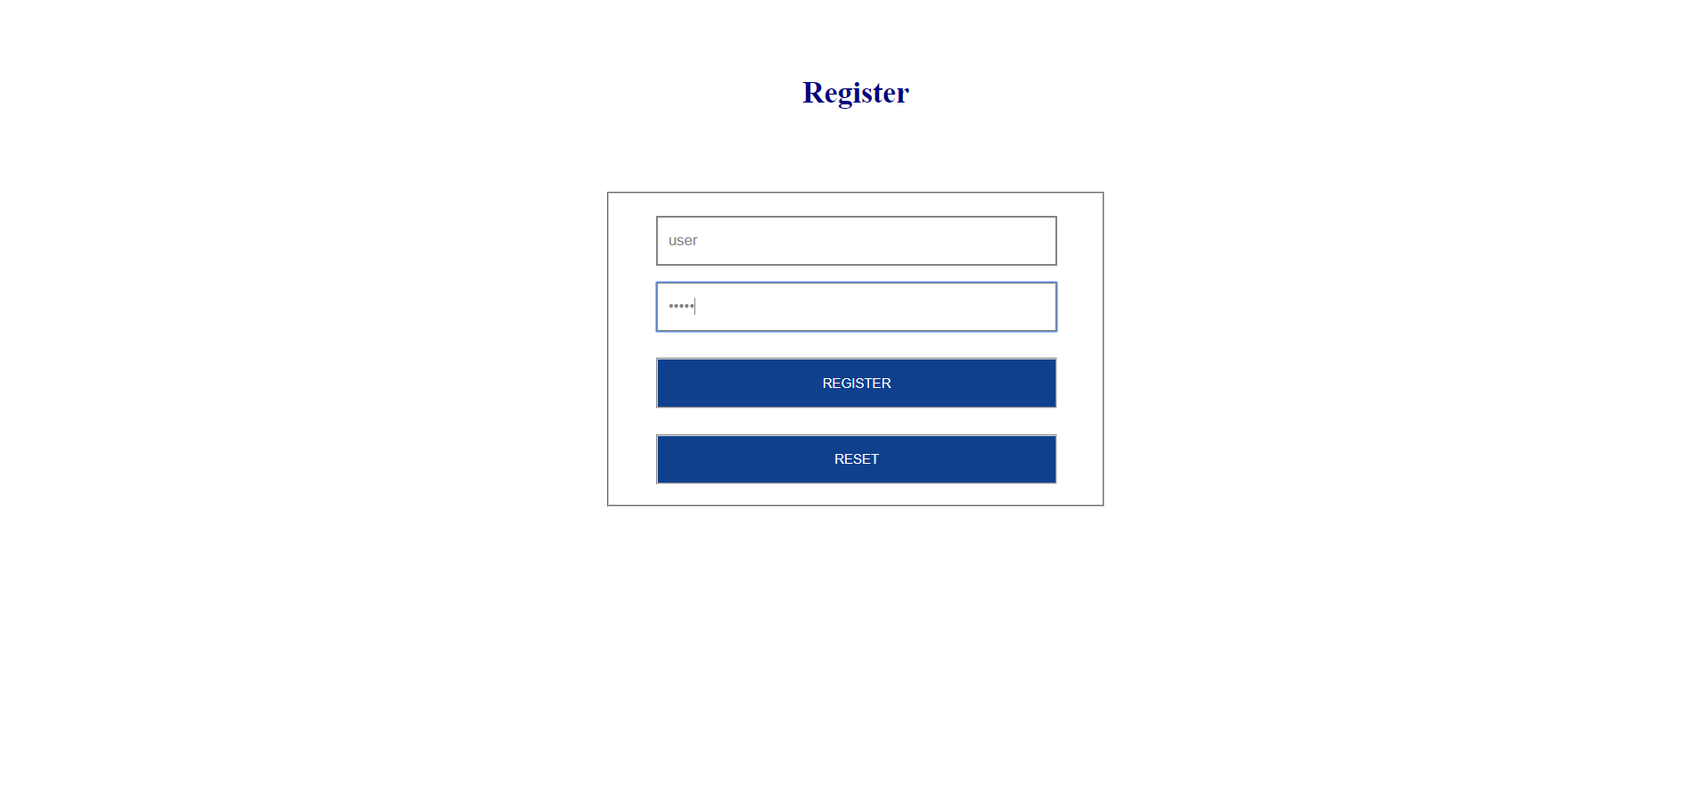
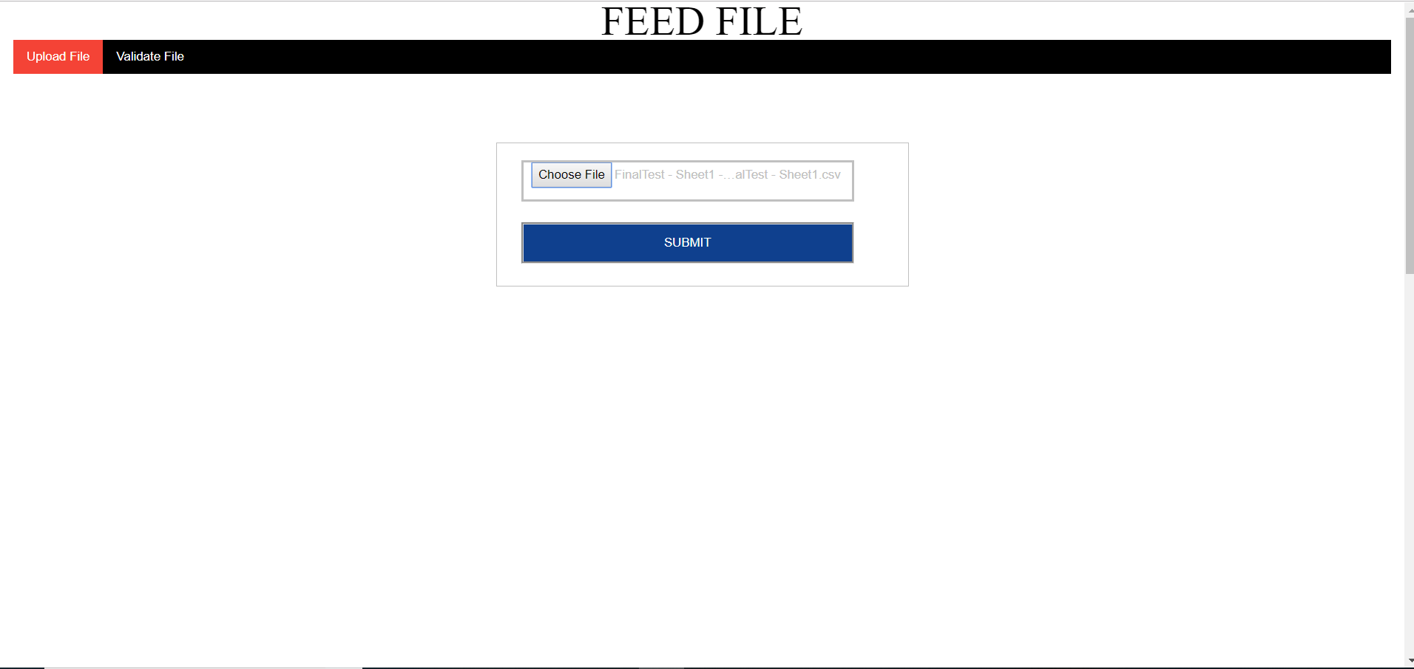
Working Project

Slide 12
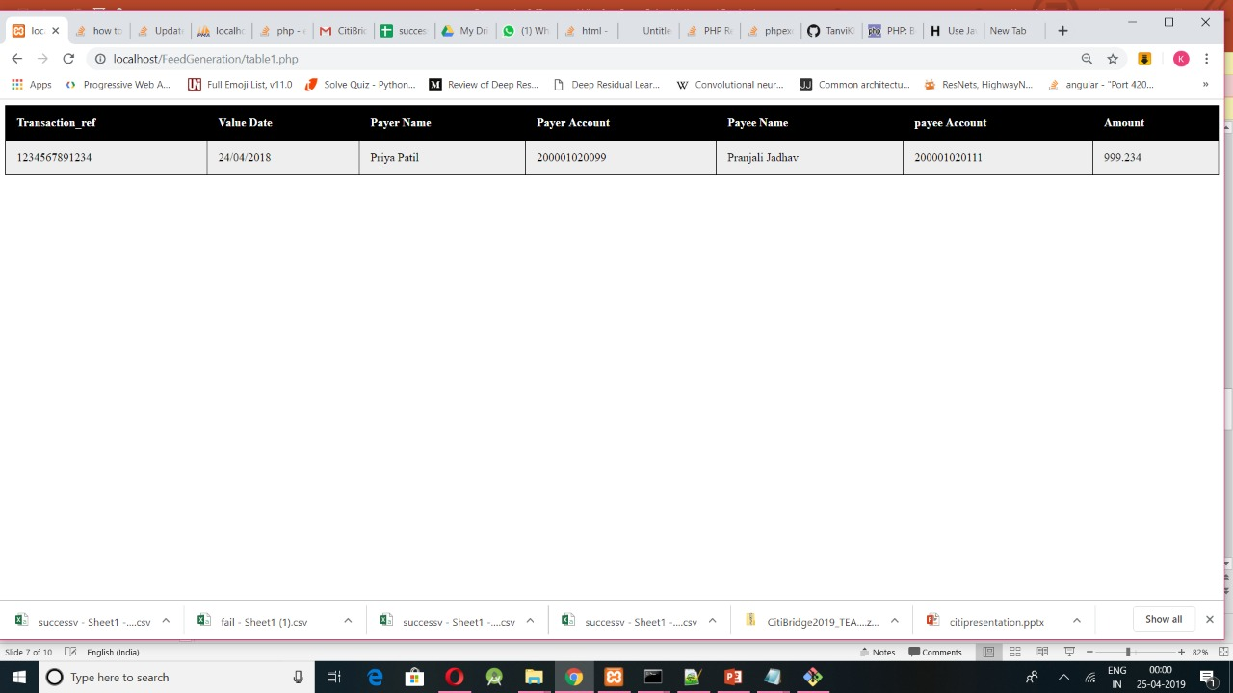
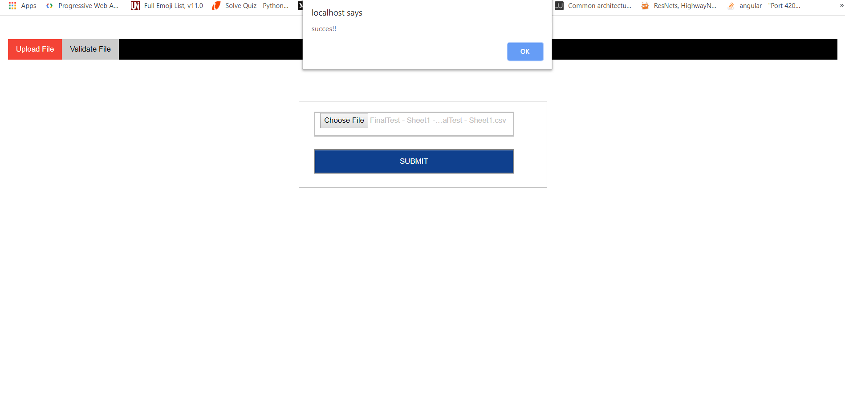

Slide 13

Transaction File can be managed , that is we can manage the overall status of file in terms of number of transactions passed and validations failed.
Can be scanned for multiple records.

Slide 14


