Slide 1
Capstone Project
~Tanvi Kulkarni

Slide 2

About the website
Saree.com is an e-commerce platform specializing in ethnic wear, featuring a diverse range of sarees, lehenga cholis, kurtis, and gowns.
Users can easily browse the latest designer dresses and filter options by price, colour, style, and fabric type, among others.
The site includes a convenient cart functionality for easy selection and offers multiple secure payment options for a smooth checkout experience.

Slide 3




Milestones
Identify 5 scenarios and create 50+ test cases, both positive and negative
Perform manual testing and execute all the test cases associated with the scenarios
Write automation test scripts using Selenium/TestNG for 80% scenarios and using Cucumber/ TestNG for remaining 20%
Use testng.xml, POM, Page Factory, Extent Reports and take screenshots for failed test cases

Slide 4










Technology stack used

Slide 5
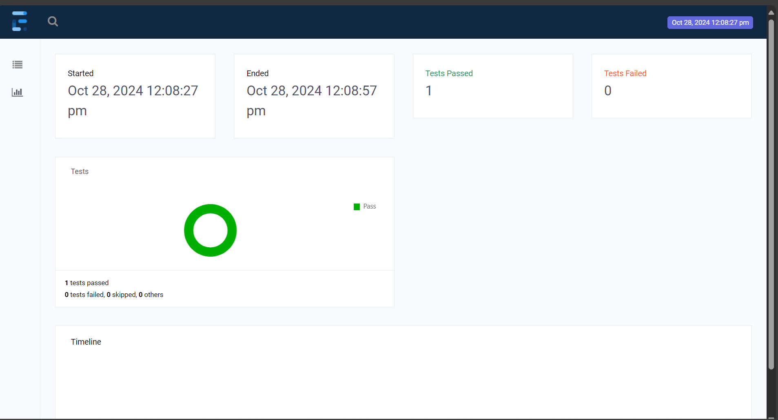
Selenium: Extent Reports(1)

Slide 6
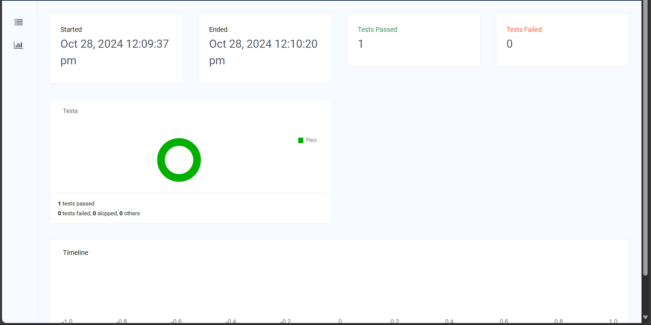
Selenium: Extent Reports(2)

Slide 7
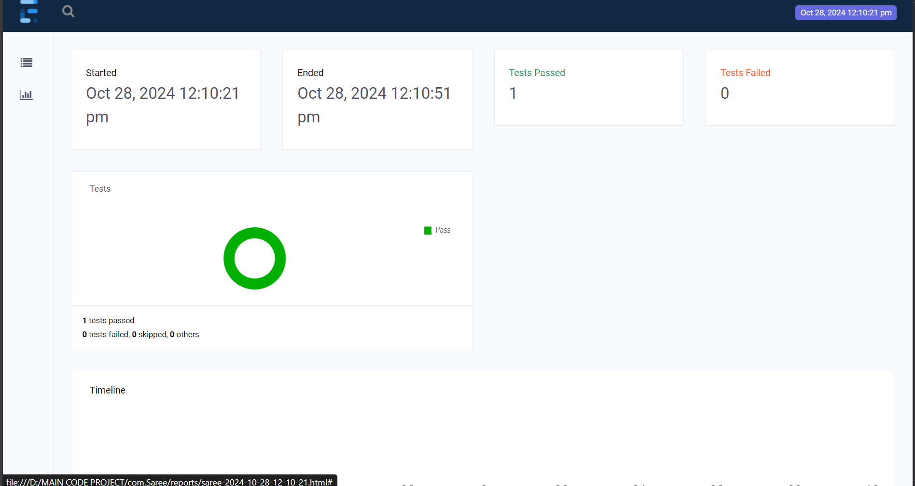
Selenium: Extent Reports(3)

Slide 8
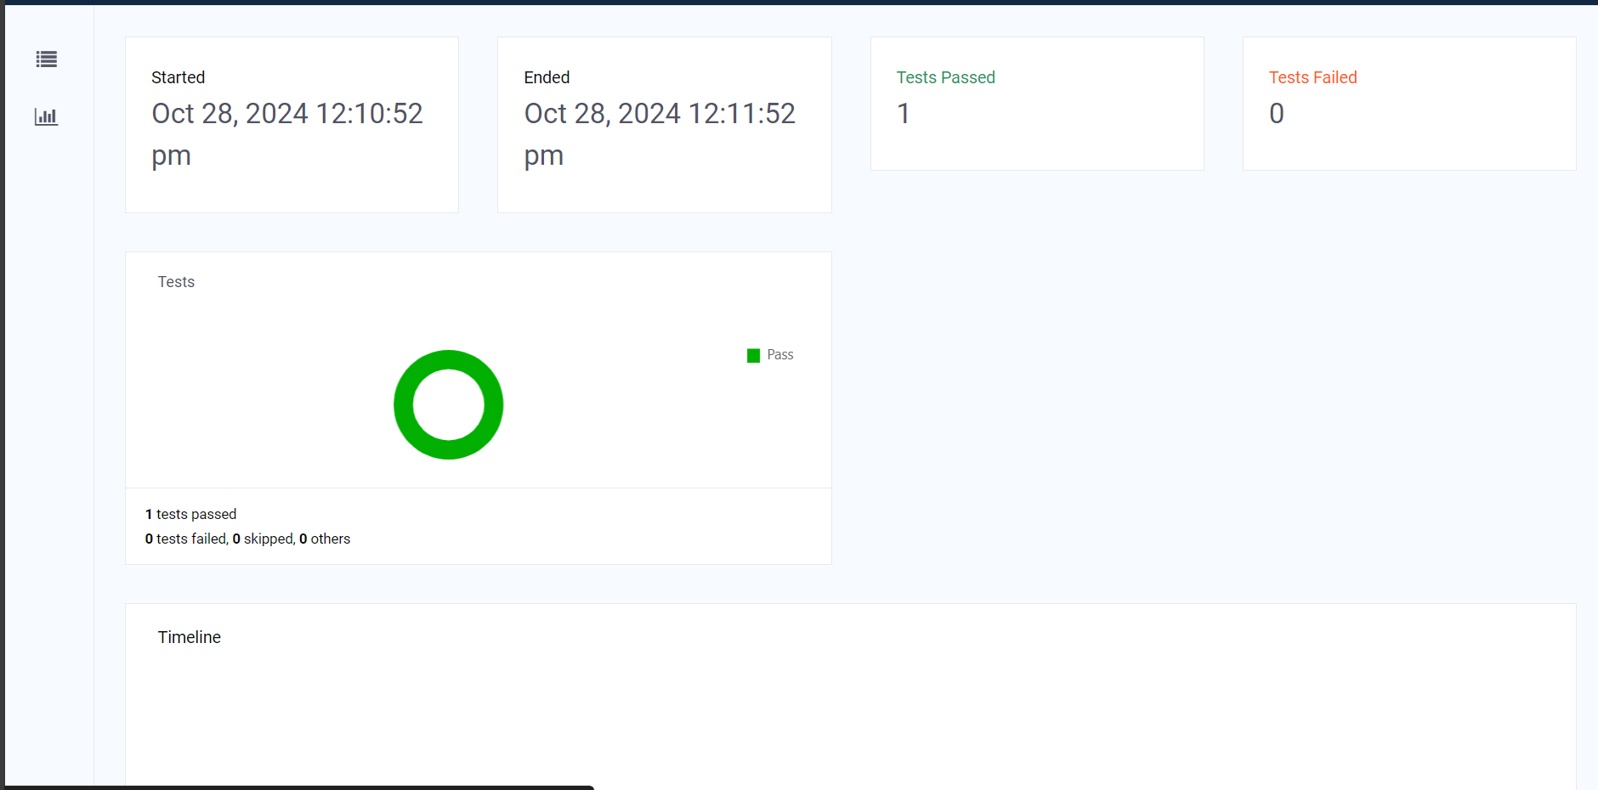
Selenium: Extent Reports(4)

Slide 9
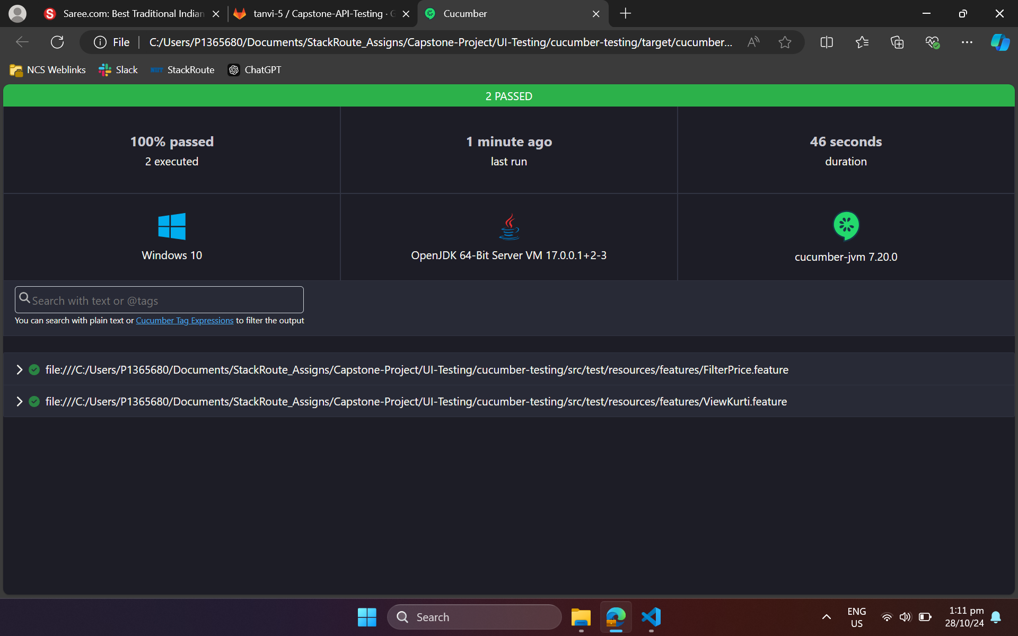
Cucumber Reports(1)

Slide 10
THANK YOU

