Slide 1
PREDICTING ELECTION RESULTS THROUGH SOCIAL NETWORK ANALYSIS

Slide 2
SOCIAL MEDIA
Social media has exploded as a category of online discourse where people create content, share, bookmark and network at a prodigious rate. Examples include Facebook, MySpace, Digg, Twitter on the academic side. Because of its ease of use, speed and reach, social media is fast changing the public discourse in society and setting trends and agendas in topics that range from the environment and politics to technology and the entertainment industry.

Slide 3
SENTIMENT ANALYSIS
Sentiment Analysis is the process of determining whether a piece of writing or opinion is positive, negative or neutral. It’s also known as opinion mining, deriving the opinion or attitude of a speaker. A common use case for this technology is to discover how people feel about a particular topic.
The applications of sentiment analysis are broad and powerful. The ability to extract insights from social data is a practice that is being widely adopted by organisations across the world.

Slide 4
OBJECTIVE
The impact of social media in elections will be studied extensively in this project. Our objective here is to study the social network of the two prominent election candidates- Hillary Clinton and Donald J. Trump. The main aim of the project is to understand the reach of Hillary Clinton and Donald J. Trump among Twitter users and how their social media strategy is helping or affecting their election campaign.
Twitter provides us with live access to opinions about the election across the globe. We are analyzing recent tweets regarding the top candidates in the 2016 election to predict the public sentiments towards each candidate.
Our project attempts to solve the real world problem of understanding the current sentiment towards election candidates based off the public’s live opinions and emotions rather than off of smaller, localized polls typically done by mainstream media corporation.

Slide 5
APPLICATION OF PROJECT
Apart from prediction of election results, sentiment analysis enables enterprises to understand consumer sentiments in relation to specific products/services. Moreover, these insights could be used to improve their products and services by gauging consumers’ comments and feedback using sentiment analysis. In the long run, sentiment analysis, if implemented the right way can aid business enterprises in improving the overall consumer experience, enhance brand image and propel business growth.

Slide 6
RESULTS OBTAINED
After performing sentiment analysis on the tweets we extracted using R, we concluded that Donald Trump was mostly likely to win the Presidential Elections.
Based on a list of pre defined positive and negative words we determined whether a tweet is positive, negative or neutral.
After analyzing the sentiment scores and the performing a comparative analysis we came to our conclusion.

Slide 7
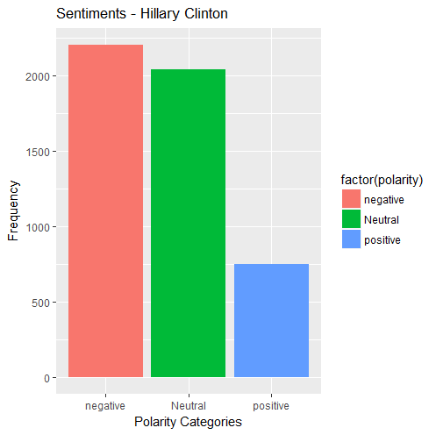
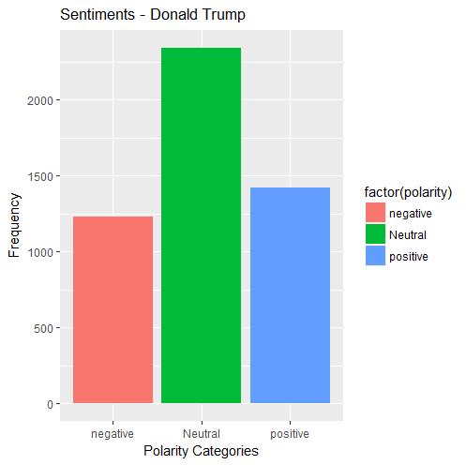
As evident from the above sentiment graphs, Donald Trump has fewer negative and higher number of positive tweets related to him.

Slide 8
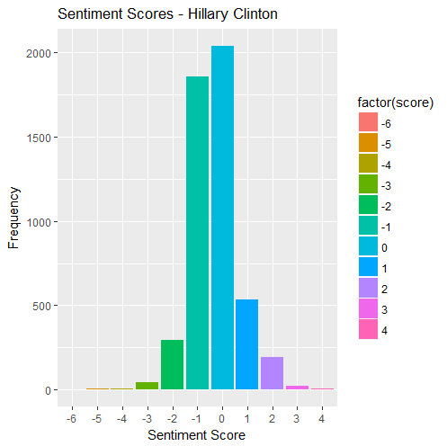
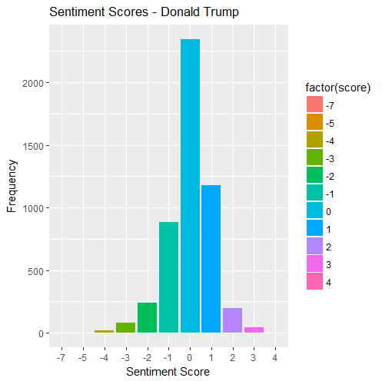
Sentiment scoring was performed as well which shows that Hillary Clinton’s scores were tending more towards the negative side.

Slide 9
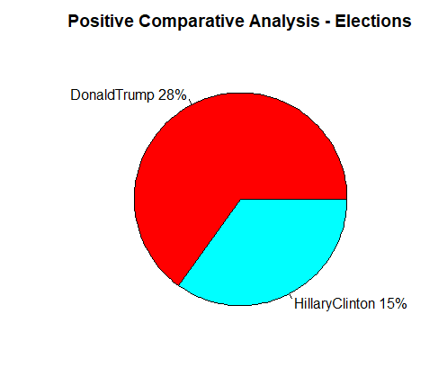
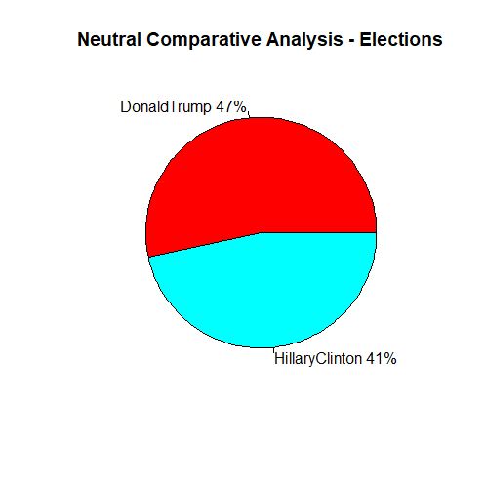
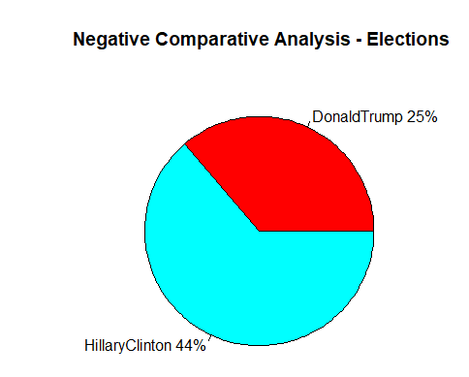
COMPARATIVE ANALYSIS

Slide 10
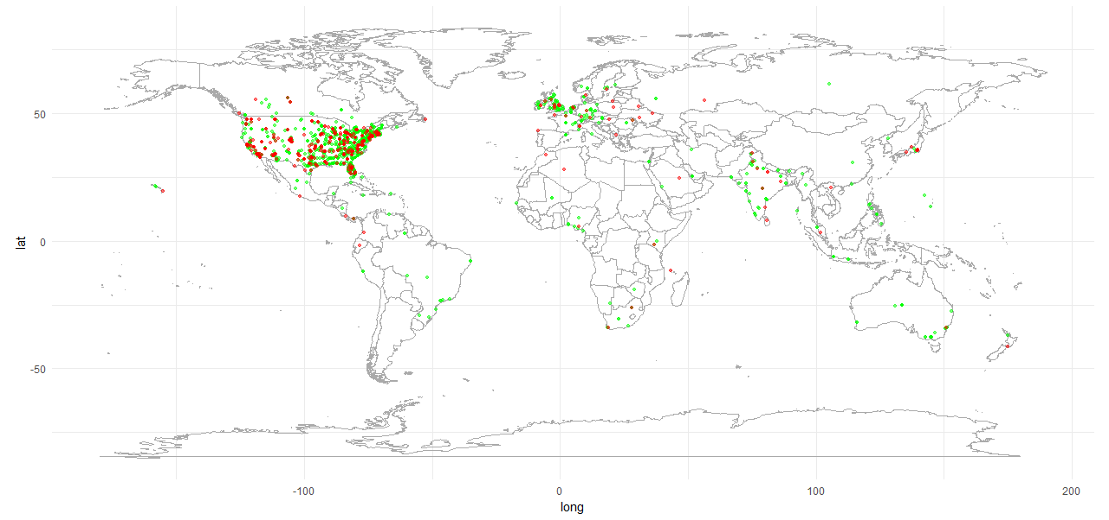
Here we have shown the tweets about the two candidates based on the locations. Using the tweet locations we have plotted them on a world map.

