Slide 1

Project Title - Healthcare Analytics for Doctor Visits
Tanvi Praveen Shikhari

Slide 2

PROBLEM STATEMENT
Healthcare data contains valuable information about patients, their health conditions, and their utilization of medical services. However, analyzing this data is necessary to identify patterns in doctor visits and understand how factors such as age, gender, income, illness, healthcare access, and chronic health conditions are associated with healthcare utilization. This project aims to analyze the given healthcare dataset using exploratory data analysis and visualization techniques to identify meaningful patterns in doctor visits and provide insights into the factors associated with healthcare utilization.

Slide 3
Project Description
This project focuses on analyzing healthcare data to understand patterns in doctor visits and the factors associated with healthcare utilization. The dataset contains information related to patients’ doctor visits, gender, age, income, illness, reduced activity, health conditions, healthcare access, and chronic illnesses. Exploratory Data Analysis techniques are used to examine the dataset, perform statistical analysis, and identify relationships between different variables. Data visualization techniques are also used to represent the findings clearly and understand patterns in doctor visits based on demographic and health-related factors.

Slide 4

WHO ARE THE END USERS?
Healthcare Providers
Understand patterns in patient healthcare utilization.
Identify groups with higher healthcare needs.
Hospitals & Clinics
Support healthcare resource planning.
Understand patient visit patterns.
Healthcare Analysts
Analyze demographic and health-related trends.
Generate insights from patient data.
Researchers
Study relationships between health conditions and healthcare usage.
Healthcare Management
Use data-driven insights for planning and decision-making.

Slide 5

Technology Used
Programming Language
Python
Libraries
Pandas — Data loading and manipulation
NumPy — Numerical operations
Matplotlib — Data visualization
Seaborn — Statistical visualization
Analysis Techniques
Exploratory Data Analysis (EDA)
Descriptive Statistics
Univariate Analysis
Multivariate Analysis
Data Visualization
Environment
Google Colab

Slide 6
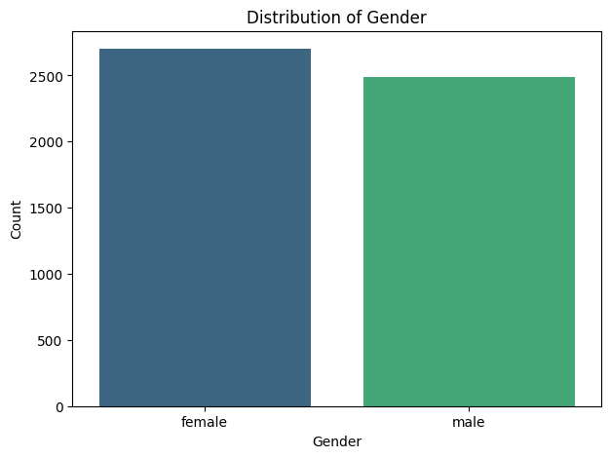
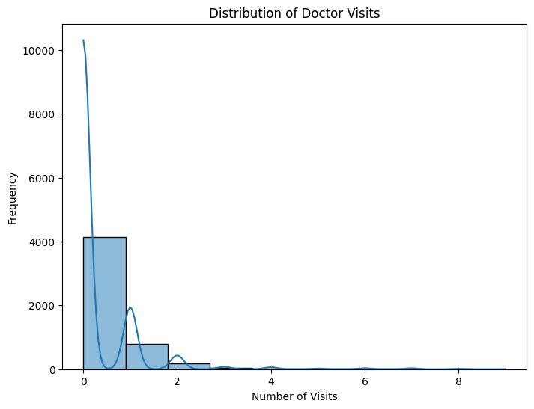
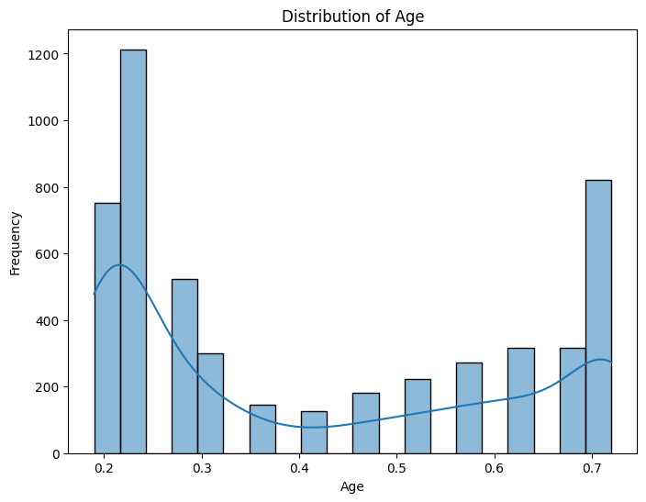
RESULTS
Demo Link

Slide 7
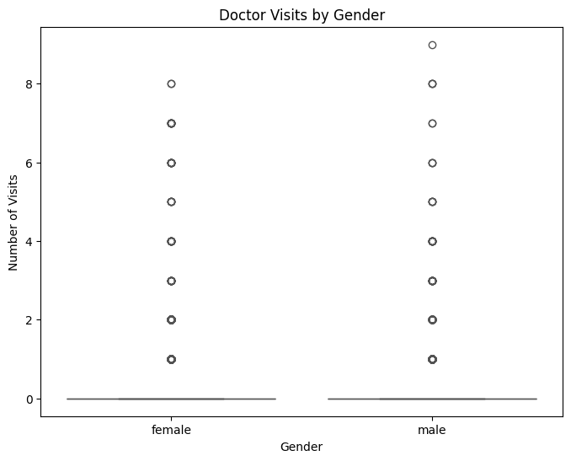
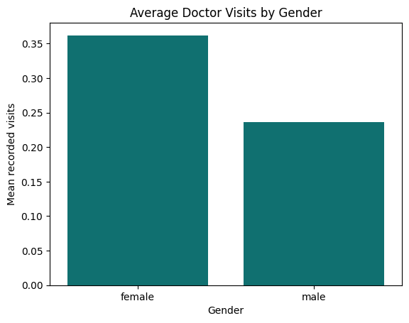
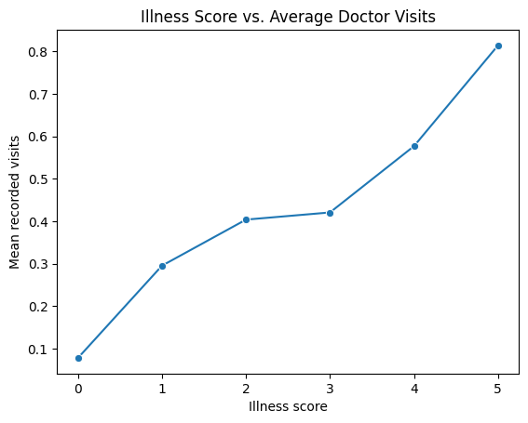
RESULTS
Demo Link

Slide 8
Thank you
.
.

