Slide 1
CA3 MINI PROJECT
Explainable Multi Label Classification
of Cardiac Abnormalities
from Electrocardiograms
Using Lightweight Deep Learning
Tanvi Bandebuche and Maheen Meshram
Computer Science and Engineering
Symbiosis Institute Of Technology, Nagpur, India
Notes:
Authors: Tanvi Bandebuche and Maheen Meshram. Emails: tanvi.bandebuche.btech2023@sitnagpur.siu.edu.in and maheen.meshram.btech2023@sitnagpur.siu.edu.in. The title and study match the six-page IEEE report. This presentation reports internal academic evaluation, not clinical deployment.

Slide 2
Problem and project objectives
One ECG can carry several diagnostic labels.
01
Classify five diagnostic categories from a 10-second, 12-lead ECG.
02
Compare a compact CNN with residual, inception, and logistic baselines.
03
Measure held-out performance, CPU latency, and model sensitivity.
NORM: normal ECG MI: myocardial infarction STTC: ST/T change CD: conduction disturbance HYP: hypertrophy
02
Notes:
ECGs may contain overlapping diagnostic labels. Source: Wagner et al., Scientific Data 2020, https://doi.org/10.1038/s41597-020-0495-6. Explain that five independent sigmoid scores allow more than one label. Research question: can a compact CNN balance predictive performance and CPU inference cost under a controlled comparison?

Slide 3
Research context and study scope
Research direction | Relevance to this project
PTB-XL benchmark [2] | Residual and inception network comparison families
Self-supervised ECG learning [3] | Context for learning useful waveform representations
PTB-XL+ [8] | Published feature and waveform reference scores
Explainability [6] and MERL [15] | Context for model interpretation and multimodal learning
Our scope: controlled supervised comparisons on one public dataset.
Citation numbers match the IEEE report. Published studies provide context rather than matched reproductions.
03
Notes:
Sources: Strodthoff et al., IEEE JBHI 2021, https://doi.org/10.1109/JBHI.2020.3022989. Mehari and Strodthoff 2022, https://doi.org/10.1016/j.compbiomed.2021.105114. Strodthoff et al. 2023, https://doi.org/10.1038/s41597-023-02153-8. Liu et al. 2024 MERL, https://proceedings.mlr.press/v235/liu24bg.html. van de Leur et al. 2022, https://doi.org/10.1093/ehjdh/ztac038. The report cites 18 sources, including 15 research papers from 2022 onward. Our baselines compare architecture families rather than reproduce published checkpoints.

Slide 4
PTB-XL dataset and patient partitions
21,388 eligible recordings
12 leads × 1,000 samples at 100 Hz
Partition | Official folds | ECGs | Patients
Training | 1–8 | 17,084 | 14,823
Validation | 9 | 2,146 | 1,917
Test | 10 | 2,158 | 1,877
411 exclusions from 21,799 source records. No patient overlap or exact waveform duplicates across partitions.
04
Notes:
Source: PTB-XL v1.0.3 release, https://doi.org/10.13026/kfzx-aw45. Project evidence: results/data-audit.json and results/data-provenance.json. 21,799 source records minus 411 without mapped diagnostic categories leaves 21,388. Official stratified folds 1–8 train, 9 validation, 10 test. Label mapping uses diagnostic-code presence rather than a likelihood threshold. No patient overlap or exact waveform duplicates across partitions.

Slide 5
Experiment workflow
01
Download 100 Hz waveforms and verify release SHA-256 checksums.
02
Apply official folds and compute normalization on training records.
03
Fit models and select checkpoints and thresholds on validation data.
04
Freeze selections before evaluating the held-out test fold.
05
Save predictions, metrics, checkpoints, and occlusion measurements.
Training statistics and validation selections remain separate from the test evaluation.
05
Notes:
Project code: ecg_project/data.py and ecg_project/experiment.py. Evidence: results/data-provenance.json, results/data-audit.json, results/training-manifest.json, results/frozen-selection.json and results/test-access-log.json. Training data alone determine normalization and class weights. Validation data determine checkpoints and thresholds. All selections freeze before the first test inference. No test result triggered retraining.

Slide 6
Compact convolutional network
Stage | Channels / units | Time samples
Input waveform | 12 leads | 1,000
Convolution 1, kernel 15 | 64 filters | 500
Convolution 2, kernel 9 | 128 filters | 250
Convolution 3, kernel 5 | 192 filters | 125
Global pooling and dense head | 192 pooled, then 64 | 1
Independent sigmoid outputs | 5 categories | 1
221,573 trainable parameters. Batch normalization and ReLU in every convolution block. Dropout: 0.2.
06
Notes:
Source: ecg_project/models.py, CompactCNN. Every convolution block uses batch normalization and ReLU. Kernels are 15, 9 and 5. Stride is 2 in all three blocks, with symmetric padding. Each model receives normalized waveform tensors of shape batch × 12 × 1000. The head uses a 64-unit dense layer, ReLU, dropout 0.2 and five output logits. Sigmoid probabilities are independent. Exact trainable count: 221,573.

Slide 7
Learning objective and decision thresholds
Train-only normalization
z = (x − μ) / (σ + ε)
Each lead uses frozen training statistics μ and σ.
Weighted binary cross entropy
ℓ = −w y log(p) − (1 − y) log(1 − p)
Training class counts determine w.
Validation-selected thresholds
Independent sigmoid scores allow overlapping labels.
Validation F1 selects one threshold per category.
07
Notes:
Source: ecg_project/experiment.py and configs/protocol.json. Normalization uses per-lead means and standard deviations from training data, epsilon 1e-6. Weighted binary cross entropy uses the training negative-to-positive ratio per category. Actual implementation uses BCEWithLogitsLoss for numerical stability. AdamW optimizes logits. Sigmoid scores are uncalibrated. Validation F1 selects thresholds from 0.05 to 0.95 in steps of 0.01, ties favor larger threshold. Source report equations 1–5 define the notation.

Slide 8
Training protocol and comparison models
Setting | Fixed value
Optimizer / learning rate | AdamW / 0.001
Weight decay / batch size | 0.0001 / 64
Maximum epochs / patience | 25 / 5 epochs
Checkpoint selection | Highest validation macro AUROC
Seeds | 42, 123, 2026
Compute environment | Intel Core Ultra 5 245K, 32 GB RAM
12 neural runs and one logistic feature baseline
Windows, Python 3.12.14, PyTorch 2.14.1+cpu. Neural hyperparameters remain fixed across comparisons.
08
Notes:
Sources: configs/protocol.json, results/training-manifest.json, ecg_project/models.py, results/all-runs.csv. Compact CNN, 1D ResNet, InceptionTime CPU variant and the unweighted compact CNN each use seeds 42, 123, 2026: 12 neural runs total. Each run stops after 12–18 epochs under the fixed rule. The logistic baseline uses 96 waveform features and validation-selected C=0.1. CPU: Intel Core Ultra 5 245K, 14 cores, 32 GB RAM, four PyTorch threads per process, up to three training processes. Python 3.12.14 and PyTorch 2.14.1+cpu on Windows.

Slide 9
Measured performance on held-out patients
Model | Macro AUROC | Macro AP | Macro F1
Compact CNN, weighted | 0.920 ± 0.0016 | 0.802 ± 0.0045 | 0.737 ± 0.0025
1D ResNet | 0.914 ± 0.0018 | 0.793 ± 0.0028 | 0.722 ± 0.0022
InceptionTime variant | 0.914 ± 0.0004 | 0.795 ± 0.0023 | 0.726 ± 0.0024
CNN, unweighted | 0.920 ± 0.0029 | 0.807 ± 0.0043 | 0.740 ± 0.0088
Logistic features | 0.817 | 0.613 | 0.600
Class weighting did not improve average performance here.
Neural values: mean ± sample SD over three seeds. Logistic baseline: one fit. Test set: 2,158 ECGs.
09
Notes:
Sources: results/aggregate-results.json and results/logistic-test-results.json. Neural results are means ± sample standard deviation over seeds 42, 123, 2026. Logistic regression is one fitted baseline. AP is scikit-learn average precision. Macro metrics weight the five categories equally. The held-out fold contains 2,158 recordings from 1,877 patients. Differences are descriptive and do not establish statistical superiority.

Slide 10
CPU inference cost and model size
Trainable parameters
Compact CNN
221,573
1D ResNet
244,005
InceptionTime variant
115,729
Batch size 1, four CPU threads. Average of checkpoint medians across seeds. Model forward pass only.
10
Notes:
Sources: results/aggregate-results.json and results/runs/*/test-results.json. Values average each checkpoint median across three seeds. Batch size one, four CPU threads, 50 warmups, 500 timed forward calls per checkpoint. Timing excludes disk access, preprocessing and explanation generation. These are observed CPU timings, not clinical workflow latency. Compact CNN has 221,573 parameters, ResNet 244,005, InceptionTime variant 115,729.

Slide 11
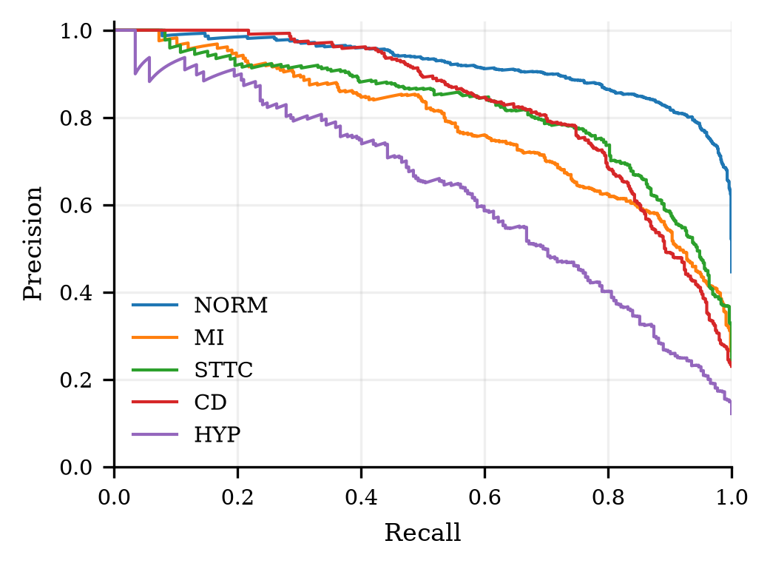
Category errors and uncertainty
Hypertrophy is harder
HYP F1: 0.592
HYP recall: 0.615
262 positive test labels
Selected checkpoint AUROC
0.9178
95% patient-bootstrap interval
0.9099–0.9253
Precision–recall curves and category scores use the selected weighted compact CNN, seed 42.
11
Notes:
Sources: results/per-class-results.csv and results/runs/compact_cnn_seed42/test-results.json. Detailed checkpoint is compact_cnn_seed42, selected by validation AUROC among weighted seed-42 candidates before test access. Patient-bootstrap 1,000 resamples gives test macro AUROC 0.9178, 95% CI [0.9099, 0.9253]. These describe one checkpoint and not seed averages. HYP test support 262, recall 0.6145 and F1 0.5919. Threshold tuning yields macro F1 0.7360 versus 0.7199 at fixed 0.5.

Slide 12
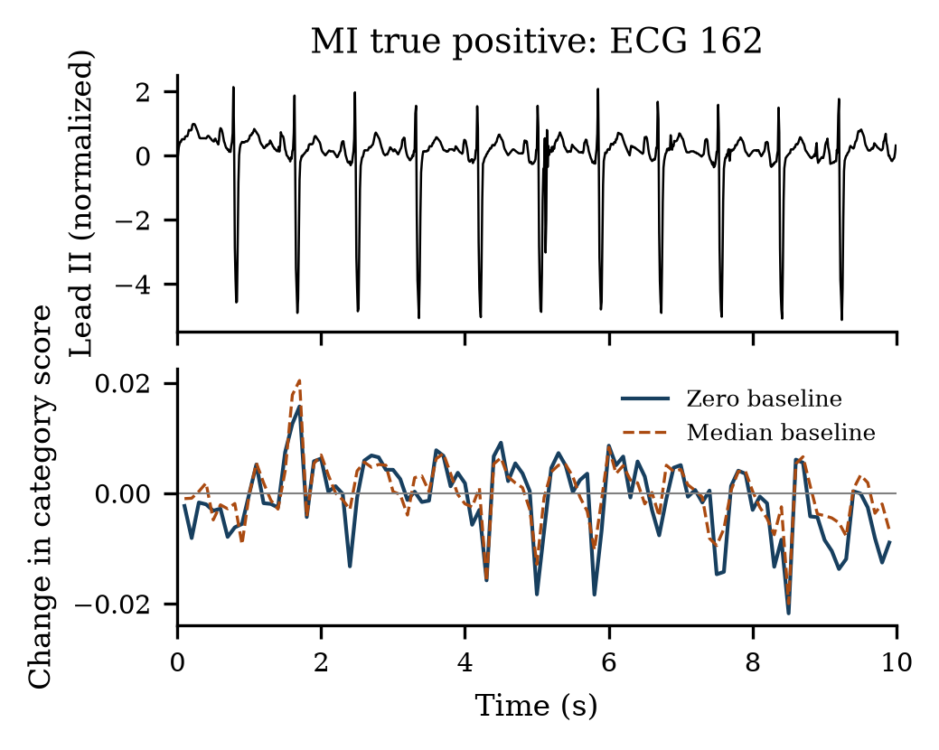
Occlusion responses for an MI example
ECG 162
MI score: 0.860
Decision threshold: 0.45
200 ms masking windows
100 ms window stride
Baseline correlation: 0.834
Occlusion measures model sensitivity. It does not establish physiological causality or clinical validity.
12
Notes:
Sources: results/occlusion-analysis.json and results/figures/occlusion_MI_true_positive.png. Prespecified MI true positive ECG 162, score 0.860490143 against threshold 0.45. Mask all leads in a 200 ms window, stride 100 ms, replace by normalized zero or per-record lead median. Spearman correlation between temporal baseline responses is 0.833543599. Positive score change means removal reduced the category score. Ten prespecified TP/FN cases cover all five categories. No clinician validated these highlighted regions.

Slide 13
Conclusions and project deliverables
Main finding
Evidence delivered
Compact CNN: macro AUROC 0.9195
and mean median forward latency 0.639 ms.
Checkpoints, predictions, and figures.
Verification notebook and IEEE report.
Limits of the study
Next steps
One dataset and an internal test fold.
No external or prospective clinical evaluation.
External testing and calibration.
Subgroup checks and clinical review.
The experiment supports a reproducible academic baseline. GitHub publication remains pending.
13
Notes:
Sources: results/aggregate-results.json, results/evidence-verification.json, Healthcare_ECG_Colab.ipynb, README.md and the IEEE report. Internal evaluation on one historical dataset. No external hospital test, prospective study, probability calibration, subgroup fairness assessment or clinician explanation review. The notebook recomputes saved metrics without retraining. Future work: external validation, calibration, subgroup analysis and expert-reviewed explanations. GitHub repository publication is still pending and no repository URL is invented.

Slide 14
Selected references
[1] Wagner et al. PTB-XL dataset. Scientific Data, 2020.
[2] Strodthoff et al. Deep learning for ECG analysis. IEEE JBHI, 2021.
[3] Mehari and Strodthoff. Self-supervised 12-lead ECG learning. CBM, 2022.
[6] van de Leur et al. Explainable ECG interpretation. EHJ Digital Health, 2022.
[8] Strodthoff et al. PTB-XL+ feature dataset. Scientific Data, 2023.
[15] Liu et al. Zero-shot ECG classification with multimodal learning. ICML, 2024.
[17] Liu et al. Knowledge-enhanced multimodal ECG learning. EMNLP, 2025.
[18] Wagner et al. PTB-XL version 1.0.3. PhysioNet, 2022.
Full citations and 15 recent research papers appear in the report. Source links accompany the relevant slide notes.
14
Notes:
The full IEEE report contains 18 references, including 15 research papers from 2022 onward. Report numbering is retained below. [1] https://doi.org/10.1038/s41597-020-0495-6 [2] https://doi.org/10.1109/JBHI.2020.3022989 [3] https://doi.org/10.1016/j.compbiomed.2021.105114 [6] https://doi.org/10.1093/ehjdh/ztac038 [8] https://doi.org/10.1038/s41597-023-02153-8 [15] https://proceedings.mlr.press/v235/liu24bg.html [17] https://doi.org/10.18653/v1/2025.findings-emnlp.385 [18] https://doi.org/10.13026/kfzx-aw45

