Slide 1
CSE 212 : OBJECT ORIENTED PROGRAMMING SESSIONAL Presented to - Md. Muhtadir Rahman Lecturer Department of Computer Science and Engineering Port City International University. Project Title:- Car Showroom Management System. Prepared by
Md. Tanvir Alam - CSE (02106988).
Md. Atef Abrar Bhuyian - CSE (02106990).
Md. Gulapur Rahman - CSE (02106987).

Slide 2
CONTENTS
Problem Statement.
Problem Objectives.
Preliminary Solutions.
Project Scopes -
Functional Requirements
Non – Functional Requirements
Project Stakeholders.
Use Case Diagram.
Activity Diagram.
User Interface (UI).
Cost Analysis.
Thank you.
Q & A.

Slide 3
Problem Statement
In a big car showroom, there is a lot of cars.
Due to large quantity it is not possible to determine how many cars available in the showroom.
Also, the price of those cars are more hard to keep track of.

Slide 4
Problem Objectives
The main purpose of “Car Showroom Management System” project is to store every available car information in the database.
It will provide the information of the available cars in the showroom.
The project is totally built at administrative end and thus only the administrator is guaranteed the access.
The purpose of this project is to reduce the manual work.

Slide 5
Preliminary Solutions
All the information of the available cars will be stored in the system.
Problems will be solved with this system. Because through this we will know how many cars we have available in our showroom.

Slide 6
Project Scopes
Functional Requirements –
Login system for authority.
Dashboard for the list.
Insert information and save.
Update and delete information’s .
Features Requirements-
System will run on PC.
Car information can be found easily.
Imported and exported products can be calculated effortlessly.

Slide 7
Project Stakeholders
Authority
User
Authority:- Authority can access all the functions in the system.
For Example:
Add.
View.
Edit & Update.
Save.
Delete.

Slide 8

Use Case Diagram
Log in
Dashboard
Add
View
Authority
User
Edit
Delete

Slide 9
Activity Diagram (View)
Log in
Dashboard
Start
End
View
Car Information
Home

Slide 10
Activity Diagram(Add)
Start
Dashboard
Log in
End
Add
Insert
Information
OK
Add, View, Edit,
Delete.
Success
Save
Home

Slide 11
Activity Diagram(Delete)
Start
Dashboard
End
Log in
Delete
Warning
OK
Yes
No
Success

Slide 12
Activity Diagram(Update)
Start
Log in
Dashboard
End
Edit
OK
Update
Home
Success

Slide 13
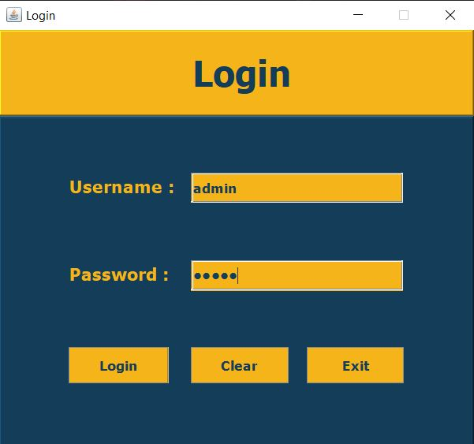
User Interface (UI)
Login

Slide 14
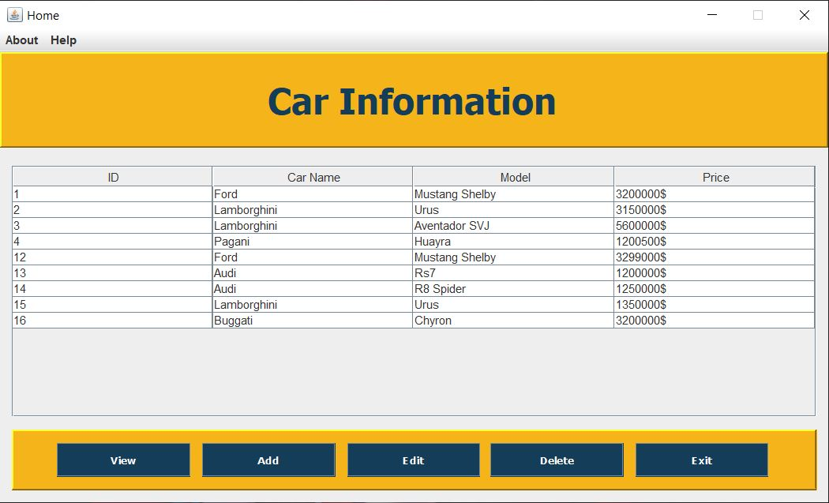
User Interface (UI)
Dashboard

Slide 15
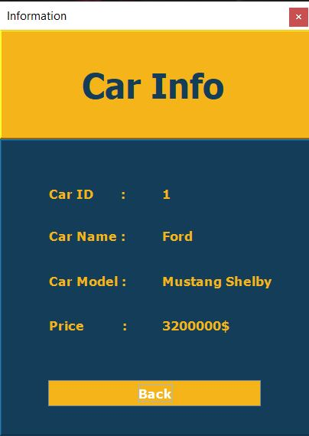
User Interface (UI)
View

Slide 16
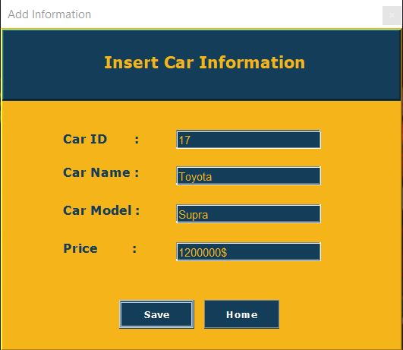
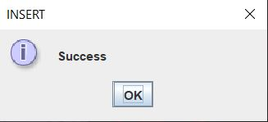
User Interface (UI)
Add
Save

Slide 17
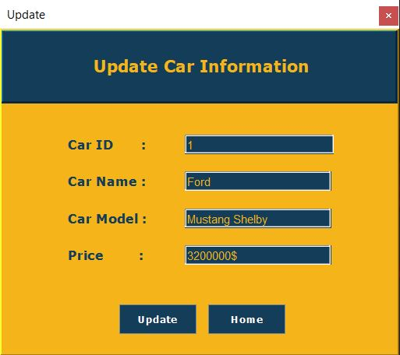
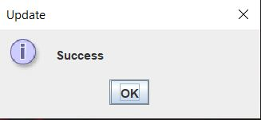
User Interface (UI)
Update
Updated

Slide 18
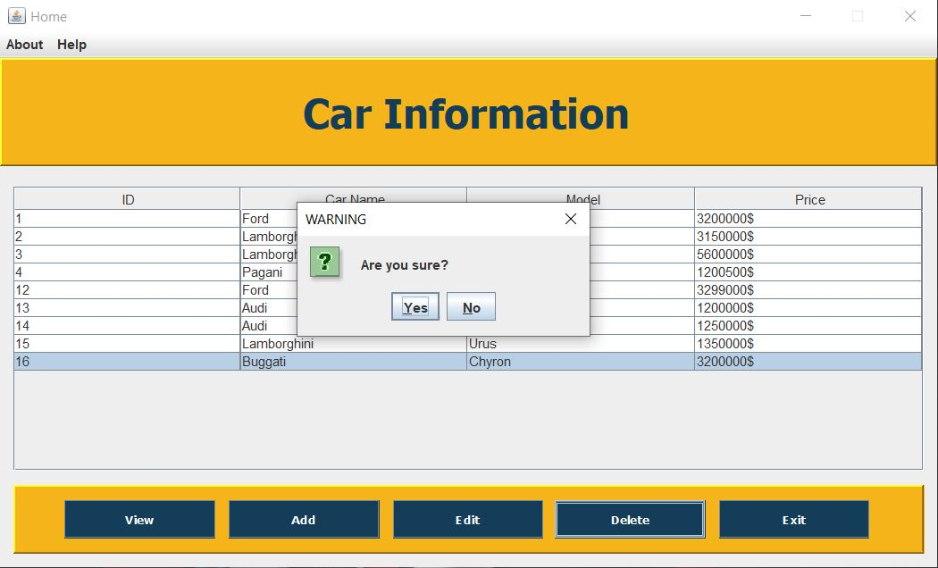
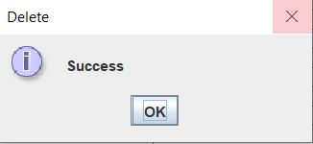
User Interface (UI)
Delete
Deleted

Slide 19
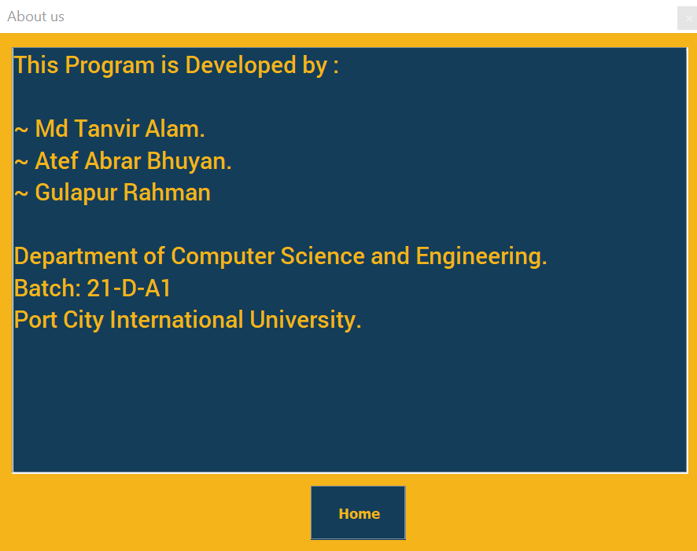
User Interface (UI)
About us

Slide 20
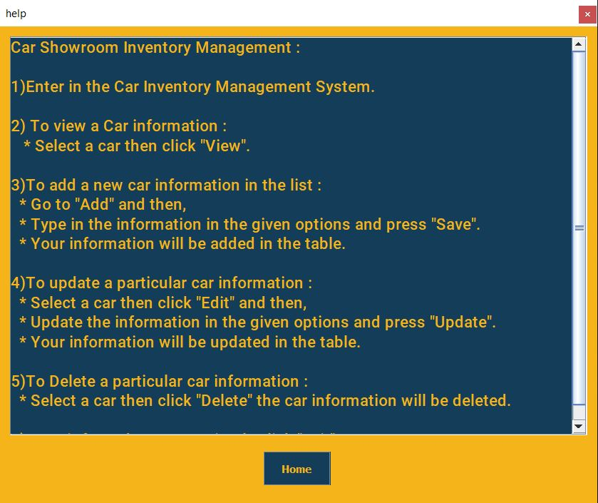
User Interface (UI)
Help

Slide 21
Cost Analysis
Serial No | Item | Amount
01 | Application Software Development | 70,000৳
02 | Personal PC | 1,50,000৳
03 | Database server | 25,000৳
 | Total | 2,45,000৳

Slide 22
“Car showroom management system” github repo link: https://github.com/Tanvir-Alam-Jadid/Car-Showroom-Inventory-Management.git

Slide 23
Thank You

Slide 24
Q & A

