Slide 1

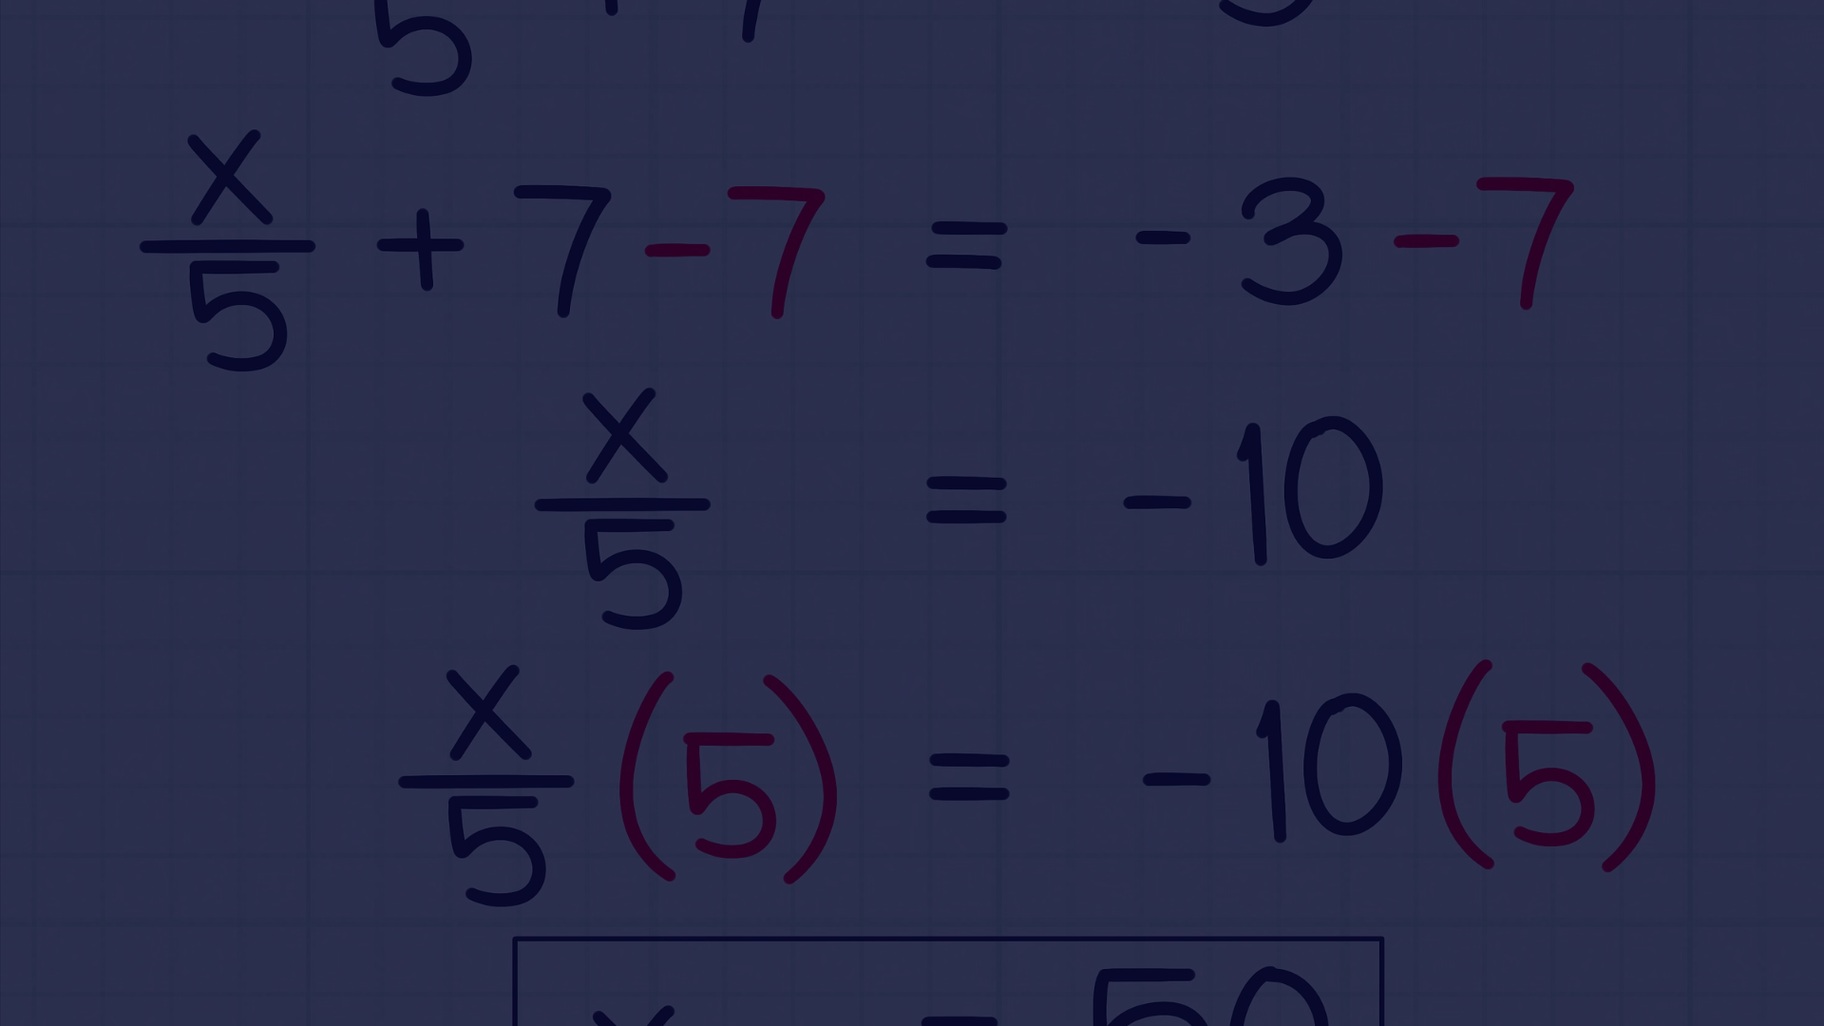
Understanding the Accuracy of Euler’s Method in Solving Differential Equations
Basic: Shuvo 小明
Mighty Math To Feel Almighty And His Creation

Slide 2
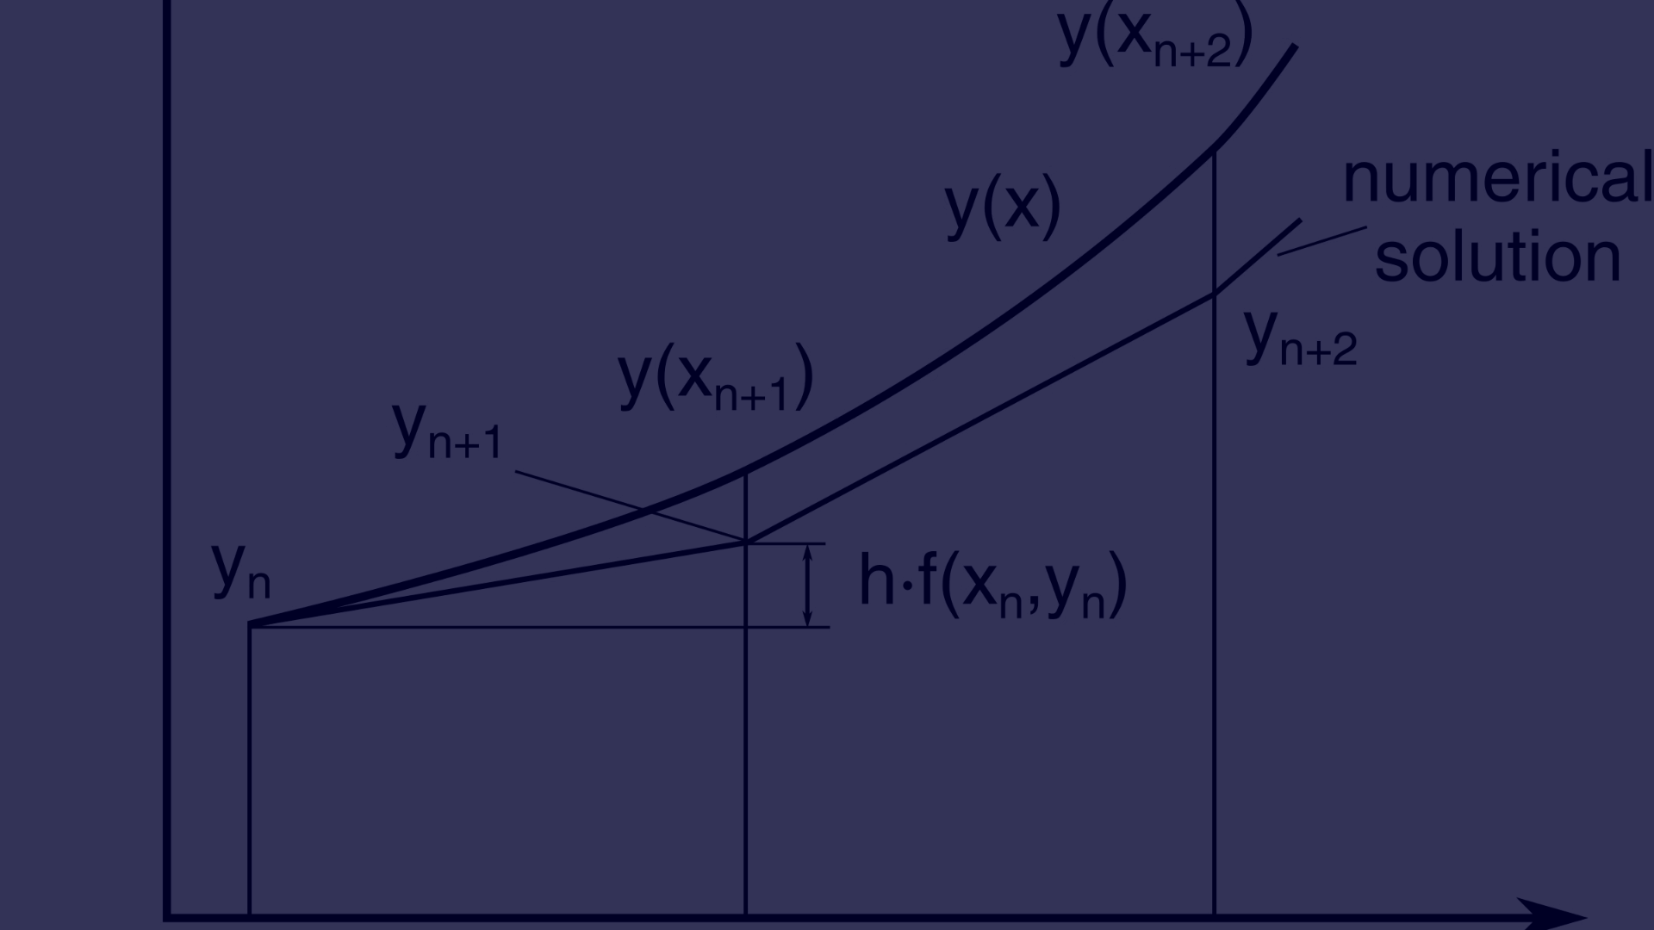
What is Euler's Method?
1
Iterative Approach
2
First-Order Accuracy
3
Stepwise Process
Euler's Method is an iterative approach to solving initial value problems for ordinary differential equations.
The method involves dividing the interval into small increments to approximate the solution step by step.
It belongs to the family of explicit Runge-Kutta methods and has a first-order accuracy.
Euler's Method is widely used to approximate solutions to ordinary differential equations. It provides a foundational understanding of numerical integration and is essential in various scientific and engineering applications.

Slide 3
How does Euler's Method work?
Given a differential equation dy/dx= f(x, y) and an initial condition y(xo) = yo, we can approximate the solution y = y(x) by its linearization
L(x) = y(x0) + y' (x0) (x - x0) Or L(x) = yo + f(x0, y0) (x - x0).
Y= Yn-1 + (Xn-1,Yn-1) *h h or dx=Xn+1- Xn

Slide 4
Factors affecting the accuracy of Euler's Method
1
Step Size Selection
2
Order of the Differential Equation
3
Nonlinear Systems
The accuracy is influenced by the careful selection of the step size used in the approximation process.
The method may struggle with high nonlinearity, leading to reduced accuracy in certain scenarios.
The complexity of the differential equation affects how well Euler's method can approximate the solution.

Slide 5



Examples of Euler's Method in action
Differential Equations
Engineering Applications
Physics Simulations
Utilized in approximating solutions to various types of differential equations.
Used to simulate physical processes and predict behaviors based on initial conditions.
Applied in engineering to model systems and predict behaviors over time.

Slide 6


Conclusion

Slide 7
Euler's Method
Python code: Md. Tanvir
C code: Shuvo 小明
Mighty Math To Feel Almighty And His Creation

