Slide 1
Automated Hand-Sanitizer System
Shadman Ahmad Abeer 2121835642 Tanvir Ahmed 2031105642 Shakil Mahmud Resvy 2014319042
To
Faculty: Dr. Mosabber Uddin Ahmed (MUA3)
Course: CSE 323.03
North South University
Department: Electrical and Computer Engineering

Slide 2
Objective
The Objective of the project is to develop an Automated Hand Sanitization System via arduino uno, servo motor & ultrasonic sensor

Slide 3
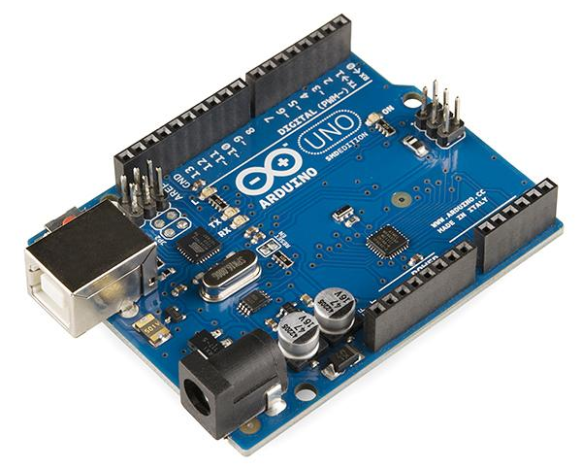
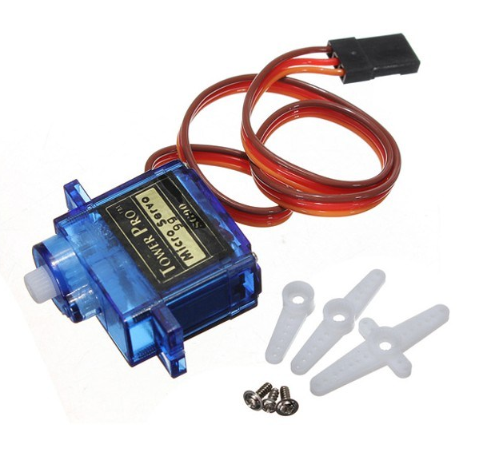
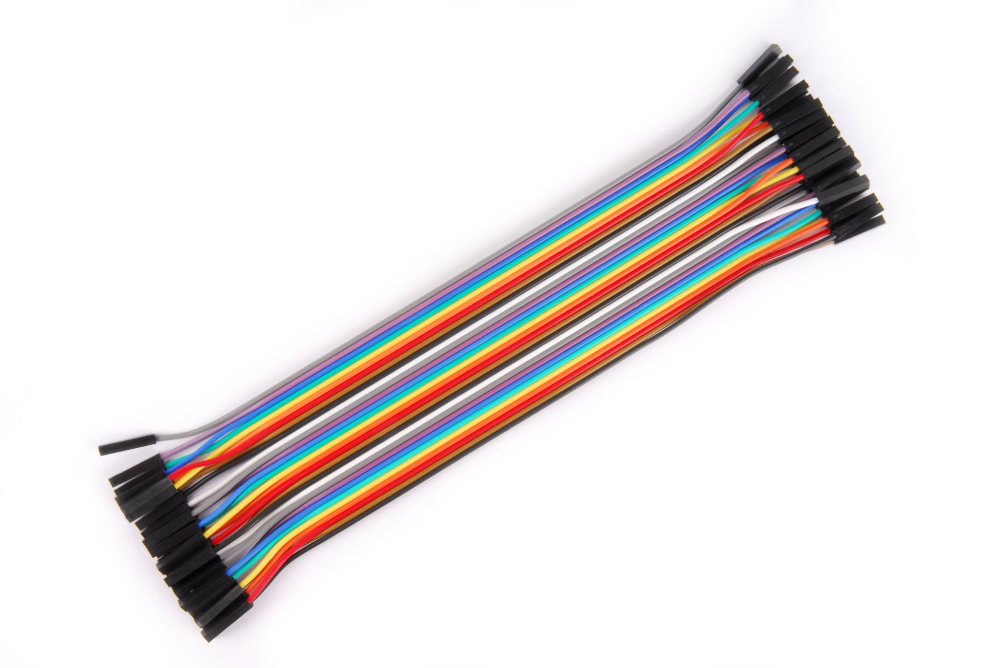
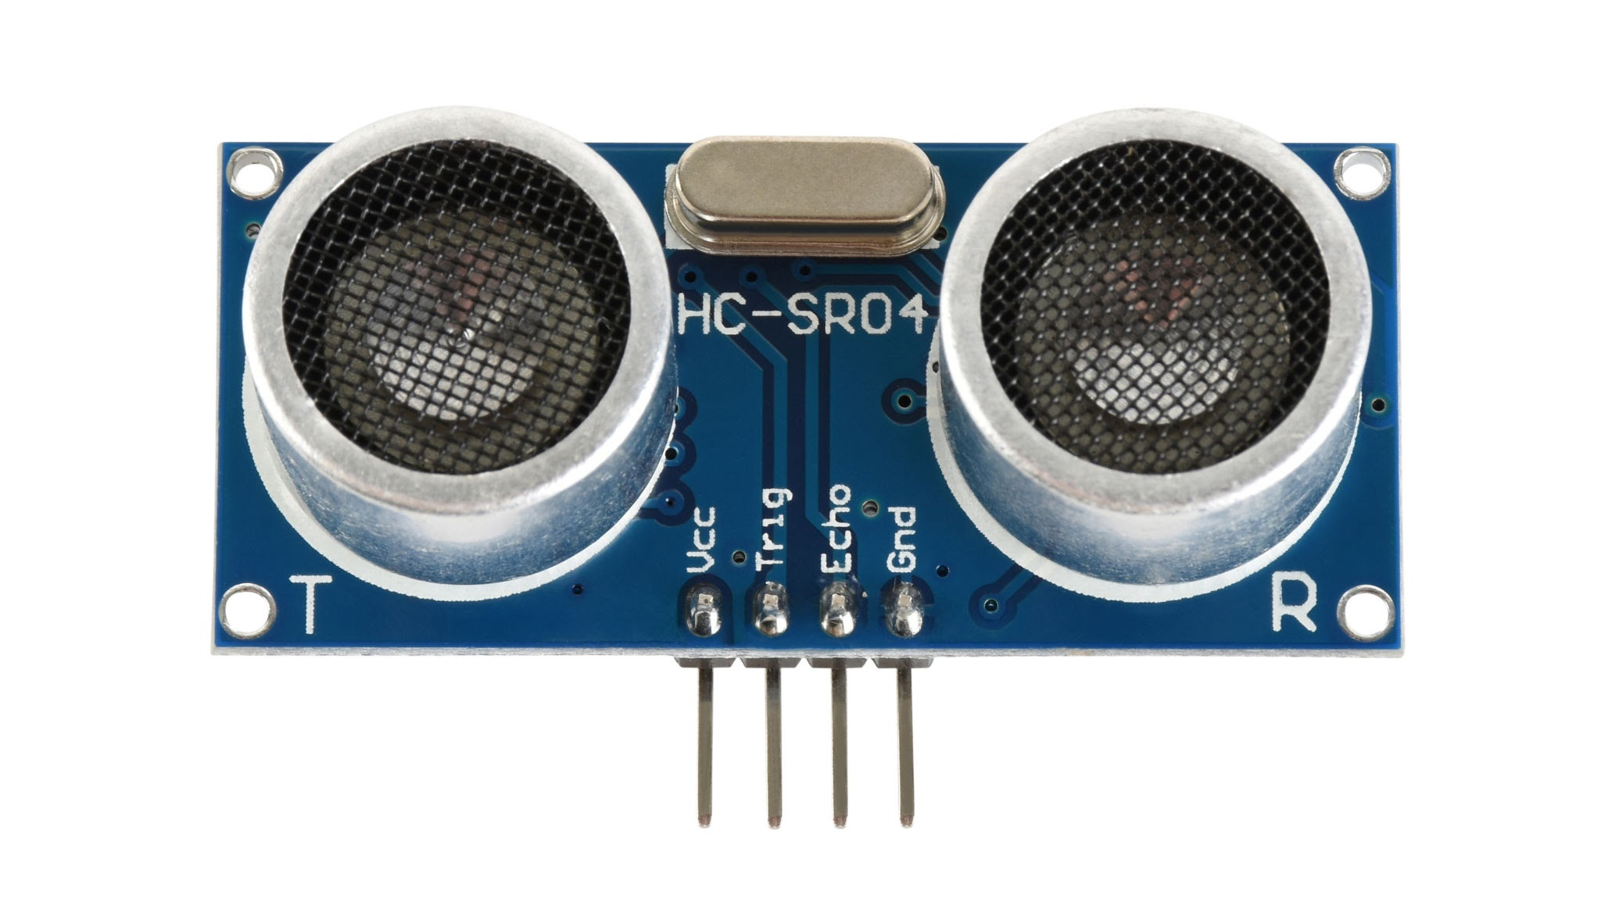
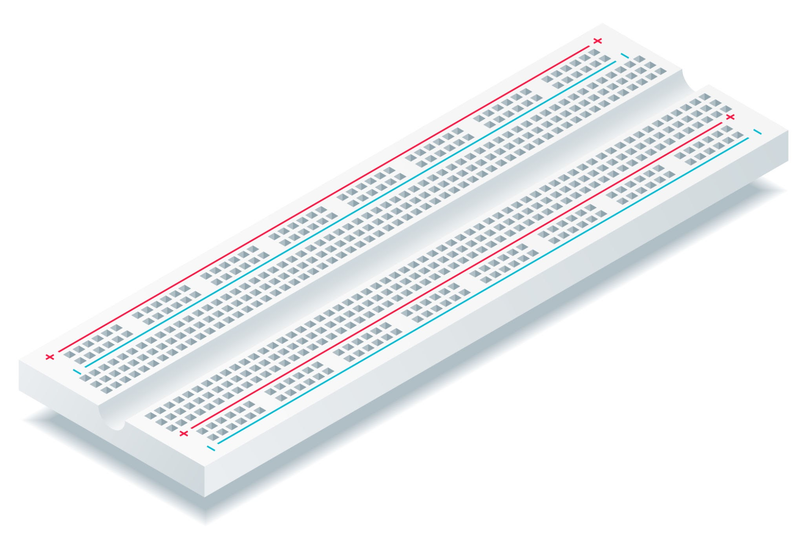
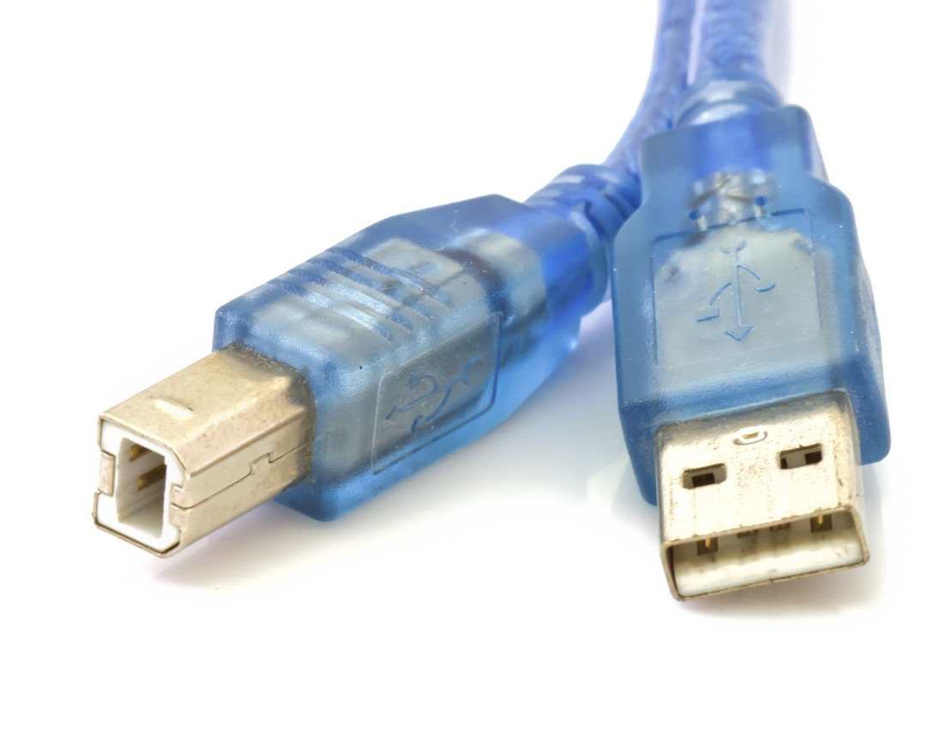
Methodology
Elements
Setup: HC-SR04 sensor is connected to Arduino pins 5 & 6. The 180° servo (pin 9) moves the lever, and the 360° servo (pin 10) pumps sanitizer. All powered via Arduino cable with breadboard and jumper wires.
Operation: When a hand is within 15 cm, the 180° servo rotates the lever and the 360° servo pumps sanitizer, then reset when the hand moves away.
Programming: Arduino reads sensor values and controls servos with delays to protect motors.
Result: Provides touchless, automated sanitizer dispensing for hygiene and safety.
Arduino Uno
Servo Motor Micro SG90 (180°)
Servo Motor Micro SG90 (360°)
Ultrasonic Sensor HC-SR04
Breadboard
Male-to-Male Jumper Wires
Male-to-Female Jumper Wires
Arduino USB Cable
Serial Monitor

Slide 4
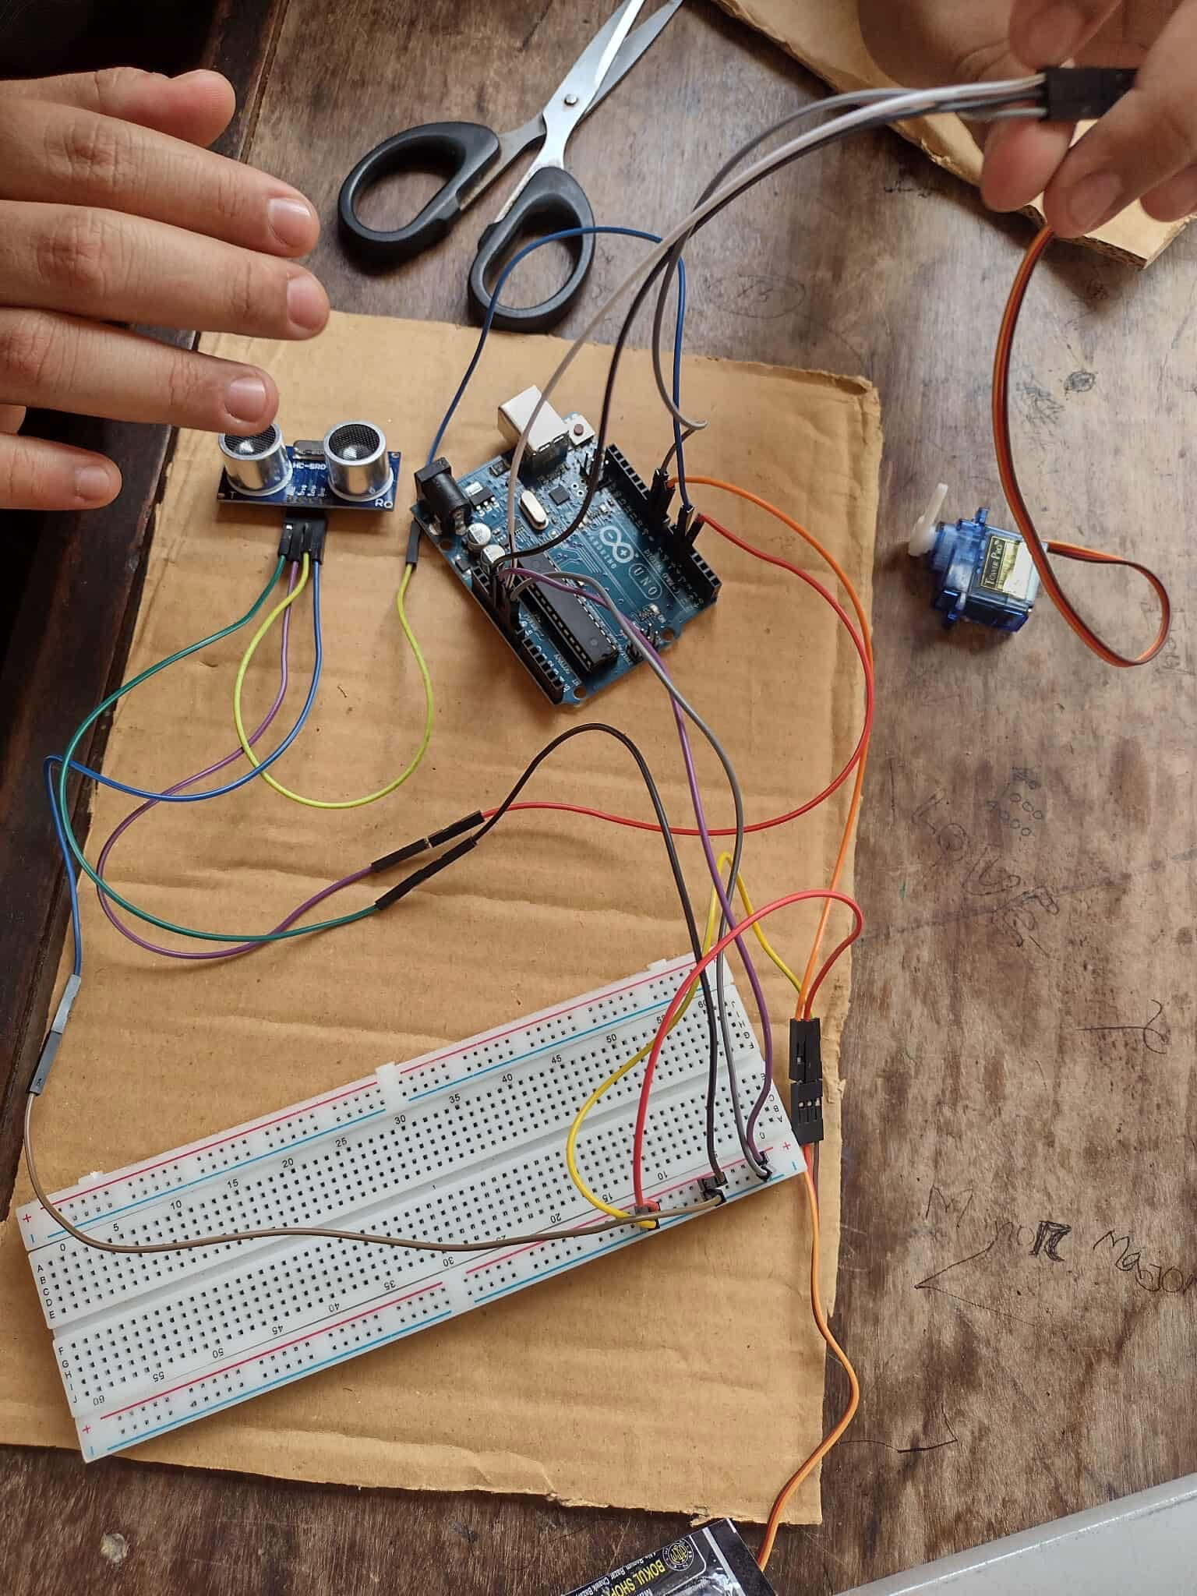
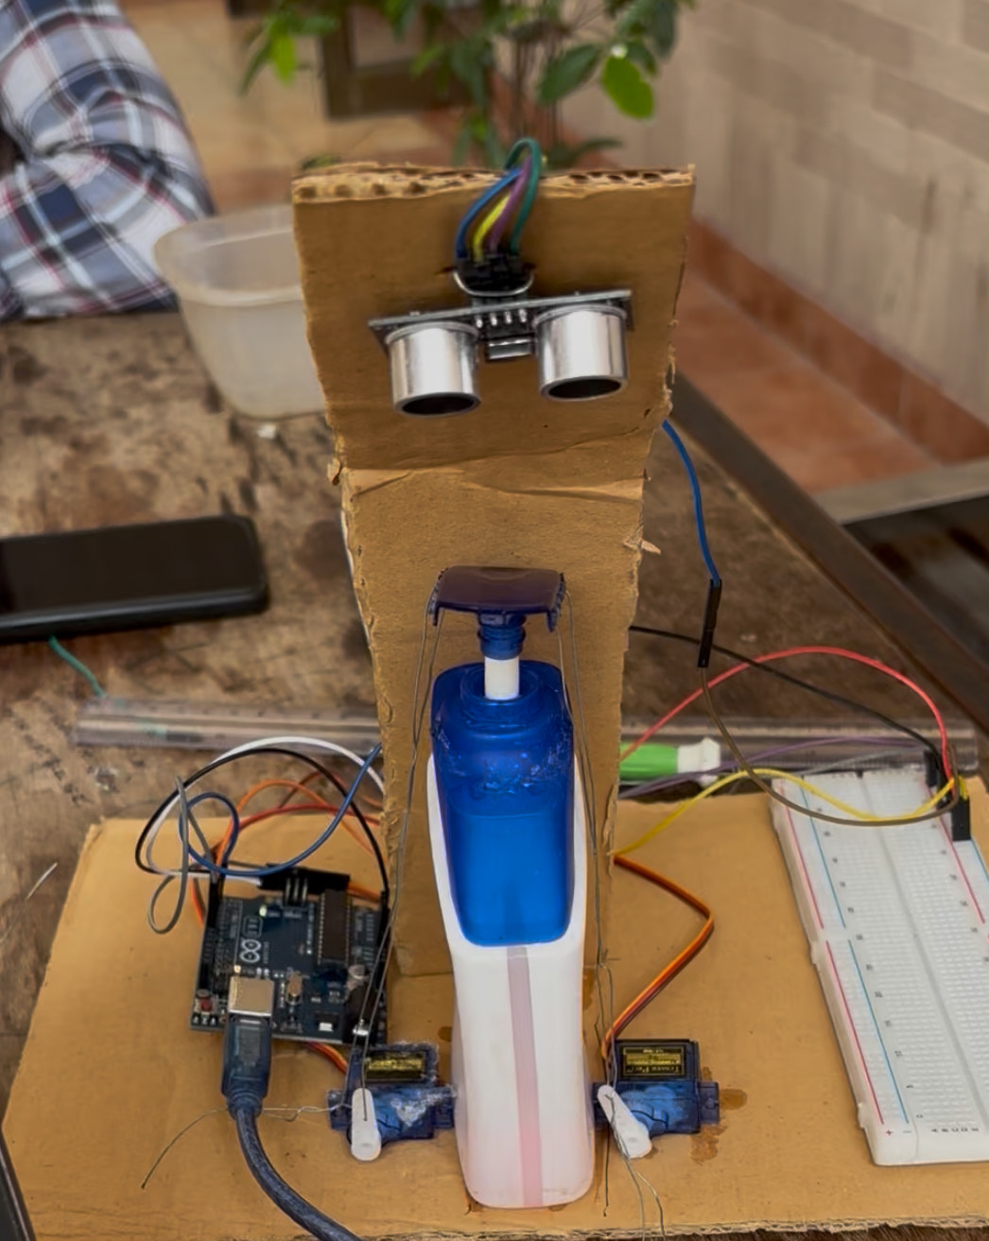

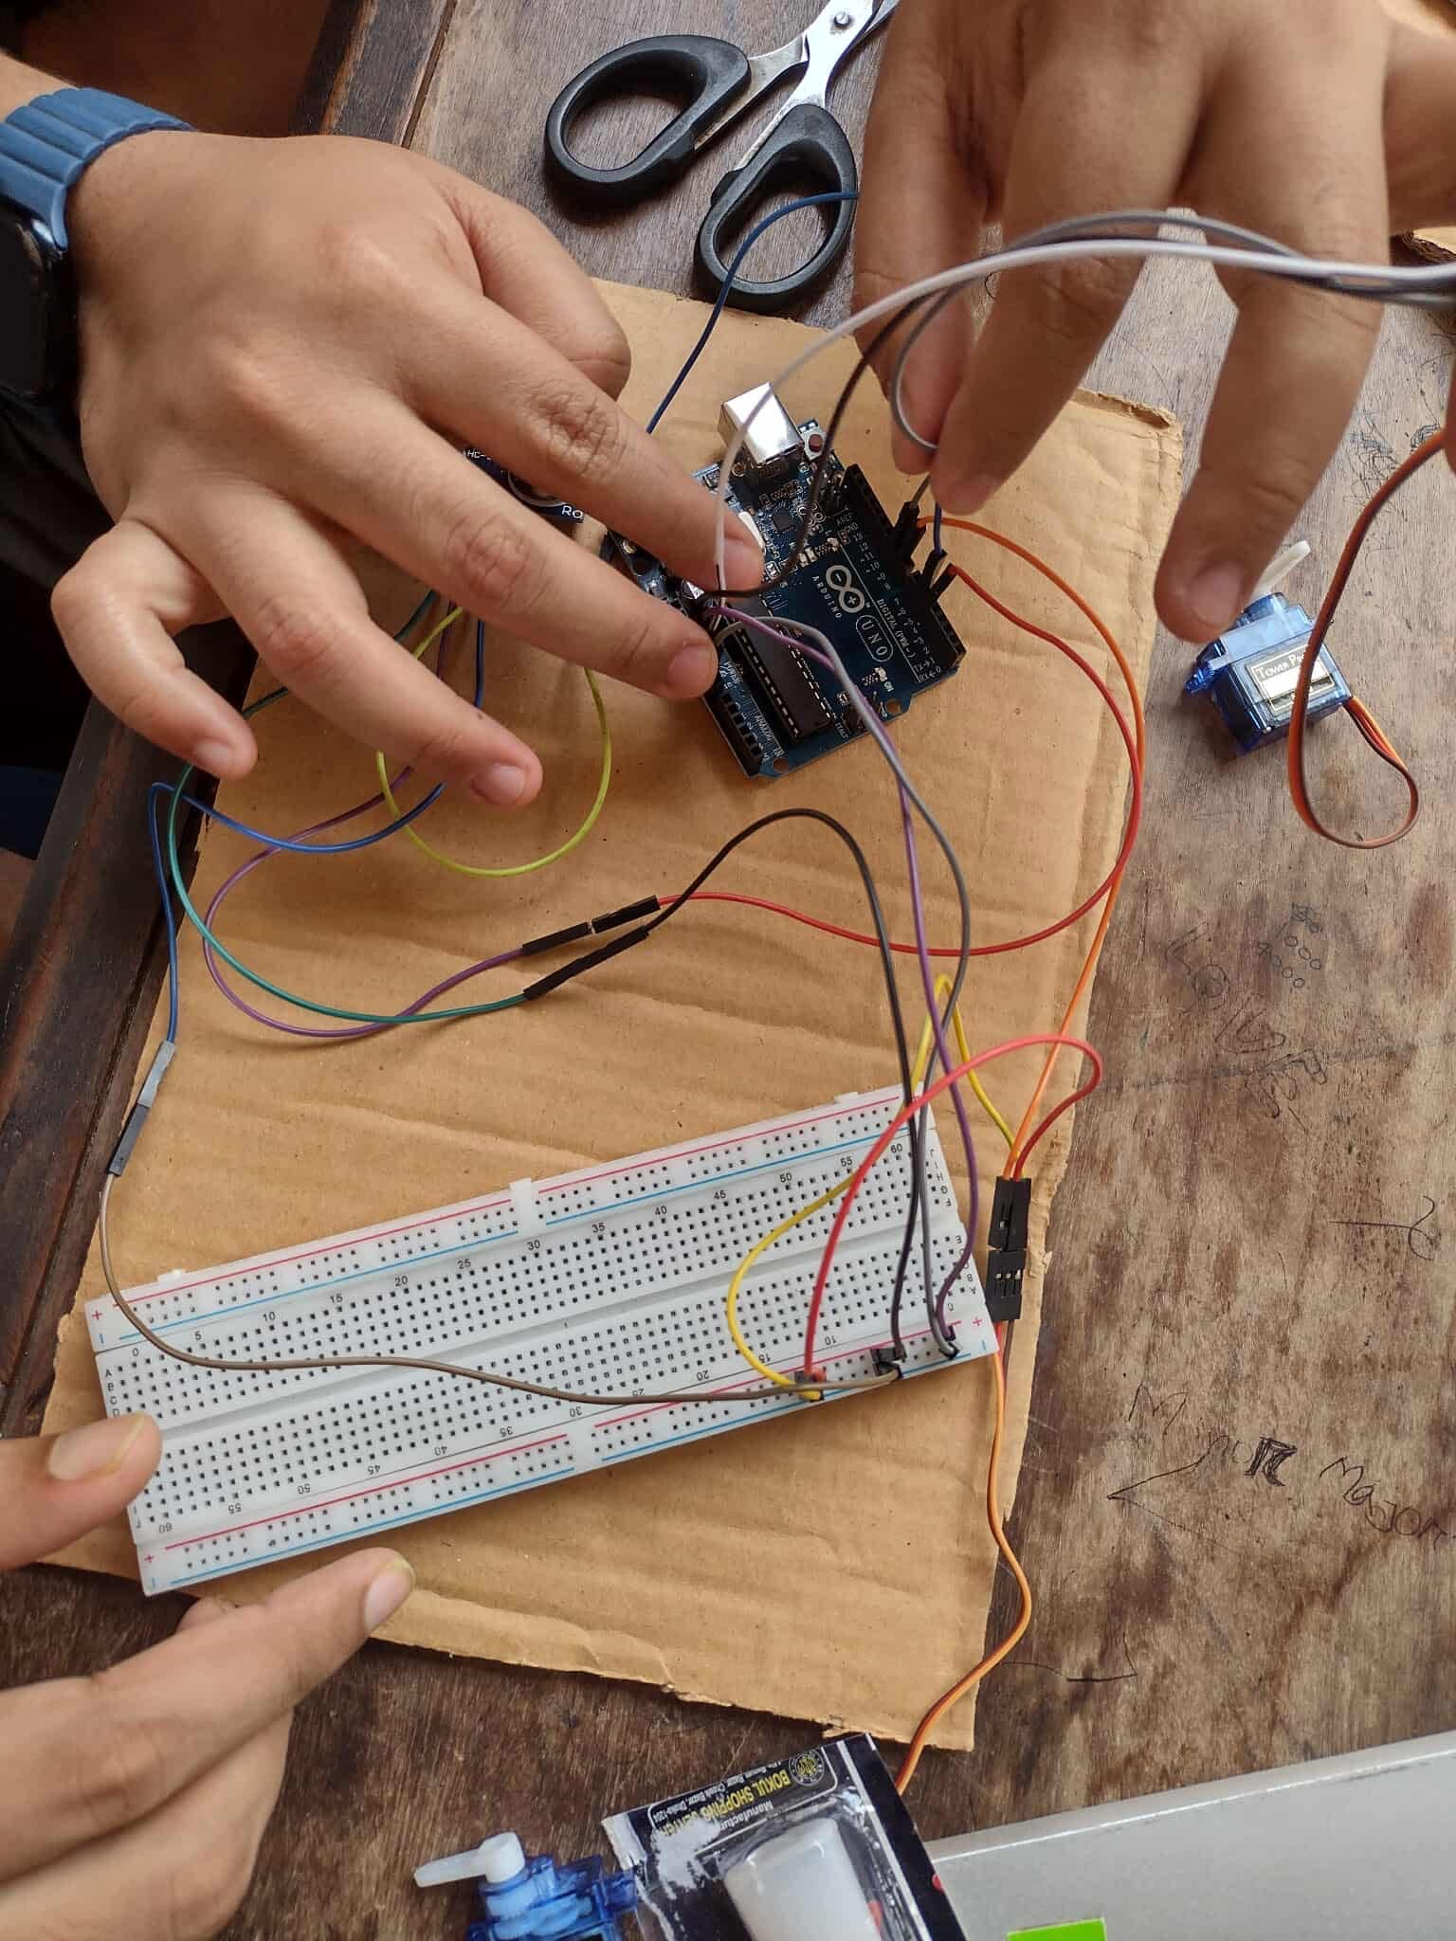
Code & Images
Fig: Sensor Setup
AhmadSaheb007/Automated-Hand-Sanitizer-System: Automated Hand-Sanitizer System Using Arduino Uno R3
Fig: Motor Setup
Fig: Final Product

Slide 5
Budget
Challenges
Item | Quantity | Price
Arduino Uno | 1 | 1050 tk
Servo Motor | 2 | 360 tk
Ultrasonic Sensor | 1 | 100 tk
Jumper Wire | 1 set | 120 tk
Breadboard | 1 | 135 tk
Sanitizer Bottle | 1 | 85 tk
Miscellaneous |  | 350 tk
Total |  | 2200 tk
To sink 180 deg motor with 360 deg motor.
Distance measurements with Ultrasonic sensor.
Alternative power source from battery.

Slide 6

Thank You For Your Time
Feel Free To Ask Any Questions

