Slide 1



Films
What indicates movie success?
Shuwen Zhang
Yang Wei
Anthony Simonelli
Tanvir Bhullar

Slide 2
What factors drive box office?
Do film ratings play a role in how much money a movie makes?
Which ratings matter more? – Audience or Critics?
How do ratings skew among the different sites?
Is it Genre?
Is it Studios?
Is it Actors/Directors?

Slide 3
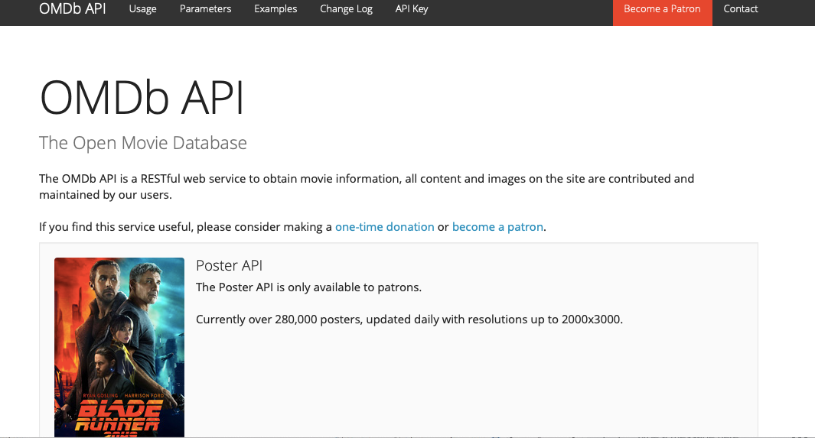
Data Sources
IMDB
csv file of films (1972-2018)
OMDB
API

Slide 4
Data Processing
IMDB – Internet Movie Database
A csv file downloaded directly from site
Useful fields:
Title
IMDb Rating
Year of Release
Genre
Number of votes (popularity)
OMDB – Open Movie Database (API)
JSON object via API request
Useful fields:
Title
IMDB, Rotten Tomatoes, Metacritic ratings
Box Office
Production Studio
Actors & Directors
Notes:
Using IMDB list of film titles, we created a list of titles to loop through for an API request from OMDB, which would allow us to bring relevant information for all the films into a pandas data-frame.

Slide 5
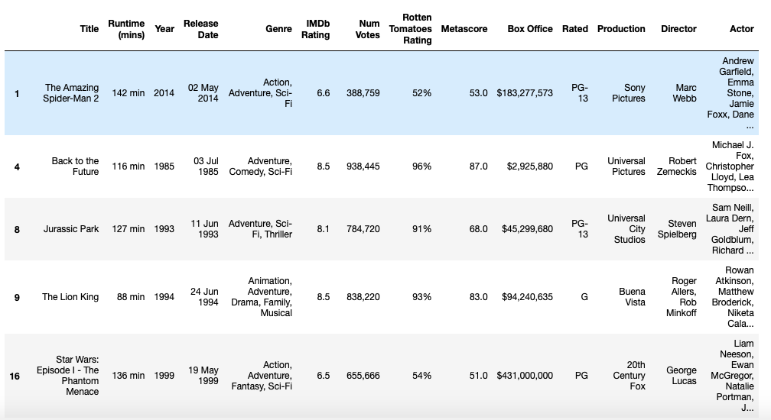
Data Processing
Cleaning Data:
Keep only films which have Box Office (~3000 titles)
Remove records with blank ratings
We analyzed aggregates of box office by genre, directors/actors, and production studios
Filtered by rating type and genre for analysis

Slide 6

How do Ratings and Box Office Relate?

Slide 7
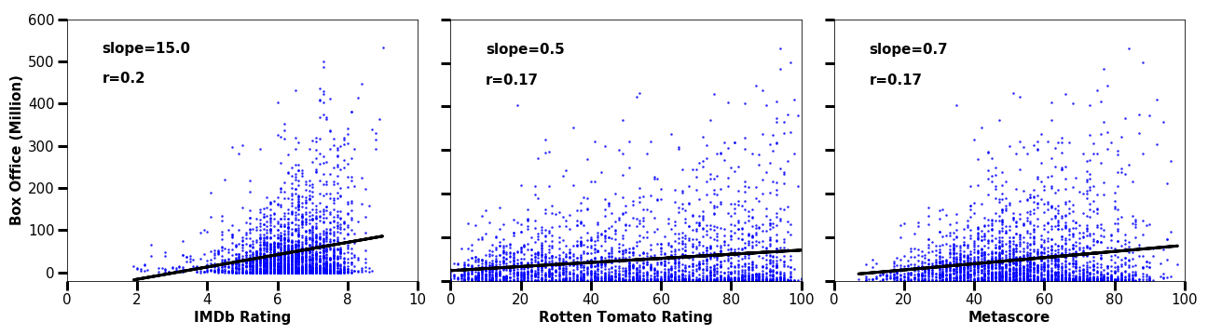
Box Office Vs Ratings
IMDB Rating seems to have the strongest correlation to higher Box Office
IMDb scores show highest Box Office increase (slope of best fit is 15).
Rotten Tomatoes shows the least (slope =0.5).
However, r² is close to 0 for all.

Slide 8
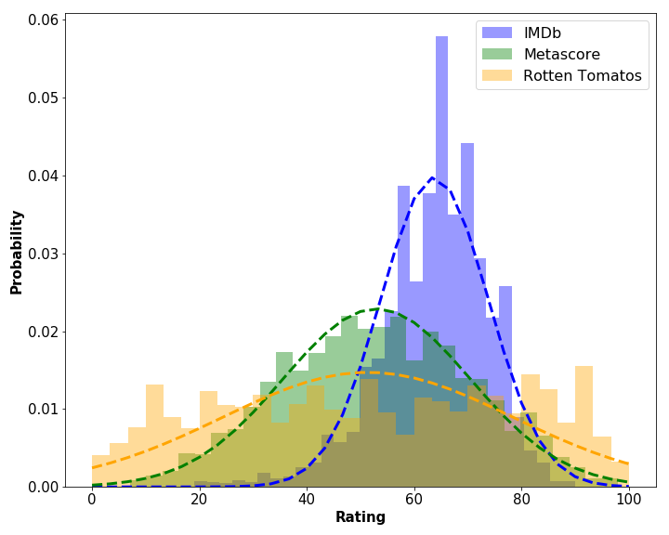
How skewed are move rating websites?
IMDB (Audience) – skews more favorably, most ratings around 6-7.
Metascore/Rotten Tomatoes (Critics) – more normally distributed.
Notes:
IMDB (Audience) – skews more favorably, most ratings around 6-7
Metascore and Rotten Tomatoes (critics) – more normally distributed

Slide 9
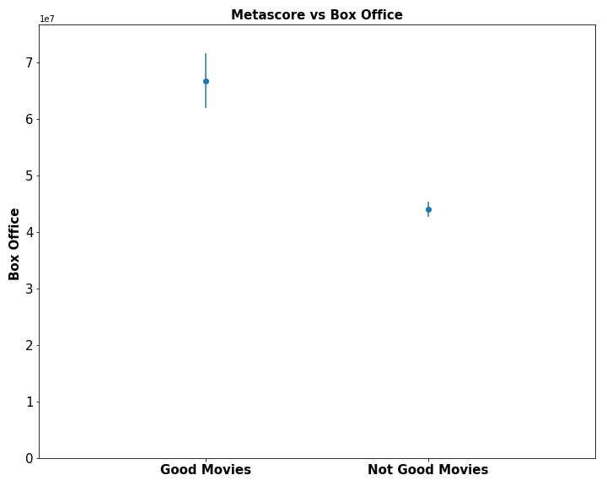
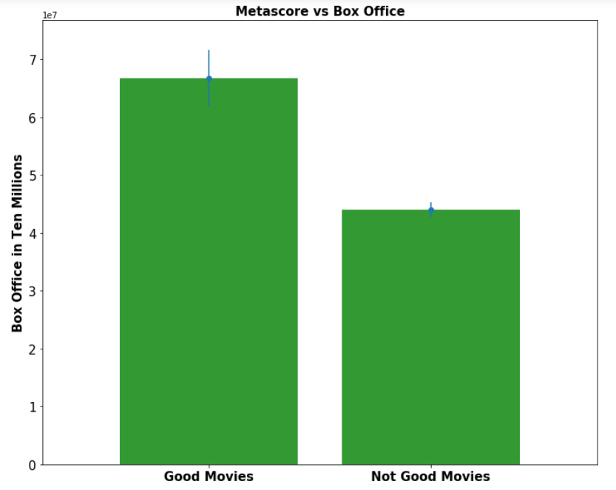
Critics vs Box Office p-value = .0000073 Good Mean = $67,000,000 Bad Mean = $44,000,000
Notes:
Change y-axis labels

Slide 10
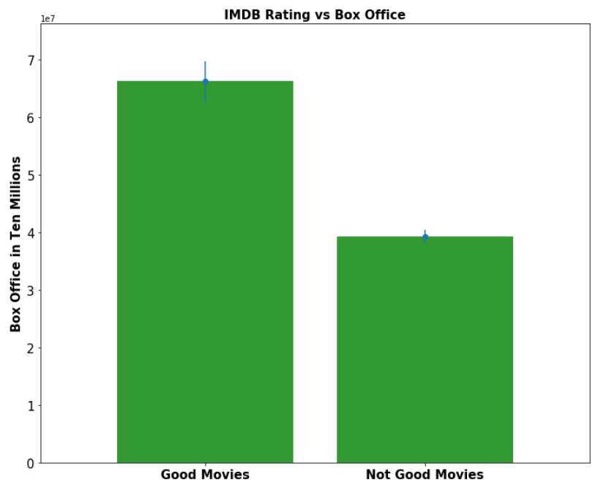
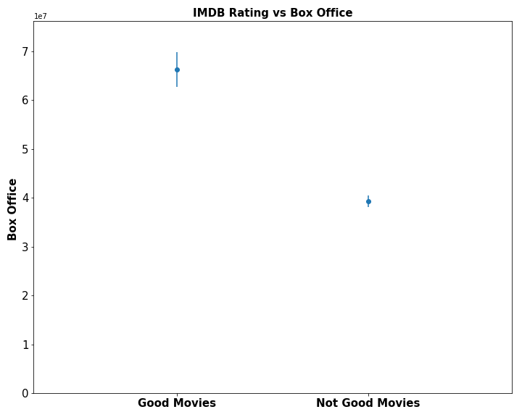
Audience vs Box Office p-value = .0000000000011 Good Mean = $66,000,000 Bad Mean = $39,000,000

Slide 11

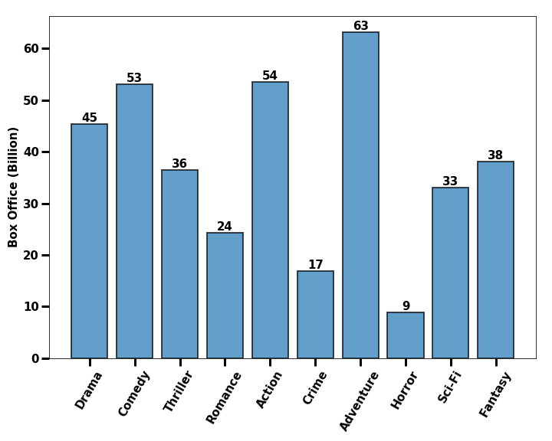
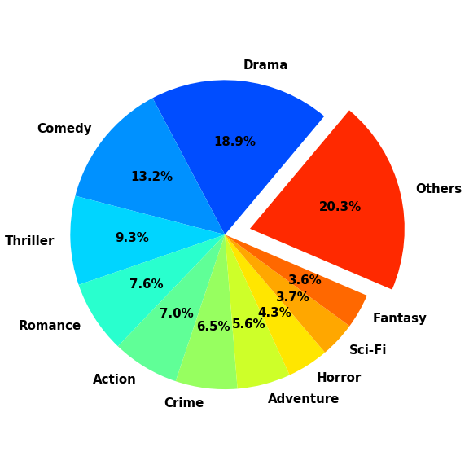
Movie ratings cover wide array of genres

Slide 12
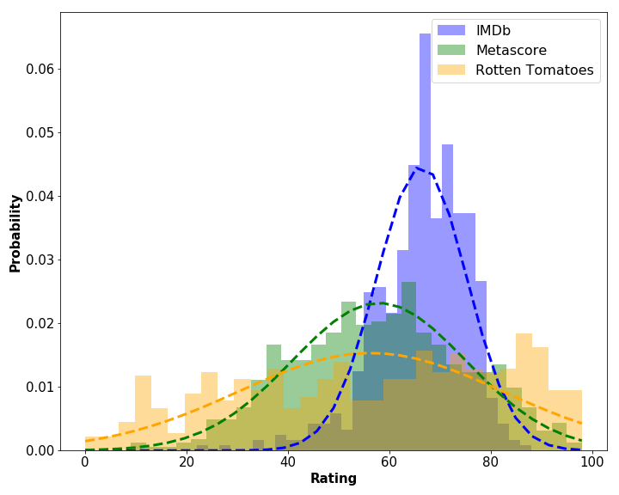
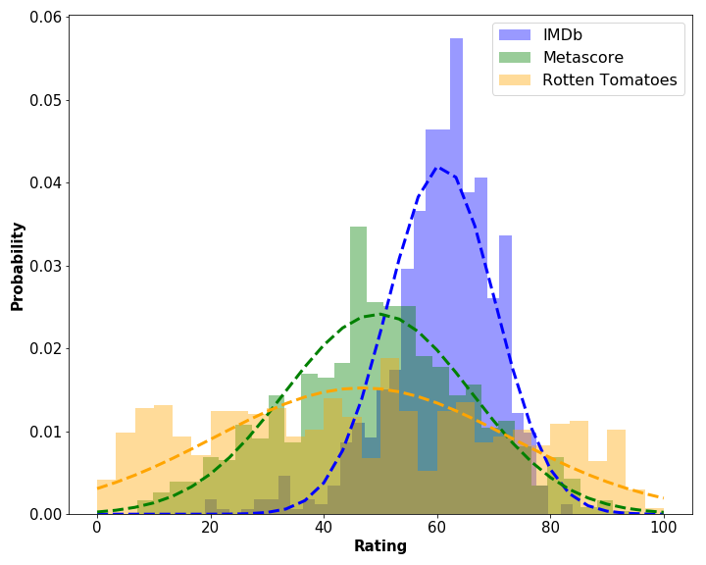
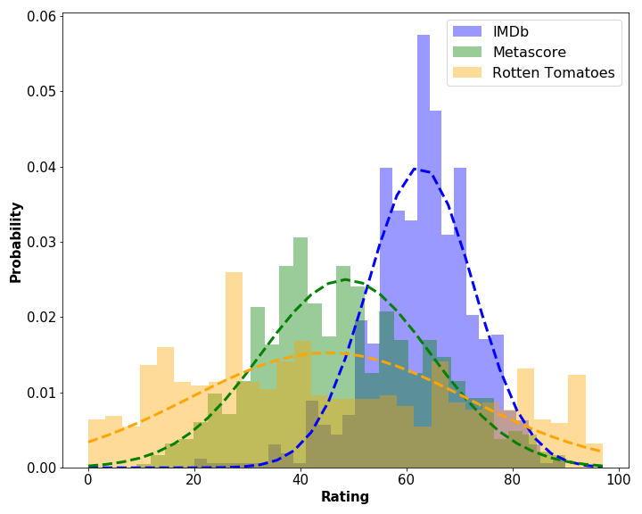
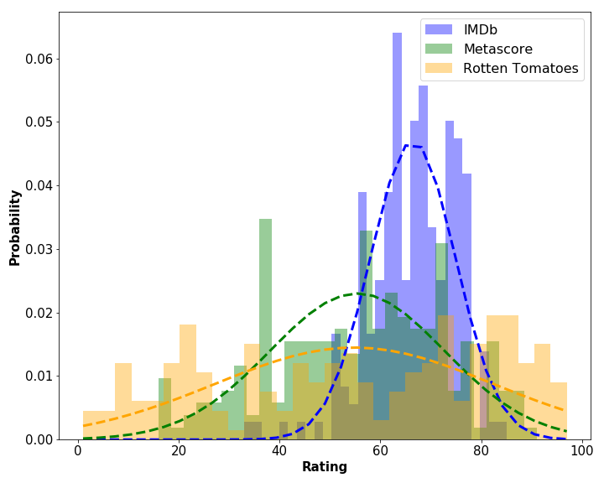

Rating Distribution by Genre
Action
Romance
Dramas and Romance slightly more favored
Comedies earn lower ratings from critics
Comedy
Drama

Slide 13
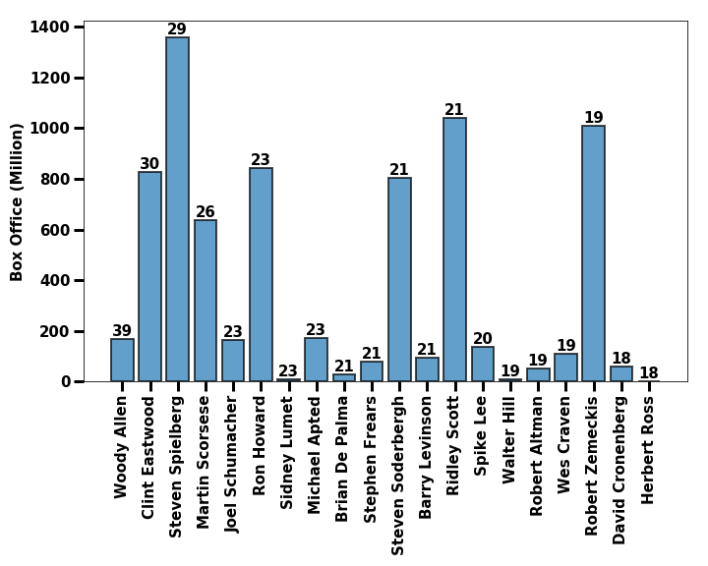
Top Directors

Slide 14
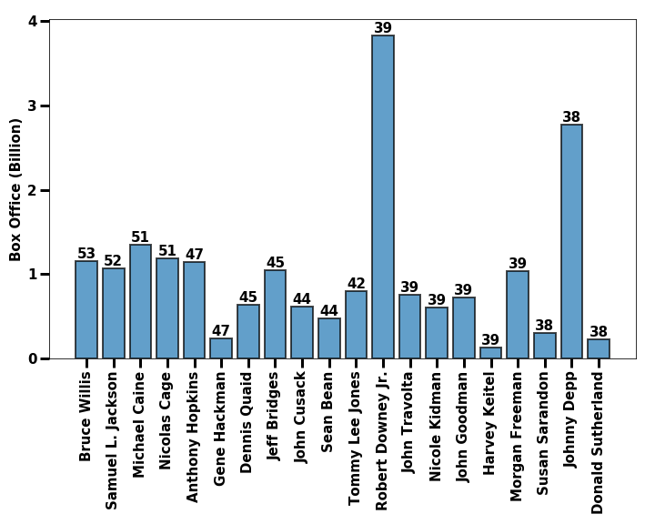
Top Actors

Slide 15
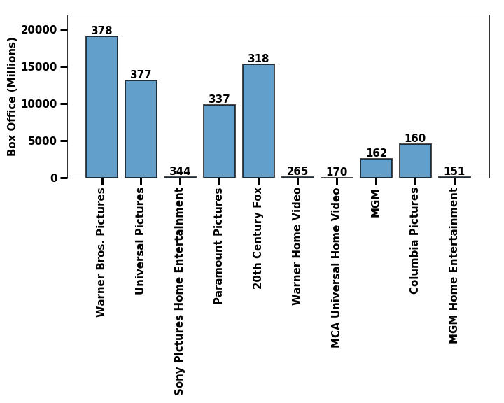
Production STUDIOS
Notes:
Label wrap

Slide 16
Conclusions
Audience and Critic ratings distribute differently.
Ratings and box office do have a statistically significant relationship.
Audience ratings correlates to Box Office.
Higher ratings not necessarily cause higher Box Office.
Certain Actors and Directors generate large Box Office. (Spielberg/Ironman)
Certain Genres generate large Box Office. (Action/Adventure)
More information is necessary to determine causality – do good ratings promote higher box office, or does high box office indicate higher ratings?
Notes:
Big Budget Action movies typically capture largest box office, but
Genre does not affect ratings (ie., there is no discernable difference between ratings given by movie-goers for Drama as compared to Comedy or Action)

Slide 17

Any Questions?

