Slide 1
MediConnect
A Smart Web-Based Medical Appointment Management System
Submitted by
Submitted to
Md. Tanvir Islam
Student ID: CE-180626
Program: M. Engineering
Session: 2017–18
Dr. Mehedi Hasan Talukder
Professor
Department of Computer Science and Engineering (CSE)
M. Engineering Project Presentation

Slide 2
Project Overview
What it does
MediConnect helps patients, doctors, and administrators manage appointments in one place.
Main users
Main problem
Value
Patients, doctors, and admins use the system for booking, review, and appointment management.
The system reduces manual scheduling work and centralizes appointment records.
It supports faster communication, better tracking, and easier updates to visit information.
Simple and practical solution for medical appointment management

Slide 3
Main Features
Patient
Doctor
Admin
Other
Register, log in, and book appointments.
Review appointments, update diagnosis, notes, and prescriptions.
View, search, edit, and delete appointment records.
Email reminders, reference lookup, and API documentation.
Appointment-related email notifications are included when the workflow succeeds and patient email data is available.
Doctors can also generate prescription PDFs for patient records.

Slide 4
Frontend Technologies
Angular 18
TypeScript
HttpClient
Single-page application framework for structured UI development.
Adds strong typing and easier maintenance for the application code.
Sends requests to the backend API and reads server responses.
Bootstrap 5 / Tailwind / SCSS
ngx-toastr
pdfmake
Used for layout, design, and responsive styling.
Displays success, warning, and error notifications to the user.
Generates printable prescription documents in PDF format.
Modern frontend stack for a clean, responsive, and patient-friendly interface

Slide 5
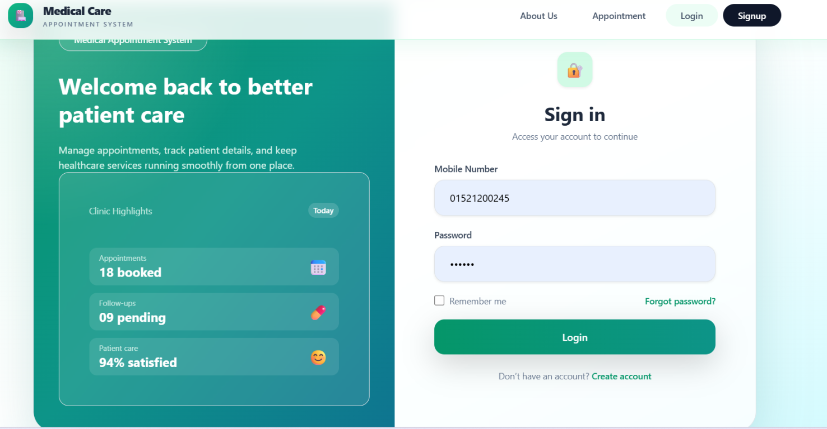
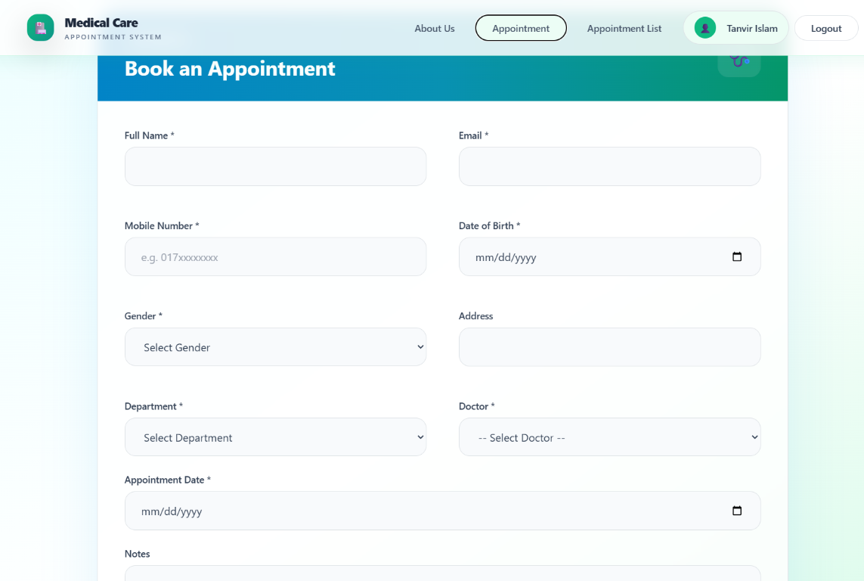
Application Screenshots
Login and appointment booking pages
The login page and appointment booking form are part of the live patient workflow.

Slide 6
Backend and API Technologies
C#
ASP.NET Core Web API
Main language used for backend development.
Provides the REST API layer for frontend communication.
CQRS
MediatR
Separates commands for writes and queries for reads.
Connects requests to handlers in a clean structure.
Dapper + Stored Procedures
Swagger / OpenAPI
Main database access approach for application operations.
Helps developers explore and test the API endpoints.
The backend exposes patient, doctor, and appointment operations through simple web API endpoints.

Slide 7
Backend Architecture
API Layer
Application Layer
Domain / Infrastructure
Shared DTOs
Handles requests and responses.
Contains business logic and handlers.
Stores rules, data access, and support services.
Transfers data between layers and API clients.
The design keeps responsibilities separated so the system is easier to extend and manage.
API Layer → Application Layer → Domain / Infrastructure Layer

Slide 8
Database Overview
Database: Microsoft SQL Server
Database Name: MedicalAppointmentSystemDB
Patients
Doctors
Departments
Appointments
Medicines
Prescription details and user-related records are also managed in the database structure.
The database stores appointment, patient, doctor, department, and medicine information with relationships and stored procedures.

Slide 9
How the System Works
Patient / Doctor / Admin
Angular Frontend
REST API (.NET 9)
CQRS / MediatR
Dapper + Stored Procedures
The frontend sends requests, the API processes them, and the database stores the appointment data.
SQL Server Database

Slide 10
Appointment Booking Workflow
1. Patient enters appointment information
2. Frontend sends request to the API
3. Backend validates and processes the request
4. Database stores the appointment record
5. API returns the result to the frontend
6. Frontend displays confirmation and updates the UI
Appointment-related email notifications can be triggered after a successful booking when the patient email is configured.

Slide 11
Additional Tools and Security
Swagger
Docker
Documents and tests API endpoints for developers.
Packages the application for containerized deployment.
SMTP / Gmail
Future Security
Sends appointment-related email notifications.
JWT auth, stronger role authorization, secret management, and secure deployment are recommended improvements.
Security items above are future improvements and were not claimed as already implemented.

Slide 12
Conclusion and Future Improvements
Summary
Benefits
Future work
MediConnect integrates frontend, backend, and database into a central appointment management system.
It improves coordination, reduces manual effort, and keeps medical records better organized.
JWT auth, secure role checks, password reset, automated testing, and production deployment.
Thank You
Questions and discussion

