Slide 1
Kernelized SVMs
Rose Sloan
rsloan@bard.edu

Slide 2
Finding Better Boundaries
We are trying to find a model that can find good non-linear boundaries
SVMs can find very good linear boundaries
Kernel methods can turn linear boundaries into non-linear boundaries
Today: Using kernel methods with SVMs to get good non-linear boundaries

Slide 3
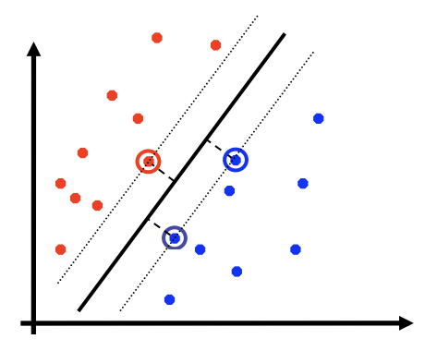
Recall: SVMs
SVMs classify points by finding the decision boundary that maximizes the margin
Margins can be defined either algebraically or geometrically:
Algebraic: smallest value of y(wx+b) normalized by the norm of the weight vector (so margin remains the same regardless of scaling)
Geometric: Euclidean distance from nearest training example to the margin
Slack points allow us to trade off accuracy vs. margin size

Slide 4
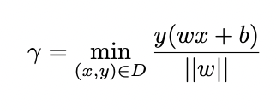
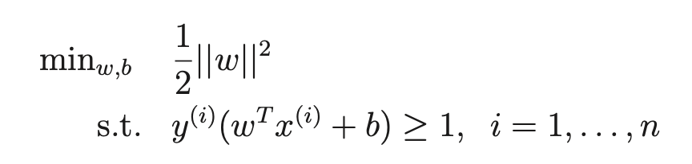
SVM Classifier
Both definitions of the margin γ give us:
We can define this as an optimization problem and use mathematical manipulation to turn it into a convex optimization problem

Slide 5
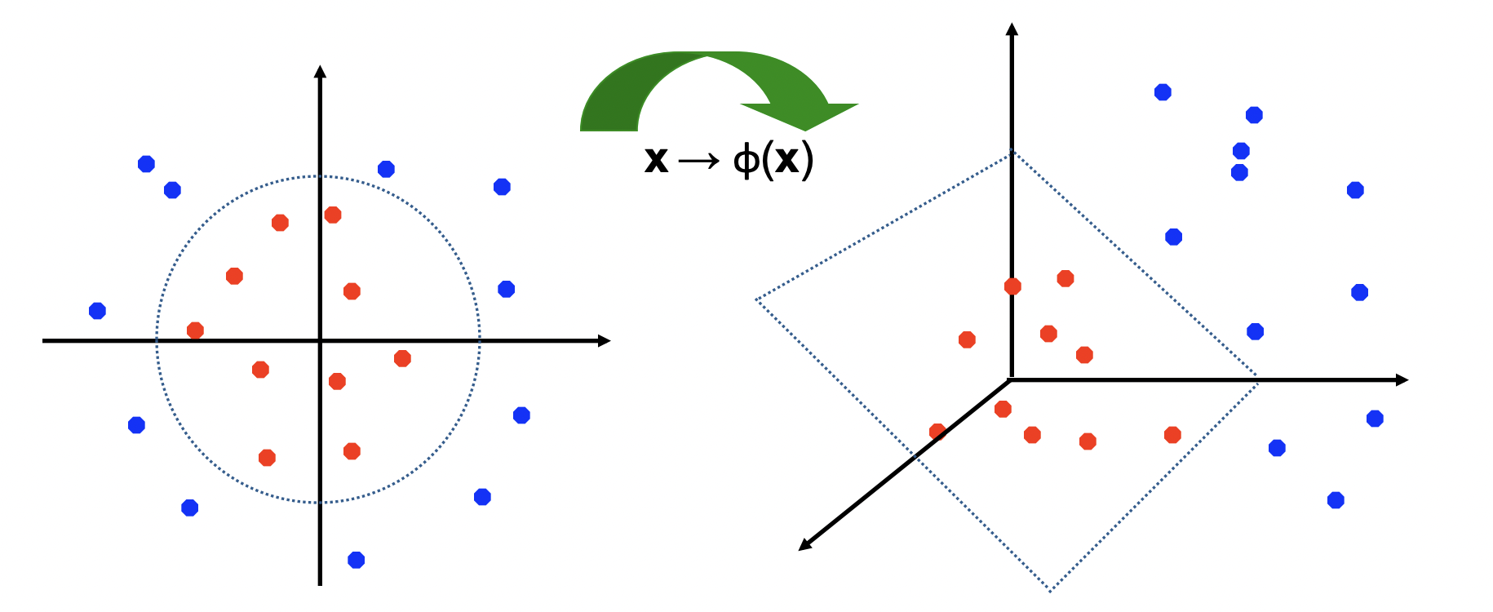
Kernel Methods
Kernel methods are used to move non-linearly separable data into higher dimensions where they are linearly separable
Because φ(x) may have a huge number of dimensions, we never want to work with it directly
Instead, rewrite all functions to use kernel functions K(x,z)=φ(x)•φ(z)

Slide 6
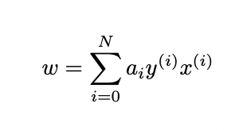
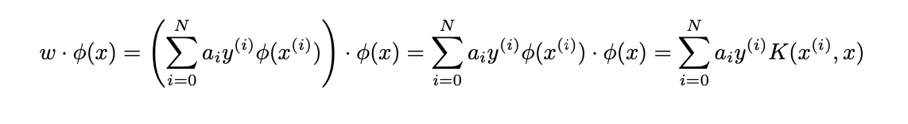
Kernel Methods for SVMs
We can easily kernelize SVMs if we figure out how to express w as a linear combination of training data
This is because:
We now need to find values of a that maximize the margin

Slide 7
Constrained Optimization
We have presented finding an SVM boundary as a constrained optimization problem:
So far, we have assumed that software packages can find this minimum for us
Now we will talk more about constrained optimization to find a different way to rewrite this problem

Slide 8
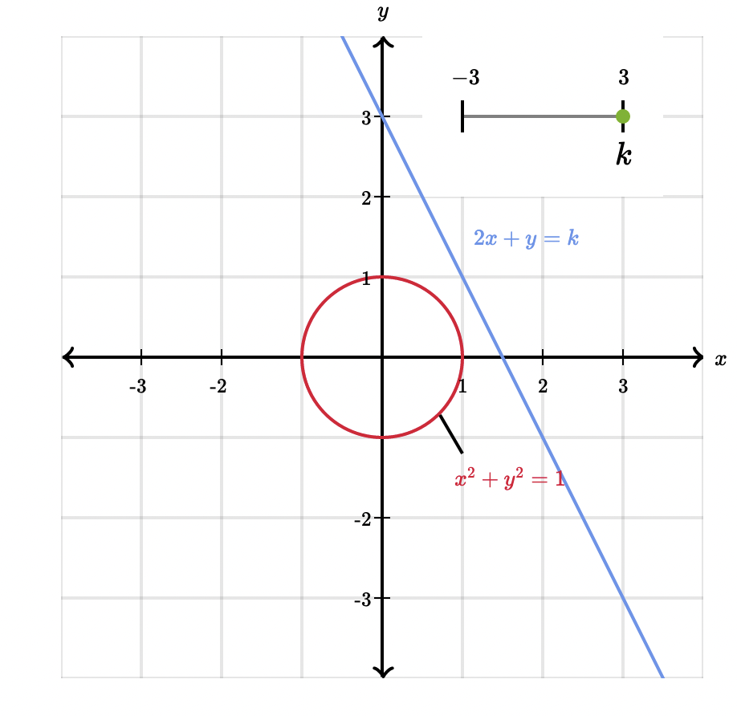
Constrained Optimization
Let us assume f(x,y) = 2x + y and g(x, y) = x² + y²-1
We would like to find the maximum value of f(x,y) such that g(x,y) = 0
If the maximum value of f(x,y) (under these constraints) is k, the optimal values of x and y fall on the line 2x+y = k

Slide 9
Constrained Optimization
There are three possibilities for the line f(x,y)=k
If the line doesn’t intersect g(x,y) = 0, then k is not a viable maximum because we cannot meet our constraints
If the line intersects g(x,y) = 0 twice, we can find some ε > 0 such that f(x,y) = k+ε also intersects g(x,y) = 1 (so k is not a maximum)
If the line is tangent to g(x,y) = 0, then k must be either a maximum or a minimum!
Therefore, we’re trying to find k such that f(x,y)=k is tangent to g(x,y) = 0

Slide 10
Finding a Tangent
f(x,y) and g(x,y) are tangent at a point if (and only if) their gradients at that point have the same direction
Note that this is true even f is not linear
Since the magnitudes may be different, we now need to find x, y, b such that ∇f(x,y) = b∇g(x,y)
In this case, since f(x,y) = 2x + y, ∇ f(x,y) = <2, 1>
Since g(x, y) = x² + y² - 1, ∇g(x,y) = <2x, 2y>
We now have two constraints we need to fill to find optimal (x,y)
b * <2x, 2y> = <2, 1>
x² + y² - 1 = 0

Slide 11

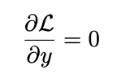

Using Lagrangians
We have now reduced our problem down to two constraints:
∇f(x,y) = b∇g(x,y)
g(x, y) = 0
Now, let’s define a function ℒ(x, y, b) = f(x,y) - b*g(x,y)
Since ∇f(x,y) - b∇g(x,y) = 0, and
Additionally,
Thus, we can find optimal values of x and y if ∇ ℒ = 0

Slide 12
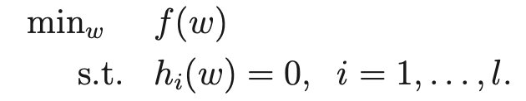
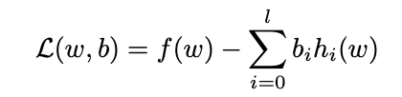
Lagrangian Optimization: Multiple Constraints
We can extend this to a broader case where we have multiple equality constraints, all of which must be tangent to the function we’re trying to optimize:
Then we define the Lagrangian function:
Again, we can solve for ∇ ℒ = 0
Notes:
Note that we could turn the minus into a plus by flipping the signs on b

Slide 13
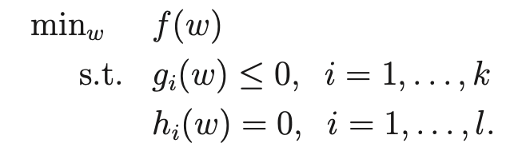
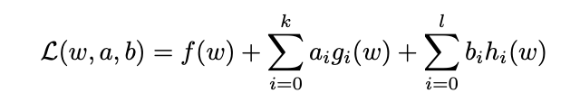
Generalized Lagrangian
Now let’s look at our general convex optimization case that includes inequality
Let us now define a generalized Lagrangian function

Slide 14
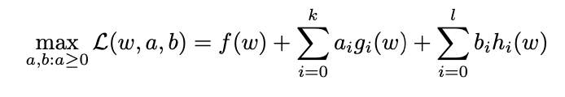
Generalized Lagrangian
Let us consider the maximum value of ℒ on a fixed w, given that a_{i} is always nonnegative:
If g_{i} > 0 for some i, we can make this arbitrarily large by making a_{i} arbitrarily large
If h_{i}(w) ≠ 0 for some i, we can make this quantity arbitrarily large by setting b_{i} to be arbitrarily large or arbitrarily small depending on the sign of h_{i}(w)

Slide 15

Generalized Lagrangian
Let us consider the maximum value of ℒ on a fixed w, given that a_{i} is always nonnegative:
If all conditions are met a_{i}g_{i}(w) ≤ 0 for all i, and h_{i}(w) = 0, so the maximum value of ℒ is just f(w)
Because we could set a_{i} to be 0 for all i, the maximum value for the sum over all values of a_{i}g_{i}(w) is 0
Then, our optimization problem is just

Slide 16

The Dual Form
We have shown that our minimization problem is equivalent to
We call this the primal form of the optimization problem
We can now pose the dual optimization problem:
In the general case, the value of the dual problem is always less than or equal to the value of the primal problem
If f and g_{i} are all convex and h_{i} are all affine (linear), they primal form and dual form are equal!

Slide 17
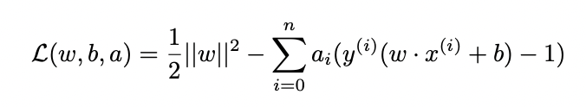

The Dual Form for SVMs
Recall we are trying to find:
Then, we can write the Lagrangian function:
We will try to find the dual form:
Notes:
We’re using the hard margin version for now

Slide 18
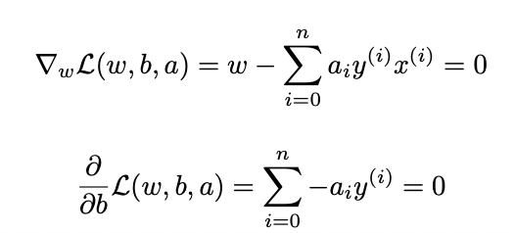
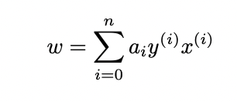
Dual Form for SVMs
To find , we must first find w and b that minimize ℒ for a given value of a
We can do this by setting gradients to 0:
Note that this means:

Slide 19
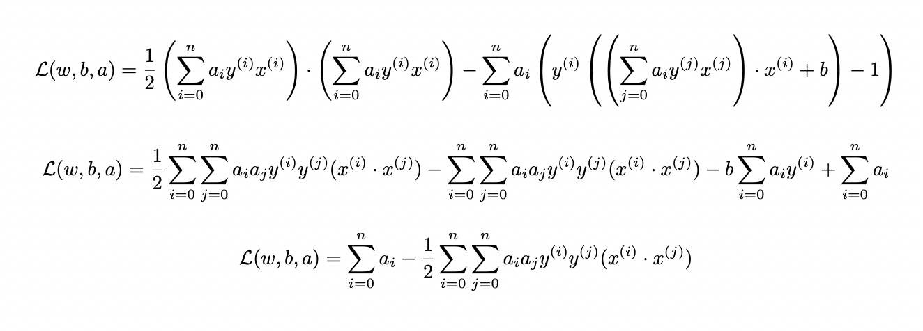
Dual Form for SVMs
Now we can plug this value of w back into our Lagrangian:

Slide 20
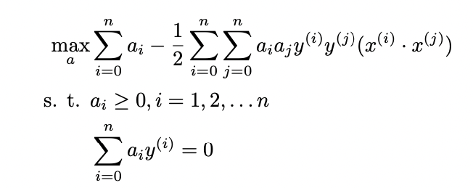
Dual Form For SVMs
Now we can rewrite our minimization as the dual form, a maximization problem over a:
Again, this can be solved using software for convex optimization (using an approach similar to gradient descent)
To do soft margin SVM, the inequality constraint becomes 0 ≤ a_{i} ≤ C

Slide 21

Support Vectors
Note that we got here by trying to optimize the Lagrangian
Because we are trying to maximize this (given a fixed w), we want the second term to be 0, and we would specifically like for all i:
This means that if a_{i} isn’t 0, y^{(i)}(w • x^{(i)} + b) = 1
Therefore, a_{i} is only nonzero if (x^{(i)}, y^{(i)}) is a support vector!

Slide 22
Kernelized SVM
We now have done we set out to do and found a way to express the problem of finding an SVM classifier as the problem of finding a_{i} such that
Furthermore, we can classify all points using a small number of calculations of the kernel function, since a_{i} is only nonzero for support vectors!

Slide 23
More on Kernels
Recall, the only kernel we have looked at is the polynomial kernel K(x,z) = (1 + x•z)^{n}
However, this is only one possible kernel!
A kernel can be any function that behaves like a dot product

Slide 24
Kernels, In General
What does dot product actually mean geometrically?
Recall that a•b = ||a|| ||b|| cos(θ), where θ is the angle between a and b
cos(θ) is larger, the smaller the angle between the two vectors is, so the dot product can be seen as a measure of similarity between two vectors
We want our kernels to also be measures of similarity
Specifically we will be looking at how close a point is to our different support vectors!

Slide 25
Properties of Kernels
Instead of thinking about kernels in terms of feature maps (i.e. what φ do they correspond to), let’s think about them in terms of desirable properties
Kernels should roughly measure similarity between two points and should otherwise “behave like dot products”
K(x, x) > 0 for nonzero x
K(x, z) = K(z, x)

Slide 26
RBF Kernels
The most common kernel used with SVMs is actually the radial basis function aka Gaussian kernel
Since ||x – x’|| is the Euclidean distance, this is 1 when x=x’ and get exponentially smaller as they grow further apart
Note: the feature map here corresponds to the Taylor series expansion of this function and has infinitely many dimensions
Packages exist to approximate the feature map if needed

Slide 27
Tuning RBF Kernels
The RBF kernel is based on a Gaussian (bell curve) function on the square of the Euclidean distance between two vectors
Large when the two vectors are close, very small otherwise
σ determines how close counts as “close”
Small σ: points must be very close together, chance of overfitting
Large σ: more distant points can count as close, chance of underfitting
Often will wind up tuning a hyperparameter γ that is inversely proportional to σ

Slide 28
Mercer’s Theorem
Let us define a n x n matrix M by picking n arbitrary points x⁽¹⁾ through x^{(n)} and defining M_{i,j} as K(x^{(i)}, x^{(j)}) for any i, j
We will call M the kernel matrix
Mercer’s theorem: A function K(x, z) is a valid kernel iff it is symmetric and if the kernel matrix M is positive semidefinite
Positive semidefinite: for any vector z of length n, zMz^{T} is nonnegative
Proof provided in textbook

Slide 29
Commonly Used Kernels
Linear: K(x, z) = x • z
Polynomial: K(x, z) = (x•z + c)^{n}
RBF:
Sigmoid: K(x, z) = tanh(γ x•z + r)
Notes:
Sigmoid similar to the logistic regression sigmoid function

