Slide 1
Nearest Neighbors
Rose Sloan
rsloan@bard.edu

Slide 2
How do we represent data?
Data can take on many forms (images, text, numerical)
Many ML techniques can be used on all of this data
How do we bridge the gap?

Slide 3
From Data to Feature Vectors
All data needs to be represented as vectors
Each component numerically represents a different feature
May have large dimension—all data points in our data set should have the same dimension

Slide 4
Features and Abstraction
Features may be “direct” representations of data, results of sophisticated analysis, or something in between
(Note: this is separate from data cleaning)
Text (e.g. movie reviews)
Bag of words
Counts of specific key words (e.g. “good”)
Words with positive correlations
Images (e.g. OCR)
Pixel by pixel RGB values
Number of lines and curves

Slide 5
From Features to Vectors
Numerical features (e.g. age) – include directly
Boolean features (e.g. isAdult) – 1 for true, 0 for false
Category features (e.g. eye color) – how?
Could say brown=1, blue=2, green=3, etc., but this causes problems… why?

Slide 6
One-Hot Vectors
Don’t want to collapse categorical features into one component because, e.g., brown isn’t closer to blue than green
Instead, treat a feature with n possible feature, as n binary features
One-hot vector, one component is 1, rest are 0
<0, 1, 0, 0, 0>
brown
blue
green
hazel
gray

Slide 7
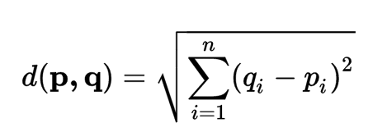
Distance between Vectors
Now that we can represent data points as vectors, we can find distance between any two data points
Many ways to do this, most common is Euclidean distance

Slide 8
Nearest Neighbor: Concept
For a new data point, find the “closest” labeled data point in our training data
Assign new point the same label as this closest point

Slide 9
Nearest Neighbor: Pseudocode
NN-predict(x, training_data):
min_distance = infinity
for y in training_data:
if distance(x,y) < min_distance:
min_distance = distance(x,y)
nearest_neighbor = y
return label(nearest_neighbor)

Slide 10
Evaluating Nearest Neighbors Results
NN is a classification problem (may be binary or multi-class)
Look at error rate, what percentage of items does our classifier get wrong?
Error rate on the training set will always be zero—why?
Calculate error rate on a held out test set—never touch this during training
Some data (including MNIST) will come with pre-made test set
Otherwise, hold out about 20% of data before training

Slide 11
Example: Digit OCR
Given a handwritten digit, can we tell what digit it is?
Input: 28x28 greyscale images
Output: label in {0,1,2,3,4,5,6,7,8,9}
MNIST Dataset
From the National Institute for Standards and Technology
60,000 training images, 10,000 test images
All images have been pre-processed—size normalized and centered

Slide 12
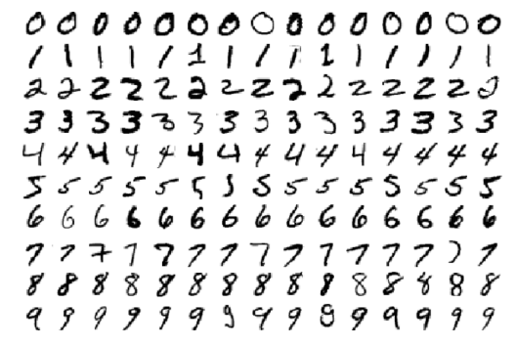
Digit OCR: MNIST data set

Slide 13
Nearest Neighbors for OCR
Represent each image as a 28² = 784 dimension vector
Each component is the grayscale value of a pixel
Take Euclidean distance (compares pixel by pixel differences)

Slide 14
Nearest Neighbors for OCR
Why is this good for images?
When is this not so good for images?

Slide 15

Nearest Neighbors Examples

Slide 16

Nearest Neighbors Examples

Slide 17
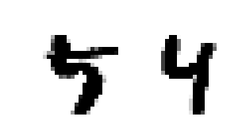
Nearest Neighbors Examples

Slide 18
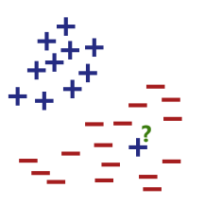
Beyond Nearest Neighbor
NN algorithm assumes that “nearby” images usually have the same label
What happens in the gray areas?
What happens with outliers in the training set?

Slide 19
Improving the method: kNN
To account for outliers, let’s instead look at multiple neighbors
New concept: find the k nearest neighbors, assign most common label among those labels
Break ties randomly
Need to determine k beforehand

Slide 20
kNN Pseudocode
kNN-predict(k, x, training_data):
for y in training_data:
store (label(y), distance(x,y)) in S
sort S by distance
S_{k}= k smallest distances in S
return plurality_label(S_{k})

Slide 21
Choosing k
k is what we call a hyperparameter—quantity that controls how the ML algorithm runs and must be set before training
What are the benefits/risks of different values of k?
Low value–risk of overfitting
High value—risk of underfitting
k often has to be determined experimentally
Usually want to use an odd value of k–why?
For digit OCR: 3 is generally the best value for k

Slide 22

kNN examples: digit OCR

Slide 23
Considerations with kNN
Nearest neighbors methods are non-parametric
Parametric methods–machine learning techniques where training determines some set of values (parameters) that can be stored and used to run the model
No training phase, must go through the entire training set
By default, O(nd) where n is size of training set and d is dimension
This can be optimized a little with some cleverness

Slide 24
More Considerations: Features and Scaling
Base assumption: points that are “close” together are likely to have the same label
Remember our vectors are made up of features
By default, kNN uses all features and weights them all equally
Scaling of features matters a lot (e.g. 10 vs. 1 is a bigger difference than 1 vs. 0.1)
Noisy features can be a big problem, especially if scale is off

Slide 25
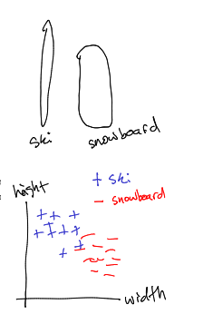
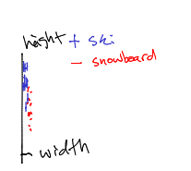
Feature Scaling Example
Consider classifying skis vs. snowboards by length and width
Length usually measured in centimeters:
Skis 130-190 cm, snowboards 90-170 cm
Height usually measured in millimeters: usually measured in millimeters
Skis 70-130 mm, snowboards 230-270 mm
But what happens if we measure width also in cm?

Slide 26
“Curse” of Dimensionality
We are usually going to work on high dimensional data
Computation slower in larger dimensions
Large distances/data sparsity
Consider breaking a (hyper)cube with side length 5 into unit (hyper)cubes
25 in dimension 2, 125 in dimension 3, 10⁵⁴⁸ in dimension 748
Distances go up, but variance stays the same throughout dimensions (but fortunately distributions are not uniform!)
Notes:
Only 10^82 atoms in the universe, so our data is definitely not that big!

Slide 27
Going Further: Distance Metrics
Euclidean distance is a good general purpose distance metric
Not the “best” in every case
Can look at other distance metrics for certain problems

Slide 28
Distance Metrics: Requirements
distance(x, x) = 0
distance(x, y) >= 0 (positivity)
distance(x, y) = distance(y, x) (symmetry)
distance(x, z) <= distance(x, y) + distance(y, z)

Slide 29

Generalizing Distance
Minkowski distance or l_{p} distance is a generalization of Euclidean distance

Slide 30
Manhattan Distance
Another name for l₁
Also called taxicab distance
Simply the sum of differences among all coordinates
Can be useful for very high dimensional data

Slide 31
Domain-Specific Distances
Text: string edit distance
Number of insertions, deletions, and substitutions to get between 2 strings
E.g. Kitten and sitting have distance 3
Kitten->sitten->sittin->sitting
Images: Shape distance
Audio: Difference of various features using dynamic time warping

Slide 32

Distance metrics: Digit OCR
l₂ works pretty well, l₃ works better
Image-specific distance functions work even better

Slide 33
kNN Conclusions
Nearest Neighbors approaches can be very powerful when items that are ”close” to each other geometrically are likely to have the same label
kNN treats all features as equally important
Features need to be scaled correctly
Proper choice of k is important
kNN is non-parametric, inefficient to store and (in most cases) to run

Slide 34
For next time
Read chapter 3 of textbook

