Slide 1
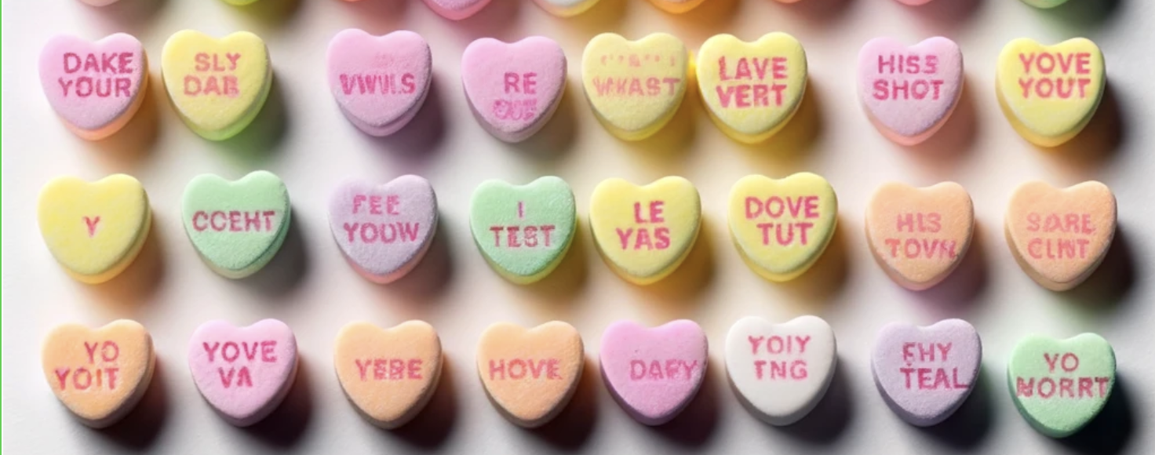
Decision Trees and Evaluation
Rose Sloan
rsloan@bard.edu

Slide 2
Assignment 1
Available now
Implement kNN on digit OCR and test for four values of k (1, 3, 5, 7)
Must use at least 6000 training points, 1000 test points
May want to test your code on a very small subset of this!
Must turn in code and report three things:
Error rates for each k
Confusion matrix (discussed Wednesday) + written description of most commonly confused numbers
Suggestion for improvement

Slide 3
What About Overfitting?
So far, we have stopped only when we have either perfectly classified all our data or we have run out of features
We are perfectly fitting to our training data
This might be bad! (Why?)
Need to find ways to make our trees smaller and less tailored to the training data

Slide 4
A Simple Approach
By default, our maximum depth is the number of features (may be large!)
Instead, set a maximum depth
At maximum depth, turn all nodes into leaves
Maximum depth becomes a hyperparameter
May work well, but may fail when different branches need different numbers of features

Slide 5
A Better Approach: Pruning
Basic idea: Instead of having a maximum depth for the whole tree, make sure we don’t expand nodes that don’t need to be expanded
Pre-pruning: While training, run tests to see if a node should be expanded
Post-pruning: Train the whole tree first, then remove branches that overfit

Slide 6
Post-Pruning
Split our training data into two parts
One part is used to train the tree as before: training set
One part is used to figure out how to prune: validation set
For each node, turn the node into a leaf—does doing this improve our classification accuracy on the validation set?
If yes, prune subtree rooted at that node
If no, do not prune

Slide 7
Tennis Example: Pruning
Overcast?
yes
no
return YES
High Humidity?
yes
no
Sunny?
Strong Wind?
yes
no
no
yes
return NO
Strong Wind?
Return YES
Sunny?
no
yes
no
yes
return YES
return NO
return NO
return YES

Slide 8
Tennis Validation Set
Day | Weather | Temperature | Humidity | Wind | Play Tennis?
1 | Sunny | Hot | Normal | Strong | Yes
2 | Rain | Mild | Normal | Strong | Yes

Slide 9
Tennis Example: Pruning
Overcast?
yes
no
return YES
High Humidity?
yes
no
Sunny?
Strong Wind?
yes
no
no
yes
return NO
Strong Wind?
Return YES
Sunny?
no
yes
no
yes
return YES
return NO
return NO
return YES

Slide 10
Calculating Validation Error
Strong Wind?
If we expand this node: would classify 1 right and 2 wrong: .5 validation error
If we don’t: majority class at this node is Yes, would get 0 validation error
Therefore: Prune tree
yes
no
Return YES
Sunny?
no
yes
return YES
return NO
Day | Weather | Temperature | Humidity | Wind | Play Tennis?
1 | Sunny | Hot | Normal | Strong | Yes
2 | Rain | Mild | Normal | Strong | Yes

Slide 11
Tennis Example: Pruning
Overcast?
yes
no
return YES
High Humidity?
yes
no
Sunny?
Return YES
yes
no
return NO
Strong Wind?
yes
no
return NO
return YES

Slide 12
More Stopping Heuristics
Generally will want to use pruning but can also use
Depth
Number of data points at node
Entropy at a node
These are all hyperparameters and will need to be determined based on the data size, range, etc.
DO NOT use decrease in loss after splitting as a stopping heuristic (why?)

Slide 13
Classification vs. Regression
So far, we’ve only been looking at classification
Classification – predict from a set of discrete labels
Given weather data, will it rain tomorrow?
Regression – predict a continuous value
Given weather data, how many inches of rain will we get tomorrow?

Slide 14
Regression Trees
Can use the same framework from decision trees to do regression
Same recursive algorithm, but can’t use entropy
Instead, generally trying to minimize differences between predicted and true values
Each leaf will return the average value, instead of the majority class
Pruning (or otherwise stopping overfitting) very important!

Slide 15
Example: # of Minutes Playing Tennis
High Humidity?
yes
no
Sunny?
Sunny?
yes
no
yes
no
return 0
return 30
return 120
return 60

Slide 16
Decision Trees: Conclusions
Decision trees are a parametric model that is best used when data can be classified by looking at a (relatively) small number of features per data point
Looking at information gain and entropy can help us pick “good” splits
Pruning is necessary to avoid overfitting

Slide 17
Discuss
What do we want our models to do?
What do we NOT want our models to do?

Slide 18
Bias and Variance
Bias: How wrong are our model’s predictions?
i.e. how much are we using our model’s priors instead of things we’ve learned from the data?
Models with high bias are underfitting
Variance: How inconsistent is our model when trained on different data?
i.e. how much are we tailoring our model to our specific training data
Models with high variance are overfitting

Slide 19
Training and Testing
To avoid overfitting, we never want to evaluate our model based only on training performance
In some cases (like kNN), training accuracy is meaningless
Hold out part of the data as a test set – usually 20%
Ideally: do not touch test data until we are ready to evaluate our final model’s performance
Note: using this approach, we cannot evaluate how our data performs on a (substantially) different data set
ML models will never generalize to data that is very different from our training set!

Slide 20
Validation Set
We may need to tune our model using data that’s not in our training set
Generally, we don’t want to use our test set for this
We do not train on the validation set but can test models on them and adjust based on results
Usual split: 80% train, 10% test, 10% val

Slide 21
The Many Uses of Validation Sets
Early stopping
Pruning or other tuning
Determine optimal hyperparameters
Determine which ML algorithm to use

Slide 22
One Use of Validation: Grid Search
Method for determining optimal hyperparameters
Approach: for each hyperparameter, determine a discrete set of possible values
Try all combinations, calculate validation loss on each
Generally want to train the different models in parallel!

Slide 23
Using Validation: In Practice
Pruning/tuning/early stopping: must use validation set
Can never use test set directly in the training process!
Exhaustive grid search: should use validation
If we are testing many models with many different hyperparameters, picking the optimal one based on test performance will likely overfit to our test data
Comparing a small number of models: might use validation set
If comparing a very small number of models, less likely to overfit to test data
Still a good idea to use a validation set, but in practice, some don’t

Slide 24
Another Approach to Testing
What happens when we need to use validation loss to set stopping conditions but also have many hyperparameters?
Can we run a grid search without using a validation set and without overfitting to the test set?
Concept: try various train/test splits, average performance over them

Slide 25
K-Fold Cross-Validation
Split our data into k even partitions
Instead of training and testing once, train k models
Each time, use a different partition as a test set and train on the remaining k-1 partitions
Report average error over all k models
Common values for k: 5 or 10

Slide 26
Leave One Out Validation
Leave One Out Validation
Set k to be the size of our data set (N)
Train N models, testing each one on a single data point
Usually not practical, but used for kNN (why?)
Leave One X Out Validation
When working with real data, our data set may have a small number of “natural” partitions
Speakers in speech data, locations of images, authors of text data, e.g.
To avoid overfitting to any one of these partitions, do cross-validation on these partitions
Requires that the partitions have roughly equal sizes

Slide 27
Moving Beyond Accuracy
So far, we’ve looked at only at accuracy—what percentage are we getting right?
This is a useful measure, but it doesn’t give us the whole picture, especially with imbalanced classes
Consider: a test set with 90 negative examples and 10 positive examples
A model that predicts 1 positive example correctly and otherwise always predicts negative has 91% accuracy
A model that gets 80/90 negative examples right and 9/10 positive examples right only has 89% accuracy

Slide 28
Precision and Recall
Instead of looking at accuracy, we can look at precision and recall
Precision: are the points we’re classifying as positive actually positive?
Precision = # of true positives/# of points classified as positive
High precision means few false positives
Recall: are we classifying all the actually positive points correctly?
Recall = # of true positives/# of points with positive labels
High recall means few false negatives

Slide 29
Precision and Recall: Imbalanced Data
Again, consider a test set with 90 negative and 10 positive examples
Model 1: 1 true positive, otherwise predict negative
Precision: 1
Recall: 0.1
Model 2: gets 80/90 negative examples right and 9/10 positive examples right
Precision: 9/19 ≈ 0.47
Recall: 0.9

Slide 30
F-Measure
Also called f-score, a way to compare both precision and recall
F1 is the harmonic mean of precision and recall
Last slide’s example
Model 1’s F1 = 2/(1 + 10) ≈ 0.18
Model 2’s F1 = 2/((10/9) + (19/9)) ≈ 0.62
Can also calculate F-scores that prioritize precision or recall

Slide 31
Confusion Matrix
In addition to precision and recall, we can report the confusion matrix
Table that displays precise numbers of true positives, false positives, true negatives, and false negatives
Model 2 from example’s confusion matrix:
 |  | Predicted Label
 |  | Positive | Negative
Actual Label | Positive | 9 | 1
 | Negative | 10 | 80

Slide 32
Multi-Class Classification Evaluation
If using precision and recall, must calculate them separately for each class
Can average F1 across different classes
Confusion matrices are frequently used in multi-class classification
 |  | Predicted Label
 |  | Happy | Sad | Angry
Actual Label | Happy | 300 | 30 | 70
 | Sad | 10 | 350 | 40
 | Angry | 90 | 60 | 250

Slide 33
How good is good enough?
On some tasks, we can expect very high accuracy or F1
On other tasks, we are unlikely to achieve very high accuracy or F1
For example, 90% accuracy is quite poor on digit OCR, but well above state of the art for many tasks!
How do we determine if our model is actually good?

Slide 34
Baseline
An easy to train (or already trained) model that we can try to outperform
Baselines are trained on the same data and for the same task
Some baselines are quite weak, others may be quite strong
There are uses for both, but you should know (and report) how strong or weak your baselines are

Slide 35
Common Baselines (Weakest to Strongest)
Majority class baseline
Model that uses 1-2 most relevant features
Shallow decision tree
Model already known to perform well on this task
Prior literature on the same task using the same data
Note: sensitive to train/test split!

Slide 36
A Note on Comparing to Human Performance
In addition to comparing to other ML models, we might want to see how our models perform compared to human performance
For a few tasks, this is a reasonable baseline
For other tasks, this is a ceiling
If reporting human performance, which humans?
If we get “better than human performance” on a human-labeled data set, what does that mean?

Slide 37
Human Performance: Various Tasks
Tasks that humans are bad at
E.g. Lie detection – untrained human performance is barely better than chance
Human performance may be a useful baseline
Tasks that humans are good at
E.g. speech recognition or (some) medical diagnosis
Most ML models will perform worse than humans, but outperforming humans is (maybe) possible
Subjective/human-labeled tasks
E.g. Sentiment analysis
Human error reflects disagreement more than incompetence
Vastly outperforming humans is probably a result of overfitting

