Slide 1

Learning about Social Learning in MOOCs From Statistical Analysis to Generative Model
Nusrat Maisha | Tanvir Mobasshir
Zuhair Ishraq Zareef | Zareen Tasnim Nishat
CSE475
Dr. Md. Golam Rabiul

Slide 2


What is MOOC?
Massive Open Online Courses (MOOCs) are free online courses available for anyone to enroll. MOOCs provide an affordable and flexible way to learn new skills, advance your career and deliver quality educational experiences at scale.

Slide 3
Motivation
Since social learning is a key element of scalable education on MOOC and is done via online discussion forums, our main focus is on understanding forum activities, improving its User Experience, and consequently improving the learning experience.

Slide 4

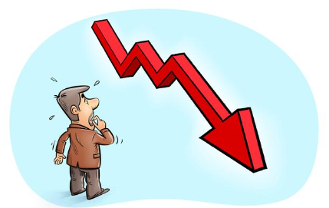

Focused Problems
The Paper addressed following problems on MOOC
Sharp Decline Rate: The amount of interaction rapidly drops soon after a course is launched.
Information Overload: As a course reaches a larger audience, its forum is often flooded by discussions from many students.

Slide 5
Research Questions
How rapidly does the participation rate in the forums decline over time, and what behavioral factors maintain a healthy participation rate?
Is there a way to codify the generative process of forum discussions into a simple model, and if so, can we leverage such a model to facilitate user navigation?

Slide 6


Dataset Sources And Description
_______________________________________________________________________________
_______________________________________________________________________________
All Courses of Coursera During Summer-2013
Primarily two types of data have been collected
Course Info
Forum Posts
Course Categorization:
Vocational or not
Quantitative or not

Slide 7

Description of Course Dataset
_______________________________________________________________________________
_______________________________________________________________________________
Independent Features
Notation | Column Name | Data Type | Description
Q | Quantitative | Boolean | Is the course mathematical?
V | Vocational | Boolean | Is the course theoretical?
L | Video Length | Float | Total video length
D | Duration | Float | Course duration
P | Peer-grading | Boolean | Are some assignments graded by students?
S | Staff activity | Integer | No. of posts by teaching staff
H | Graded homework | Integer | Total no. of homework
M/ M’ | Intrinsic popularity | Integer | How popular was the course at the beginning. M (In case of y) / M’ (In case of z)

Slide 8
Description of Course Dataset
_______________________________________________________________________________
_______________________________________________________________________________
Dependent Features
Notation | Total number of | Data Type | Description
y | posts | Integer | Total posts
z | users | Integer | Total Users

Slide 9
Description of Post Dataset
_______________________________________________________________________________
_______________________________________________________________________________
Column Name | Data Type | Description
Post | Text | Forum Post
Length | Integer | No. of sub posts
Is Course related | Boolean | Is the post course related?

Slide 10

Methodology
For The First Problem
To address the first issue, we will examine factors that contribute to a decline in user participation. We will also consider whether creating too many threads has an impact on user participation.
Regression model: to identify what variables are correlated with the number of posts (or users) in each day for each course.
T-test score: to understand whether the creation of too many new threads in a short time will reduce the depth of discussion.

Slide 11
Methodology
For The Second Problem
To solve this problem we will have to identify which posts are course relevant.
Apply TF-IDF Vectorizer: To extract keywords.
Then place scores on posts based on the rate of keywords found in each post.
Posts with lower scores would be irrelevant.

Slide 12

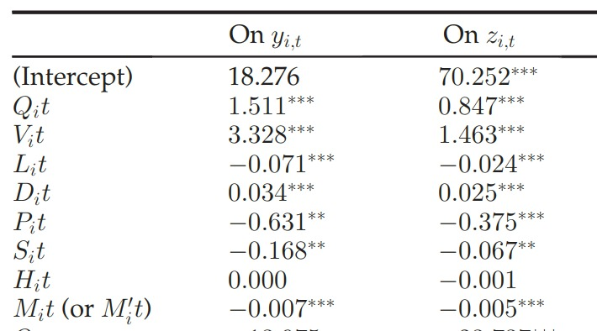
Outcome
_____________________________________________________

Slide 13
Outcome
_____________________________________________________
Outcome for Q1​ ​
Using the mentioned methodology, we found that increased staff activity and peer-grading contribute to a decline in user participation, which was surprising to many. ​
Video length also contributes to the decline in participation rate. ​
Which means these three features are negatively correlated. ​
Outcome for Q2​ ​
Applying the mentioned methodology, it has been managed to rank the posts as per their relevance score. ​
​

Slide 14
Conclusion
_____________________________________________________
The key achievement of this paper is its ranking algorithm which will provide future students with much better learning experiences.
The open issues that need to be addressed after the results reported here are how to stop forum participation from declining and how to use thread rating.

