Slide 1

Welcome

Slide 2
Submitted
By
:
Submitted To:
Tanvirujjaman | CSE2202026130
Mehedi Hasan | CSE2202026147
Md . Tarek Rahman | CSE2202026122
Ayesha Akter Akhi | CSE2202026145
Eva Rahman Fatema | CSE2202026113
Mitu Rani Das | CSE2202026107
Kohinur Parvin,
Lecturer At Sonargaon University

Slide 3
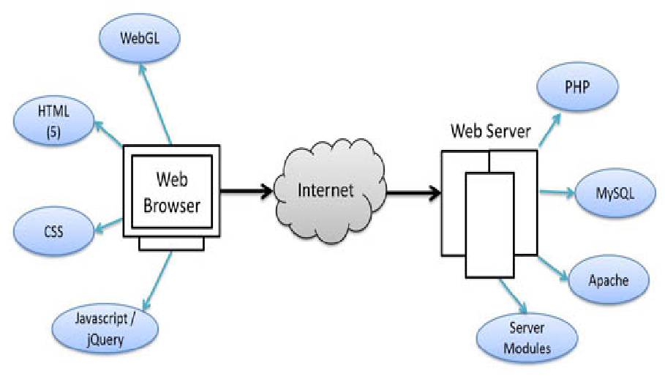
Overview

Slide 4
Project Overview
Introduction
1
6
Conclusion
2
Features
7
Future Scope
3
Advantage
8
Reference
4
Vulnerabilities
5
Architecture &
Diagram

Slide 5
Introduction
‘SU REAL-TIME’ A Notice board means a bulletin board is a surface intended for the posting Of Public Messages, for example- Announce events, or provide information etc.
This is our online notice board.
Online Bulletining :Online bulletin boards are not unlike traditional bulletin boards; their purpose is to display, inform and advertise facts and figures to multiple people at any given time.

Slide 6
Features
This noticeboard is the information box of our University. Every user can clearly see the information that is important for them in the present time in a organize way. The posts on the noticeboard can be addressed to assignees or operators and organized into folders. And also user friendly.

Slide 7
Advantage
Online bulletin board are a very versatile market research tool and offer many benefit ,such as:
1.Convenience
2.Lower cost
3.Anonymity
4.Time saving

Slide 8
Vulnerabilities
It’s a static website.
Its have Some security issue.
Some page are under maintenance.

Slide 9
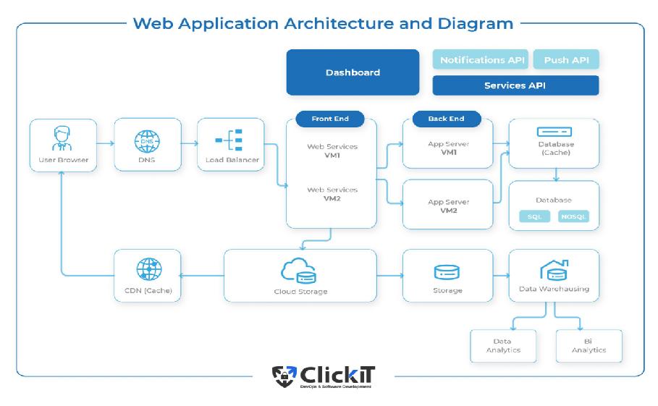

Slide 10
Block Diagram
User
Register page
Yes
Login Page
No
Yes
No
Home Page
Select Another categories
Yes
No
Back to Register page
End

Slide 11
Conclusion
Online notice board is one of the applications to improve the usage of notice board of the college by making it Available online. This web application involves almost all the features of notice board. In the online Notice board project all the updates like, add, delete, view are done by admin, so that user will get the updated .Current information through notice board online. It is efficient and easy to handle.

Slide 12
Future Scope
1.Add maintenance pages and other department notice page.
2.Desing home page more better way.
3.Do CSS in better and attractive way.
4.Add searching option to search custom date notice.
5.Secure database.

Slide 13
Reference
1. Sonargaon University Website
2. Sonargaon University CSE BD ( Facebook Group )

Slide 14

Thank You
Everyone

