Slide 1
Secure data Hiding in images using Steganography
CAPSTONE PROJECT
Presented By:
Student Name : ADNAN TANWEER
College Name & Department : AL-KABIR POLYTECHNIC, C.S.E
Computer Science & Engineering

Slide 2
OUTLINE
Problem Statement
Technology used
Wow factor
End users
Result
Conclusion
Git-hub Link
Future scope

Slide 3
Problem Statement
In today's digital world, ensuring secure communication is a major challenge. Text-based encryption can often be detected, making it vulnerable to cyber threats. This project embeds secret messages within image pixels, offering an undetectable and secure way to store and transfer sensitive information.

Slide 4
Technology used
Programming Language: Python
Libraries: OpenCV (cv2), OS
Platform: Windows/Linux

Slide 5
Wow factors
Steganography-Based Security: Instead of encrypting messages traditionally, this project hides text inside an image.
Undetectable Encryption: The message is stored in pixel values, making it invisible to the human eye.
Lightweight & Fast: The method does not require large computation power.
Secure Access: The message can only be retrieved using the correct passcode.

Slide 6
End users
Cybersecurity Professionals: For secure data transmission.
Government & Military Organizations: To hide sensitive communication.
Journalists & Activists: For secure information exchange.
General Users: For private and confidential messaging.

Slide 7
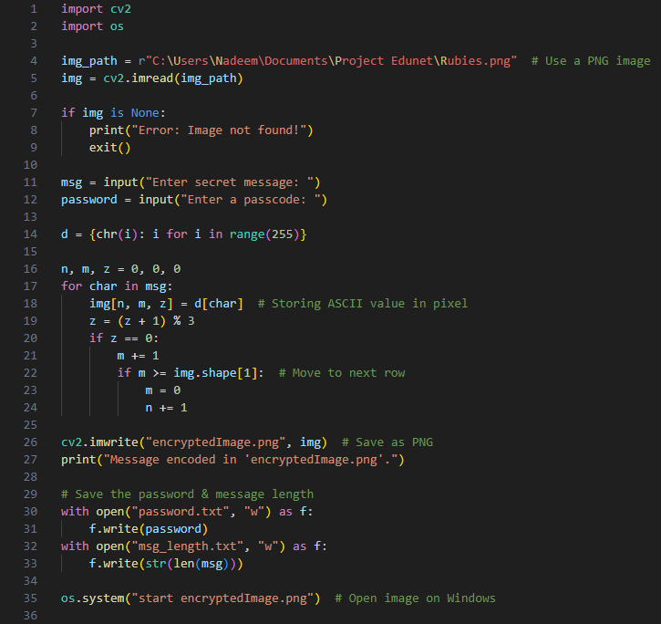
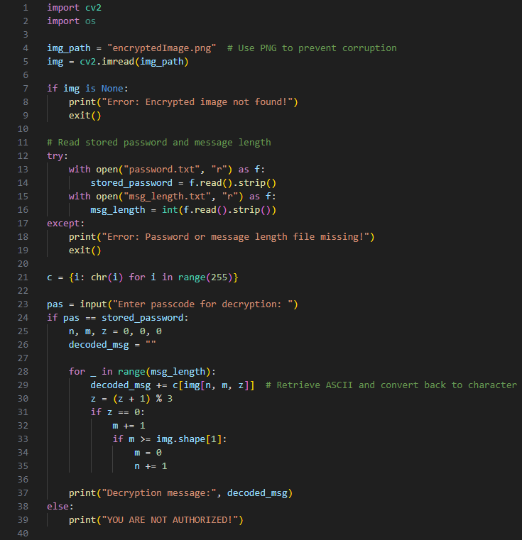

Results
Output Image
Encryption Execution
Decryption Execution

Slide 8
Conclusion
This project successfully implements a steganography-based encryption system to store secret messages inside images. The technique ensures secure, undetectable communication without altering the visible properties of the image. The use of a passcode further enhances security, preventing unauthorized access.

Slide 9
GitHub Link
https://github.com/TanweerAdnan/Edunet_x_AICTE_Project.git

Slide 10
Future scope(optional)
Implementing AES encryption along with steganography for double security.
Extending to video-based encryption for secure multimedia communication.
Developing a GUI-based tool for user-friendly access.
Enhancing support for multiple image formats like JPEG, BMP, and TIFF.

Slide 11
THANK YOU

