Slide 1

CAPSTONE PROJECT Real-Time Intrusion Detection Using ML
Presented By
Student Name: Adnan tanweer
College Name: al-kabir polytechnic
Department: computer science & engineering
Email ID: ADNANTANWEER83@GMAIL.COM
AICTE Student ID: STU67670e3ccc5de1734807100

Slide 2
OUTLINE
Problem Statement (Should not include solution)
Proposed System/Solution
System Development Approach (Technology Used)
Algorithm & Deployment
Result (Output Image)
Conclusion
Future Scope
References

Slide 3
Problem Statement
Currently, the rise in cyber threats poses a significant challenge to maintaining secure and trustworthy digital infrastructures. Organizations often struggle to identify potential intrusions in real-time, leading to data breaches and service disruptions. Manual monitoring of network activities is insufficient and prone to delays or human error. Therefore, an automated system capable of accurately detecting potential cyber intrusions in network traffic is essential to bolster security defenses and ensure timely incident response.

Slide 4
Proposed Solution
The proposed system focuses on developing an automated machine learning-based intrusion detection system to classify network
activities as either normal or potential attacks. The system combines data preprocessing, model training, and prediction with
meaningful recommendations to improve network security awareness.
Data Collection:
Utilize a labeled cybersecurity intrusion dataset with features representing various aspects of network sessions (e.g., port number).
Ensure the dataset includes both numerical and categorical variables relevant to intrusion detection.
Data Preprocessing:
Handle missing values, encode categorical variables using one-hot encoding, and scale numerical features using standardization.
Use a Column Transformer to apply transformations within a single pipeline for consistency and efficiency.
Machine Learning Algorithm:
Employ a Logistic Regression model, suitable for binary classification problems like attack vs. no attack.
Optimize hyper parameters (e.g., maximum iterations) and evaluate the model on a hold-out test set.
Deployment:
Build a predictive pipeline using scikit-learn that integrates preprocessing and classification steps.
Use the trained model to classify incoming data and generate alerts for potentially malicious activity.
Provide actionable recommendations based on model predictions for enhanced threat response.
Evaluation:
Evaluate model performance using metrics like the confusion matrix, precision, recall, and F1-score.
Visualize results using heatmaps and structured classification reports for better interpretability.

Slide 5
System Approach
System Requirements:
A stable Python development environment (Google Colab, Jupyter Notebook, or local IDE)
Access to a labeled intrusion detection dataset (cybersecurity_intrusion_data.csv)
Sufficient memory and processing capabilities for training and testing models
Libraries Required:
pandas, numpy – Data manipulation
matplotlib, seaborn – Data visualization
scikit-learn – Preprocessing, model training, and evaluation
io, files (Colab-specific) – Data upload and file handling

Slide 6
Algorithm & Deployment
Algorithm Selection:
The Logistic Regression model is selected due to its effectiveness in binary classification and its interpretability.
It is a fast and efficient algorithm, suitable for large datasets with both numeric and categorical features.
Data Input:
Inputs include numerical and categorical columns from the dataset (e.g., bytes sent, protocol type, connection state).
The target variable is attack_detected, which is binary (1 = Attack, 0 = No Attack).
Training Process:
Split the dataset into training and testing sets (80/20 ratio).
Apply standard scaling to numeric features and one-hot encoding to categorical ones.
Use a pipeline to ensure consistent transformation and modeling steps.
Fit the model to the training data and validate using the test set.
Prediction Process:
Make predictions using the trained model.
Map output to user-friendly labels ("Attack", "No Attack").
Provide basic recommendations based on the prediction label to assist in decision-making

Slide 7
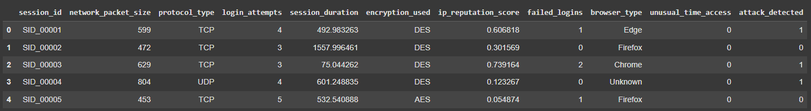
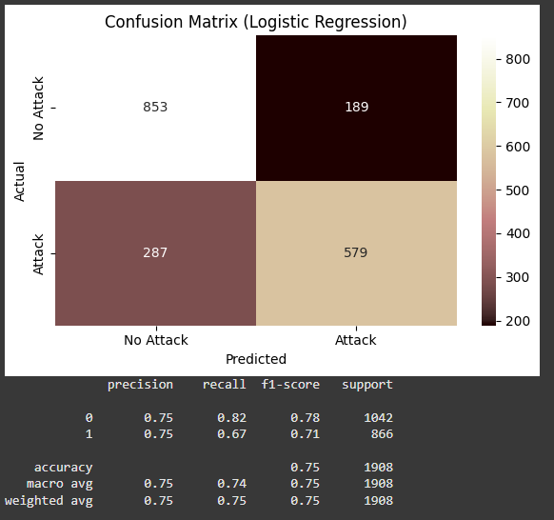
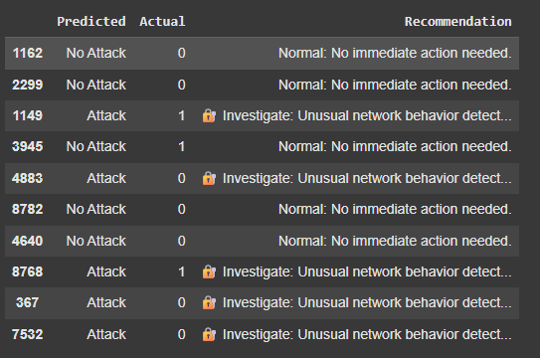
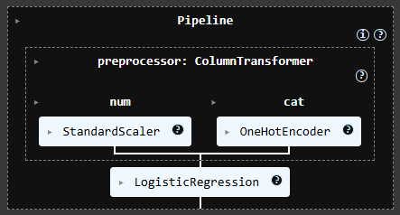
Result
Model Performance:
A Confusion Matrix heatmap is generated to visualize the number of correct and incorrect predictions.
A Classification Report is printed, showing precision, recall, F1-score, and support for each class.
Training data
Model Training
Final Output
Confusion Matrix

Slide 8
Conclusion
The implemented intrusion detection system successfully identifies suspicious network activities using machine learning. The combination of preprocessing, modeling, and interpretability through Logistic Regression results in a lightweight yet effective solution. The system demonstrates the potential of automated cybersecurity tools to support real-time monitoring and decision-making. The integration of recommendation logic adds contextual relevance to each prediction, increasing practical utility.

Slide 9
Future scope
Integrate advanced classification algorithms such as Random Forest, XGBoost, or deep learning models for enhanced accuracy.
Incorporate real-time streaming data using tools like Apache Kafka or socket programming for live monitoring.
Extend support to multi-class classification to distinguish between different types of attacks.
Develop a dashboard for visualization and management of detection results.
Leverage cloud platforms for scalable deployment and monitoring across multiple network segments.

Slide 10
References
Scikit-learn Documentation: https://scikit-learn.org/stable/
Cybersecurity intrusion detection datasets (e.g., NSL-KDD, CICIDS)
Research articles on machine learning for cybersecurity
Python Official Docs: https://docs.python.org/3/
Matplotlib and Seaborn documentation for visualization techniques
GitHub Link: https://github.com/TanweerAdnan/intrusion-detection-ml.git

Slide 11
Thank you

