Slide 1

1. YOLO Detection
VisionGuard
2. Depth Estimation
Real-Time Depth-Aware Object Detection
3. TTC Calculator
and Risk Analysis Prediction
Deep Learning Project
4. Conditions Detect
No LiDAR
Camera Only
Indian Roads
5. RL Alert Agent
K.Tanya [160123748018]
Complete AI Pipeline

Slide 2




Problem Statement
1,53,972
LiDAR too expensive
Tesla ADAS uses LiDAR/Radar costing $4,000–$75,000 per unit — unaffordable for most Indians
Road accident deaths
India — 2021
Indian roads ignored
Existing models trained on western COCO dataset — no autorickshaws, cattle, or overloaded bikes
No adverse conditions
Most ADAS systems fail in night, rain, and fog — critical for Indian monsoon driving
VisionGuard solves all three — using only a camera.

Slide 3
Our Solution — VisionGuard
Feature
Tesla ADAS
Mobileye
VisionGuard
Hardware
LiDAR + Radar + Cam
Proprietary chip
Single RGB Camera
Cost
$10,000+
$1,000+
~$0
Indian Classes
✗ No
✗ No
✓ Yes
Night / Rain
Partial
Partial
✓ Detected
RL Alert Policy
✗ Rule-based
✗ Rule-based
✓ PPO Trained
Camera-Only ADAS — Making Road Safety Accessible to Every Indian Vehicle Owner

Slide 4





System Architecture
1
2
3
4
5
6
7
VIDEO INPUT
YOLO DETECTION
DEPTH ESTIMATION
TTC CALCULATOR
CONDITIONS DETECT
RL ALERT AGENT
OVERLAY OUTPUT
Camera / Phone / Video file
Fine-tuned on Indian roads
DepthAnything v2 (no sensor)
Regression on distance history
Night / Rain / Fog / Glare
PPO policy — 200K steps
Boxes + Alerts + Dashboard
All 7 modules run in a single loop — processing each frame from any video or live camera feed in real time

Slide 5
Dataset & YOLO Fine-Tuning
Per-Class Detection Accuracy (AP50)
3,438
749
bike
99.5%
Training Images
Validation Images
autorickshaw
98.4%
car
96.7%
10
50
bus
95.0%
Indian Road Classes
Training Epochs
bicycle
88.8%
motorbike
80.0%
person
5.2%
Overall mAP50: 0.777

Slide 6
Monocular Depth Estimation
DepthAnything v2 infers 3D scene structure from a single 2D camera frame — no LiDAR, no radar, no depth sensor needed
1
RGB frame captured from camera
Distance Accuracy
0 – 10 m
85–88%
2
DepthAnything v2 Small generates per-pixel depth map
10 – 20 m
79–85%
3
For each YOLO bounding box, median depth of center region is extracted
20 – 30 m
70–79%
4
Depth value converted to approximate distance in metres
30 – 40 m
60–70%
5
Distance feeds into TTC calculator and risk scorer
> 40 m
< 60%
Most accurate in 0–20m critical safety zone

Slide 7
Reinforcement Learning Alert Agent
Why RL?
4 Alert Actions
Rule-based alerts cause alert fatigue — drivers ignore them.
Our PPO agent learns WHEN and HOW urgently to alert,
balancing missed alerts (dangerous) vs false alarms (annoying).
0
NO ALERT
Max reward: +5
TTC > 10s, dist > 35m
Observation Space
1
CAUTION
Max reward: +8
[0] Distance (metres)
TTC 6–10s, dist 20–35m
[1] TTC (seconds)
2
WARNING!
Max reward: +15
[2] Object class (0–9)
TTC 2.5–6s, dist 10–20m
[3] Weather code (0–3)
3
BRAKE NOW!
[4] Time of day (0–1)
Max reward: +20
TTC < 2.5s, dist < 8m
Trained: 200,000 timesteps | Algorithm: PPO | Framework: Stable-Baselines3

Slide 8

Results & Performance
0.777
0.984
200K
4.2ms
Overall mAP50
Autorickshaw AP50
RL Training Steps
Inference Speed
Object Detection
Best Indian class
PPO agent trained
Per frame on GPU
RL Agent Decision Accuracy
Scenario
Agent Decision
Reward
Car very close (4m, TTC 1s)
BRAKE NOW!
+20
Pedestrian approaching (7m)
BRAKE NOW!
+20
Car at night (8m, TTC 3s)
BRAKE NOW!
+20
Car far away (35m, TTC 15s)
NO ALERT
+5
Everything safe (50m)
NO ALERT
+5

Slide 9
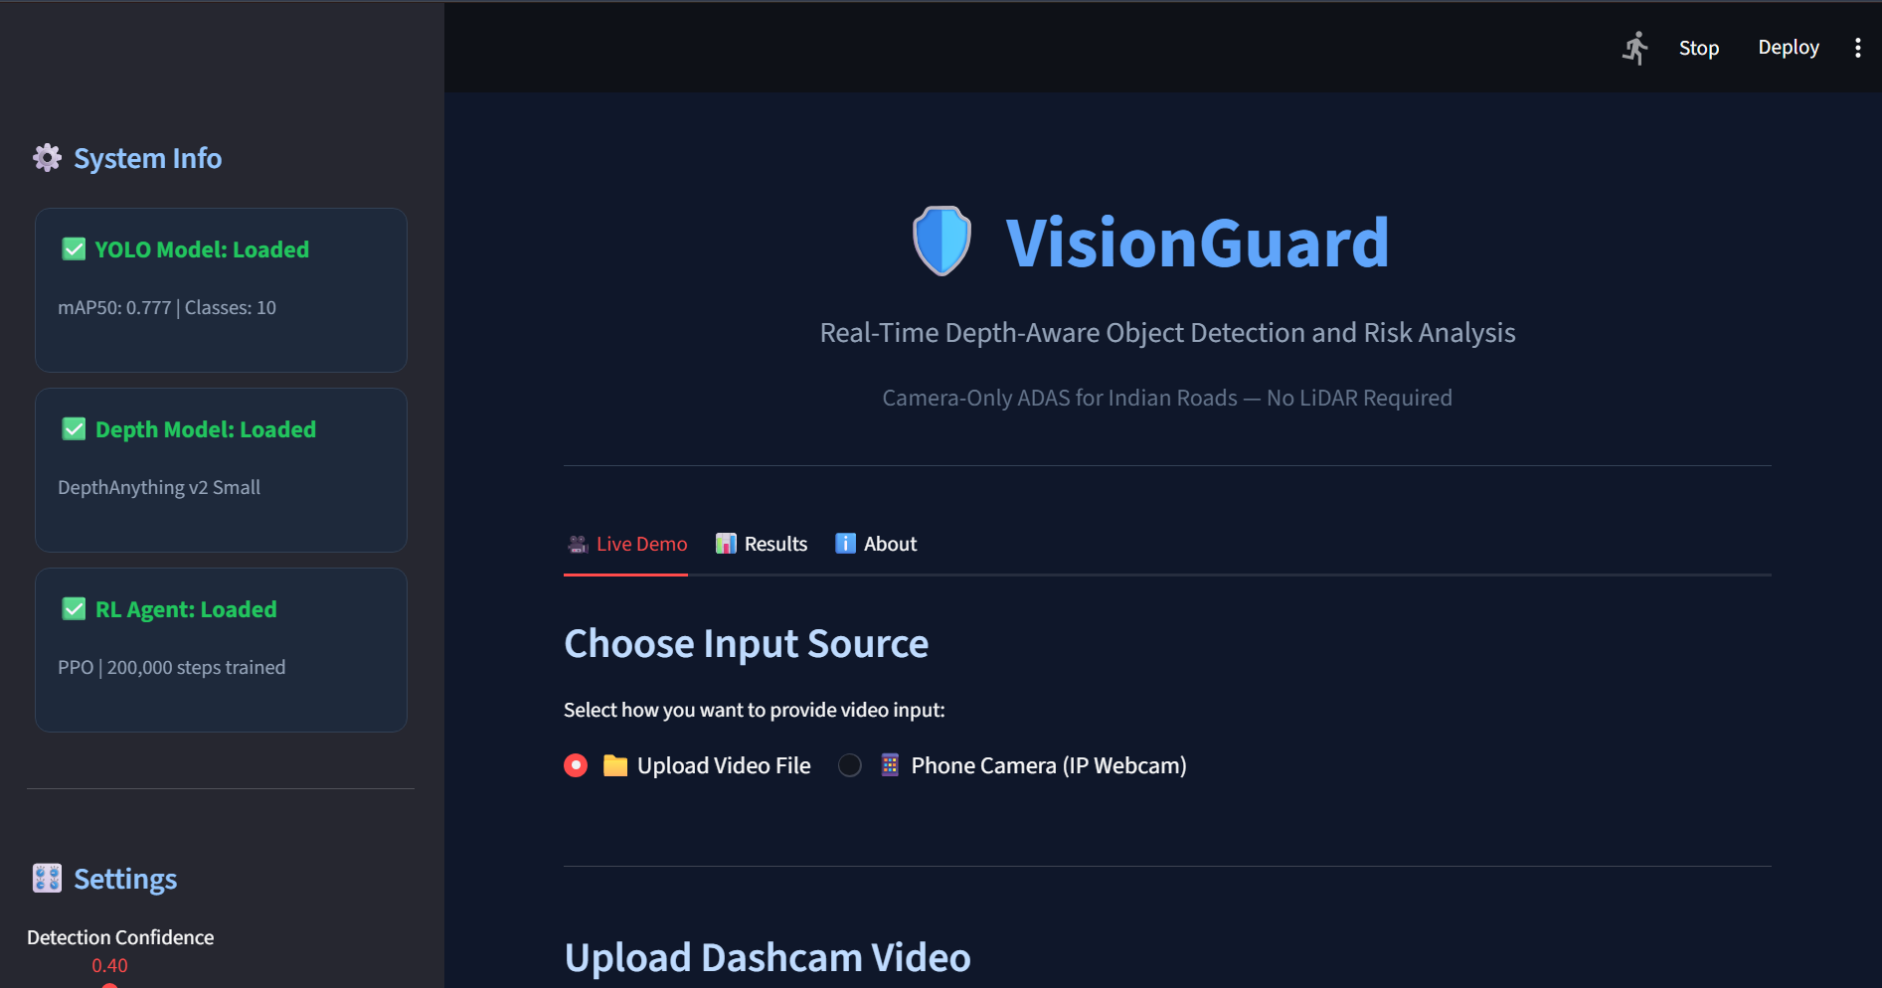

Slide 10
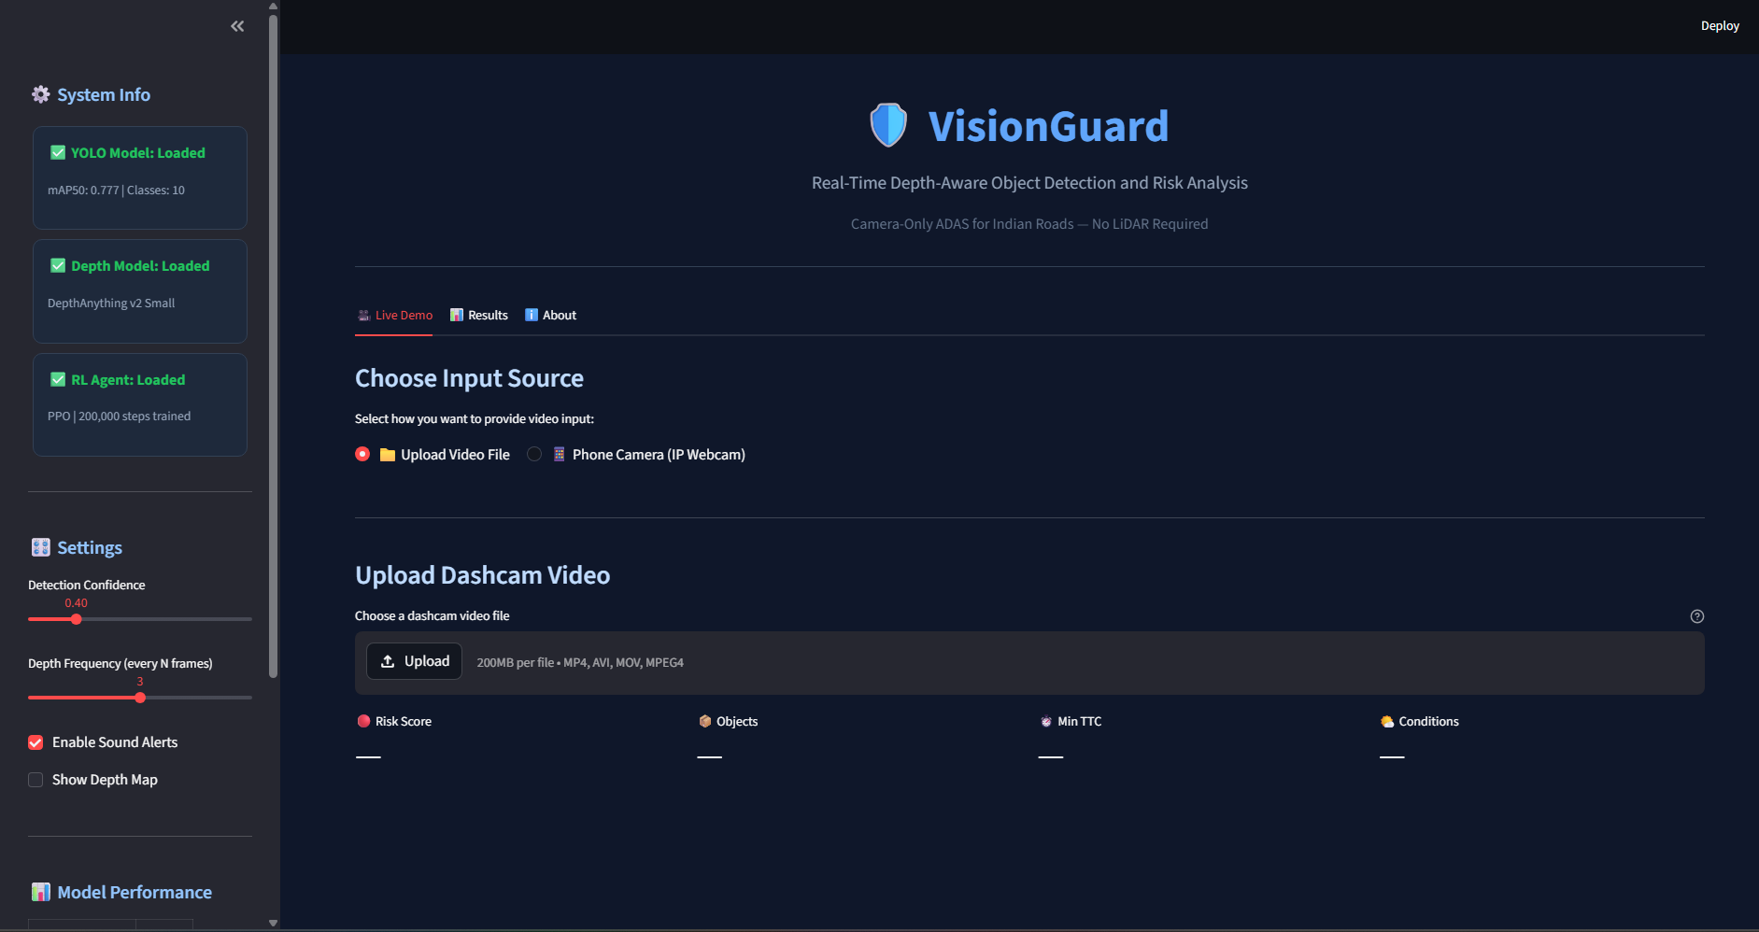
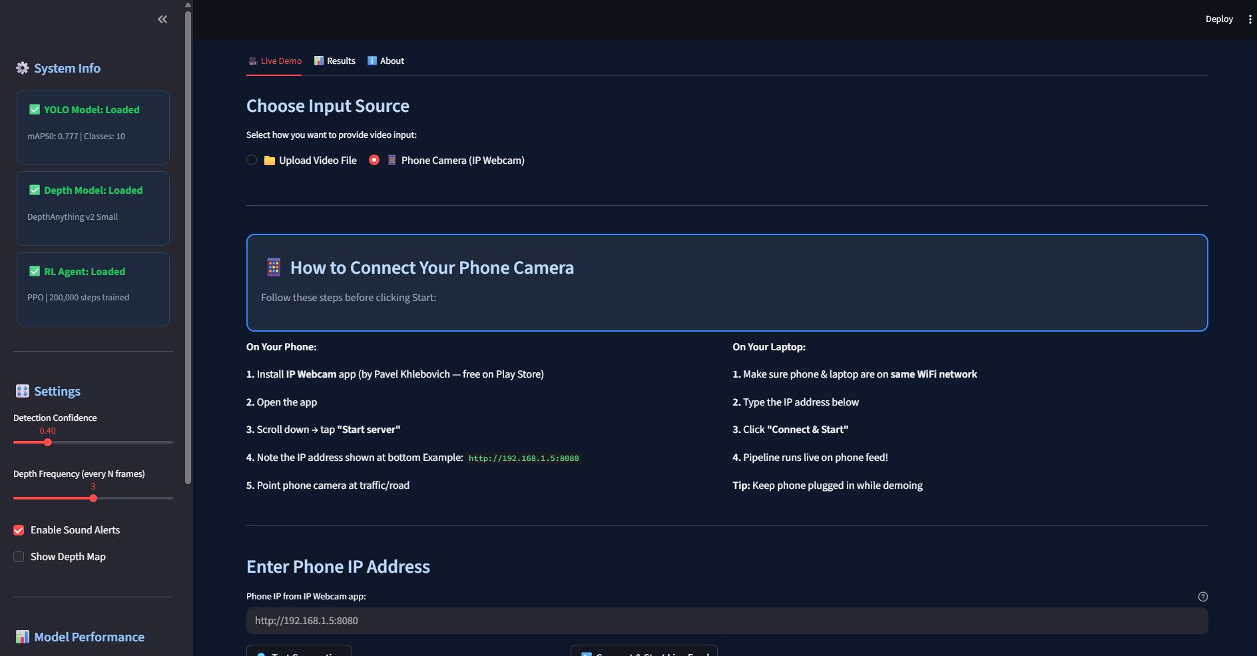

Slide 11
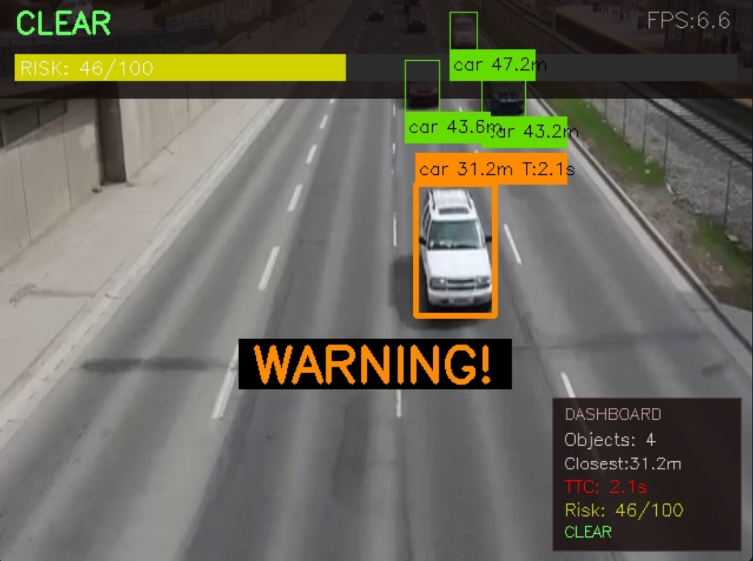
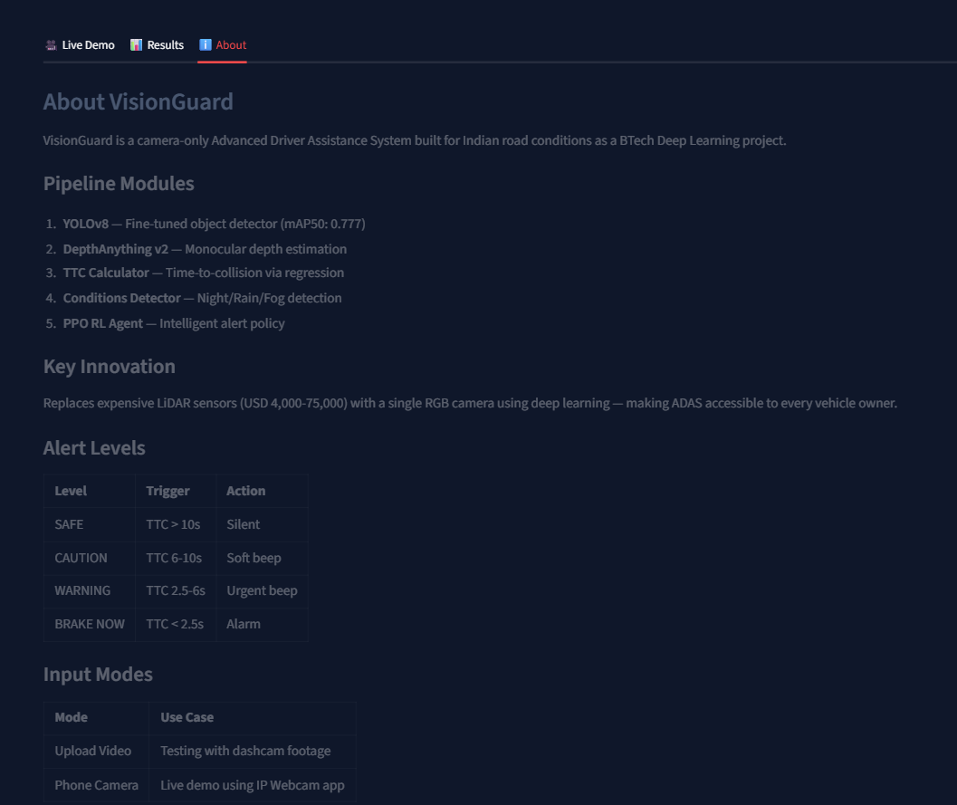
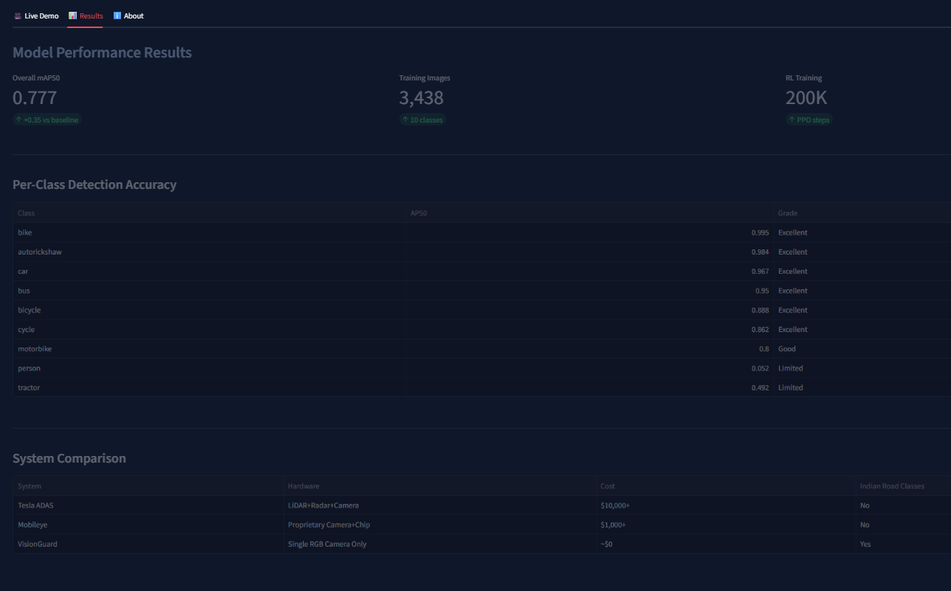

Slide 12
Live Demo — VisionGuard UI
What the Demo Shows:
Phone Camera Setup (IP Webcam):
📁 Upload dashcam video or connect phone camera via IP Webcam app
1
Install IP Webcam app on Android phone
📦 YOLO detects objects — cars, bikes, autorickshaws — in real time
2
Open app → tap Start Server
📏 Distance shown in metres on every bounding box
3
Note IP address shown on screen
(e.g. http://192.168.1.5:8080)
⏱️ TTC (Time-to-Collision) updates live as objects approach
4
Select Phone Camera in VisionGuard UI
🔴 Risk score bar (0–100) updates every frame
🔔 RL agent triggers CAUTION / WARNING / BRAKE NOW alerts
5
Enter IP → click Connect & Start
🌙 Night / Rain / Fog automatically detected and displayed
6
Point phone at traffic — live detection!

Slide 13

Conclusion & Future Work
What We Built:
Future Work:
✓ Fine-tuned YOLOv8 on 3,438 Indian road images — mAP50: 0.777
→ Deploy on Raspberry Pi 5 for real vehicle
✓ Monocular depth estimation replacing LiDAR — distance in metres
→ Add lane detection module
✓ Time-to-Collision calculator using velocity regression
→ Improve person & tractor detection
✓ Adverse conditions detector (night, rain, fog, glare)
→ Test in CARLA driving simulator
✓ PPO RL agent — 200,000 step trained alert policy
→ DeepSORT tracking for stable TTC
✓ Streamlit web UI with phone camera live mode
→ Speed estimation per vehicle
VisionGuard — Making ADAS Accessible to Every Indian Vehicle Owner
Camera Only | No LiDAR | No Radar | ~Min Cost | Built for Indian Roads

