Slide 1
DevOps & Cloud Infrastructure SEIS 615 Orchestration Review
Jason Baker
Adjunct Instructor
Graduate Programs in Software
University of St. Thomas
St. Paul, MN

Slide 2
Agenda
Questions
Assignment 11 solution
Final challenge
Continuous Course Improvement
Lecture review
Classroom project

Slide 3
Lecture Review
Service discovery: a mechanism that one service can use to find another.
Service discovery patterns and methods
ELB
Systems Manager Parameter Store
Secrets Manager
CloudMap

Slide 4
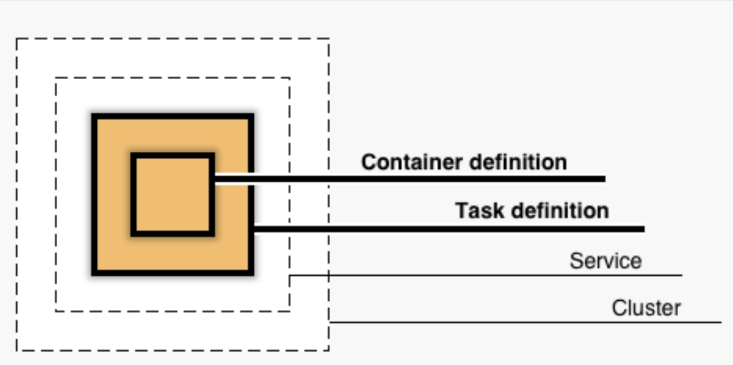
Lecture Review
Container Orchestration
AWS Elastic Container Service (ECS)
Elastic Container Registry (ECR)
AWS Fargate
Cluster
Service
Task definition
Container definition

Slide 5
Classroom Project
Overview:
Build a Fargate cluster and launch a set of services.
Show me your work when completed!

