Slide 1
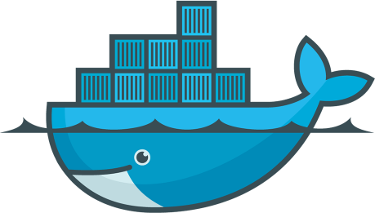
DevOps & Cloud Infrastructure SEIS 665 Containers Review
Jason Baker
Adjunct Instructor
Graduate Programs in Software
University of St. Thomas
St. Paul, MN

Slide 2
Agenda
Questions
Assignment 9 solution
Lecture review
Classroom project

Slide 3
Lecture Review
Containers
A way to encapsulate an application and its dependencies in a lightweight and portable environment.
A container isn't a VM.
Containers use the same kernel as the host.
Docker
A client-server technology which manages containers.
Docker daemon/server, Docker client, Docker registry (Hub)
Working with Docker containers
Run in interactive vs. detached mode
List, start, stop, remove containers
Docker image
Consists of layers -- unified file system
Image is read-only

Slide 4
Lecture Review
Building Docker images
Create an image starting from an existing image.
Image tags
Dockerfile
Dockerfile commands
FROM, LABEL, CMD, ENTRYPOINT, COPY, WORKDIR, ENV, EXPOSE
Networking: port mapping
Volumes: allow data to persist outside of container.
Docker compose

Slide 5
Homework
Assignment 10: Docker
Watch Lecture 12 videos

Slide 6
Classroom Project
Attendance
Overview:
Create a basic Docker container using a Dockerfile.
Show me your work when completed!

