Slide 1



Slide 2
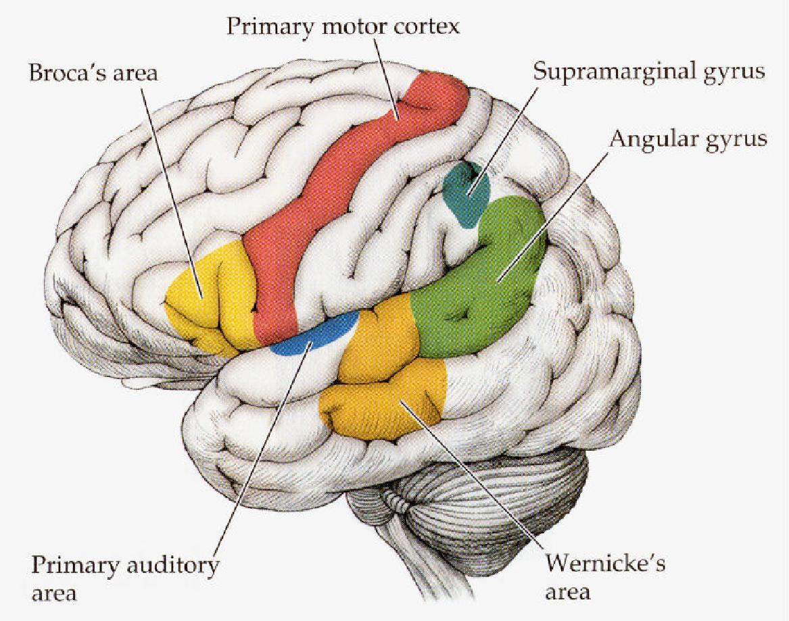
Brain areas involved in Language

Slide 3
I. What is Aphasia?
Literally means “without language”
Definition:
  A disturbance in the adult language system after the language has been established or learned
  Results from neurological injury to the language-dominant hemisphere of the brain
  Includes disturbances of receptive and/or expressive abilities for both spoken and/or written language
  Crossed aphasia
  Childhood aphasia

Slide 4
II. How is Aphasia Classified?
Aphasia types should be grouped or classified (taxonomy), but some debate over how to do this
Categorization by location of the brain damage
Categorization based on the language characteristics
-fluent vs. non-fluent speech
-receptive vs. expressive deficits
-motor vs. sensory deficits
Classifications are a necessary evil..
Damasio 1998

Slide 5
Behavioral Symptoms
Most professionals classify aphasia types based on distinct behaviors:
  Fluency of expression
  Language comprehension
  Naming
  Repetition
  Additional considerations:
    Motor output: Are the motor systems involved with speech affected? This indicates a concomitant motor-speech disorder
    Reading and writing: To what extent is reading and writing affected? This usually reflects the overall impact of aphasia on language more generally

Slide 6
Fluency
Expression of thoughts using a smooth, uninterrupted flow and rate of speech
Fluent aphasia: spontaneous speech flow with adequate phrase length
  Generally reveals posterior brain damage (temporal/parietal regions)
Non-fluent aphasia: diminished phrase length, slowed or labored speech production, grammatical errors
  Generally reveals anterior brain damage (frontal lobe)

Slide 7
Language Comprehension
Ability to understand spoken messages
Based on this ability, aphasia can be classified as predominantly receptive or predominantly expressive

Slide 8
Agrammatism
Entails the dropping out of articles, connective words, auxiliaries and inflections so that grammar may, in extreme cases, be reduced to rudimentary form - the use of one or two words sentences.
  “Yes… ah… Monday… er… Dad and Peter H… (patient’s name), and Dad… er… hospital… and ah… Wednesday… Wednesday, nine o’clock… and oh… Thursday… ten o’clock, ah doctors… two… an’ doctors… and er… teeth…yah”
    (Goodglass & Geschwind, 1976)

Slide 9
Garrett’s sentence production model
Inferential processes
Message representation
Lexical selection
Determination of functional structures
Lexical assignment
Functional level representation

Slide 10
Functional level representation
Retrieval of word forms
Selection of positional level planning frames
Assignment of segmental
and prosodic structure for words
Interpretation and siting of node
information
Positional level representation

Slide 11
Thematic role assignment and Predicate-argument structure
Verb: “Deliver”
  Implies that someone (agent) is doing the ‘delivering’ (agent), that some kind of item (theme) is being ‘delivered’, and that someone is receiving the delivery (recipient)

Slide 12
Verb: ‘Delivered’
  Implies
    ‘agent’ & ‘theme’ & ‘recipient’
  John delivered the guns to the military base
  The choice of a particular verb commits a speaker to specify the persons or objects related to the thematic roles associated with that verb.

Slide 13
Disturbances affecting the realisation of Thematic Roles in Agrammatism
disturbance has been said to affect the patients' ability to use the basic word order of English to convey propositional features such as thematic roles.

Slide 14
Aphasic responses
Target
a key is in a suitcase
a chair is on a car
a boy is pulling a baby
a man is washing a baby
Aphasic response
“the luggage ….. The key is the luggage. The key is in the luggage”
“Automobile is… The chair is…the chair was under the car.”
“The boy and girl was falling down.”
“Washing… bath… me….. boy .. boy….bath”

Slide 15
Results
AA could not with any consistency produce NP-V-NP orderings that reflected underlying semantic roles.

Slide 16
Also linked to difficulty in producing verbs
Many AA have particular difficulties with the production of verbs.
Not only ties to trouble in producing the correct inflectional and derivational forms of a verb in a given context, also affect ability to produce verbs themselves, resulting in omissions, paraphasias, and nominalisations of verbs

Slide 17
Paragrammatism
Term is rarely used in the U.S.
Omissions and substitutions of both content & function (grammatical) elements of speech
  Substitutions may be outside the word class—putting a Verb in a N place
Paragrammatics (usually Wernicke’s aphasics) often have ‘logorrhea,’ press of speech (talk very fast and can’t stop)

Slide 18
Agrammatism/Paragrammatism
Syntax – words strung together to form phrases or sentences in a complex way that obeys grammatical rules
A loss of syntactic production results in agrammatism:
  Broca’s Aphasia
    Speech is simplified, reduction in prepositions (e.g.“on” ) articles (“the”, “a/an”), inflections - ing, verbs, tense, person, plurals
The production of sentences with incorrect use of syntactic elements results in paragrammatism
  Wernicke’s Aphasia
    Running or increased speech production,
    tendency to acceleration.
    Content lacks information-conveying nouns and verbs.
    Phrases do not make sense together because abnormal syntactic inflections produced or due to paraphasias including neologisms
    “word salad”

Slide 19
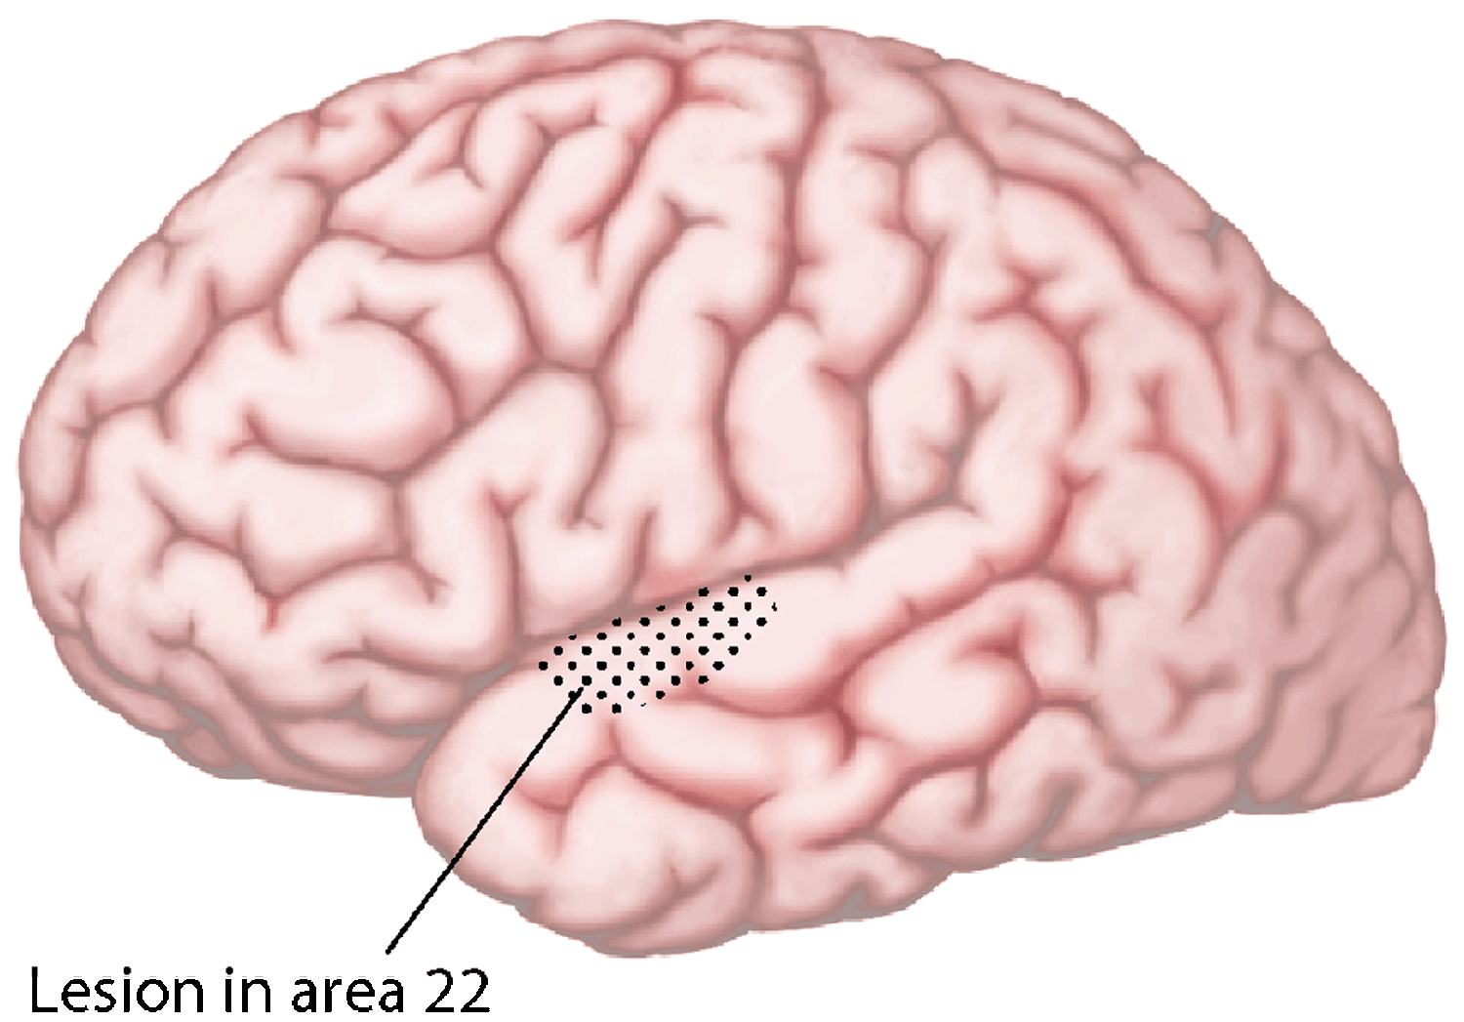
09-20b
Summary of lesions in the anterior superior temporal cortext that lead to deficits
In Syntactic processing (Mazoyer et al, 1993)
W. W. Norton

Slide 20
Repetition
Ability to accurately reproduce verbal stimuli
In order to display this ability, one must:
  Receive and process incoming stimulus
  Convey the information to regions of brain that formulate and plan motor sequence for speech
  Articulate to reproduce the initial stimulus

Slide 22
Naming
Ability to retrieve and produce a targeted word
Anomia: refers to word finding difficulty
Patient is unable to evoke, retrieve, or recall a particular word.
Most evident in the case of nouns
Verbal paraphasia and circumlocutions may be examples of a more generalized category of symptoms called anomia.
Most pervasive and most persistent deficit

Slide 23
Paraphasias (patterns of speech errors):
Phonological paraphasias also called literal paraphasias, involve the substitution, addition, or rearrangement of speech sounds so that the error can be identified as sounding like the target. Goodglass and Kaplan (1972) used the criterion that more than half of the intended word is preserved. Examples: pike/pipe, kipe/pipe
Verbal paraphasias are identified based on whether there is a semantic relationship between the error and the intended word. Examples: wife/husband; talking/hearing
Neologistic paraphasias are spoken words which cannot be identified as having come from the patient's language. Example: planker/comb; pinwad/light

Slide 24
Circumlocutions - Some patients, unable to evoke an elusive word, substitute another word, phrase, gesture or use circumlocutions (i.e., they talk around or about the specific word). The circumlocuting patient might say, "I wear it right her (pointing to his wrist) " and I tell time with it."

Slide 25
Semantic errors
Two possible levels of impairment in spoken word production
Semantic impairment
Post semantic impairment
How can we distinguish these different levels of impairment?

Slide 26
Heard Speech
Print
Pictures,
seen objects
Lexical
Semantics
Phonological Output Lexicon
Orthographic
Output Lexicon
Phonological Output Buffer
Graphemic Output Buffer
Speech output
Writing

Slide 27
Heard Speech
Print
Post-Semantic impairment
Speech output:
Pictures,
seen objects
Lexical
Semantics
Phonological Output Lexicon
Orthographic
Output Lexicon
Phonological Output Buffer
Graphemic Output Buffer
Speech output
Writing
Notes:
Post-semantic impairment
Will result in semantic errors in Speech output

Slide 28
Heard Speech
Print
Post-semantic impairment
Speech output:
(semantic errors)
Written output:
Speech comprehension:
Written comprehension:
(assuming no additional impairments)
✗
Pictures,
seen objects
✓ok
Lexical
Semantics
✓ok
Phonological Output Lexicon
Orthographic
Output Lexicon
✓ok
Phonological Output Buffer
Graphemic Output Buffer
Speech output
Writing

Slide 29
Heard Speech
Print
Semantic impairment
Speech output:
Written output:
Speech comprehension:
Written comprehension:
Pictures,
seen objects
Lexical
Semantics
Lexical
Semantics
Phonological Output Lexicon
Orthographic
Output Lexicon
Phonological Output Buffer
Graphemic Output Buffer
Speech output
Writing

Slide 30
Heard Speech
Print
Semantic impairment
Speech output:
(semantic errors)
Written output:
Speech comprehension:
Written comprehension:
✗
✗
Lexical
Semantics
Lexical
Semantics
✗
Phonological Output Lexicon
Orthographic
Output Lexicon
Phonological Output Buffer
Graphemic Output Buffer
✗
Semantic errors in all modalities
Speech output
Writing

Slide 31
Heard Speech
Print
Pictures,
seen objects
Repetition of nonwords
Lexical
Semantics
Sublexical reading
Phonological Output Lexicon
Orthographic
Output Lexicon
Phonological Output Buffer
Graphemic Output Buffer
Speech output
Writing

Slide 32
 | Semantic impairment | Post-semantic /lexical access | Phonological output buffer
Speech output Errors | ✗ Semantic | ✗ Semantic | ✗ Phonological
Written output | ✗semantic | ✓ok
Speech comp. | ✗semantic | ✓ok
Written comp. | ✗semantic | ✓ok
Phonological errors in repetition & reading | No | No
No
No
Yes
Length effect
✓ok
✓ok
✓ok
Yes

Slide 33
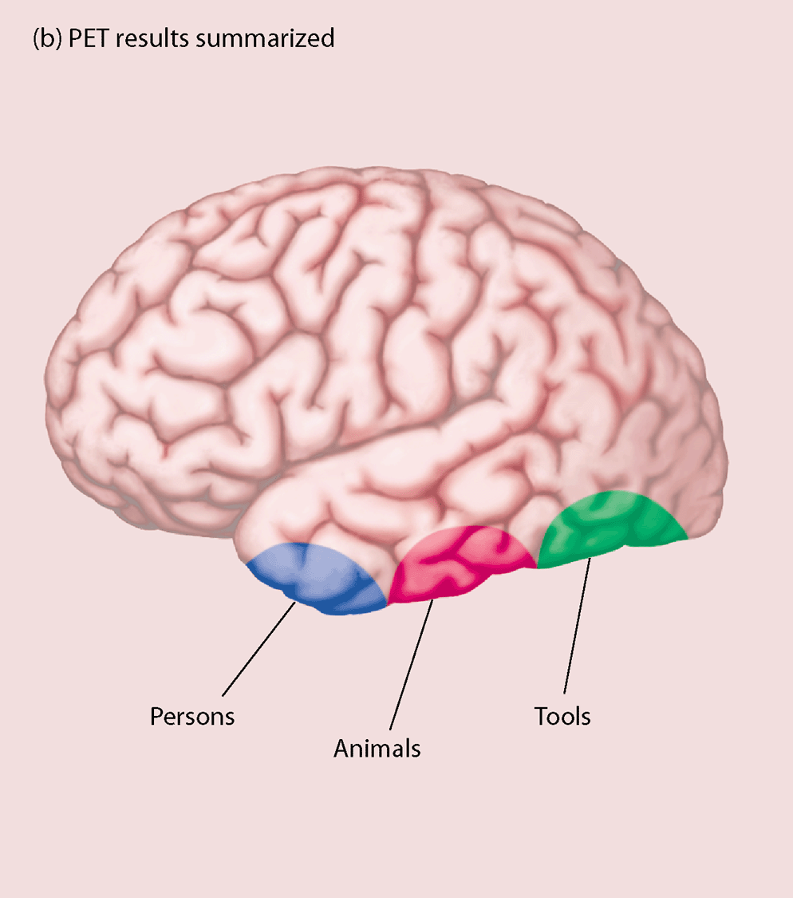
09-04b
Location of the brain lesions that are correlated with selective deficits
in naming persons, animals, or, tools. (Damasio et al (1996)
W. W. Norton

Slide 34
Reading and Writing
Written language disturbances usually parallel spoken language impairments
  Non-fluent speakers will also be non-fluent in writing and reading
  Individuals with auditory comprehension problems also have problems comprehending written information

Slide 35
Articulatory deficits
Dysarthria - reduced intelligibility [paresis, ataxia] - slurred speech
- dysphonia
- nasality
- rhythm anomalies
- volume anomalies
Speech apraxia
• staccato speech: each syllable is uttered separately.
• dysprosody deficit
• phonetic disintegration syndrome: deficit of articulatory motor programming

Slide 36
Phonological deficits
phonemic paraphasias
omissions
additions
transpositions
Duplications
phonemic neologisms
neologistic jargon

Slide 37
Lexical-semantic deficits
Anomias
circumlocutions
semantic paraphasias
semantic jargon

Slide 38
Morpho-syntactic deficits
agrammatism
simplified sentence structure
telegraphic speech (omissions of function words, verbs in infinitive form)
paragrammatism
agreement errors (gender, number)
substitutions of grammatical function words

Slide 39
Automatic elements
Recurring utterances (recurrent syllabic fragments: TAN)
Perseverations
Echolalia
Patients, who are not able to retrieve a lexical element when asked to do it or when they would like to do it (voluntary condition), can sometimes manage to retrieve it if it is facilitated by the context (automatic condition).

Slide 40
Goodglass (1972)
Broca’s aphasia
Wernicke’s aphasia
Anomic aphasia
Conduction aphasia
Transcortical sensory aphasia
Transcortical motor aphasia

Slide 41
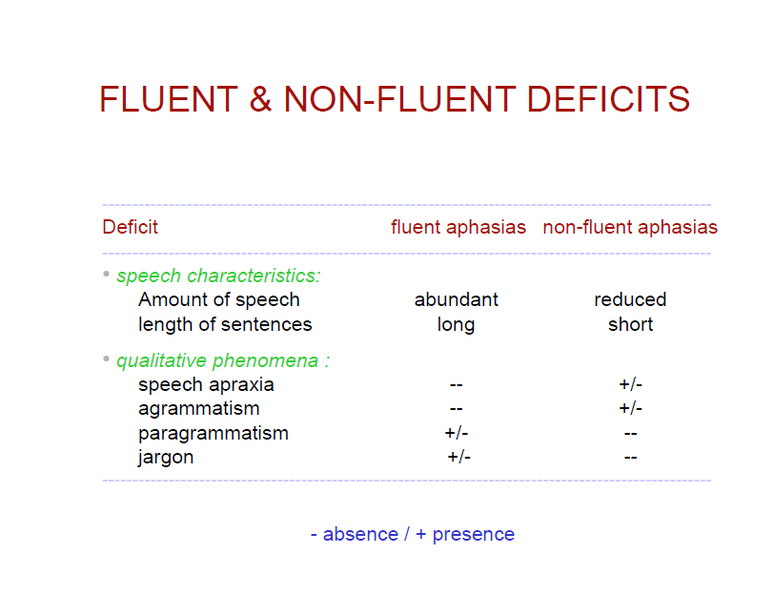

Slide 42
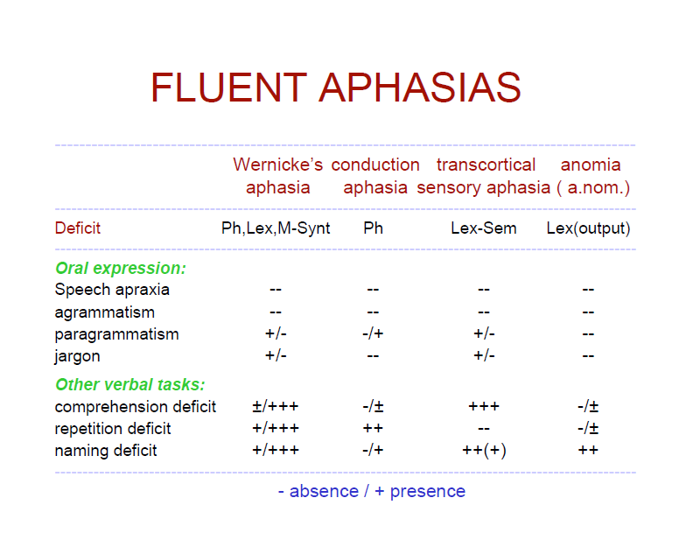

Slide 43
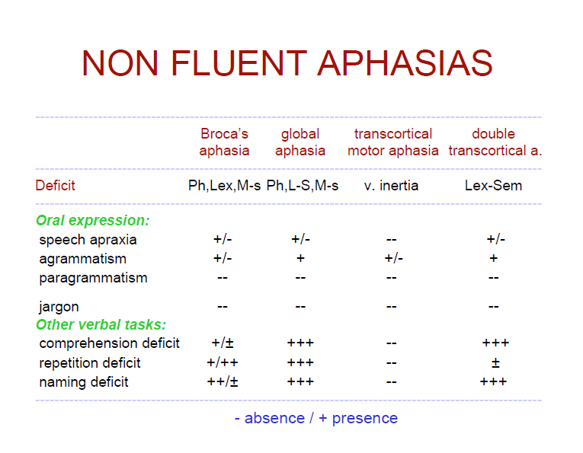

Slide 44
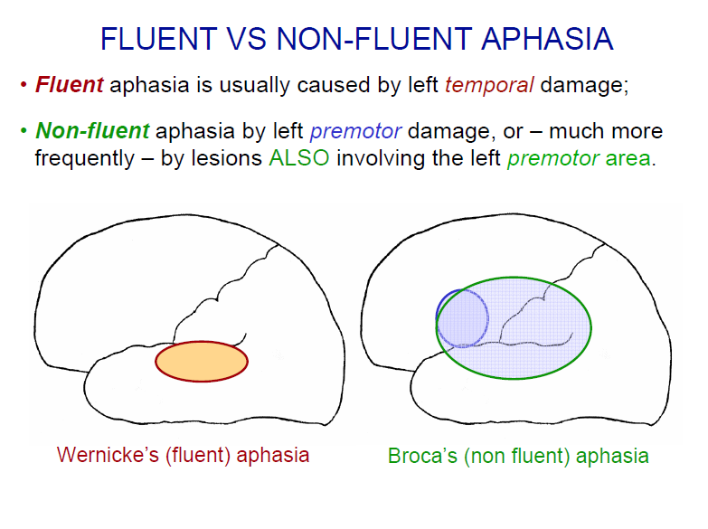

Slide 45
Different aphasia syndromes
Wernicke’s Aphasia/fluent
􀁹 Normal fluency, sometimes excessive(logorrhea)
􀁹 Impaired auditory comprehension
􀁹 Affected repetition
􀁹 Neologism, paraphasia, jargon speech( lexical retreival)
􀁹 Usually normal prosody and articulation
􀁹 Affected reading and writing

Slide 46
Site of Lesion
The lesion is located in Wernicke's area
posterior region of the left superior temporal gyrus or the first gyrus of the temporal lobe.
Brodmann's areas 22
The damage often extends into the parietal lobe, affecting the angular gyrus (Brodmann's area 39).
Meaning is associated with speech sounds in Wernicke's area. It is also a center for abilities like reading and writing which have been learned in conjunction with auditory comprehension.
As Wernicke's area is adjacent to Heschl's gyrus (41,42), it can be considered an auditory association area. Temporal lobe lesions are responsible for a number of problems other than aphasia.

Slide 47
Speech may be essentially meaningless "Jabberwocky.“
Paraphasias are common
Patients may use paraphasias and also commonly add words, complicating the utterance. This phenomenon is known as augmentation.
Also due to auditory comprehension deficits, the patient may repeat the examiner's words without understanding them=echolalia
Hemiplegia/hemiparesis are rare
A phenomenon called press of speech also characterizes Wernicke's aphasics. Patients may speak very rapidly, interrupting others.
Unlike Broca's aphasics, Wernicke's aphasics tend to have anosognosia

Slide 48
Broca’s aphasia
􀁹 Nonfluent effortful speech, slow rate, flat melody
􀁹 Limited word output /telegraphic speech
􀁹 Agrammatic
􀁹 Impaired repetition
􀁹 Affected naming, reading, writing(often hemiparesis)
􀁹 Better auditory comprehension

Slide 49
Speech is telegraphic: content words function words
articles, conjunctions, prepositions, auxiliary verbs and pronouns (function words) and morphological inflections (e.g. plurals, past tense), are omitted.
In addition, nouns, verbs, adjectives and adverbs (content words) may be retained.
Output can be restricted to noun-verb combinations.
Sentence length is short.
Syntax and morphology are affected; only the most basic and over-learned grammatical forms are produced (often limited to nouns and verbs).
Speech is labored and slow.
Few paraphasias :mostly literal

Slide 50
Site of Lesion
The lesion that causes Broca's aphasia affects the third frontal convolution (both the gyrus and the sulcus) of the left frontal lobe. This location is called Broca's area.

Slide 51
Conduction Aphasia
􀁹 Fluent, less than Wernicke’s
􀁹 Minor defect….auditory comprehension
􀁹 Repetition impaired
􀁹 Phonemic paraphasia
􀁹 Usually paresis of face and body

Slide 52
Poor repetition, in comparison to problems with comprehension and spontaneous expression, is the hallmark of this syndrome.
Spontaneous speech is better than repetition.
Conduction aphasics usually perform even more poorly on tasks when given a model. (A Broca's patient would perform better when modeling.)
Although this is classified as a fluent aphasia, fluent speech may be restricted to brief runs (they don't sound like Wernicke's patients). In this case, conduction aphasics can be differentiated from Broca's aphasics by their good articulation, normal intonation and use of a variety of syntactic patterns.
The major speech difficulty in this syndrome is the sequencing of phonemes.
Anomia is common.
Auditory Comprehension is typically nearly normal and may be completely intact.

Slide 53
Conduction aphasics could comprehend the nouns and verbs in a sentence, but would not be able to understand grammatical morphemes such as prepositions and conjunctions because incoming information is not transferred from Wernicke's area to Broca's area.
A patient could understand "Do you write with a pen?"
A patient could not understand "Before you wave your hand, read this.“
Reading are typically good (varies with severity)
They have difficulty reading aloud.
Writing typically contains spelling errors and transpositions of words and syllables (Brookshire, 1997).

Slide 54
Site of Lesion
According to Geschwind, conduction aphasia results from damage to the arcuate fasciculus, a bundle of nerve fibers that lies below the supramarginal gyrus in the temporal lobe and connects Broca's and Wernicke's areas. Both Broca's and Wernicke's areas are left intact.
Lesions are also found in the left perisylvian area of the cortex.

Slide 55
Transcortical sensory
􀁹 Fluent, paraphasic speech
􀁹 Global paraphasia
􀁹 Intact repetition(occassional echolalia)
􀁹 Impaired naming

Slide 56
According to Goodglass and Kaplan (1983) the hallmark of this syndrome is extremely well-preserved repetition abilities in the context of no comprehension and no propositional speech.
This shows that the arcuate fasciculus is still intact, allowing information to pass from Wernicke's to Broca's area.
In addition, patients may echo their conversation partners in such a way that they sound as if they do understand language and are participating in the conversation. For example, if asked if he likes his lunch, the patient might say "like lunch." Within the repeated phrases, phonology and intonation are intact.
Reading and Writing
Patients cannot read and also cannot write, even in the absence of paralysis or limb apraxia.

Slide 57
Site of Lesion
It is hypothesized that this type of aphasia occurs when Broca's area, Wernicke's area and the arcuate fasciculus are undamaged but are cut off from the rest of the brain.
A lesion of this type could occur due to vascular insufficiency because of problems at the ends of the cerebral arteries distribution system, the watershed areas of the blood supply.
Such lesions would be found in Brodmann's areas: 37 (occipital temporal area), 22 (superior temporal area), and 39. Lesions in area 37 are known to cause anomia. Area 22 is near Wernicke's area and area 39 is the angular gyrus.

Slide 58
Transcortical Motor
􀁹 Nonfluent speech
􀁹 Global and phonemic paraphasia
􀁹 Intact repetition(echolalia)
􀁹 Affected auditory comprehension, not
severe

Slide 59
Site of Lesion
Lesions are typically smaller than those that cause Broca's aphasia and are superior to and often anterior to Broca's area.
Broca's area itself is not affected, but the damage may extend down into the white matter including the white matter below Broca's area.
Communication between Broca's area and the pre-motor or supplementary motor area (Brodmann's Area 6) is cut off.

Slide 60
Repetition is much better than other types of speech. In repetition, grammar and articulation are normal.
The patient will have great difficulty initiating and organizing responses in conversation, but will be unable to answer highly structured questions.
For example someone with transcortical aphasia would probably not be able to answer question like "Why are you in the hospital?" but would be able to name their home town, answer yes/no questions, and name the days of the week. When faced with a question he/she cannot answer, the patient may appear "blocked" and produce fragmentary responses.

Slide 61
Generally, with transcortical motor aphasia there is little or no paraphasia, fair to good articulation and fair to excellent auditory comprehension (Goodglass and Kaplan, 1983).
Articulation in general is fair to good.
Little or no paraphasia is present.
Confrontational naming is well-preserved. The patient will respond well to prompting with phonemic cues.
Auditory comprehension is fair to excellent.

Slide 62
Anomia
􀁹 Naming difficulties as a residual symptom.
􀁹 Normal fluent output with occasional interruptions as the patient pauses to find the next correct word.
􀁹 Circumlocution.
􀁹 Anomia does not have clear localizing significance.

Slide 63
The boundary between anomic aphasia and Wernicke's aphasia is fuzzy, A patient may initially be diagnosed with Wernicke's aphasia, but eventually come to resemble the profile of anomic aphasia as he/she recovers.
Naming or word finding problems are the major feature of the syndrome. Patients sometimes use elaborate circumlocutions to compensate for this, and the content of their speech may come to sound fairly bizarre as a result. For example, a patient might say that he's "had one of them up there" when trying to explain that he's had brain surgery.
Grammar is unaffected.
Paraphasias are rare.
Repetition is good.
Auditory comprehension is relatively intact.
Reading and writing are variable with abilities ranging from normal to very poor.

Slide 64
Site of Lesion
According to Goodglass and Kaplan (1983), anomia can be localized with the least reliability of any of the aphasic syndromes.
The lesion is often temporal parietal area. The angular gyrus may also be affected, causing alexia and agraphia.

Slide 65
Pure word deafness
􀁹 Specific deficit of perception of spoken language, other auditory perception is intact.
􀁹 Writing is normal, reading may be impaired.
􀁹 Lesion of the primary auditory cortex contiguous to Wernicke's area produces this syndrome.

Slide 66
Global aphasia
Deficits in
􀁹 Expression
􀁹 Comprehension
􀁹 Reading & writing
􀁹 Naming
􀁹 Ability to repeat

Slide 67
oston
 | Comprehe-nsion | Verbal expression | Repetition | Other names
Broca | Mild to moderate | Aggramatic | Agrammatic but better | Motor, expressive,syntactic
Global | Severe | Minimal stereotypic | Equally impaired
Transcortical motor | Mild to moderate | Nonfluent | Less impaired | Dynamic
Wernicke | Severe | Parahasic (jargon) | Equally impaired | Sensory, receptive, semantic
Conduction | Mild to moderate | Phonemic paraphasia | More impaired
Anomia | Mild | Circumlocution | Spared | Amnesia, nominal
Transcortical sensory | Severe | Paraphasic | Less impaired (echolalia) | Isolation syndrome

Slide 68
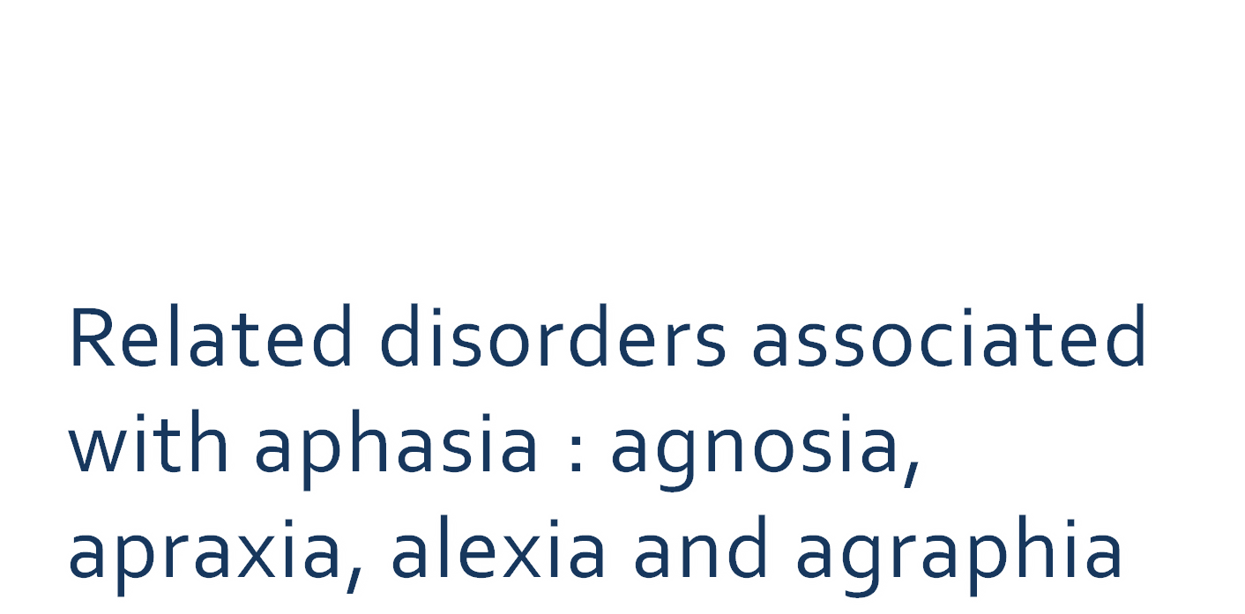

Slide 69
Recovery
Questions posed by family members after speech and language assessment:
“Will he get better?” “How much better?” “How long will it take?”
Reliable information regarding factors related to recovery:
  influence clinical decisions and actions,
  determining prognosis,
  counseling significant others
  identifying candidates for treatment.

Slide 70
Basso (1992) differentiated between neurological factors and anagraphical factors.
Neurological factors are related to etiology, size and site of lesion and severity and type of aphasia.
Anagraphical factors include personal characteristics such as age, sex, handedness and health status.

Slide 71
TIME COURSE OF RECOVERY
According to Kertesz (1988) there are two stages in recovery:
Early stage:
The stage when maximum language recovery takes place.
Coincides with spontaneous recovery.
Occurs 1-3 months post onset of aphasia.
Spontaneous recovery drops by 6-7 months post onset hence has decelerating curves.

Slide 72
Late or long term recovery:
May take place months or even years after stroke onset.
Degree of recovery varies from patient to patient.

Slide 73
PATTERN OF RECOVERY
McCabe and Kertesz (1977)
41.9% aphasics changed aphasia types as they recover.
Pashek and Holland (1988), followed subjects from 5 days post onset and subsequently at 3, 6 and 12 months.
Changes most frequently begin at about two weeks post onset, with most types of aphasia evolving within the first month (except conduction aphasia which typically showed a change at about 6 months post onset) to that of anomic aphasia.
Anomic aphasia is often the end point attained by a patient regardless of whether they were initially fluent or non fluent type.

Slide 74
NEURAL MECHANISM OF RECOVERY
Recovery after stroke involves at least three processes:
Resolution of acute tissue damage
Behavioral compensation
Neuroplasticity.

Slide 75
FACTORS RELATED TO NEUROPHYSIOLOGICAL PROCESSES
Organism internal factors
Processes occurring at the neural level such as regeneration and sprouting, changes in neurotransmitter release, return to premorbid blood flow levels, and so forth.
Organism specific factors (subject variables)
These include variables such as site and extent of lesion, age, education, gender as well as motivation and other factors.
Extent of damage (complete or incomplete)
Grafman conjectured that when lesions completely destroy cortical regions that serve a particular function, homologous area adaptation is most likely to occur. Transfer of function is less likely to occur when damage is incomplete .When damage is incomplete, inhibitory input is retained, thereby precluding transfer of function

Slide 76
According to Bach-Y-Rita (1990), several mechanisms contribute to recovery:
Diaschisis - refers to depressed function at the distance from the lesion due to sudden interruption of synaptic connection, some long term recovery, may occur dissipation of diaschisis.
Degeneration and collateral sprouting- refers to changes in connection between neurons from intact cells to denervated regions.
Most important mechanism to support recovery is unmasking of pre existing functionally inactive pathways. It occurs when axons and synapses which are present but not used for particular function was used when that function fails.

Slide 77
RECOVERY ACCORDING TO LESION SIZE AND SITE
According to Mazzoni et al.,
Small lesions demonstrate significant recovery in oral and written expression, comprehension changes were not significant because comprehension is relatively unimpaired initially.
Medium size lesions improvement are seen in all modalities except written expression.
Large lesions demonstrate improvement in auditory comprehension alone.

Slide 78
ROLE OF RIGHT HEMISPHERE IN PROCESS OF RECOVERY
1st theory (Gold and Kertesz,2000; Heiss et al., 1999)
A rightward shift of language is possible. According to some, in this theory the shift occurs in homologous areas- homologous area adaptation
2nd theory (Thomas et al.,1997)
Non brain damaged individuals have an inhibited right hemisphere and, when damage to the left hemisphere occurs, the right hemisphere becomes active due to a change in the inhibitory transcallosal pathways.
The final theory (Niccum & Speaks, 1991)
There is a shift in language lateralization (i.e., the left hemisphere maintains its dominance for language) by the phenomenon called map extension.

Slide 79
PERSONAL PROGNOSTIC FACTORS
Age- | Prognosis was seen good for young aphasic patients than older cases.
Type Of Aphasia- | Wepman (1951), Longerrich and Bordeov (1954) believes that expressive aphasics are more likely to recover than receptive aphasics.
Patient’s Ability To Self Correct
Etiology And Site Of Lesion- | Patient’s with head penetration wounds show greater improvement than do those with cerebrovascular lesions or those with neoplasm. The more widespread the lesions, the greater the number of aphasic involvements and the greater the likelihood of recovery.

Slide 80
Time Between Onset Of Aphasic Involvement And Onset Of Therapy- | It should be less if possible training be initiated, less than 2 months after onset.
Intellectual And Educational Level- | Darley (1972) concluded that the higher the original IQ, the greater the gains in therapy.
Handedness- | Left handed persons were more likely to have some aphasic involvement following cerebral insult than right handed persons and left handed persons made better recoveries than those who were right handed.
Severity And Predominant Nature Of Aphasic Involvement- | Severe impairments in comprehension and writing are poor prognostic indicators.

Slide 81
Associated Sensory And Motor Deficits- | Schuell’s and Jenkins finding indicate that the aphasic who does not have related perceptual, sensorimotor or dysarthric component has a better outlook for recovery than one with such complications.
Psychological Adjustment- | Rigidity and persistence of extreme dependency are negative prognostic indicators.

Slide 82
Assessment
Symptomatic approach
  WAB
  BDAE

Slide 83
MANAGEMENT OF APHASIA
Team Approach
When to begin therapy?
Initial therapeutic considerations
Early approaches
Approaches to aphasia management
Intervention for adult non fluent aphasics
Intervention for adult fluent aphasics
Intervention for global aphasics

Slide 84
TEAM AND PARTNERSHIP IN APHASIA INTERVENTION
Teams are groups of people collaborating in some way to reach a common goal.
There are no blue prints for teams, and the design can vary depending on the setting.
Partners in the Team
Nurses
Medical Social Worker
Pharmacists
Dietitians
Psychologists
Occupational and Physical therapist
Speech Language Pathologists
Other Allied professionals

Slide 85
Components of language function
Cognitive
Recognition, understanding, memory, attention, reasoning ability
Linguistic
Auditory comprehension, language production (form and content)
Communicative/
Pragmatic
Turntaking, topic initiation and maintenance, repairs, speech acts produced, nonverbal aspects
Notes:
Cognitive: the manner in which individuals acquire knowledge about the world and in which they continue to process this knowledge. It refers to all of the processes by which sensory input is stored recovered and used. Defined operationally within 5 mental areas:
Recognition/understanding/comprehension
Memory
Convergent thinking
Divergent thinking
Evaluative thinking
Linguistic: refers to language form of phonology, morphology, and syntax. The content is the meaning topic or subject matter involved in the utterance
Communicative/Pragmatic: System of rules and knowledge that guides the use of language in social settings. How to initiate, maintain and terminate a conversation

Slide 86
WHEN TO BEGIN THERAPY?
Eisenson (1984)
Treatment begins “as soon as the patient is able to take notice of what is going on and is able to cooperate in the effort”.
Treatment is most effective while the brain is adjusting during the period of spontaneous recovery.
Early treatment should discourage development of unproductive coping mechanism’s such as withdrawal. It is known that a patient makes much greater progress during the first two or three months than the next three months.
Davis states that therapy should begin as soon as the patient is able to take notice of what is going around him.

Slide 87
INITIAL THERAPEUTIC CONSIDERATION
Individuals particular problem must be studied in detail.
Pre and post morbid.
Determination of specific areas of deficits and identification of intact areas.
Careful study of personality of the person.
Inability to cope with frustration
Emotional liability
Rigidity and concreteness
Goal recognition.
Selection of approaches, along with modifications.
Selection of materials.

Slide 88
EARLY APPROACHES TO APHASIA THERAPY
WEPMAN’S APPROACH
Stimulation
Facilitation
Motivation
SCHUELL’S APPROACH
The cornerstone of this approach is the employment of strong, controlled and intensive stimulation. Its proponents posit that immersion in language through intensive sensory stimulation could increase neuronal firing, thereby effecting an increase in neural activation.

Slide 89
APPROACHES TO APHASIA MANAGEMENT
Language focus (impairment)
Communication focus (activity/ disability)
Handicap focus

Slide 90
Depending on the focus of management various techniques can be classified into two categories:
General techniques
Specific techniques

Slide 91
SPECIFIC TECHNIQUES
Melodic Intonation Therapy
Helm Estabrooks et al. (1986)
An aphasia treatment approach that uses intoned melodies as a means of improving verbal production.
The use of melody and intonational contour is based on the notion that the intact right hemisphere which is specialised for melodic functions, can be tapped as a means of facilitating verbal responding.
The four levels of MIT are designed to increase patients ability to independently produce high probability phrases and sentences.
Programmed instruction methods are used, as the amount of cues provided by the clinician are gradually reduced at each step of the MIT program.
It includes a variety of prompts ranging from intoning a melodic line and hand tapping to having the patient answer questions using drilled phrases and sentences.

Slide 92
Voluntary Control of Involuntary Utterances
Helm and Barresi (1980).
In this method, the vocabulary is determined involuntarily by the patient. The one criteria guiding the clinician is that only the patients real word utterances are accepted. Patient’s spontaneous utterances form the basis for therapy, and the clinician determines the treatment lexicon.
VCIU is based on the belief that virtually all aphasic patients have the ability to utter a real word under some circumstances. The clinician identifies involuntary vocabulary and helps the patient bring it under voluntary control.
This approach can be used with severely non fluent aphasic patients whose speech is limited to the stereotypic productions of few real words.

Slide 93
VCIU incorporates a progression through oral reading, confrontation naming and conversation involving production of stereotypic words and phrases.
EXAMPLE:
Clinician: How are you?
Aphaisc: amma…
Clinician: Where are you?
Aphasic: amma
Clinician: Are you in the hospital?
Aphasic: amma
Clinician: (present a picture of word amma) What is this?
Aphasic: amma
Clinician: That is right, good say it once again.
Aphasic: amma

Slide 94
Response Elaboration Training
Kearns and his colleagues
To increase length and informational content of verbal responses of non fluent aphasic patients.
The emphasis is on shaping and chaining, spontaneous patient initiated responses.
RET stimuli serve as a catalyst for client patient interaction around an action concept.
The burden of communication is taken by the patient and the clinician merely ensures that the direction chosen by the patient is properly changed to maximize the therapeutic gain.

Slide 95
The basic sequence of RET includes:
Eliciting spontaneous responses to maximally presented stimuli.
Modeling and reinforcing initial responses.
Providing “wh” cues to prompt patients to elaborate on their initial responses.
Reinforcing attempted elaborating and then modeling sentences that combines initial and subsequent response to a given stimulus picture.
Providing a second model of sentences that combine previous response and then requesting a repetition of the sentence.

Slide 96
EXAMPLE: A picture depicting a man reading a newspaper
Clinician: What is this man doing?
Aphasic: re…..
Clinician: Yes, reading. Who is reading?
Aphasic: ma…
Clinician: Yes man is reading. Say it once again.
Aphasic: Man is reading
Clinician: That’s right. What is he reading?
Aphasic: ne….
Clinician: Newspaper
Aphasic: Newspaper
Clinician: the man is reading a newspaper (ask the patient to repeat)
Aphasic: man is reading a newspaper.

Slide 97
LANGUAGE ORIENTED TREATMENT (LOT)
Psycholinguistic approach to the treatment of aphasia.
The main goal in LOT is to provide the patient with language processing system that operates at its maximum functional level.
LOT divides the communication system into five modalities, which are non overlapping and mutually exclusive:
Auditory Processing
Visual Processing
Gestural and gestural verbal communication
Oral expression
Graphic expression

Slide 98
PROMOTING APHASIC’S COMMUNICATIVE EFFECTIVENESS (PACE)
Davis and Wilcox 1991
PACE is based on the following four principles:
The exchange of new information
Equal participation
Free choice of communicative channels
Functional feedback: Rather than telling the client that a response was correct or incorrect, he/she tells the client whether the message was understood, any listener would do in an everyday interaction.

Slide 99
MANAGING AUDITORY COMPREHENSION
Models of Auditory Comprehension
Bottom up models - Comprehension begins with analysis of the physical characteristics of the message and works its way up to assignment of meaning.
Top down models - Stress listeners general knowledge of the world and expectation about what will be said.
Comprehension of spoken messages by normal and aphasic listeners involves both bottom up and top down processing (Brookshire,1992).

Slide 100
Manipulating Message Components
Linguistic timing and contextual variables influence aphasic person’s auditory comprehension.
Generally, the more syntactically complex the message, the greater the likelihood of miscomprehension.

Slide 101
Stimulus Saliency=direct wording, instead of indirect wording
Darley (1976):
Giving the patient a “word he can hold on to”.
Select salient words and incorporate these words into treatment.
Saliency may also be increased by using direct wording (e.g., Tell me your address) rather than indirect wording (Tell me your address so that I can fill this form) and by placing the information bearing contents in a prominent position (beginning of the sentence).

Slide 102
Redundancy
Message redundancy is increased with “props” of the communicative situation. For example, the client knows what is coming when he sees the physician’s white coat, stethoscope and tongue blade.
Comprehension improves if the questions match the communicative situation and its props.
Message redundancy further includes supportive information within the utterance.
Repetitions and revisions provide yet another mechanism for increasing redundancy and heightening comprehension.

Slide 103
Attention
Attentional deficits cause clients to miss the beginning of a message or to miss short messages entirely.
Signaling that a message is on the way with alertness such as “Listen to me” or “I’d like to say something now” may help.
Frequently, however, the inattentive patient gets lost because for topic change.++++++ make a mention b4 topic change…..

Slide 104
Using Context
Treatment of comprehension deficits have stressed the use of bottom up comprehension tasks.
Typically, treatment begins with single words and phrases; length and complexity of stimuli are increased as the patient improves.
Studies have shown that aphasic persons comprehension of words and unrelated sentences does not predict comprehension of discourse.
Comprehension in most communicative situations involves listening to spoken discourse. Discourse is processed on line. Online studies of aphasic persons miscomprehension are rare. The fact that fluent aphasic patients spoken discourse is online, but often faulty, coupled with the fact that these individuals do poorly on off line tasks, suggests that comprehension deficits in the fluent aphasias might be addressed within a meaningful context……. Better on online task than online task

Slide 105
Thank you

