Slide 1
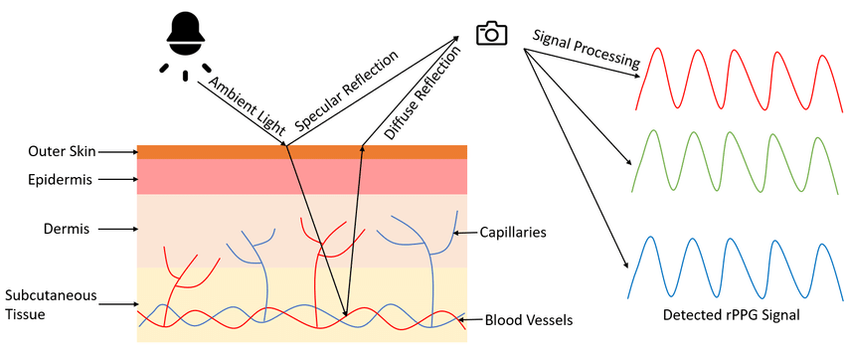
PPG signal
PPG signal: measure blood volume changes in the blood vessels close to the skin
Heart beats => wave of blood that reaches the capillarity at the tip of the finger
changes of transmission of light through tissue is recorded => waveform (pulsatile changes)
Camera records light absorbed by the tissue through video recordings
Used to extract heart rate, oxygen saturation, BP, pulse rate, pulse variability etc.
Active and promising field of research
Python libraries like neurokit, myPPG
Cheng et al. 2021

Slide 2
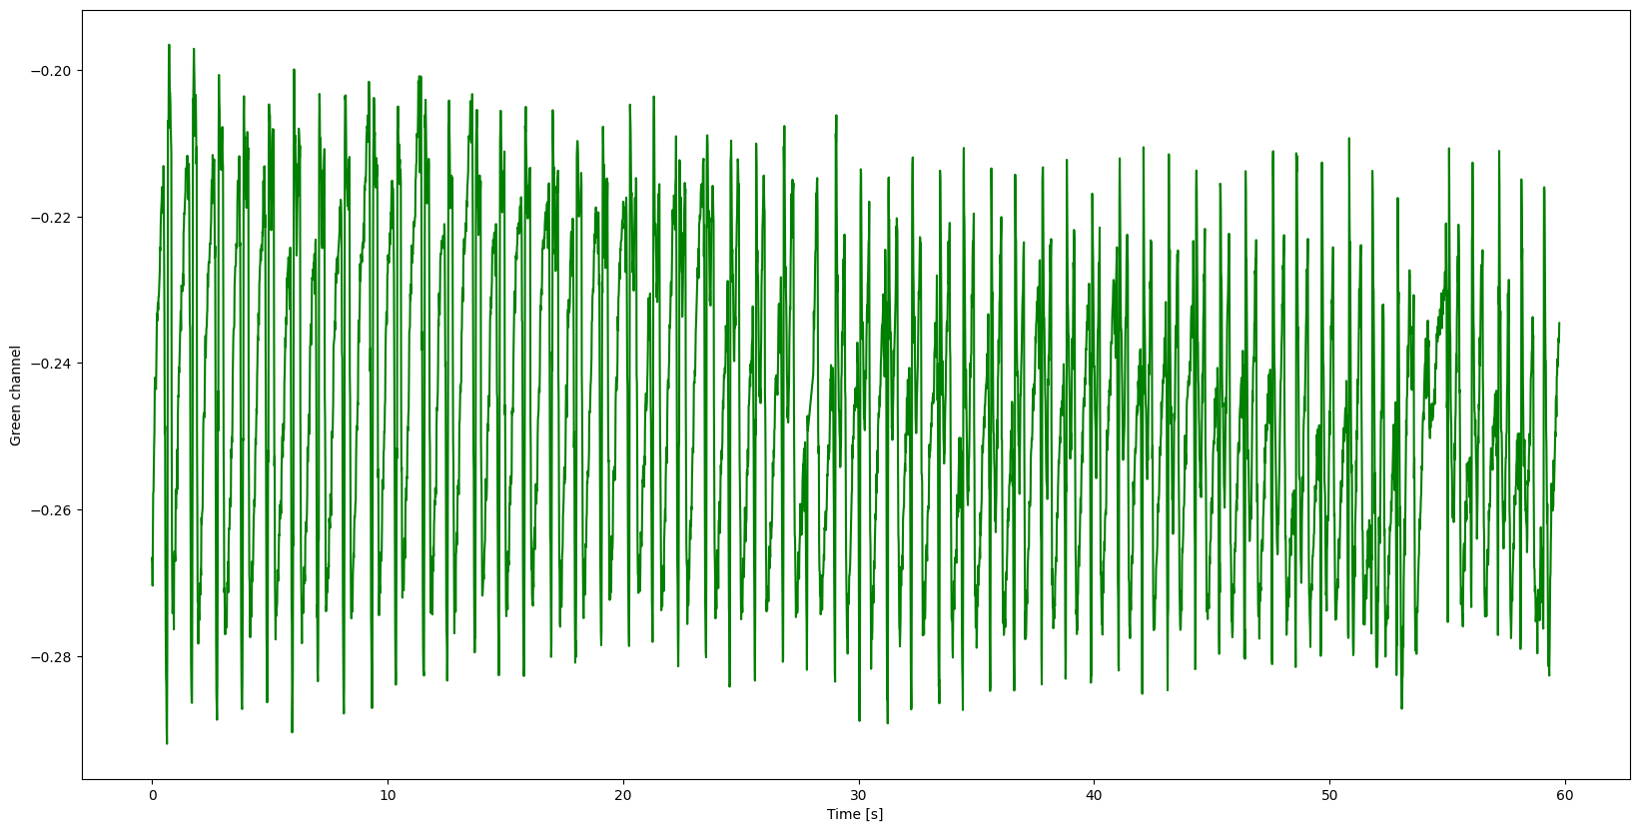
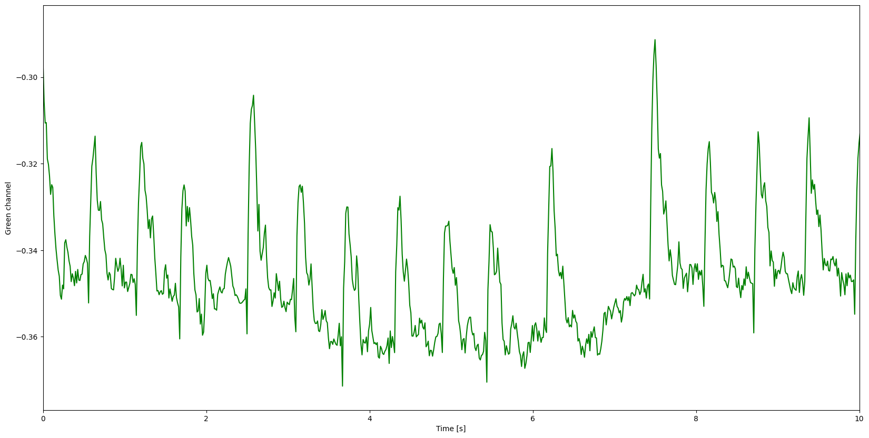
Heart rate estimation
Each frame is processed by splitting every single pixel in red, green and blue (RGB) components
Green channel => highest similarity to a ppg signal (Verkruysse et al. 2008)
Peaks -> cardiac pulses
Time difference between consecutive peaks: R-R Interval
Challenge: RGB channels to get high-quality rPPG signal => methods like superimposing GR & GB (Haugg et al. 2023)
Respiratory sinus arrhythmia (RSA) => variation in heart rate with breathing cycle (irregular pulses) => diagnosis?

Slide 3
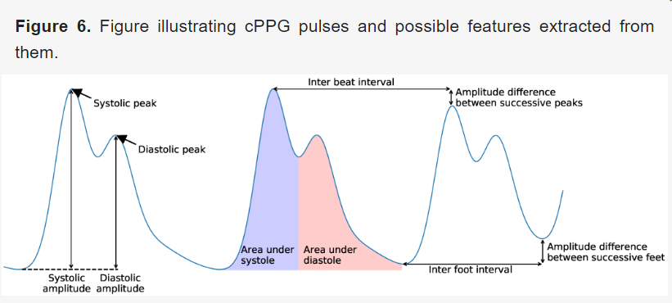
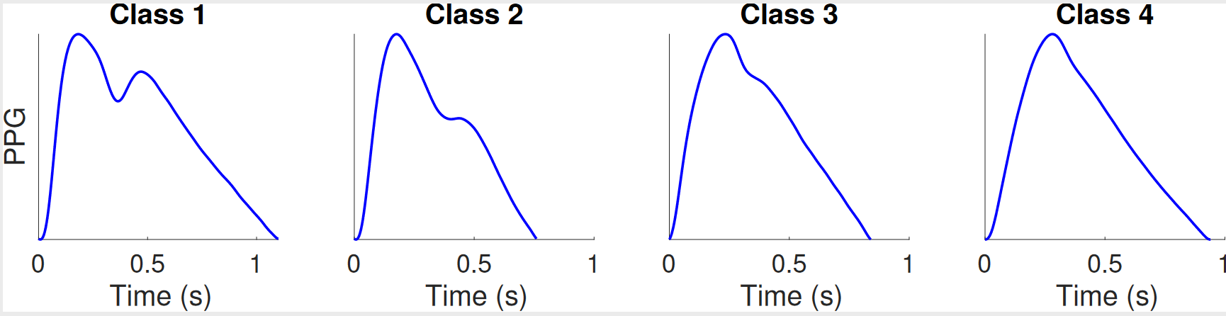
PPG Pulse
Charlton et. al 2022

Slide 4
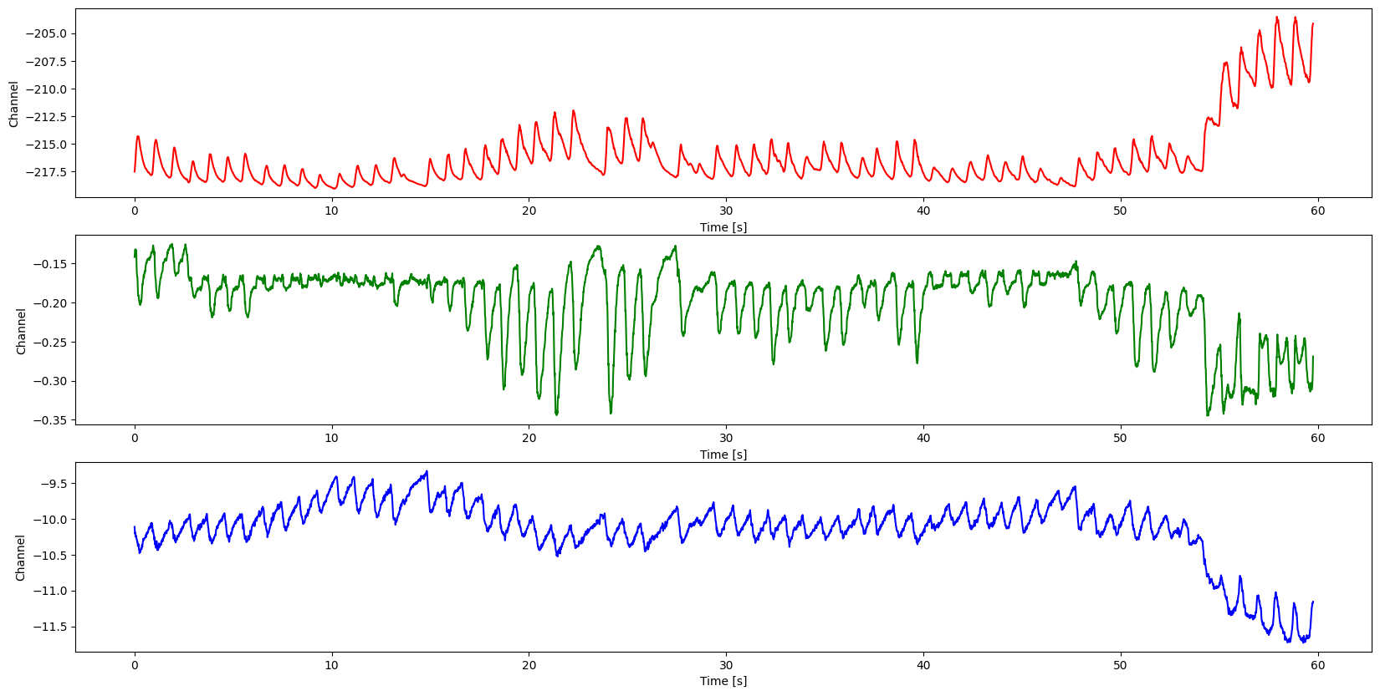
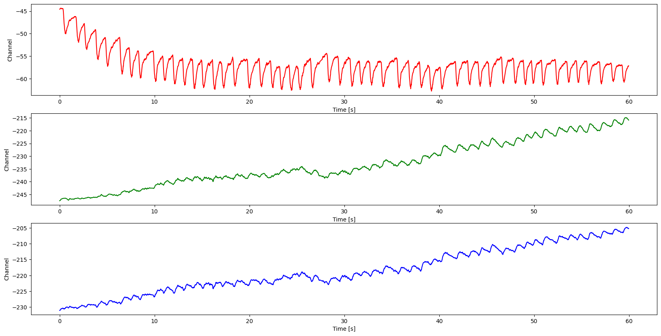
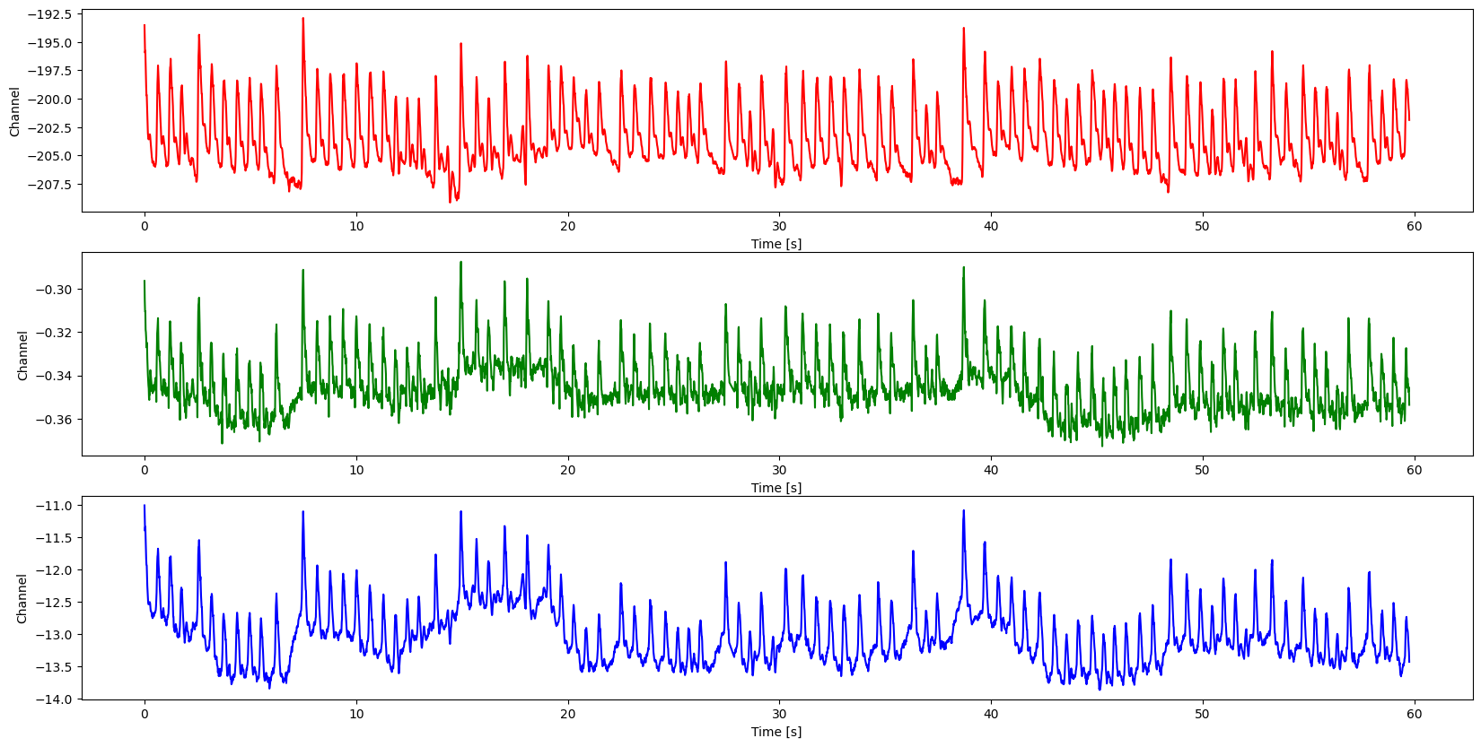
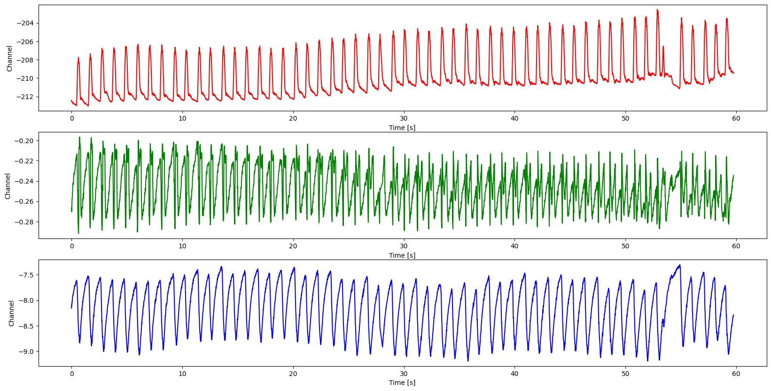
Raw RGB Signal

Slide 5
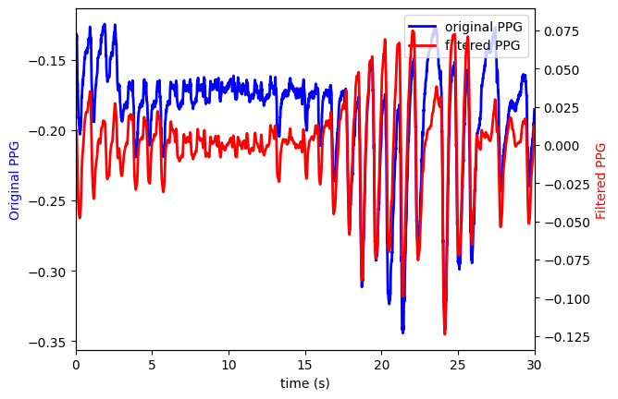
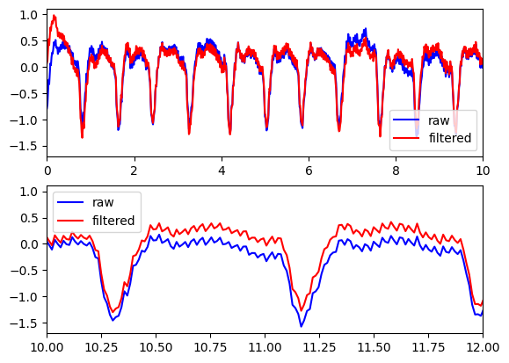
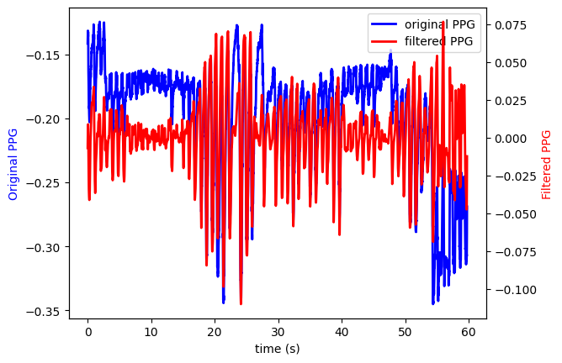
Signal Processing Techniques
Filtering: lowpass, highpass, bandpass => remove low- and high- frequency noise
Baseline Subtraction: calculate baseline of the signal (cubic spline or least squares) => subtract it from the signal
Normalisation: min-max, standardisation ((signal-mean)/sigma)
Signal amplification: amplify a part of a signal
Fourier Analysis

Slide 6
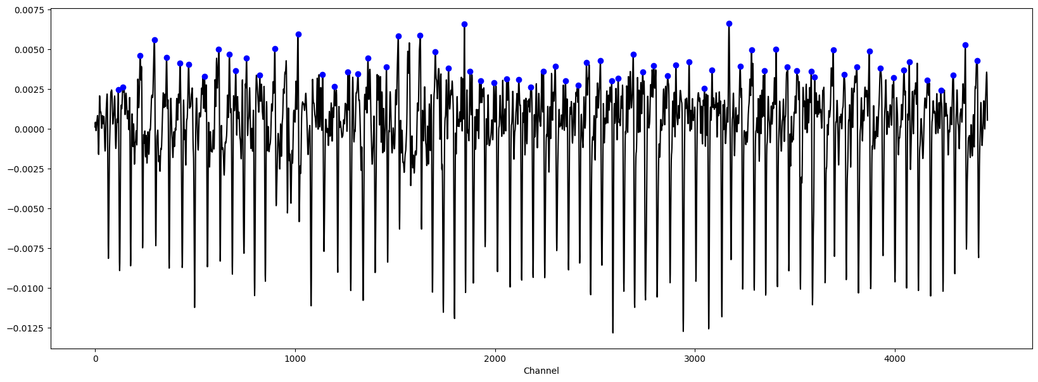
Detecting Peaks
From peaks => determine heart rate
Used Scipy find peaks function => works well but some missing peaks, picks noise as peaks
More complicated algorithms : peak to peak distance, ML models based on length of the peaks from baseline?

Slide 7
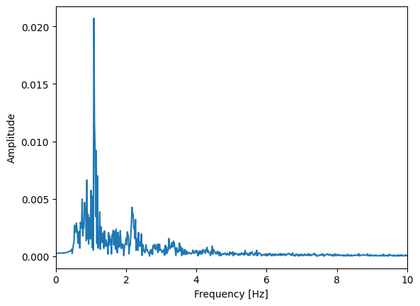
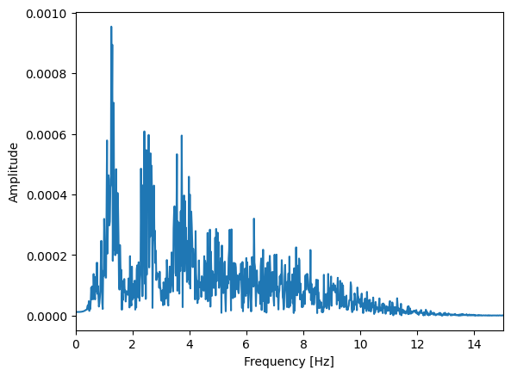
How to extract SR and AF subjects from PPG signal?
1st and 2nd derivatives of s PPG signal
PPG signal in frequency domain => see irregularities, dominant frequencies
Frequency associated to heart beats
Fourier analysis => converts signal from temporal space to frequency space

Slide 8
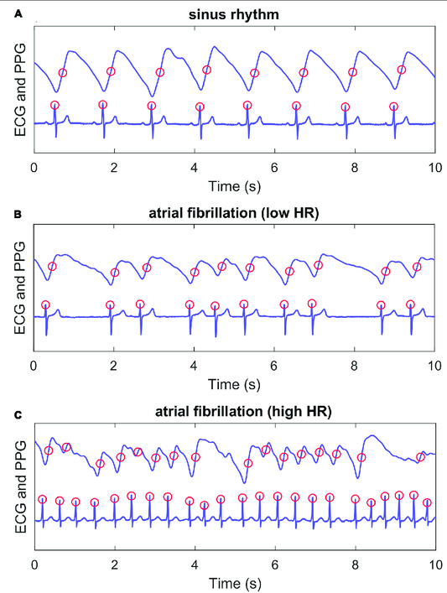
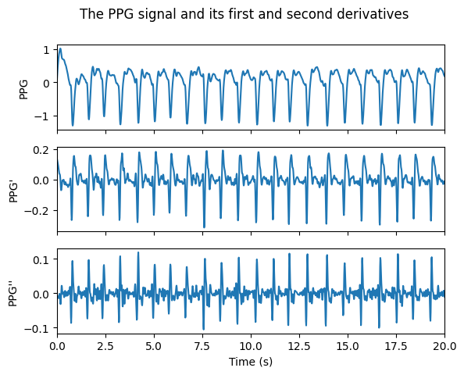
Valiaho et. Al 2021

Slide 9
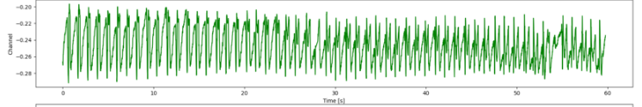
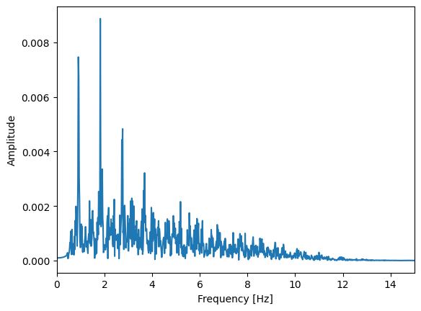
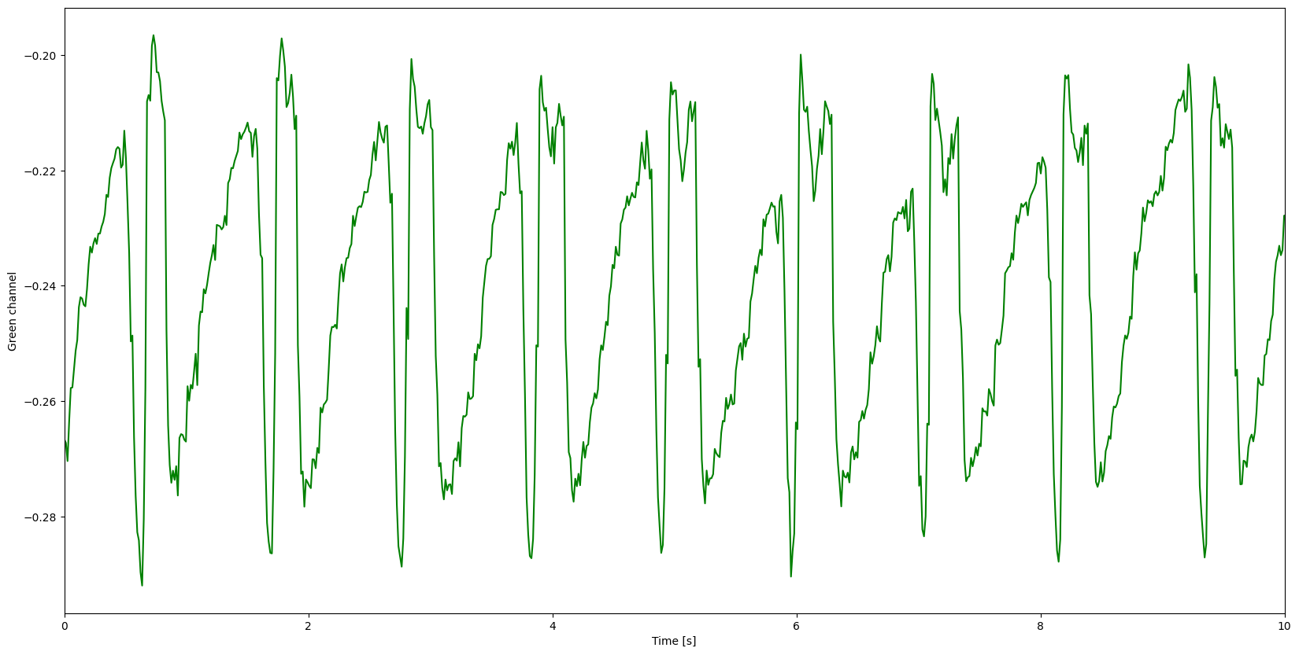
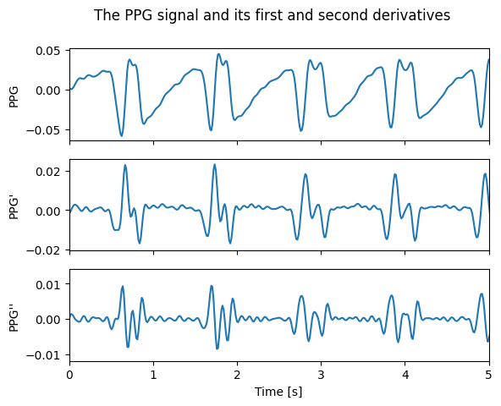
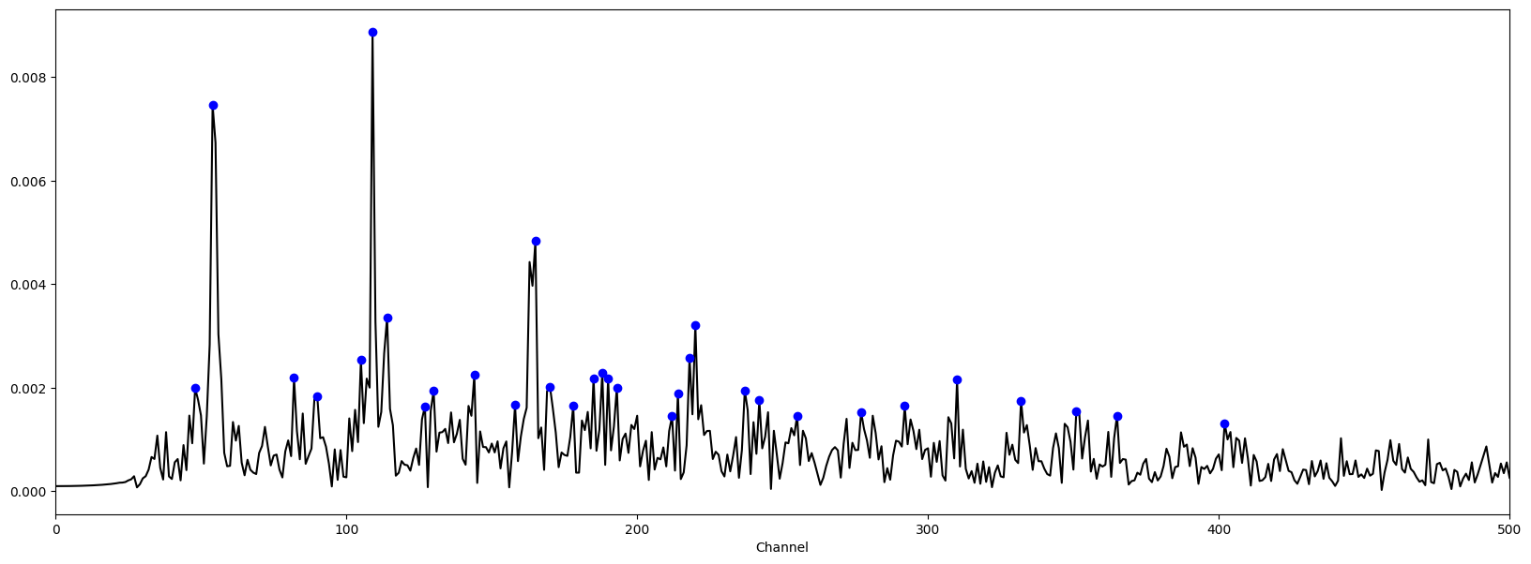

Slide 10
Other issues:
Missing datapoints:
Interpolation/ extrapolation,
removing missing datapoints from the signal,
Model or approximate functional form of the signal => estimate the missing points
Visualisations:
Phase space plots to see dynamics and non-dynamics of the signal
Plotly/Bokeh more interactive plots of the signal
Simulations

