Slide 1
A HYBRID KNOWLEDGE BASED RECOMMENDATION
ENGINE
Group Number: 5
Guide: Prof Geeta Patil
Members:Jaya Singh (B120228520)
Lavanya Killada (B120228523)
Shimita Rudra (B120228548)
Tanya Saroha (B120228556)
<number>

Slide 2
Summarization
STEPS | STATUS
Generating Learner and Learning resource Ontology | COMPLETED
Collecting Ratings from users for learning resources | COMPLETED
Generating Similarities and predictions based on rating | COMPLETED
Using the generated data to predict Top N recommendations using CF engine | COMPLETED
Collecting and maintaining Web logs of learners | To be Done
Applying SPM on top N recommendations | To be Done

Slide 3
Ontology Creation:-
A jotform was user to collect user information.
User provided personal information and judged their knowledge level.
Users took the Learning Styles questionnaire to get scores for their learning characterstics.
Resource Ontology was created manually.

Slide 4
Generating Similarities and Predictions
Pearson Correlation similarity formula has been used to calculate similarity between two learners.
It measures linear correlation between X and Y
Values lie between 1 and -1; 1 means total positive correlation, 0 is no linear correlations, -1 is total negative correlation.
Pearson correlation is very similar to cosine similarity but Pearson correlation can be used when ratings vary
Thus, objects that describe the same data but use different values can still be used.
Based on generated similarities, Ratings of unrated resources were predicted for all learners.

Slide 5
Checking Error in Predictions
Mean Absolute Error(MAE) was used to check the efficiency in recommendations.
It uses the actual and predicted ratings for calculations.
The same process was followed using 3 different datasets.
One containing 150 ratings, one with 200 ratings and other with 250 ratings.

Slide 6
Graphs Generated and Observations
The MAE for each of the implementations was plotted on a graph.
It is seen that the Error reduces as number of ratings increase.

Slide 7
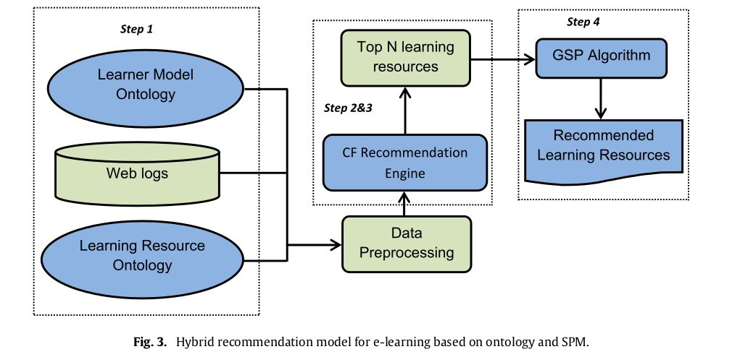
Architectural Design
<number>

Slide 8
The Last step:-
The last step is applying the GSP algorithm to the top N recommendation list to filter the recommendations according to the learners’ historical learning sequential patterns.
GSP algorithm is a sequence mining algorithm.
GSP algorithm was used to discover sequential learning patterns from web-logs.

Slide 9
THANK YOU!

