Slide 1
AI-Powered Personalized Learning Companion
TEAM NAME → TEAM BUZZ

Slide 2
Project overview→
Problem: Students with special needs struggle with one-size-fits-all learning.
Solution: Personalized AI-based learning dashboard with mood detection and gamification.
Features: Magic Survey, Mood Detection, Gamified Dashboard, Spinning Wheel, Real Games,
Progress Feedback.

Slide 3
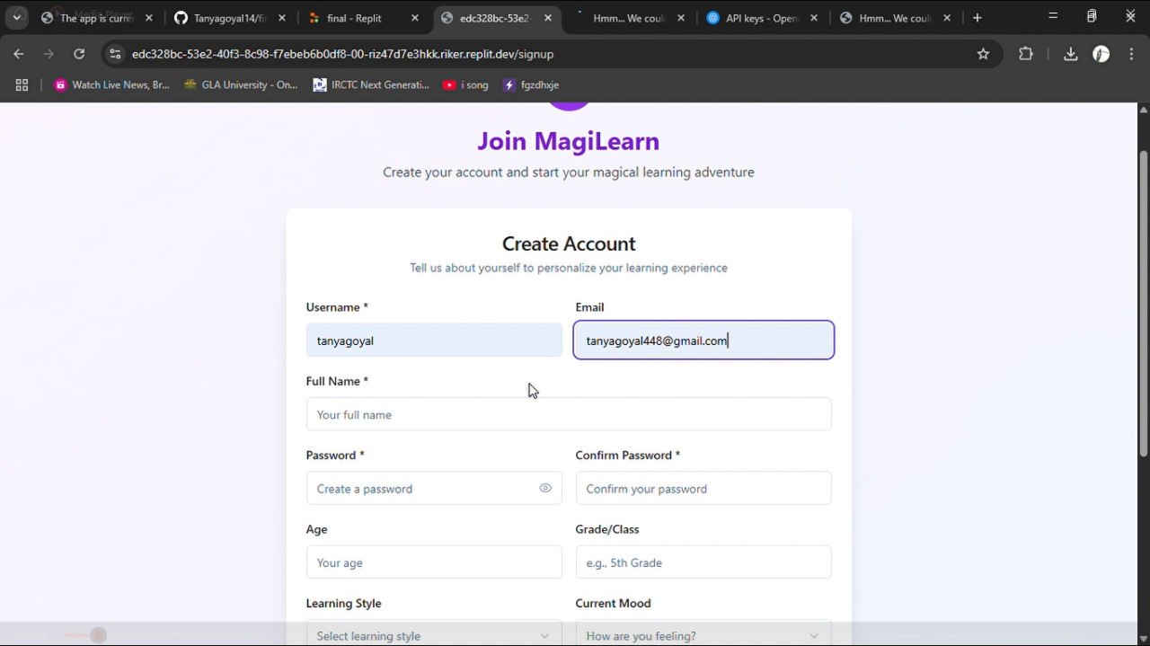
First Page → Sign up
Allows users to register securely. Once authenticated, users are redirected to the Magical Survey page

Slide 4
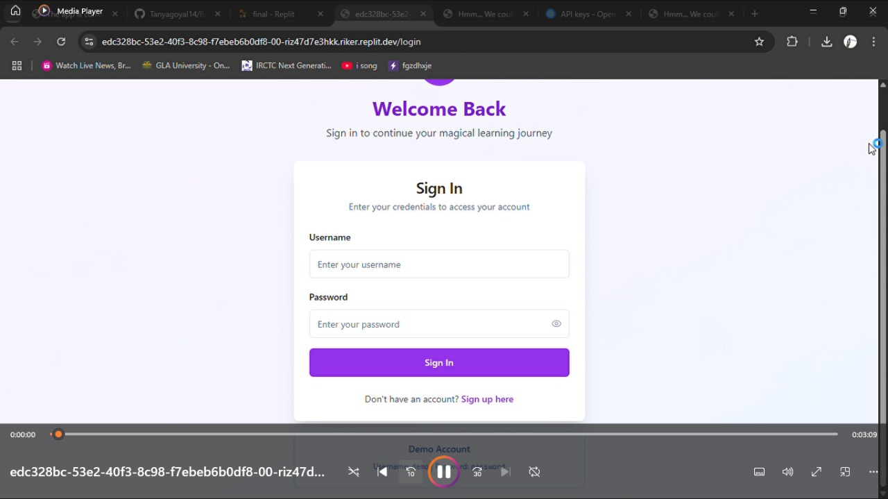
Second Page → Login
Allows users to log in securely if account is already created.
Once authenticated, users are redirected to the Magical Survey page

Slide 5
Third Page → Survey
Students fill a mood-based intake survey: Mood, Learning Style, Interests, Accessibility Needs. This data is used to personalize the dashboard with appropriate learning tools

Slide 6
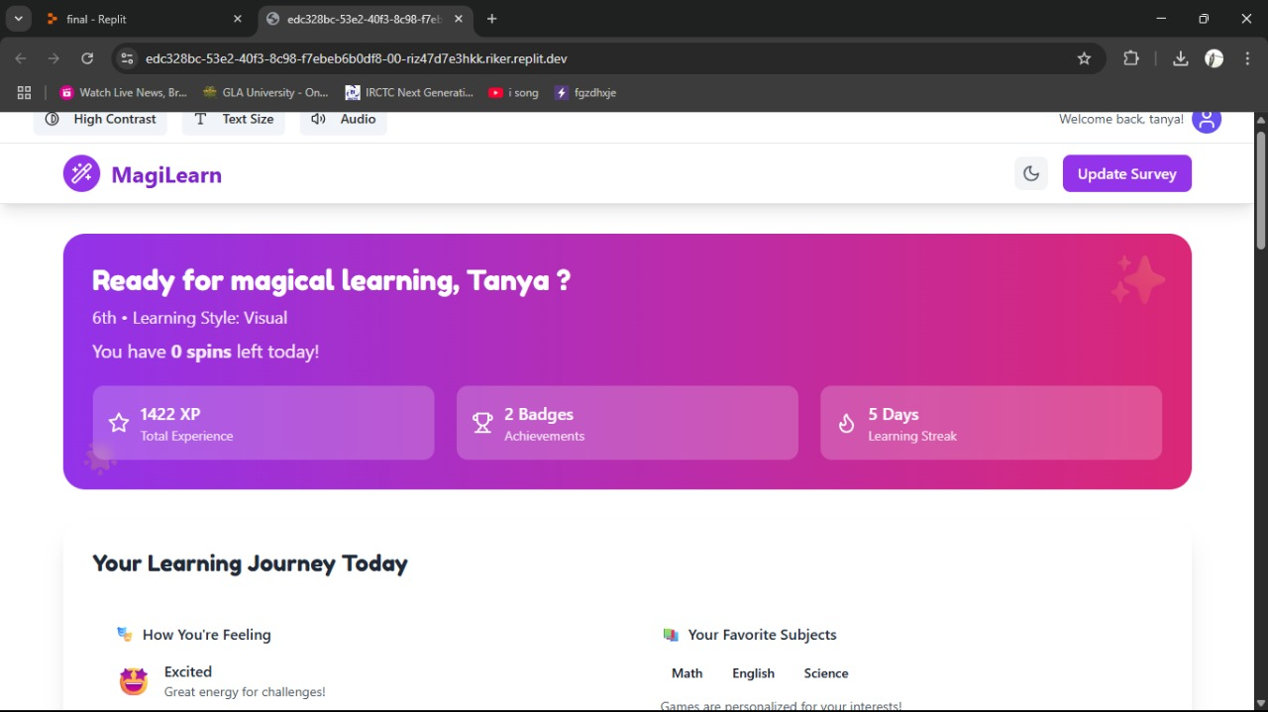
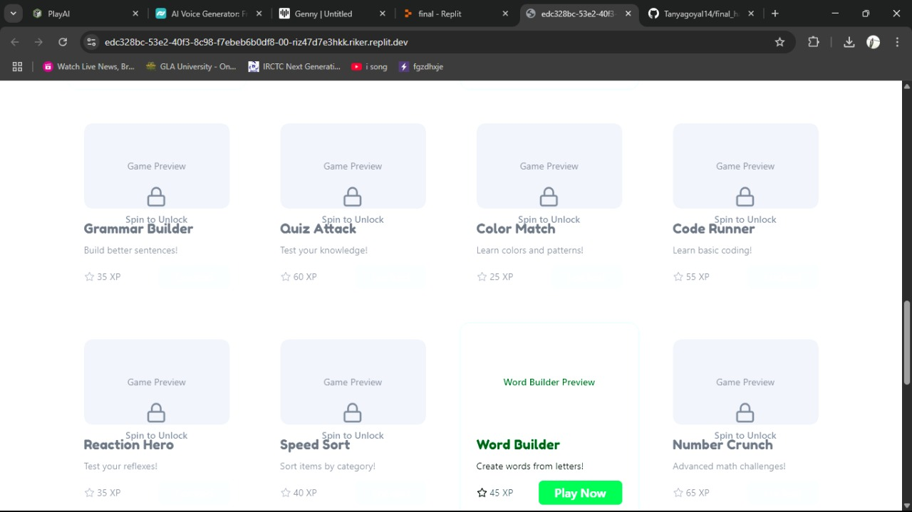
Fourth Page → Dashboard
10 suggested games
Mood-specific UI (calming, motivating)
Style-based learning tools (TTS, font
size, contrast, focus music)
Progress & feedback display

Slide 7
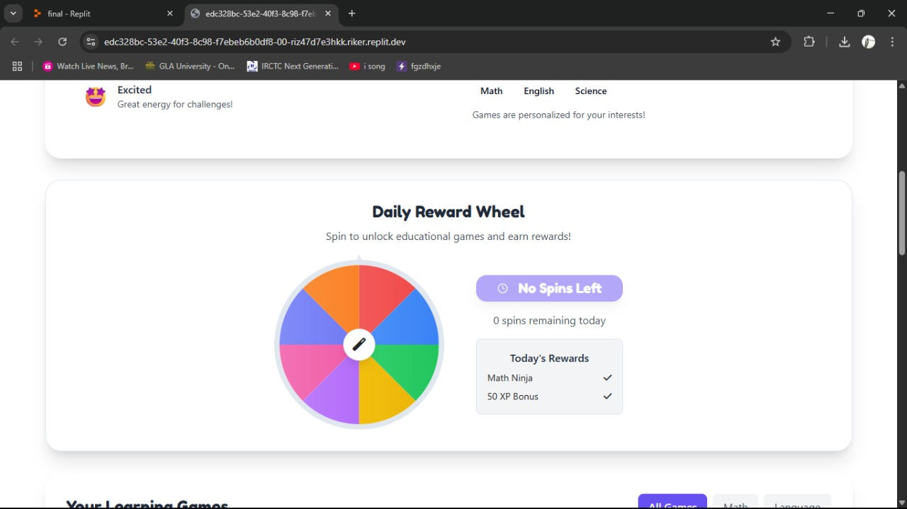
Continue Fourth Page → SPIN WHEEL
Students get 3 spins/day. Each spin unlocks 1 educational game. Real-time animation with glow + confetti on unlock.

Slide 8
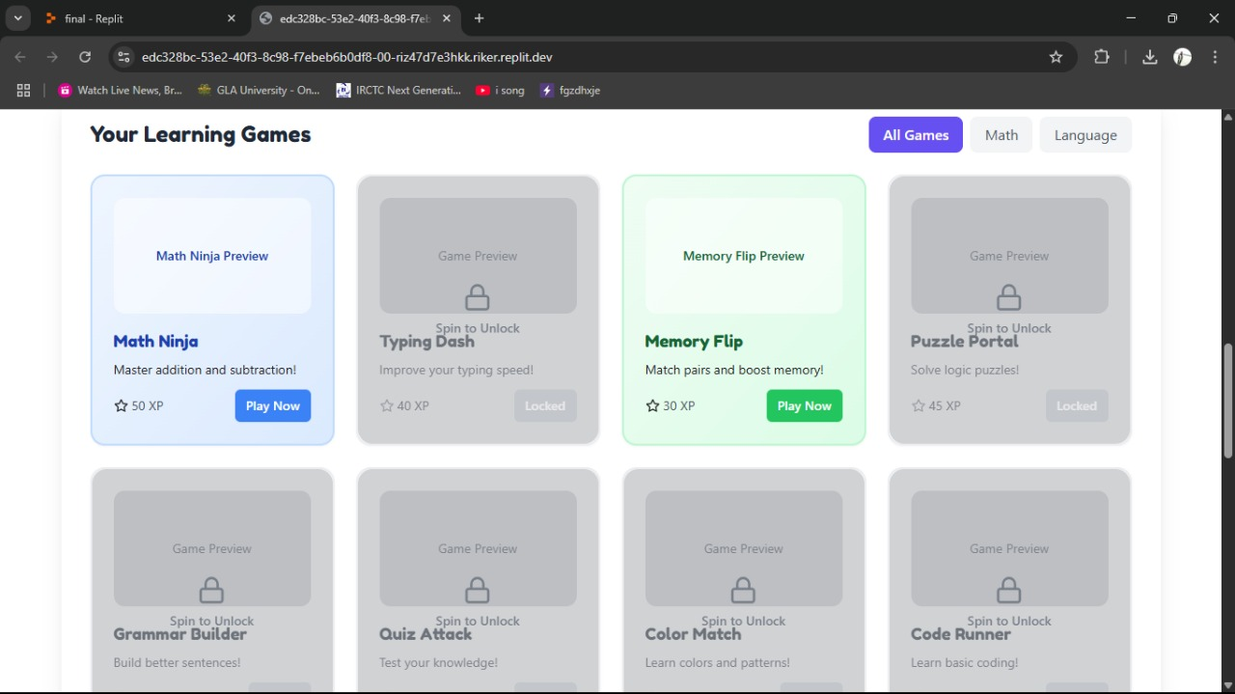
Fifth Page → Unlock Games
After spin, user clicks “🎮 Claim & Play”. Game opens in embedded interface. Locked games show padlock with “Spin to Unlock”.

Slide 9
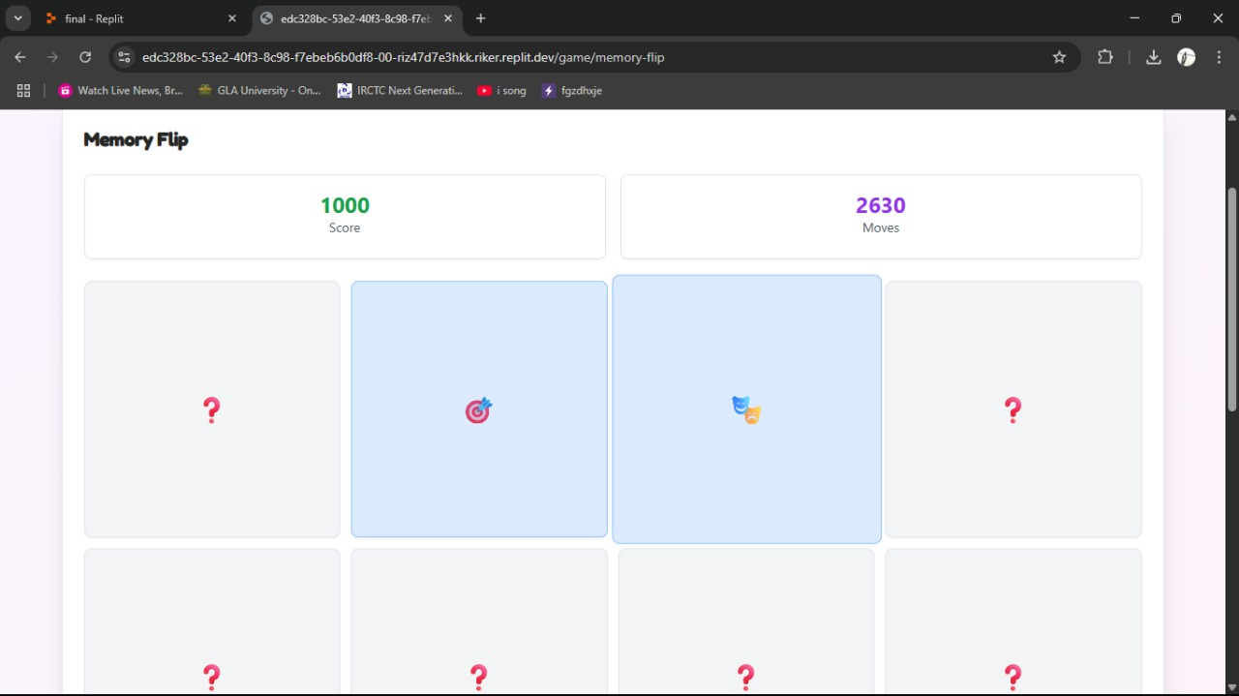
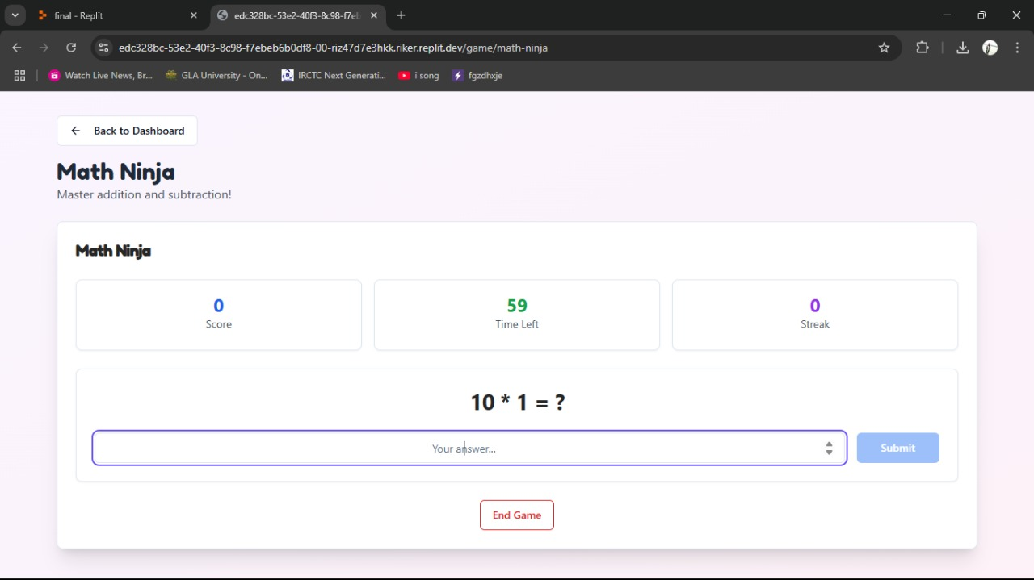
sixth Page → Games
Playing Unlock Games

Slide 10
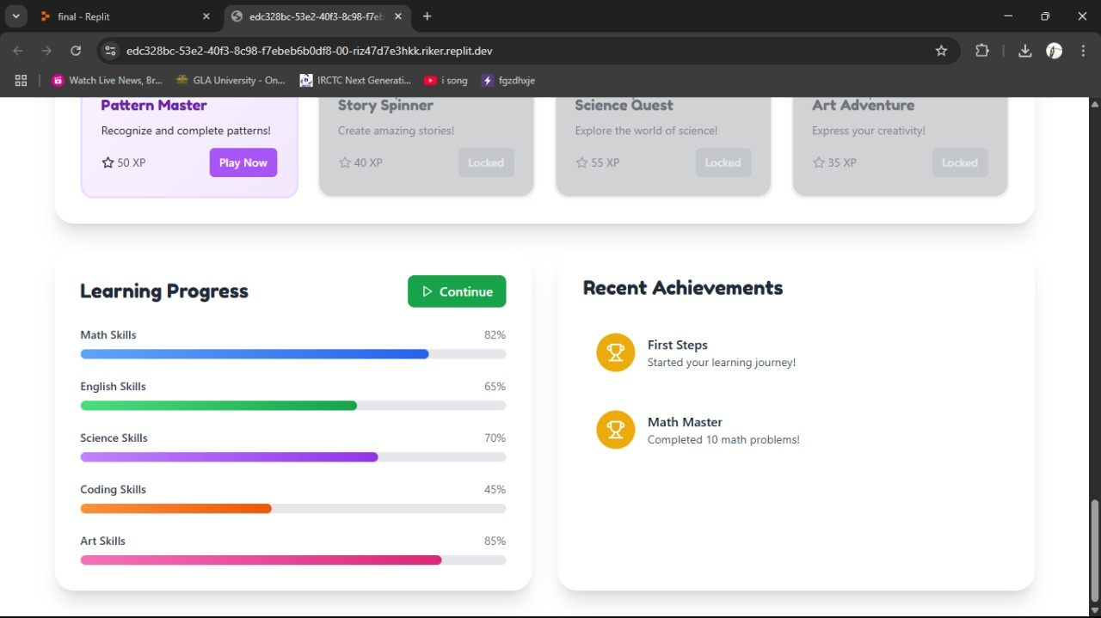
sEVENTH Page → LEARNING PROGRESS
Helps students visualize their progress in real time.
Enables mood-based adaptive learning paths..
Motivates learners with rewards and a sense of achievement.

Slide 11
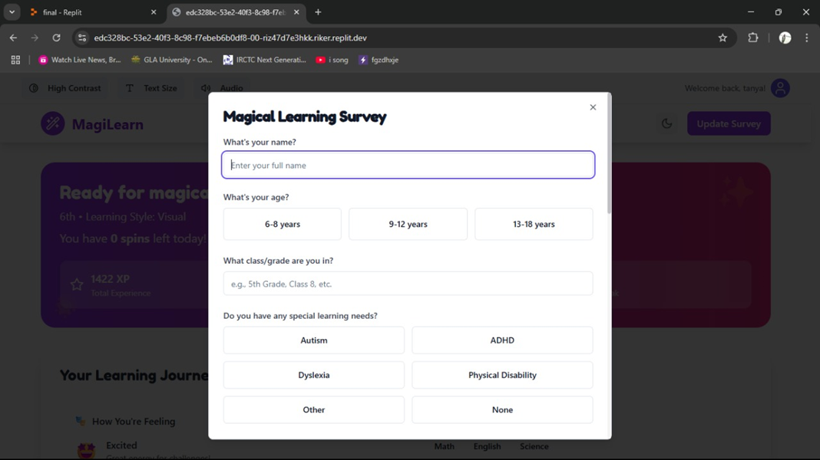
EIGHT Page → RETAKE SURVEY
Users can update preferences every 3 days AI regenerates dashboard dynamically to adapt mood and needs.

Slide 12
IMPACT
Empowering differently-abled students
Reduces learning anxiety
Makes education joyful
Enhances emotional intelligence
Real-time feedback for teachers

