Slide 1
India’s Amazon Transaction & Product analysis
in Jan - Feb 2019
16 June 2025
Tanyanid Pipobsukavadee

Slide 2
Agenda
Style
01
Executive summary
02
Overall Analysis
03
Cohort Analysis
04
RFM Analysis
05
Customer segmentation : K means

Slide 3
Executive summary

Slide 4
Executive Summary
Flat discounts are ineffective → No positive correlation with order value
High-AOV users need less incentive → These buyers convert without big discounts.
Low retention, but recurring buyers are valuable → Only 7% are repeat users, but they spend more.
Key insights
Segment discount strategy by value tier → Apply targeted incentives based on spending behavior.
Improve retention via early re-engagement:
- Launch welcome campaigns for New & Recent Buyers.
- Use NPS/post-purchase surveys for One-Time Buyers to uncover drop-off reasons.
Reduce discount levels for high-AOV/premium segments.
Introduce loyalty programs in high-potential categories (e.g. Electronics, Home & Kitchen) to retain top spenders.
Recommendations

Slide 5
Data scope
EDA, Data Cleaning

Slide 6
Data Overview
Timeframe
Jan-Feb 2019
Table
Transaction by user level
Product
Datasource
India’s Amazon

Slide 7
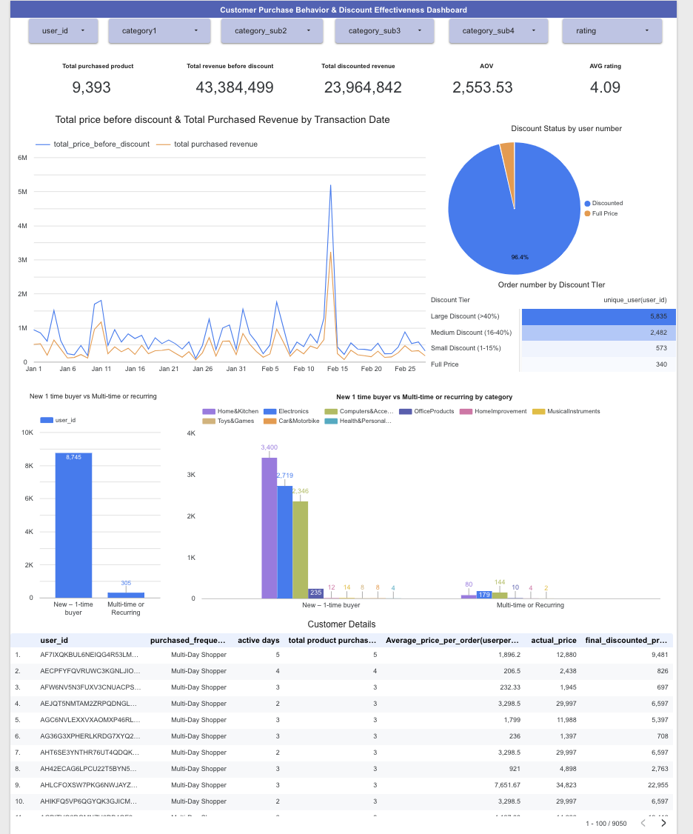
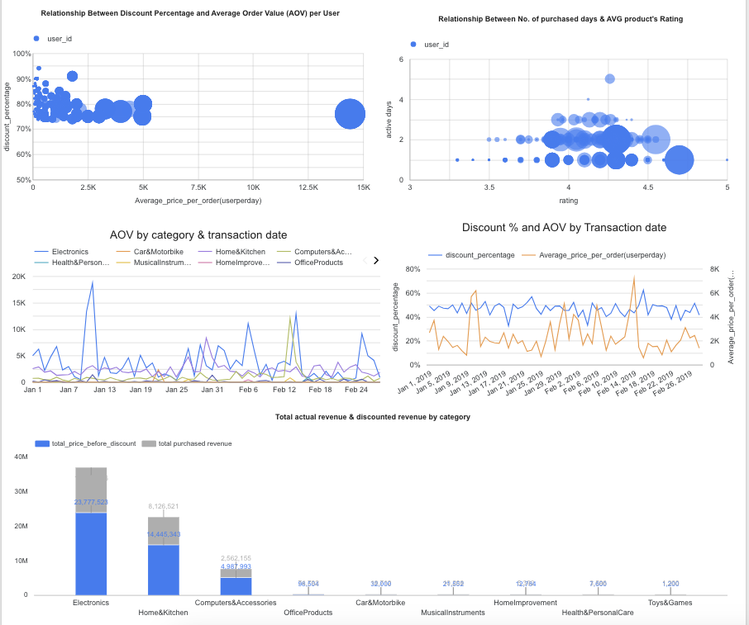
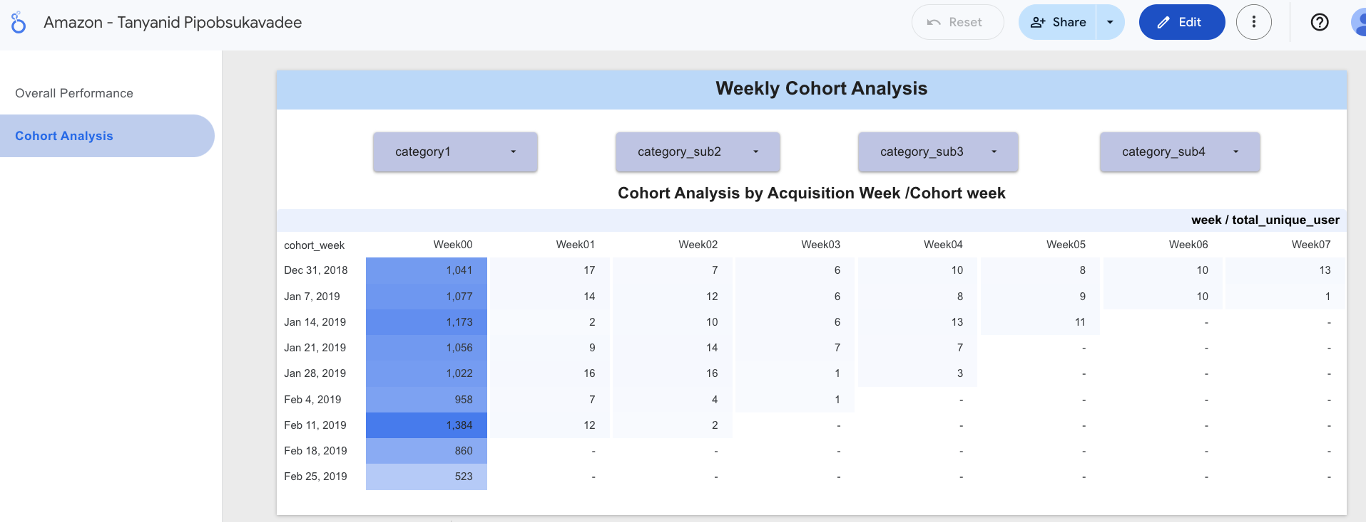
Dashboard: 2 pages “Overall Performance” & ”Cohort Analysis”
https://lookerstudio.google.com/reporting/edec0cdc-b487-41bf-a5df-d1dd515dfab2
Notes:
https://lookerstudio.google.com/reporting/edec0cdc-b487-41bf-a5df-d1dd515dfab2

Slide 8
Analysis

Slide 9
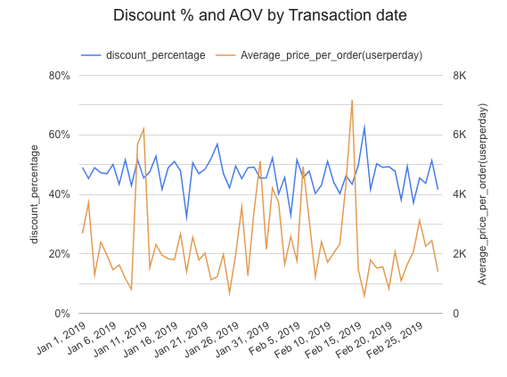
AOV Fluctuates Independently from Discount – Suggests Discount Isn’t a Key Driver
AOV fluctuates independently of discount level. Big AOV days occurred with average discounts.
AOV Spikes Aren’t Tied to Discounts
High AOV days (like Feb 8 and 17) don’t match up with changes in discount levels. These spikes likely came from specific users, products, or large purchases — not from discounting.
Flat Discount Strategy
The discount % barely changed, which suggests a mass discounting approach rather than tailored promos.
However, we have to look deeper to conclude this by each customer group
No Strong Positive Correlation Between Discount% and AOV
Discounts stayed fairly steady (40–50%), while AOV jumped up and down — sometimes even dropping when discounts increased. So, bigger discounts don’t always mean bigger orders.
Notes:
Next step : Run a Correlation Check
We expected AOV to rise with discount depth, but that wasn't the case. Some high-order days had normal discounts, proving that flat discounting doesn't reliably boost value.
However, we have to look deeper first to conclude

Slide 10
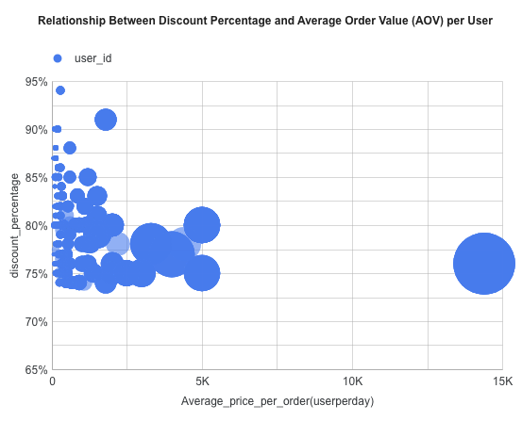
Correlation Between Percentage Discount to AOV
→Negative Correlation
: Most users with high discounts (85%-95%) tend to have lower AOVs
Suggestions
Heavy discounts do not lead to higher-value orders.
→ High-AOV Users get Lower Discount
: Users spending 5k-15k+ per order tend to receive lower discount (around 70%-75%)
Suggestions
These users may not need large discounts to convert — they might be high-intent or premium buyers.

Slide 11
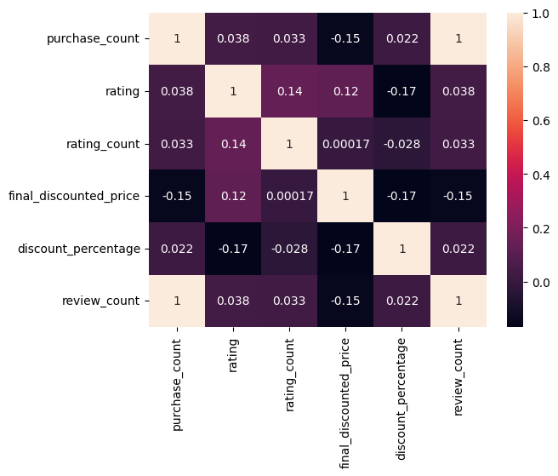
Overall Product Feature Correlation
Purchase count
vs
Review count
1.0
Every purchase comes with a review (possibly one review per purchase).
This is because of data structure
(1 transaction will have review_id)
Rating
vs
Purchase
0.038
Slightly positive correlation
a very minor tendency for higher-rated products to be purchased more.
Rating count
vs
Rating
More ratings → slightly higher average rating.
Possibly more trustworthy products receive better feedback.
0.14
Final Discounted Price
vs
Purchase count
-0.15
Lower-priced items are bought more often.
Discount Percentage
vs
Rating
-0.17
Higher discounts slightly correlate with lower product ratings.
Heavily discounted products may compromise quality.
Review count
vs
Final Discounted Price
-0.15
Cheaper price tends to have more reviews
Notes:
3) Even though cheaper products generally sell more frequently (as the -0.15 correlation suggests), some categories like Electronics break this trend — they attract many buyers despite high prices, driving both volume and revenue.

Slide 12
Key Insights for Product & Feature Correlation
Relationship | Insight | Action
Discount % vs Rating | Higher discounts slightly → lower ratings | Use discounts carefully to avoid cheapening perceived quality
Purchase Count vs Price | Lower-priced items bought more | Bundle or upsell to increase order size

Slide 13
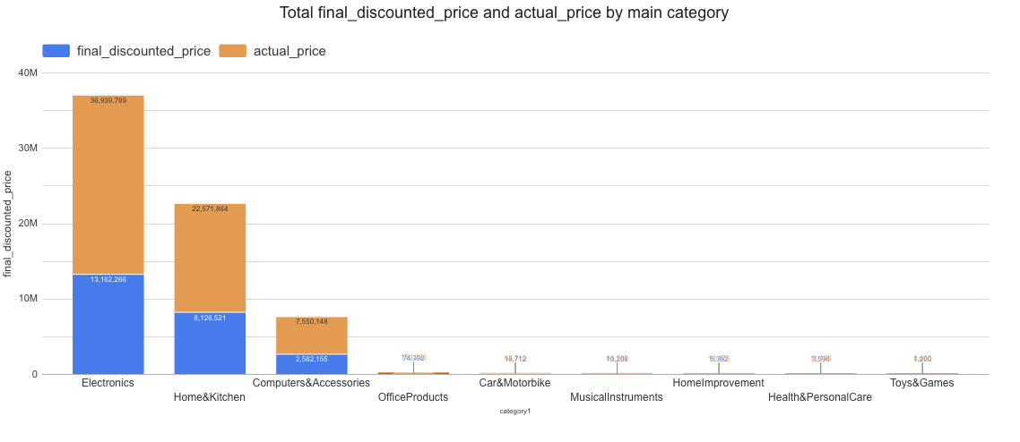
Top 3 categories by total discounted revenue & actual revenue
Revenue before discount
Electronics – ₹36.9M
Home & Kitchen – ₹25.9M
Computers & Accessories – ₹7.8M
Net Revenue after discount
Electronics – ₹13.1M
Home & Kitchen – ₹8.1M
Computers & Accessories – ₹2.6M
Notes:
Let’s look at overview by category

Slide 14
AOV comparing to Industry’s AOV in 2019
Electonics’s AOV and Health care’s AOV
are higher than Industry’s AOV
Data source : Perplexity ”figure1,2”
Notes:
AOV of each category comparing industry

Slide 15
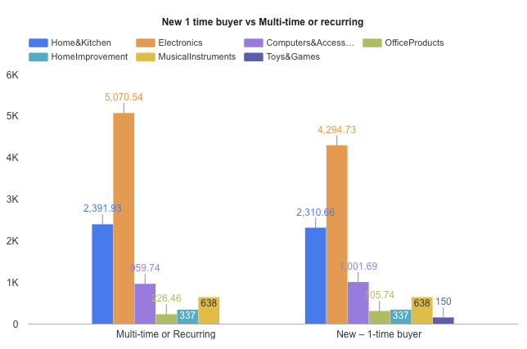
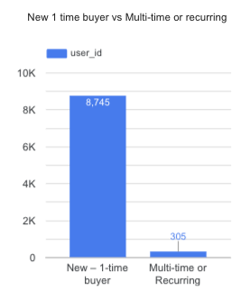
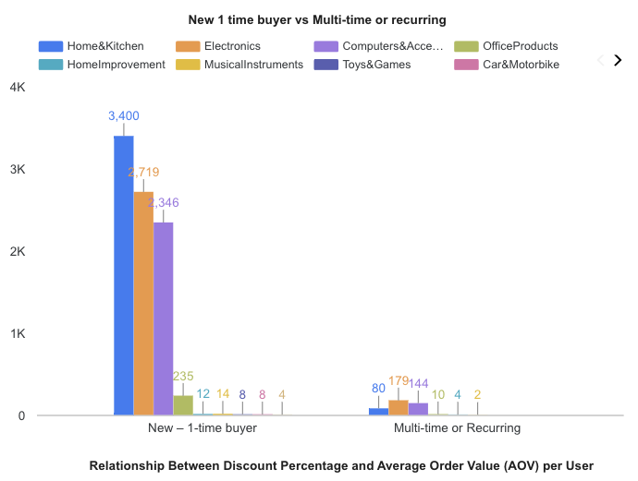
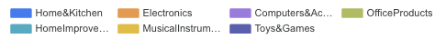
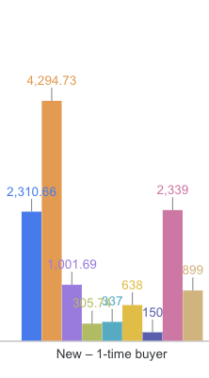
Customer segmentation Overview Top 7 categories by total revenue
Total New VS Recurring customers by category
AOV by New VS Recurring customers by category
Recurring customers spend more
Average Order Value for recurring buyers is highest in Electronics (₹5,070) and Home&Kitchen (₹ 2,392) and Computers & Accessories AOV: ₹959
: way more than 1-time buyers. This makes them high-value segments to retain.
Most buyers are 1-time only
Out of 9,050 total users, only 305 came back. That’s a recurring rate of ~3.37%, so there’s room to improve retention.
Electronics & Computers categories lead for repeat customers
These two categories bring in the most recurring users — especially Electronics, which stands out in both volume and spend.
Assumption : new user who buy product 1 time at the month we acquired them
Recurring : user who buy products more than 1 time during the lifetime
Notes:
Number of multi-recuring total and by category won’t be the same since 1 user can be in more than 1 category

Slide 16
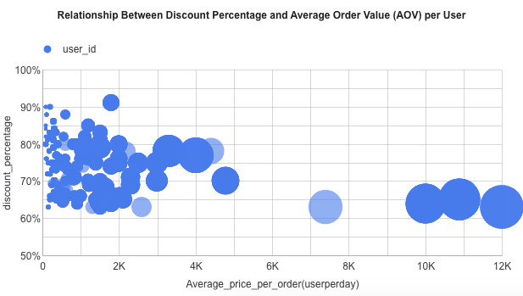
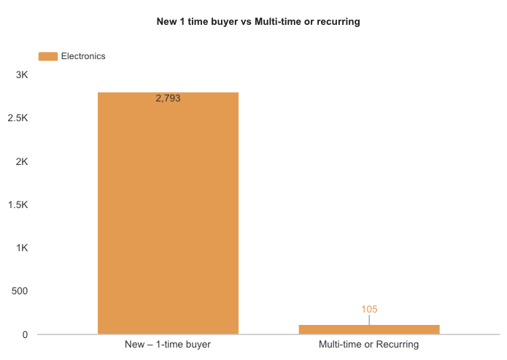
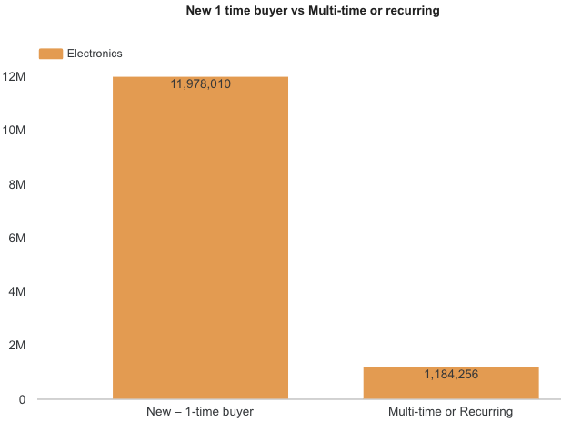
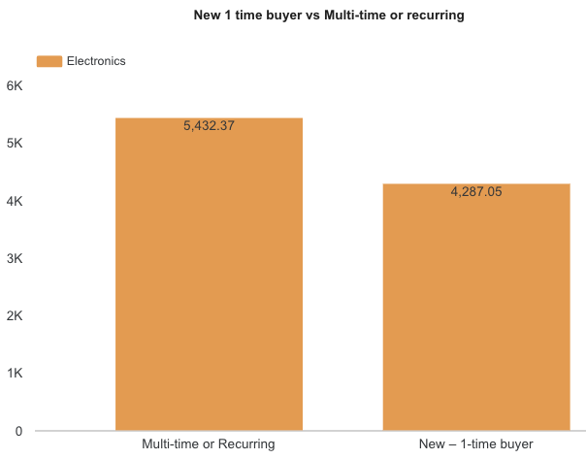
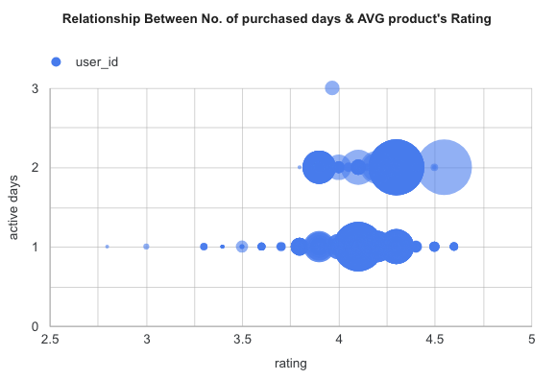
Electronic products : correlation discount% vs AOV
and purchased days vs Avg product’s rating for
Relationship b/w Discount% & AOV
Total unique users
Total discounted price
AOV
Mostly one-time buyers
(2,753 vs 105 repeat buyers)
92%+ of revenue comes from new buyers
AOV (Average Order Value):
New buyers: ₹4,937
Repeat buyers: ₹5,420
(higher than new buyers)
- Most users get high discounts (70–100%) but have low AOV (< ₹5K)
- High spenders (₹10K–₹12K) usually get lower discounts (50–60%)
Observation: We might give big discounts to low spenders, while top spenders don’t need much incentive
Repeat customers tend to have high product ratings (4.0–4.5), showing strong satisfaction.
Next Steps:
- Reduce discounts for high-AOV users
Use heavier discounts to move low spenders toward higher value (bundles, upsell)
- Try segmenting by spend/discount patterns and test different offers.
Re-engage satisfied buyers with loyalty perks to build retention.

Slide 17
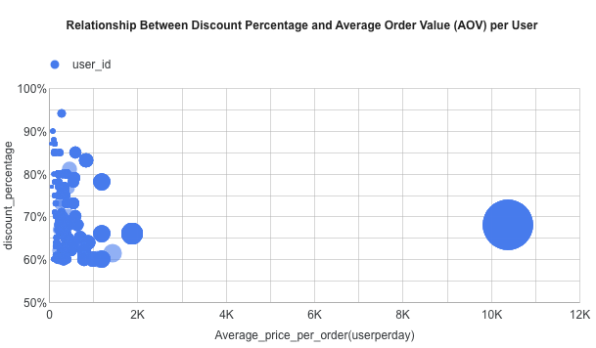
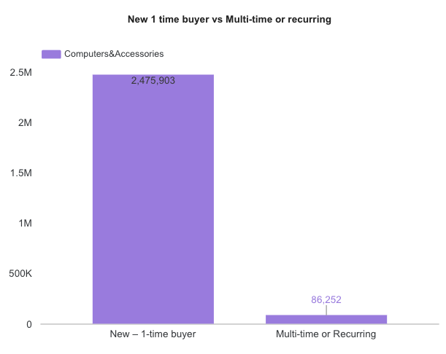
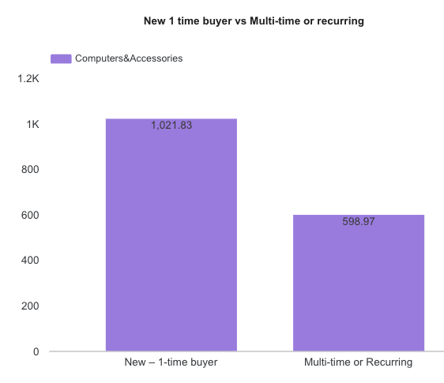
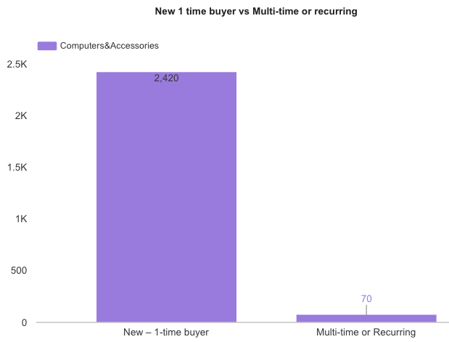
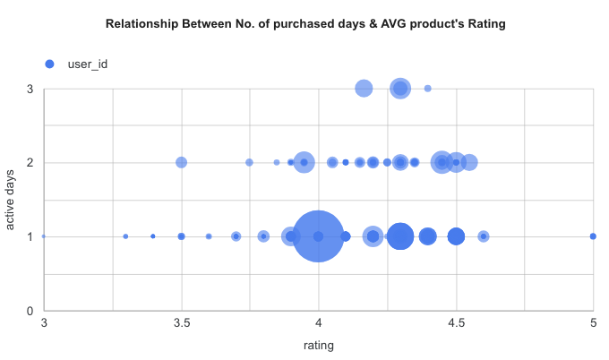
Computers&Assessories :correlation discount% vs AOV
& purchased days vs Avg product’s rating
Total unique users
Total discounted price
AOV
Almost all users
have low AOV (< ₹2K) and high discounts (70–100%)
There’s no meaningful cluster of high spenders like in Computers&Assessories
Indicates this category is heavily price-driven — users likely respond to discounts
(with one high spender outlier)
Dominated by new buyers: 2,423 new vs. only 70 repeat users.
Revenue mostly from new users: 96%+ of total.
Low AOV: ~₹1K–2K, even lower for repeat customers.
High discounts are the norm: 70–100% for most users.
High ratings (4.0–4.5) but limited repeat purchase (1–3 days).
Next step
Target discounts to low-AOV users only; avoid over-discounting everyone.
Test bundles or add-ons to increase order value.
Retarget within 72 hrs to convert satisfied buyers into repeat customers.
Use post-purchase feedback to identify drop-off reasons.

Slide 18
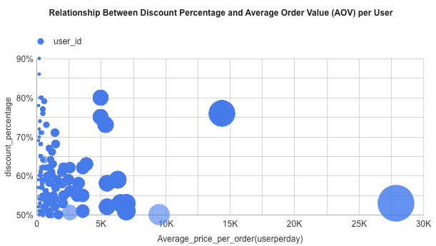
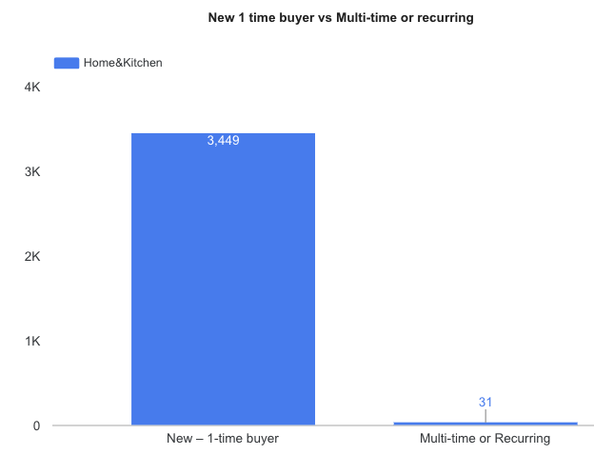
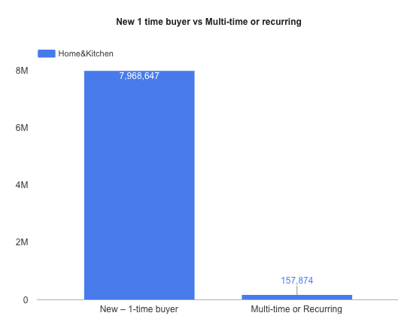
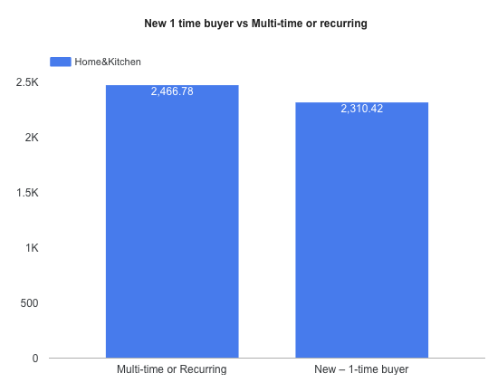
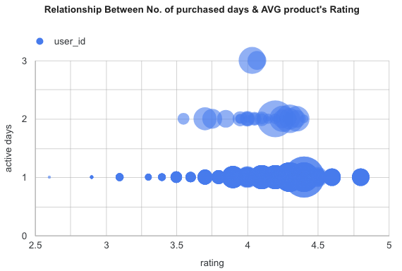
Home & Kitchen :correlation discount% vs AOV
& purchased days vs Avg product’s rating
Home & Kitchen
Total unique users
Total discounted price
AOV
User Type: Strongly leaning toward new 1-time buyers (3,449 vs only 31 repeat users).
Revenue: Nearly all revenue comes from new customers.
AOV: Repeat buyers actually spend a bit more per order
(₹2,466 vs ₹2,310).
Discounts: Most buyers get heavy discounts (70–100%), even at lower AOVs.
Meanwhile, high spenders (~₹10K–30K) get smaller discounts (~50–60%).
Engagement: Users with 2–3 active days often have high product ratings (~4.0–4.5).
Next step
Use heavier promos to upsell or convert low-AOV users.
Target high-rated buyers with loyalty offers to encourage repeat purchases.
Focus on building retention—currently just 31 users return.
Notes:
Unique user ,Total discounted price,AOV
Next steps
Keep offering discounts for mass buyers
Identify & nurture high-AOV customers (could be premium segment)
Test tiered pricing or loyalty perks for top spenders

Slide 19
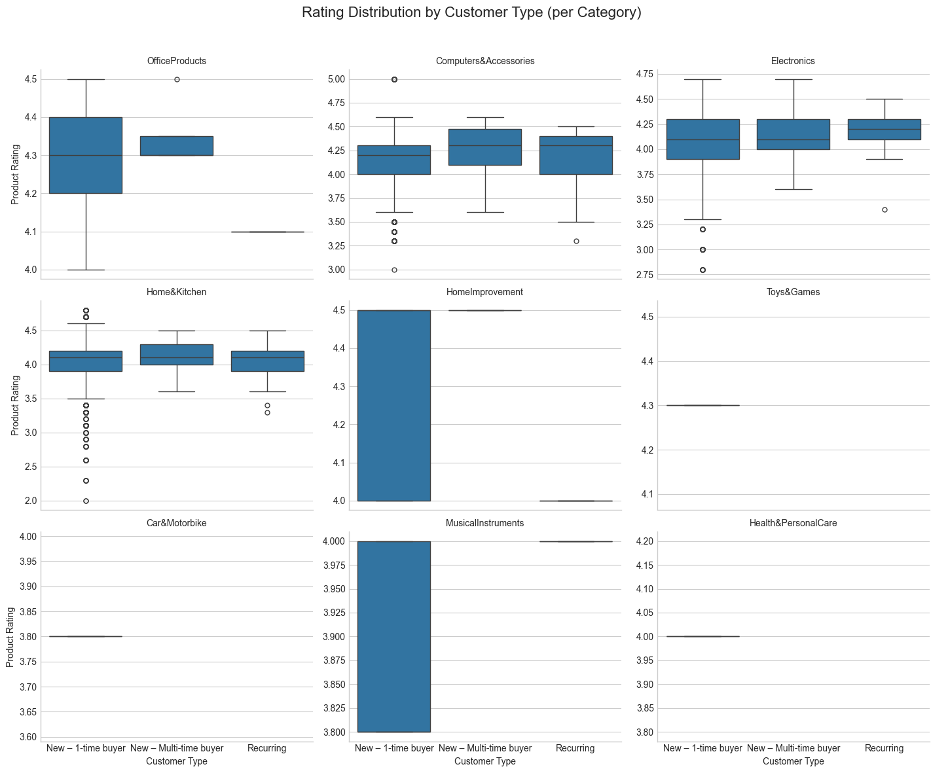
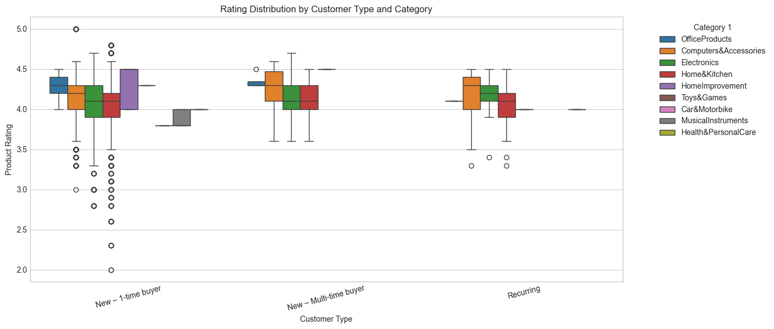
Product’s Rating among customer type by each category
1) Electronics, Computers & Accessories, and Home & Kitchen consistently get high ratings (around 4.2–4.5). This lines up with what we saw earlier—these categories also bring in higher revenue and more returning customers.
2)Office Products and Home Improvement also have moderate – high ratings but show less repeat behavior or smaller user number.
3)On the other hand, categories like Musical Instruments, Car & Motorbike, and Health & Personal Care have noticeably lower ratings. These are also the same categories with low AOV and very few repeat buyers.

Slide 20
Key findings
No | Key insights | Details | Next step
1 | Most buyers are 1-time only | 96.63% of users (8,745 of 9,050) purchased only once. Recurring customer rate is only ~3.37%. | - Launch re-engagement campaigns for 1-time buyers - Use welcome offers & post-purchase surveys to encourage second purchases
2 | Top Performing Categories: Electronics, Home & Kitchen, Computers | These three drive the most revenue and repeat customers. Electronics stands out for both high AOV and repeat rate. | Focus retention efforts here - Create category-specific loyalty programs (e.g. VIP tiers, exclusive perks)
3 | Recurring users spend more | Recurring customers consistently show higher AOV (e.g. ₹5,070 for Electronics vs ₹4,295 for new buyers) | Prioritize converting new buyers to recurring - Bundle offers or early access perks for repeat shoppers
4 | Discount & AOV: Weak correlation | Final discounted price has a slight negative correlation with purchase count (-0.15). Discount % is weakly linked to AOV. | - Avoid flat discounts - Use dynamic discounting—target low spenders only (since we can see from customer deepdive that higher spenders don’t have strong link to discount)
5 | High spenders need less incentive | Users with high AOV (₹10k–₹12k) often received smaller discounts (50–60%) and still converted. | - Don’t over-discount top spenders - Offer value-adds or VIP tiers like early access or exclusive deals instead
6 | Electronics buyers are satisfied | Repeat Electronics customers have higher product ratings (4.0–4.5). 92% of revenue is from new users, but repeat buyers spend more. | - Reduce discounts for repeat buyers - Offer loyalty packages to reinforce satisfaction
7 | Computers are price-sensitive | Most buyers have low AOV (₹1k–2k) but high discounts (70–100%). Minor group is high-spending cluster & repeated customer. | - Target discounts to low spenders only - Bundle offers to raise order value - Retarget within 72h after purchase
8 | Home & Kitchen is promising | High ratings (4.2–4.5), moderate AOV (~₹2.3k–₹2.4k), but low retention. Majority are new buyers. | - Use heavier promos to upsell low-AOV users - Launch retention packages for high-rated buyers

Slide 21
Cohort analysis

Slide 22
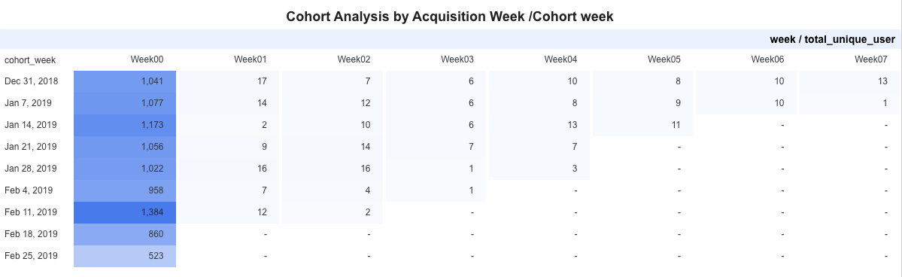
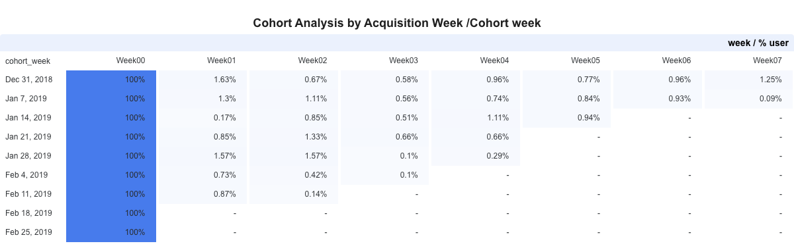
Overall Cohort Analysis : Overall Cohort Analysis: User Retention & Drop-off
Extremely low user retention after Week00 — cohorts drop to an average of just ~1% by Week01.
Metric | Insights | Implication | Suggested Action
Total unique users & % Retained users | Initial cohort size remains strong across weeks (1,000–1,300+ new users weekly). | Amazon struggles to retain users after the first week | Launch post-purchase engagement & campaigns appealing 2nd purchase
 | Extremely low user retention after Week00 — most cohorts drop to <2% by Week01. | This shows the same insight with first part of analysis that most buyers are 1-time users (~93%) which they seem to churn immediately | Launch re-engagement & retarget campaigns to follow up users within 3-5 days after purchase
Notes:
Based on power user, casual user, new user (make few user)
A

Slide 23
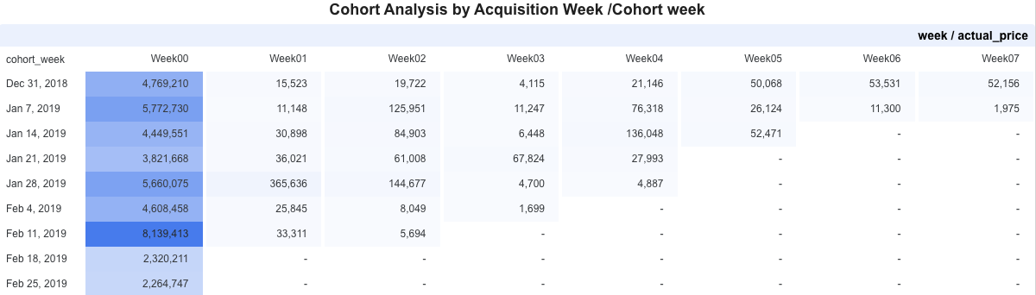
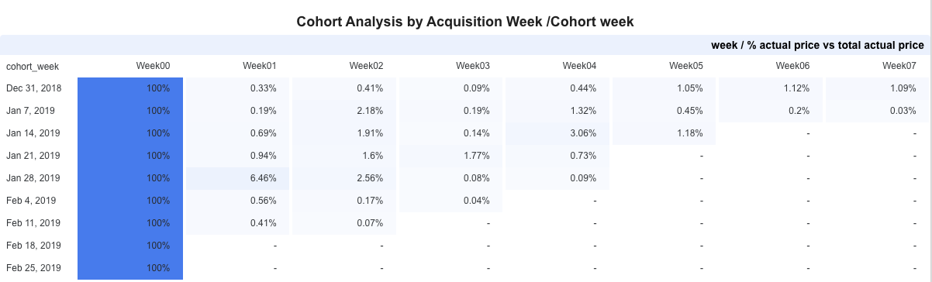
Overall Cohort Analysis :Actual price & Actual price %
Every week is less than 3%
Metric | Insights | Implication | Suggested Action
Revenue (Actual Price) | Week00 contributes nearly all revenue; following weeks show significant drop-off. | Most revenue comes from new users; returning customers contribute very little. | Offer Bundles or loyalty programs to increase revenue per order & Convert users to be repeat buyers
% Revenue Retained | Week01–Week07 contribute < 3% of actual revenue in most cohorts. | It's hard to keep revenue steady because most customers don’t come back or spend much over time.

Slide 24
Cohort Analysis : Key Insights and recommendations
1
Key insights
Amazon consistently acquires ~1,000–1,300 new users per week, indicating a strong and reliable acquisition channel.
Recommendations
Maintain same level of acquisition and on top is to focus on retaining customer
2
Key insights
Retention rate is < 2% return after Week01 meaning that
users don’t return after first purchase
Recommendations
Engage users within 3-5 days after purchase to make them repurchase
Week00 contributes nearly all revenue; very little is generated in the following weeks.
Revenue heavily on new user acquisition; repeat customers contribute minimally, risking long-term revenue stability.
Key insights
3
Recommendations
Launch bundled offers or loyalty programs to raise order value
&
Convert new users into repeat buyers to improve retention-based revenue.

Slide 25
How Recent, How Frequent, How Much users bought?
RFM Customer Segmentation

Slide 26
Clustering with K-means algorithm

Slide 27
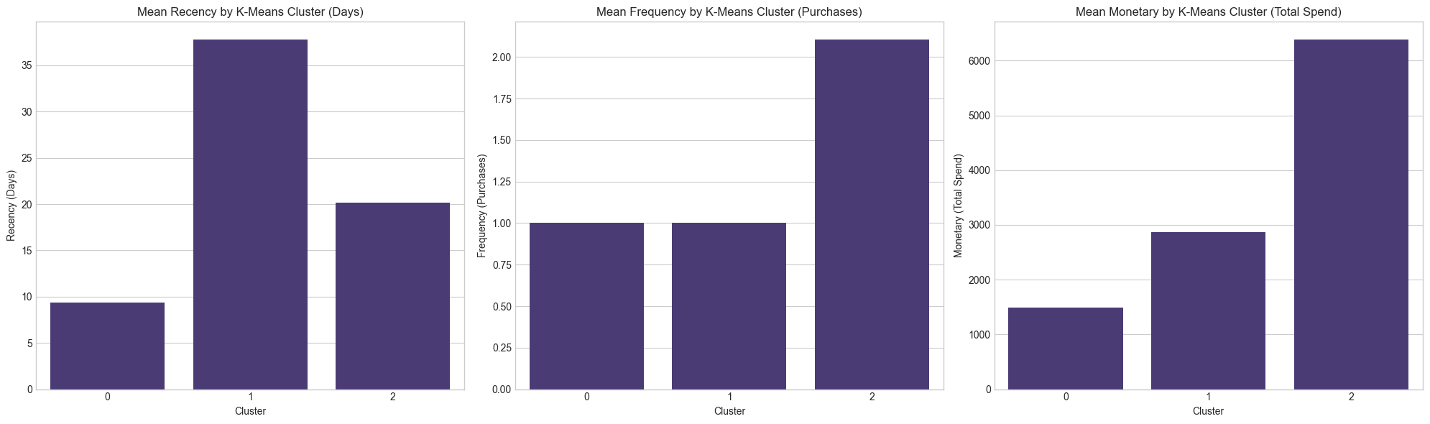
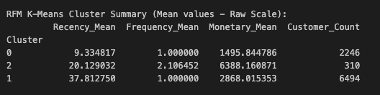
Mean Recency,Frequency&Monetary(RFM) behavior
By Kmeans clustering
There are 3 customer clusters
Mean Recency
How recently customers in each cluster made their last purchase
Mean Frequency
The average number of purchases made by customers in the cluster
Mean Monetary
The average total amount of money spent by customers in the cluster
~9 days
~37 days
~20 days
~1
~1
~2
~1,500
~2,800
~6,300
Currency is in Rupee
For Recency, our 'analysis date' was set to one day after the last transaction in the dataset. This captures how recent customers were within the data's timeframe, providing meaningful historical insights.
Cluster 0
Cluster 1
Cluster 2
New & Recent Buyers: Purchased very recently, only once, and spent low. These are newly acquired users.
One-Time Buyers: Last purchase was long ago, low frequency, and moderate spend. High risk of churn.
Loyal & High-Value Customers: Fairly recent purchase, most frequent, and highest spend. VIP segment.

Slide 28
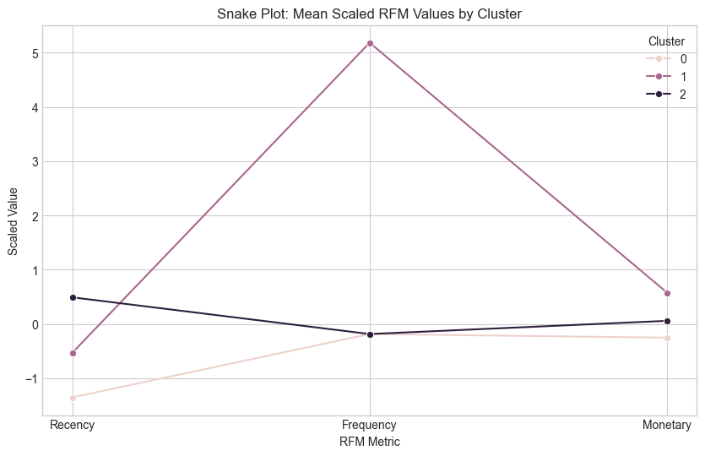
Recency, Frequency & Monetary
Cluster | Type of customers | % | RFM Intepretation | Strategy | Next step
0 | New & Recent Buyers | 25% | Customers who purchased very recently, are typically one-time buyers, and have a low monetary spend. These are new acquisitions. | New user greeting campaign, first-time incentives, product with high promotion to appeal | - Set up an automated onboarding flow (email/push) - Launch “2nd purchase” discount
1 | One-Time Buyers | 71% | The largest segment. Customers whose last transaction was a long time ago, are primarily one-time buyers, with moderate initial spend. They are at high risk of churn. | Reactivate campaign, Limited-time offer, Win back (eg. Bundle products), Net Promoter Score survey | - Send NPS to understand drop-off - Offer time-sensitive promo to reactivate
2 | Loyal & High-Value Buyers | 3% | Our most valuable customers. They are relatively recent, have the highest purchase frequency, and the highest monetary spending. | VIP Programs, referral incentive, surprise & reward | - Enroll in VIP or loyalty tier -Send exclusive early access campaign
Notes:
Cluster0new buyer (encourage to buy , incentive for next purchases )
, cluster1 (at risk) inactive for a while , need to retain back
Cluser2 (loyal VIP) : maximize CLV (Exclusive offer, loyalty program)

Slide 29
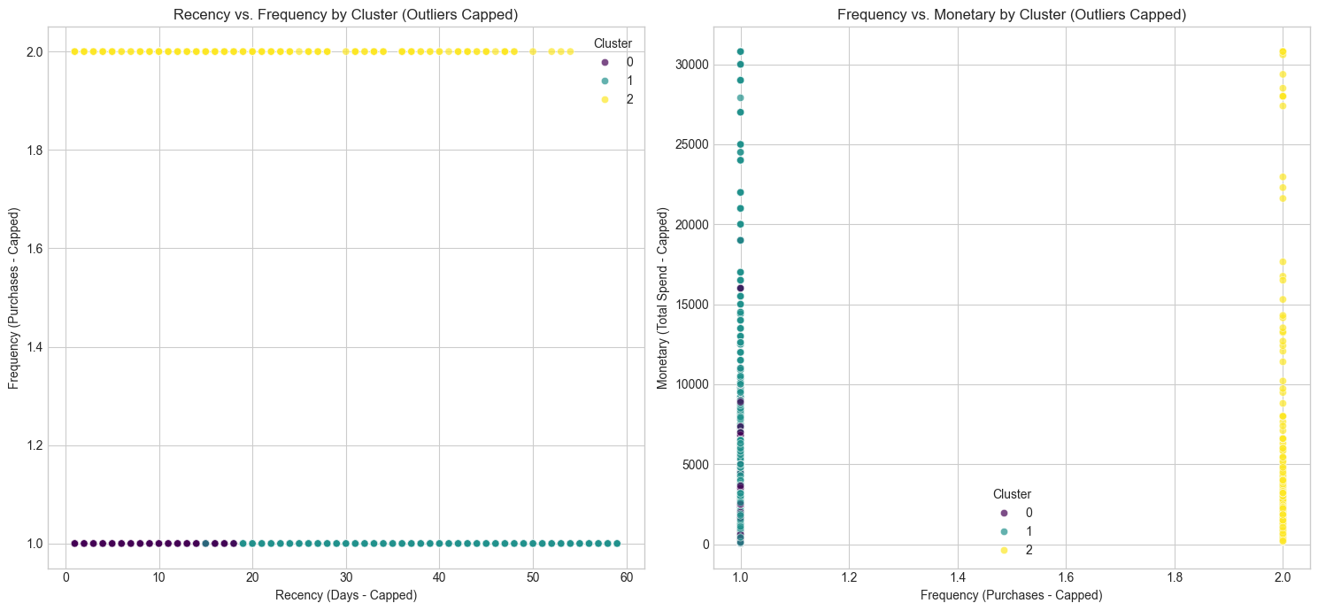
Customer Segments: RFM Scatter Plots
Recency vs. Frequency by clusters
Frequency vs. Monetary by clusters
A majority of our customers are One-time buyers(Cluster 1) (Frequency = 1),
→Re-engagement campaign, incentivized offer (to motivate 2nd purchase)
Our loyal customers (Cluster 2) spend more (high monetary) tend to be frequent buyers (High spend & frequency)
→ Retain & upsell
Recent new (Cluster 0): spend significantly less, lower frequency
→Welcome offer
Notes:
Frequncy vs monetary
Users who spend more tend to be in Cluster 2 and show higher frequency.
Cluster 0 and 1 spend significantly less despite similar or lower frequency.

Slide 30
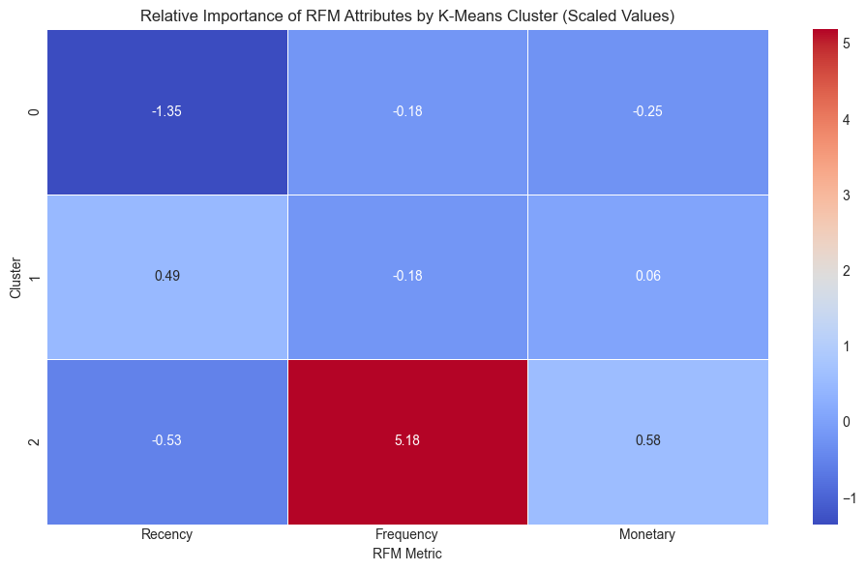
Relative importance of attributes by cluster
Cluster 2 has slightly negative Recency
(-0.53), meaning customers in this group purchased recently. However, High Frequency (5.18) and Moderate Monetary (+0.58) meaning
“They buy often & spend well”
Cluster 0 has strong negative Recency
(-1.35), meaning customers in this group purchased very recently. However, both Frequency (-0.18) and Monetary (-0.25) are low.
Cluster 1 has moderate Recency
(+0.49), meaning last purchase was longer ago. However, both Frequency (-0.18) and Monetary (+0.06) are low, which most of them are one-time buyers
These are likely new customers who made only one or a small purchase
These are likely at risk who bought product but tend to not return
They are loyal and engaged buyers
Win-back campaign, exclusive discount, survey to see why they didn’t return (NPS)
# This is majority of our customer, we need to focus to move them to Cluster 2
Loyal rewards, add on benefits eg. Early access to new products, tier benefit
# This customer is the goal
--> retain them and move other clusters to this cluster
Action:
Welcome offers, reminders to make a 2nd purchase

Slide 31
Key Takeaways & Next steps
Key Takeaways
Next steps
Low retention rate after first purchase
Over 90% of revenue & users come from Week00 (acquisition week).
Only ~3.37% of customers return after first purchase.
  Set up re-engagement triggers within 3–5 days post-purchase for new & recent buyers (Cluster 0) using welcome offers or NPS surveys.
Flat discounts fail to drive loyalty
No positive correlation between discount % and AOV. Cluster 0 (25%) gets most discounts but rarely returns.
Segment discounting strategy by AOV level:
Reduce incentives but offer other VIP benefits instead for Cluster02 & high-AOV buyers, and test heavier promos only on low-spending clusters (Cluster 0 & 1)
High spenders are loyal — but few Cluster 2 (just 3%) buys more often and contributes significant revenue despite being a small segment.
Retain loyal buyers (Cluster2) with loyalty packages (early access, bundle deals, tier benefits) to maximize lifetime value. This help generate revenue sustainably.
Key categories drive revenue & retention –
Electronics, Home & Kitchen and Computers have high AOV, good ratings, and the most repeat customers.
Increase SKUs and run retention campaigns in Electronics, Home & Kitchen, and Computers.
→ These categories attract Cluster 2 buyers.

Slide 32
References

Slide 33
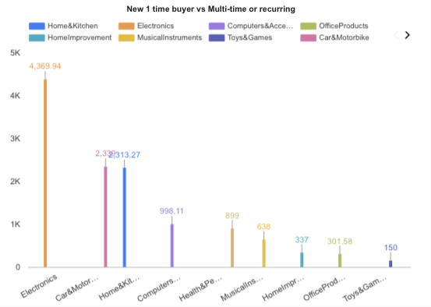
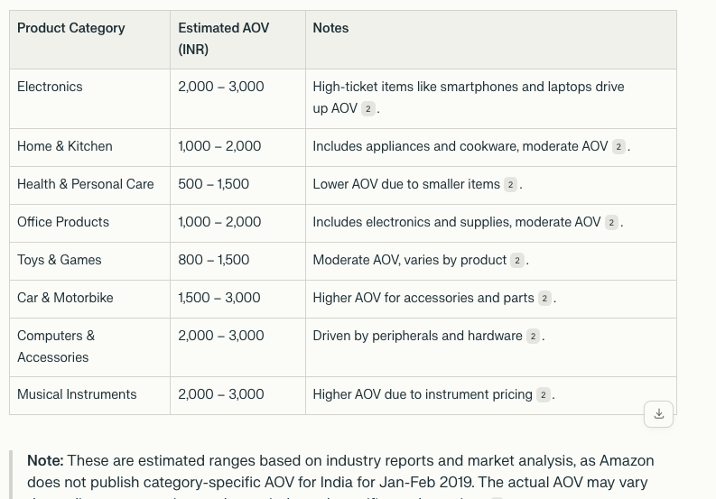
AOV by each category
AOV (INR) in 2019
Figure 1
Figure 2

Slide 34
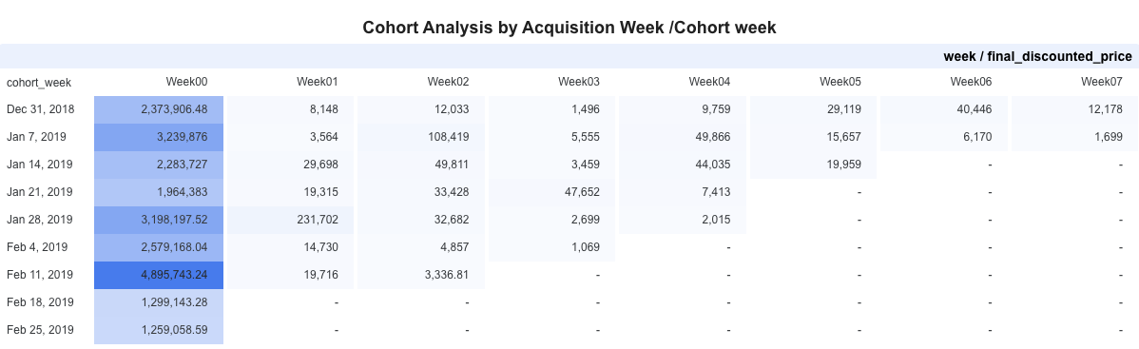
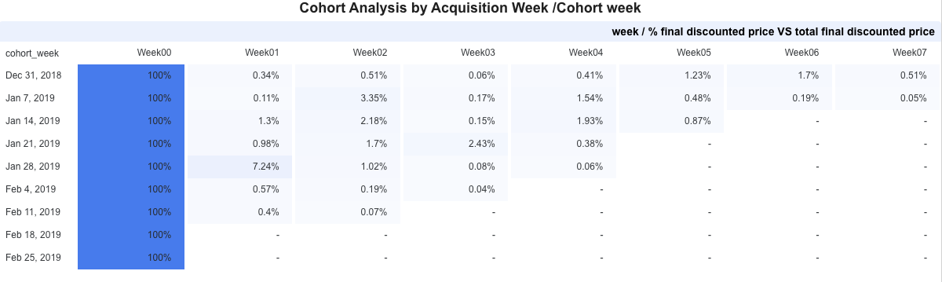
Overall Cohort Analysis : Final discount price & Final discount price %

Slide 35
Thank you

