Slide 1
A SIMPLE BUT TOUGH - TO - BEAT BASELINE FOR SENTENCE EMBEDDINGS
Sanjeev Arora, Yingyu Liang, Tengyu Ma
Princeton University
Published in 2017

Slide 2
INTRODUCTION
An “embarrassingly simple” method for sentence embedding: Smooth Inverse Frequency - compute weighted average of the word vectors in the sentence and then remove the projections of the average vectors on their first singular vectors.
Wieting and team showed in 2016 simpler methods can also do the work. The only downside was that the training data has to be labelled.
Introduced an unsupervised approach: using word embedding computed using unlabeled data like Wikipedia.
Represented the sentence by a weighted average of the word vectors, then modify a bit using PCA/SVD.
Outperforms sophisticated supervised methods like RNN and LSTM.

Slide 3
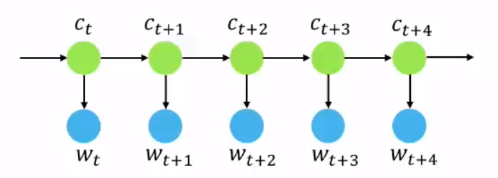
RAND-WALK, A Generative Model for Texts
Ct is the discourse vector which determines the context in time t.
Wt is the weight of word embeddings.
A simple method for creating sentence embeddings by averaging the word embeddings within each sentence.
The current paper builds upon this by justifying the use of reweighting and a generative model for sentences in the text generation process, which is an enhancement or modification to the original model.

Slide 4
A simple method for sentence embedding
Word Embeddings: derived from unlabeled corpora (e.g., Wikipedia) to capture word semantics.
Weighted Average: The sentence is represented as a weighted average of word vectors using TF-IDF weighting, with word weights computed as a/(a + p(w)), where 'a' is a parameter, and 'p(w)' is the estimated word frequency.
Common Component Removal: eliminating the projections of the average vectors onto their first singular vector, resulting in improved performance.

Slide 5

(Arora et al., 2016):
Dynamic Text Generation: The model views text corpus generation as a dynamic process, where words are produced sequentially.
Discourse and Word Vectors: Discourse vectors ("ct") represent what's being discussed, while each word ("w") has a corresponding vector. The inner product between "ct" and word vectors captures correlations.
Probability Estimation: The probability of a word at time "t" is estimated using a log-linear word production model.

Slide 6
Improved Random walk model
Sentence Embeddings: To create sentence embeddings, a Maximum A Posteriori (MAP) estimate is done for discourse vectors governing the sentence. A single discourse vector "cs" can replace multiple "ct"s for simplicity.
Enhanced Model: Enhancements are introduced for a more realistic model, addressing out-of-context word occurrences and frequent words (e.g., "the" and "and").
Additive Term and Common Discourse Vector: An additive term "αp(w)" incorporates unigram probabilities and allows low-inner-product words to occur. A common discourse vector "c_{o}" corrects for frequent discourse related to syntax.

Slide 7
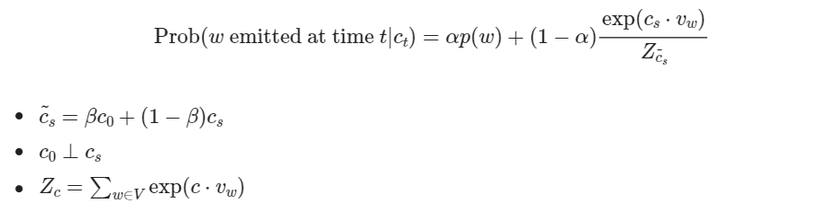
Given the discourse vector c_{s}, the probability of a word w is emitted in the sentence s is modeled by,

Slide 8

Computing the Sentence Embedding
Use c_{s} as the embedding for sentence s = w₁ .. w_{t}
MLE for b_{s}
Word Frequency
Weighted average
Down weighting of the frequent words

Slide 9
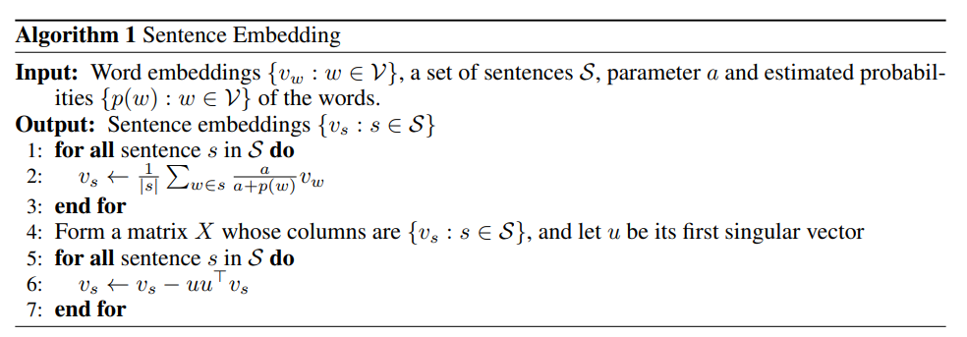
Estimating C_{S}
Initial Weighted Average
Computing C₀ ( Initial Discourse Vector through SVD)
Subtract the projection from the initial weighted average(remove common components shared across sentences)

Slide 10
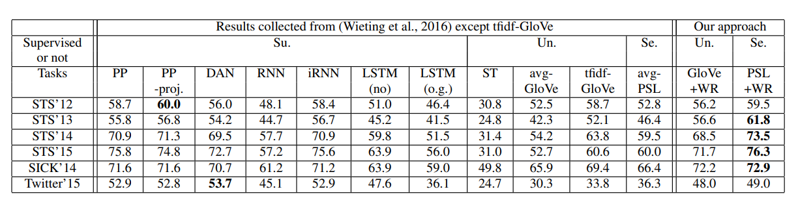
Experimental Results
Textual Similarity Tasks
Objective: To predict the similarity between two given sentences
Datasets: Tested their methods on the 22 textual similarity datasets
Notes:
The evaluation criterion is the Pearson’s coefficient between the predicted scores and the ground-truth scores. The authors compared their method with several other approaches. Unsupervised methods: ST (skip-thought vectors), avg-GloVe (unweighted average of GloVe vectors), tfidf-GloVe (weighted average of GloVe vectors using TF-IDF).
Semi-supervised method: avg-PSL (unweighted average of PARAGRAM-SL999 word vectors).
Supervised methods: PP, PP-proj., DAN, RNN, iRNN, LSTM (o.g.), LSTM (no). These methods are initialized with PSL word vectors and then trained on the PPDB dataset.
The authors applied their Smooth inverse frequency-based method to different types of word embeddings, denoted as "XXX+WR." For example, "GloVe+WR" represents their method applied to GloVe vectors.
They used a fixed weighting parameter "a" set to 10^(-3) and estimated word frequencies "p(w)" from the common crawl dataset.
These are the experimental results on textual similarity tasks. The highest score in each row is in boldface.
STS is semantic textual similarity task.
The unsupervised method GloVe+WR improves upon avg-GloVe significantly by 10% to 30%, and beats the baselines by large margins. It achieves better performance than LSTM and RNN and is comparable to DAN, even though the later three use supervision. This demonstrates the power of this simple method: it can be even stronger than highly-tuned supervisedly trained sophisticated models. Using TF-IDF weighting scheme also improves over the unweighted average, but not as much as their method. The semi-supervised method PSL+WR achieves the best results for four out of the six tasks and is comparable to the best in the rest of two tasks. Overall, it outperforms the avg-PSL baseline and all the supervised models initialized with the same PSL vectors. This demonstrates the advantage of their method over the training for those models.

Slide 11
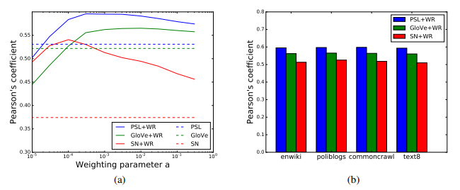
Effect of weighting parameter on performance
enwiki (wikipedia, 3 billion tokens), poliblogs (political blogs, 5 million), commoncrawl (Internet crawl, 800 billion), text8 (wiki subset, 1 million)
Notes:
They study the sensitivity of their method to the weighting parameter a, the method for computing word vectors, and the estimated word probabilities p(w). First, they test the performance of three types of word vectors (PSL, GloVe, and SN) on the STS 2012 tasks. SN vectors are trained on the enwiki dataset (Wikimedia, 2012) using the method in (Arora et al., 2016), while PSL and GloVe vectors are those used in Table 1. They enumerate a ∈ {10−i , 3 × 10−i : 1 ≤ i ≤ 5} and use the p(w) estimated on the enwiki dataset. Figure 2a shows that for all three kinds of word vectors, a wide range of a leads to significantly improved performance over the unweighted average. Best performance occurs from a = 10−3 to a = 10−4 . Next, they fix a = 10−3 and use four very different datasets to estimate p(w): enwiki (wikipedia, 3 billion tokens), poliblogs (Yano et al., 2009) (political blogs, 5 million), commoncrawl (Buck et al., 2014) (Internet crawl, 800 billion), text8 (Mahoney, 2008) (wiki subset, 1 million). Figure 2b shows performance is almost the same for all four settings. The fact that their method can be applied on different types of word vectors trained on different corpora also suggests it should be useful across different domains. This is especially important for unsupervised methods, since the unlabeled data available may be collected in a different domain from the target application.

Slide 12
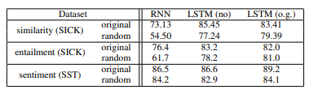
The Effect of the order of words in Sentences
Notes:
An interesting feature of their method is that it ignores the word order. This is in contrast to that RNN’s and LSTM’s can potentially take advantage of the word order. The fact that their method achieves better or comparable performance on these benchmarks raise the following question: is word order not important in these benchmarks? They conducted an experiment suggesting that word order does play some role. They trained and tested RNN/LSTM on the supervised tasks where the words in each sentence are randomly shuffled, and the results are reported in Table It can be observed that the performance drops noticeably. Thus their method —which ignores word order—must be much better at exploiting the semantics than RNN’s and LSTM’s. An interesting future direction is to explore if some ensemble idea can combine the advantages of both approaches.

Slide 13
Thank You

