Slide 1
WELL-READ STUDENTS LEARN BETTER: ON THE IMPORTANCE OF PRE-TRAINING COMPACT MODELS
Iulia Turc, Ming-Wei Chang, Kenton Lee, Kristina Toutanova

Slide 2
AGENDA
Goal
Challenge
Solution
What is special about paper?
Pre-Trained Distillation
Building compact models
Experimental Results
​​Summary​

Slide 3
GOAL
The goal is to achieve effective performance in NLP tasks while using smaller models.

Slide 4
Challenge
Developing accurate natural language processing (NLP) models within limited memory and latency constraints, particularly due to the high computational cost associated with current state-of-the-art models.

Slide 5
solution
Training compact NLP models using LM pre-training and
task fine-tuning, with the introduction of the Pre-trained Distillation (PD) algorithm to address computational cost challenges associated with large models.

Slide 6
What is special about the paper?
How to train a competitive compact model?
Pre Training + distillation + fine tune experiments
Model size & properties old unlabeled data

Slide 7
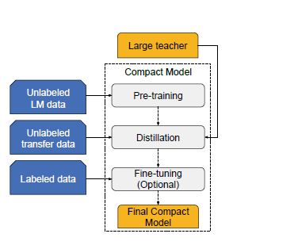
Pre- Trained distillation
Notes:
Figure 1 in the paper "Pre-trained Distillation" illustrates the process of pre-trained distillation, which is a technique for building compact models that can perform well on various natural language processing (NLP) tasks.
The figure shows the three main steps involved in pre-trained distillation: pre-training, distillation, and optional fine-tuning.
The first step is pre-training, which involves training a model on a large amount of unlabeled data, such as a language model (LM). This step helps the model learn general features of the language that can be useful for various downstream tasks.
The second step is distillation, which involves transferring knowledge from a large, accurate teacher model to a smaller, more compact student model. This is done by training the student model on the soft labels produced by the teacher model, which are the probabilities of each class or output. This step helps the student model learn from the teacher model's expertise and improve its performance on the task.
The third step is optional fine-tuning, which involves further training the compact model on a smaller labeled dataset to improve its performance on the specific task. This step can help the model adapt to the specific characteristics of the task and improve its accuracy.
Overall, pre-trained distillation is a powerful technique for building compact models that can perform well on various NLP tasks by leveraging the benefits of pre-training, knowledge distillation, and fine-tuning.

Slide 8
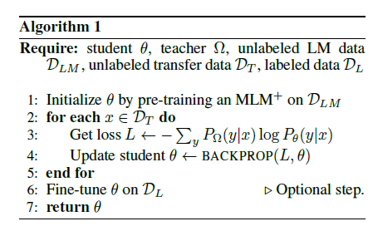
Pre- Trained distillation
Notes:
**Algorithm Overview:**
**Objective:** Train a student model () using a teacher model, unlabeled language model data (DLM), unlabeled transfer data (DT), and labeled data (DL).
1. **Initialization:**
- Initialize the student model by pre-training as a Masked Language Model (MLM) on DLM.
2. **Training Loop on Transfer Data (DT):**
- For each data point x in DT:
- Compute the loss L, measuring the difference between teacher predictions and student predictions.
- Update the student model parameters using backpropagation to minimize the loss.
3. **Optional Fine-tuning on Labeled Data (DL):**
- Fine-tune the student model on the labeled data DL. (This step is optional.)
4. **Return Trained Student Model:**
- Return the trained student model .
**Explanation:**
The algorithm initializes a student model and trains it using a combination of teacher guidance, unlabeled data for language modeling, and additional unlabeled transfer data. The training process involves adjusting the student's parameters to improve its predictions based on both the teacher's knowledge and the characteristics of the transfer data. Optionally, the student model can be fine-tuned further using labeled data. The goal is to leverage pre-training and transfer learning for effective knowledge distillation, producing a well-performing student model.

Slide 9
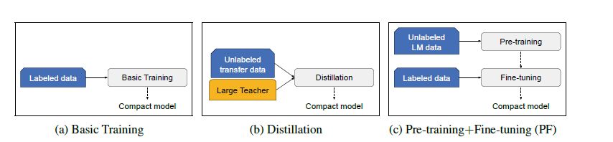
Baselines for building compact models
Notes:
Basically there are three approaches to build a compact model,
The first approach, pre-training, involves training a compact model on a large amount of unlabeled data, such as a language model. This step helps the model learn general features of the language that can be useful for various downstream tasks.
The second approach, fine-tuning, involves training the compact model on a smaller labeled dataset to improve its performance on the specific task. This step can help the model adapt to the specific characteristics of the task and improve its accuracy.
The third approach, pre-training+fine-tuning (PF), combines the two previous approaches. It involves pre-training the compact model on unlabeled data and then fine-tuning it on a smaller labeled dataset. This approach aims to leverage the benefits of both pre-training and fine-tuning to improve the model's performance on the target task.

Slide 10
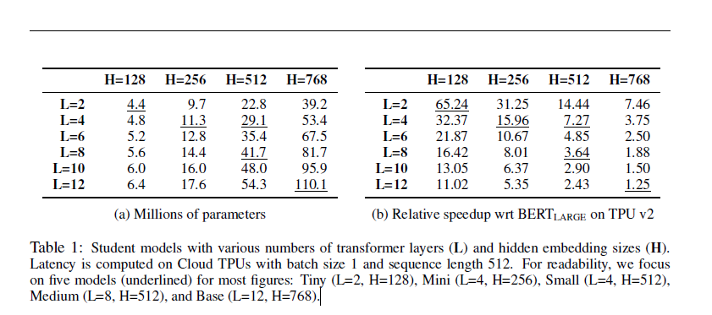
Experimental results
Notes:
a) Millions of Parameters:
The first part of the table shows the number of parameters (in millions) for various combinations of L and H.
For example, for a student model with L=2 and H=128, the number of parameters is 4.4 million.
(b) Relative Speedup wrt BERTLARGE on TPU v2:
The second part of the table provides the relative speedup compared to a reference model (BERTLARGE) when running on a specific hardware platform (TPU v2).
Speedup values indicate how much faster a student model is compared to the reference model.
For example, for a student model with L=2 and H=128, the relative speedup is 65.24, indicating that it is 65.24 times faster than BERTLARGE on TPU v2.
Interpretation:
The table is a summary of the computational efficiency and speedup achieved by different student models with varying numbers of layers and hidden sizes.
It helps in understanding how different model configurations impact the number of parameters and the computational efficiency of the models.
The focus on five models (Tiny, Mini, Small, Medium, and Base) makes it easier to compare the performance of these representative configurations.
In summary, the table provides insights into the trade-off between model complexity (number of parameters) and computational efficiency (speedup) for different student models. It helps in selecting an appropriate model configuration based on specific requirements and constraints

Slide 11
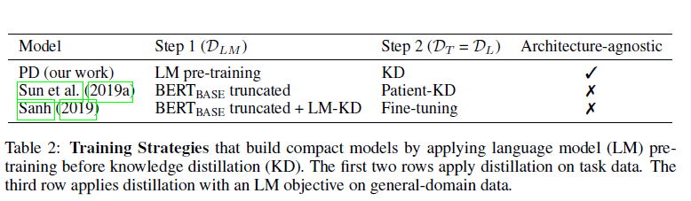
Pre-trained Distillation (PD) and concurrent work on model compression
Notes:
Table 2 - Training Strategies for Compact Models:
PD (our work): Utilizes LM pre-training in Step 1 and Knowledge Distillation (KD) in Step 2. Architecture-agnostic implies it is applicable to different model architectures.
Sun et al. (2019a): Applies truncated BERTBASE in Step 1 and Patient-KD in Step 2. Not architecture-agnostic
Sanh (2019): Uses truncated BERTBASE with LM-KD in Step 1 and Fine-tuning in Step 2. Not architecture-agnostic

Slide 12
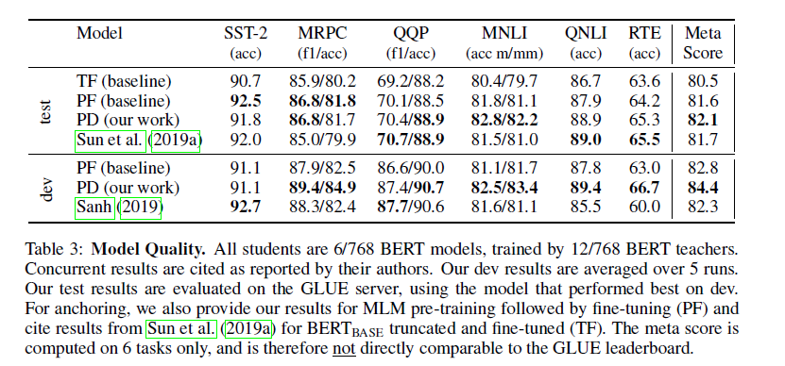
Pre-trained Distillation (PD) and concurrent work on model compression
Notes:
Values in each cell represent the performance of the corresponding model on the respective task and metric
Each row corresponds to a different model, and each column corresponds to a specific NLP task or the meta score.
PD (our work) tends to outperform the baselines (TF and PF) and shows competitive performance compared to other works (Sun et al. and Sanh).
an evaluation of different models' performance on various natural language processing tasks. :
Models: Each row represents a different model. The models include TF (baseline), PF (baseline), PD (our work), Sun et al. (2019a), PD (our work), and Sanh (2019). All these models are 6/768 BERT models, trained by 12/768 BERT teachers.
Tasks: The columns SST-2, MRPC, QQP, MNLI, QNLI, and RTE represent different natural language processing tasks. The values in the cells indicate the performance of the models on these tasks. The metrics used for evaluation may vary for each task. For example, SST-2 might use accuracy, MRPC might use F1/accuracy, and so on.
Meta Score (test): This column provides a "Meta Score" that is computed on a subset of tasks (6 tasks only). The Meta Score is not directly comparable to the GLUE leaderboard.
Data Sources: The "dev" results are averaged over 5 runs during the model development phase. The "test" results are evaluated on the GLUE server, using the model that performed best on the development set.
Comparison: you can see how well PD (our work) performs compared to other models across different tasks. It provides a comprehensive view of the models' capabilities on multiple benchmarks

Slide 13
Overall Implications:
PD demonstrates architecture-agnostic training strategies, potentially providing a more versatile approach.
PD outperforms baselines (TF and PF) and performs competitively with concurrent methods across various tasks.
Latency and speedup in Table 1 highlight the efficiency gains of different student models compared to BERTLARGE.

Slide 14
SUMMARY
Experiment Focus: Extensive experiments conducted to understand knowledge distillation and pre-training+fine-tuning in isolation.
Compound Benefits: Discovered that the benefits of these techniques compound when combined.
Power of Pre-trained Distillation (PD): Introduced PD as a simple yet powerful method, maximizing the use of available resources—leveraging a powerful teacher model and multiple data sources (labeled sets, unlabeled transfer sets, and unlabeled LM sets).

Slide 15
THANK YOU
Tanya , Bushra , Fahad, Dharana

