Slide 1
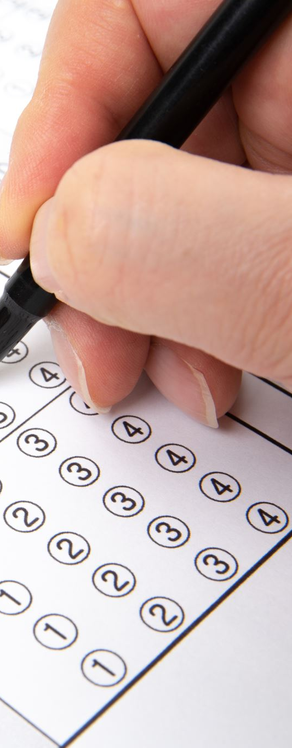
Steps Analysis During Exam Periods
Understanding the Impact of Exam Periods on Physical Activity
Tanyeli Irem Guven
DSA210

Slide 2
Introduction
This project analyzes daily step counts to understand how physical activity changes during exam periods. It compares step counts at exam days to regular days, aiming to identify patterns and correlations that reflect the impact of stress and time constraints.

Slide 3

Data Sources
1. Steps Data:
- Extracted from the Health app on an iPhone.
- Cleaned, processed, and saved as a CSV file.
2. Exam Dates Data:
- Manually compiled from university schedules.
- Recorded in a CSV file with dates formatted to match step data.

Slide 4
Methodology
- Collected and cleaned steps and exam dates data.
- Filtered steps data to include records from 2023 onwards.
- Categorized days as Exam days, or Regular Day.
- Performed statistical analysis and visualized results.

Slide 5
Statistical Analysis
- Mean Step Counts:
* Exam Periods: 5789.70 steps/day
* Regular Days: 6937.02 steps/day
- Regression Analysis:
* Exam Periods: y1 = -19.24x + 17463.90
* Regular Days: y2 = -7.49x + 9433.53

Slide 6
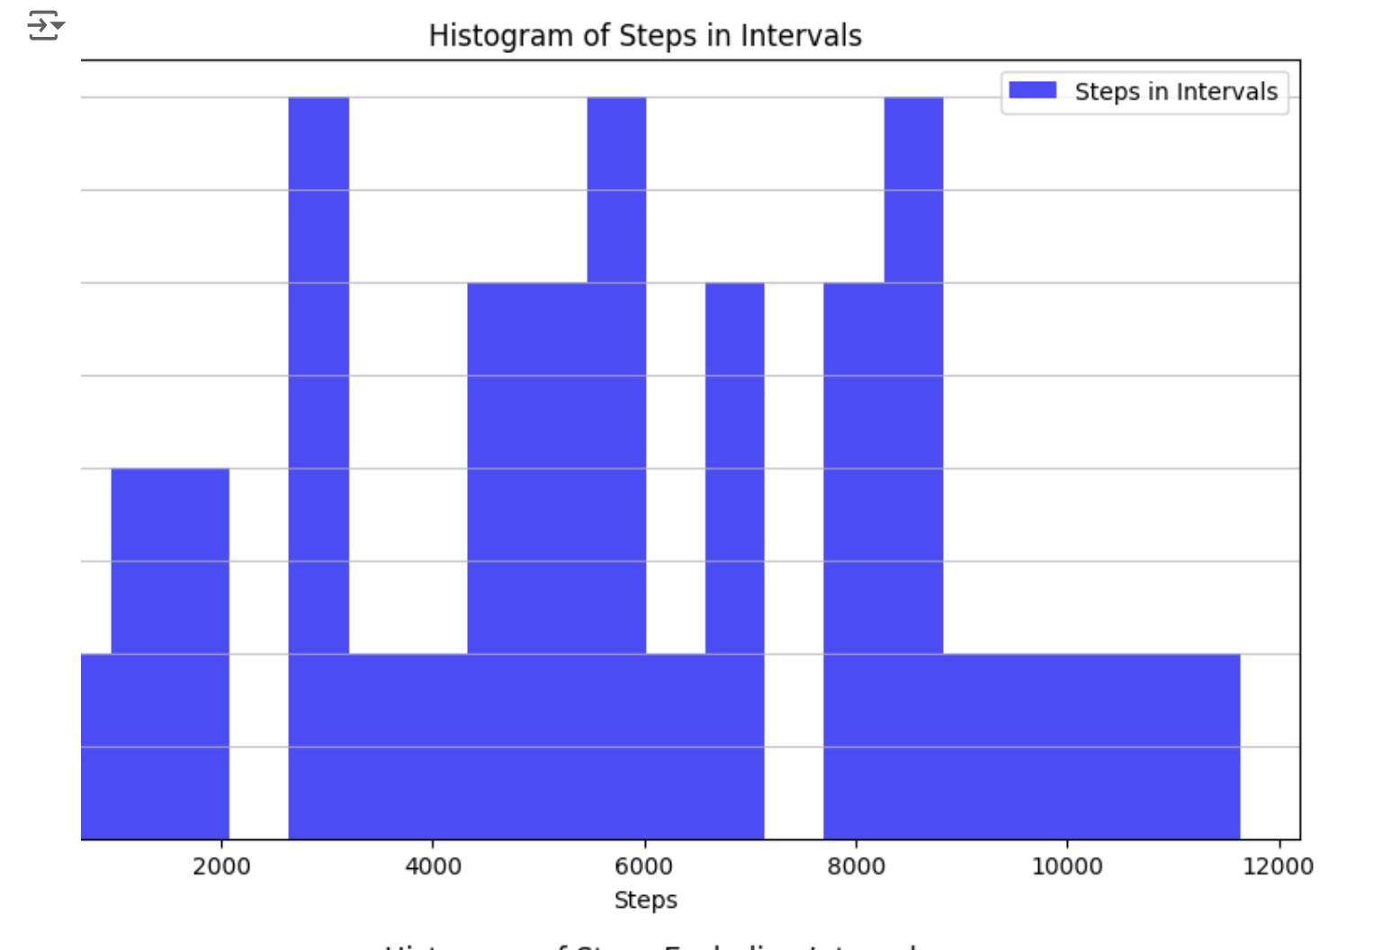
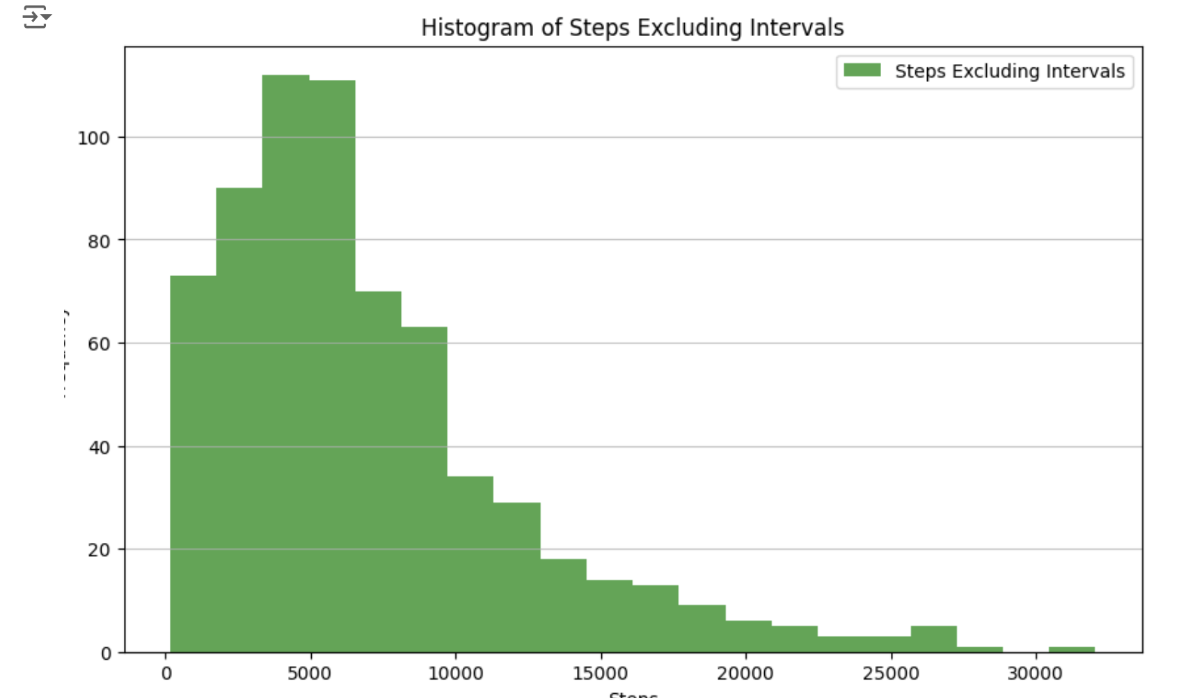
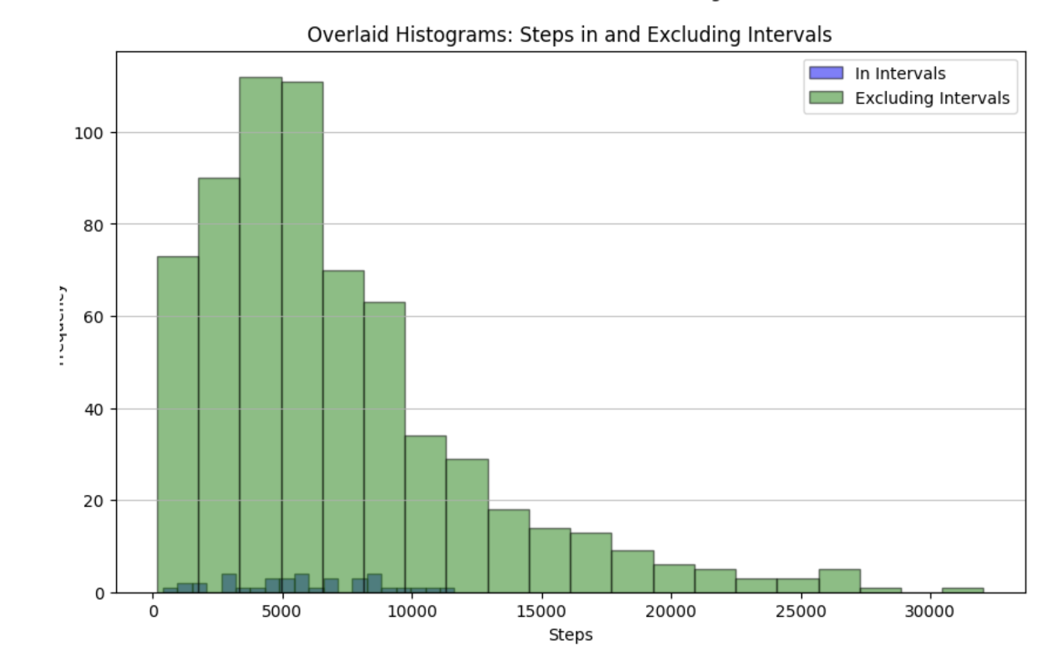
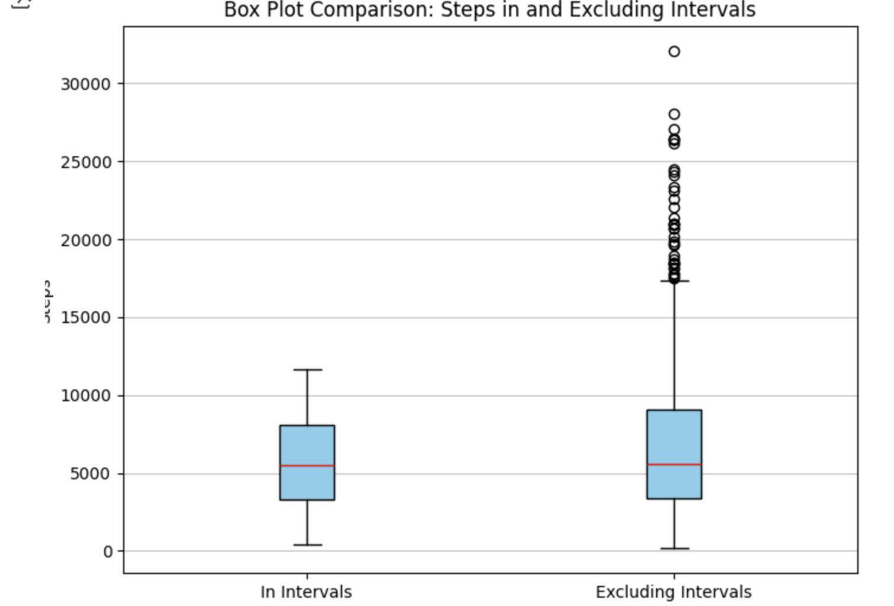
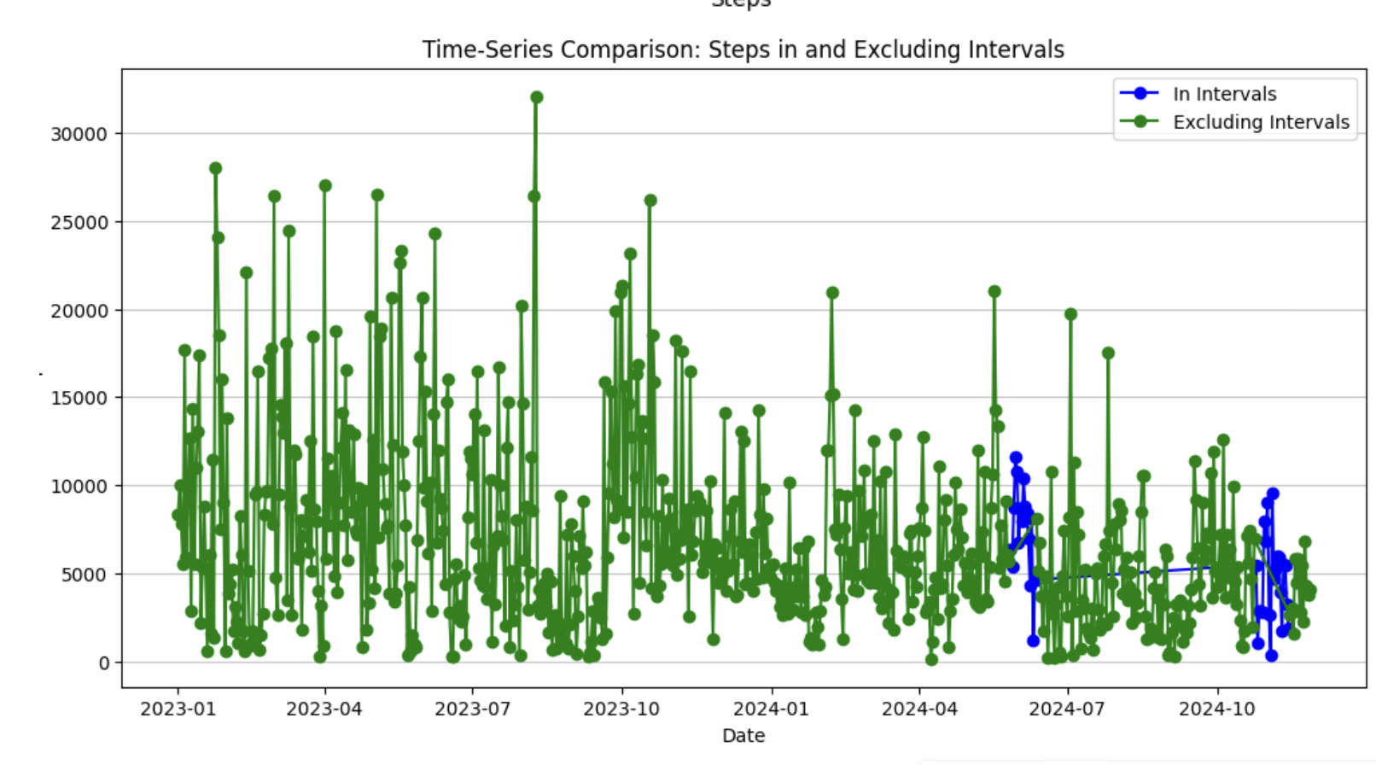
Visualizations

Slide 7
Findings
- Step counts significantly decrease during exam periods.
* Average during exam periods: 5789.70 steps/day.
* Average on regular days: 6937.02 steps/day.
- Variability in step counts is narrower during exams.
- Stress and time constraints are likely contributors to reduced activity.

Slide 8
Limitations and Future Work
Limitations:
- Focused only on step counts; excluded other health metrics.
- Dataset limited to 2024 exam periods.
Future Work:
- Include additional metrics like sleep and stress levels.
- Analyze data over multiple years for broader insights.
- Test interventions to maintain activity during exams.

Slide 9

Conclusion
- Exam periods significantly impact physical activity.
- Maintaining physical activity during exams is vital for overall well-being.
- Recommendations:
* Take short walks or schedule light exercise during exams.
* Develop routines to balance study and physical activity.

