Slide 1

Startups

Slide 2
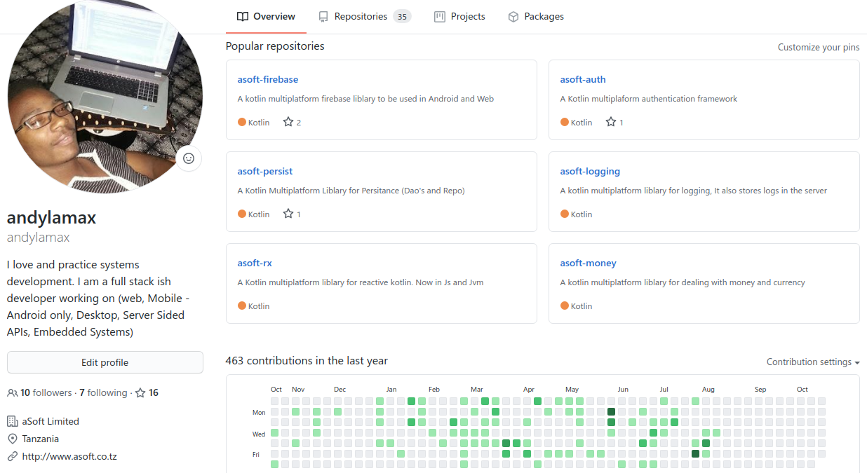

Slide 3
Developers Community Composition
1. Individual Developers (Freelancers)
2. Development Groups/Teams
3. Companies/Businesses

Slide 4
TDC Goals
(Collaboration over Competition)
- Have a community that can deliver quality and maintenable services in and out the country
- Have a community driven approach to capturing tenders (specifically inside the country)
- Help community members build profitable and sustaible business solutions and/or services spanning multiple doctrines

Slide 5
Today’s Discussion Goal
(Collaboration over Competition)
Have some what a vague plan of how we are going to help . . .
- Our community’s startups so that they can deliver quality and maintenable services in and out the country
- Community members who are business starters get their startups on their feet
[
Identify { - Ideas, - Startups, - Organisations }
Drive Community Ideas { - Community Idea }
]
- Our community startups build profitable and sustaible business solutions and/or services spanning multiple doctrines
- Community startups collaborate with well established organizations
- Community startups hire/collaborate with developers in the community

