Slide 1
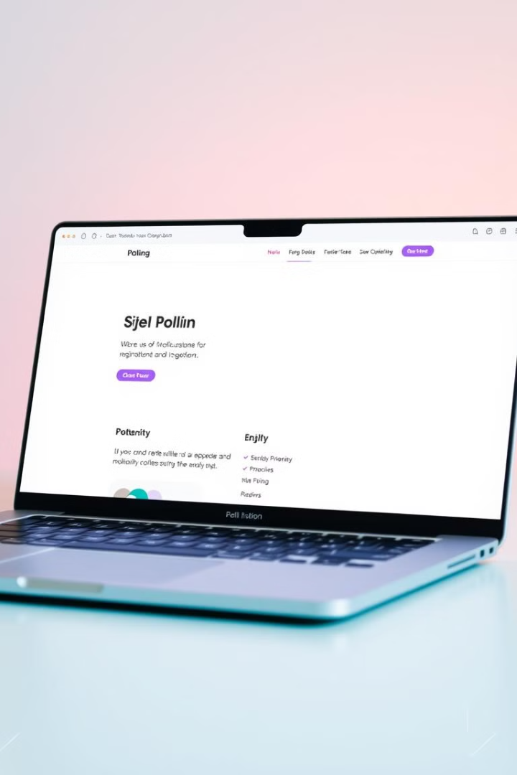
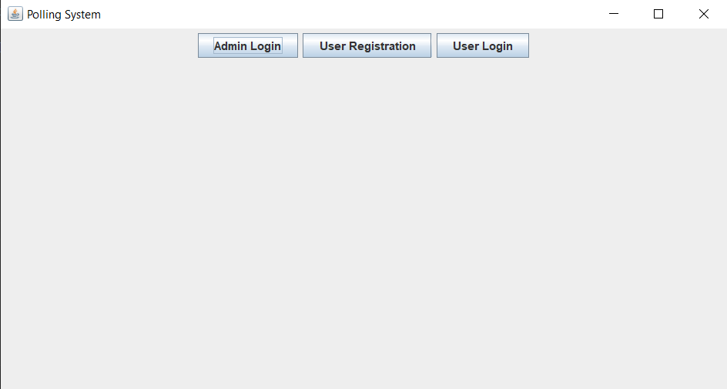
Polling System Java Application
A Java-based application for user registration, voting, and admin management.
TH
Tanzeel Hussain
Muhammad Sohail
MS

Slide 2

Introduction
What is a Polling System?
Key Features
Allows user registration, login, and voting. Admins can view results.
- User Registration and Login - Admin Login and Results Viewing - Voting Interface - Results Display

Slide 3
Project Structure
Welcome Screen
Admin Login
First screen with Admin Login, User Registration, User Login options.
Allows admin to log in and view results.
User Registration
User Login
Allows new users to register.
Allows registered users to log in and vote.
Voting Interface
Results Display
Allows users to vote for candidates.
Shows voting results.

Slide 4
Welcome Screen
Purpose
Options
The first screen users see.
- Admin Login - User Registration - User Login

Slide 5
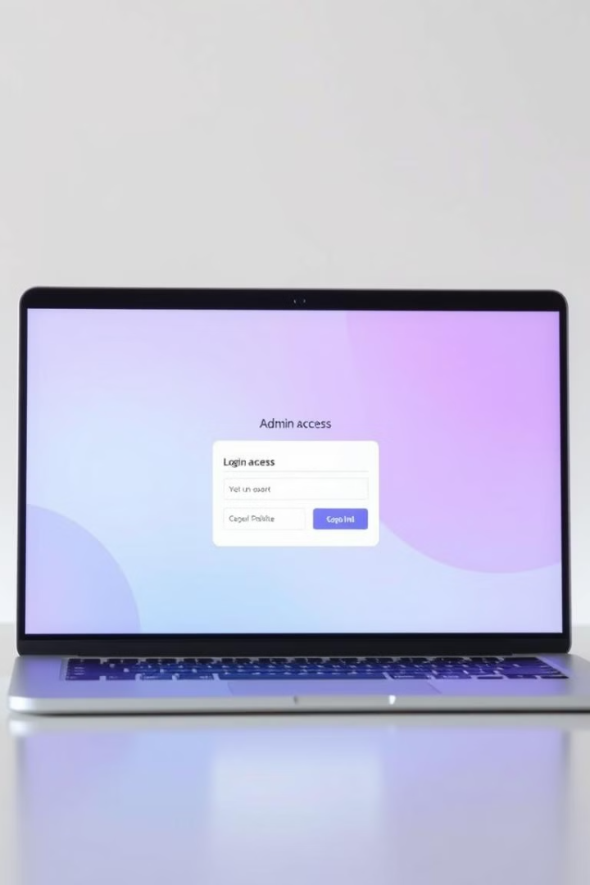


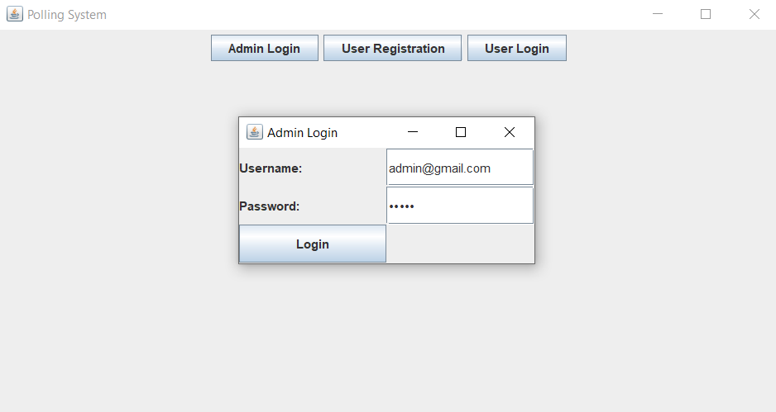

Admin Login
Purpose
Functionality
Allows admin to log in.
Checks if credentials match admin credentials.
Result
If correct, opens the Admin Panel.

Slide 6
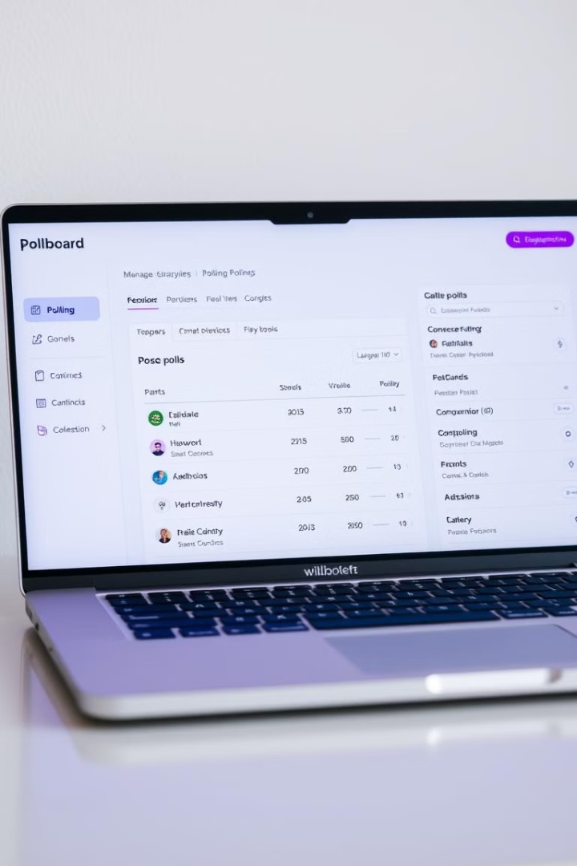
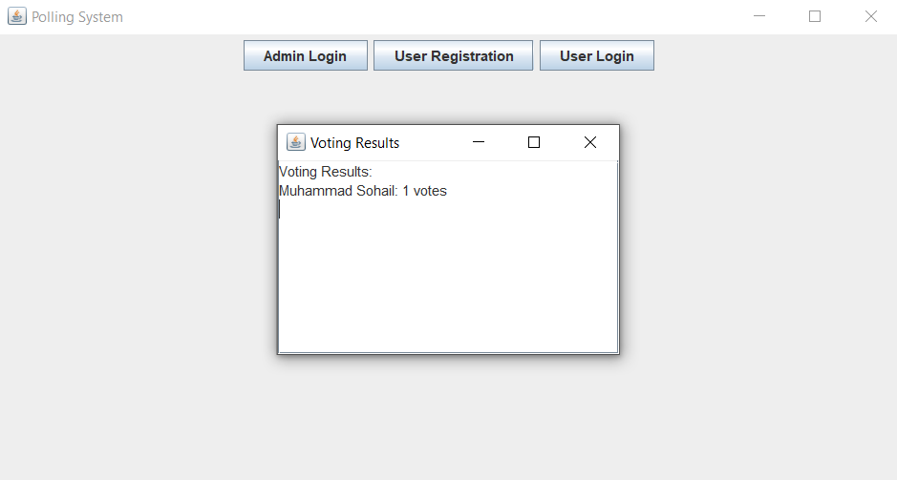
Admin Panel
1
Purpose
Admin can view voting results.
2
Functionality
- Displays a button to view results. - Opens the Results Display.

Slide 7
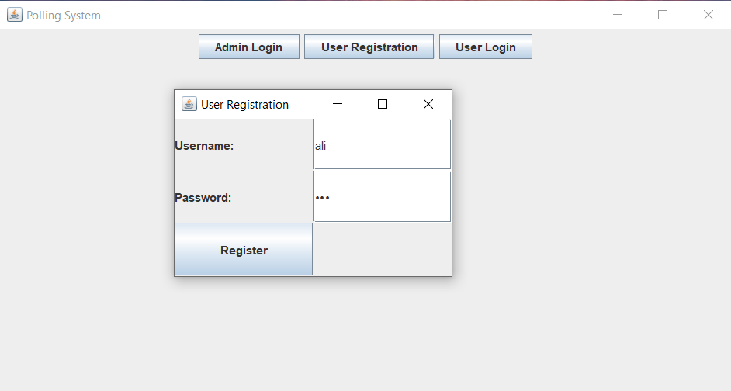



User Registration
Purpose
Functionality
Result
Allows new users to register.
- Users enter username and password.
If fields are not empty, the user is registered.

Slide 8



User Login
1
Purpose
Functionality
2
Checks if credentials match registered user.
Result
3
If correct, opens the Voting Interface.

Slide 9
Voting Interface
Purpose
1
Allows users to vote for candidates.
Functionality
2
- Users select a candidate and submit their vote.
Result
3
The vote is registered in the system.

Slide 10
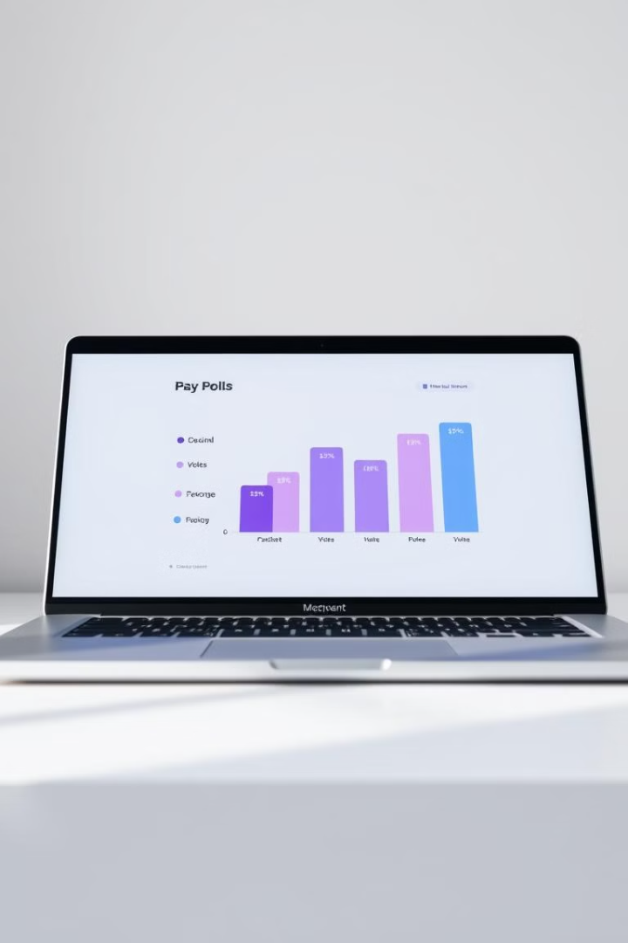
Results Display
1
2
Purpose
Functionality
Displays voting results.
Shows number of votes each candidate received.

Slide 11
Technologies Used
1
Programming Language
2
Libraries
3
Data Structures
Java
javax.swing: For GUI components.
HashMap: For storing votes and user credentials.
java.awt: For layout management.

Slide 13
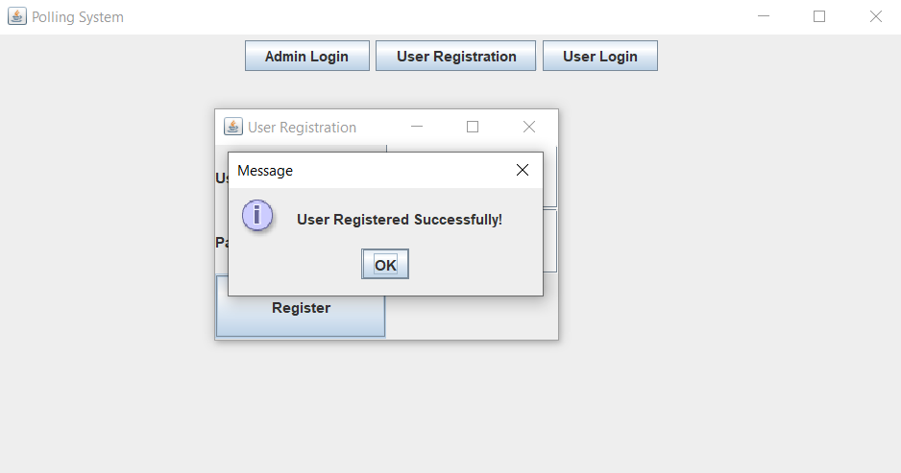

Slide 14
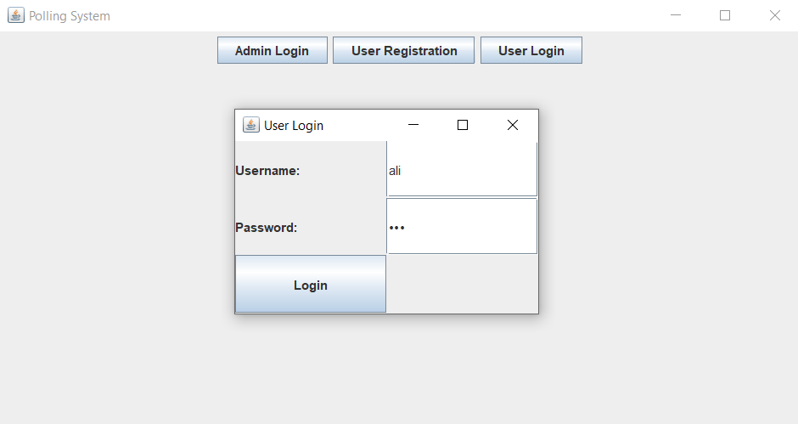
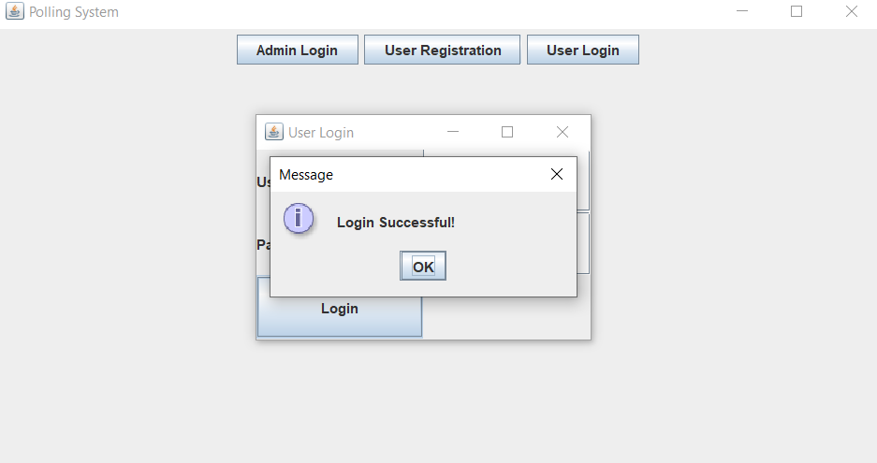

Slide 15
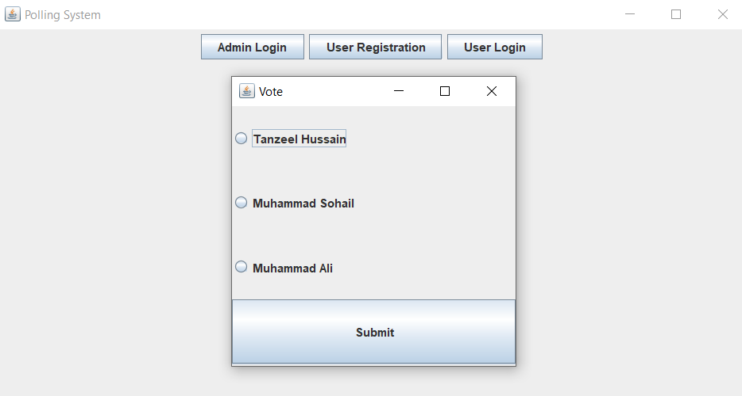
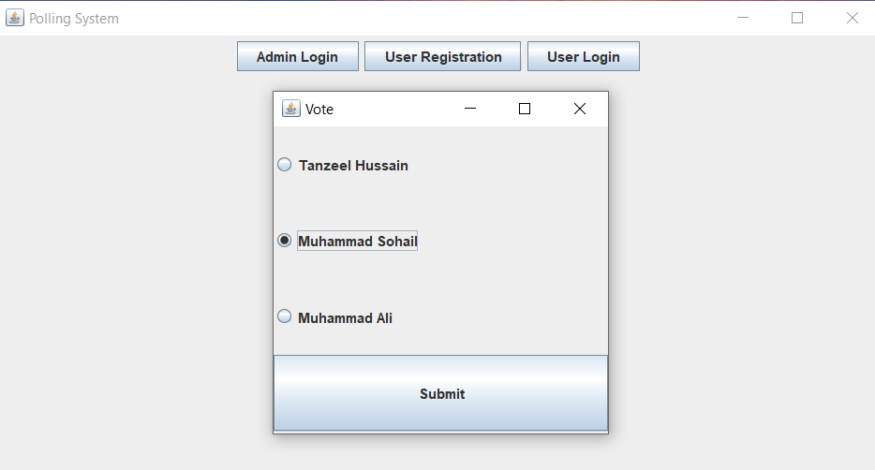

Slide 16
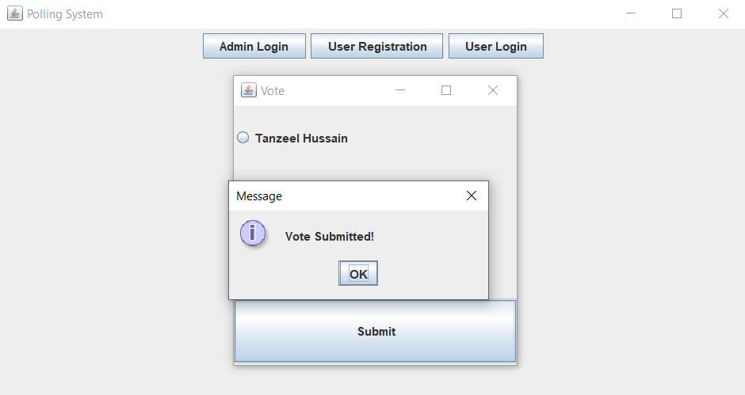

Slide 17
